Slide 1
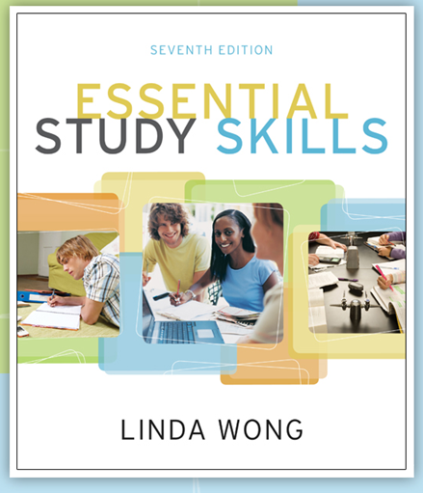
Discovering and Using Your Learning Style

Slide 2
Learning is an individualized process affected by:
  Background
  Experience
  Personality
  Motivation

Slide 3
Cognitive Learning Styles
  Visual
  Auditory
  Kinesthetic

Slide 4
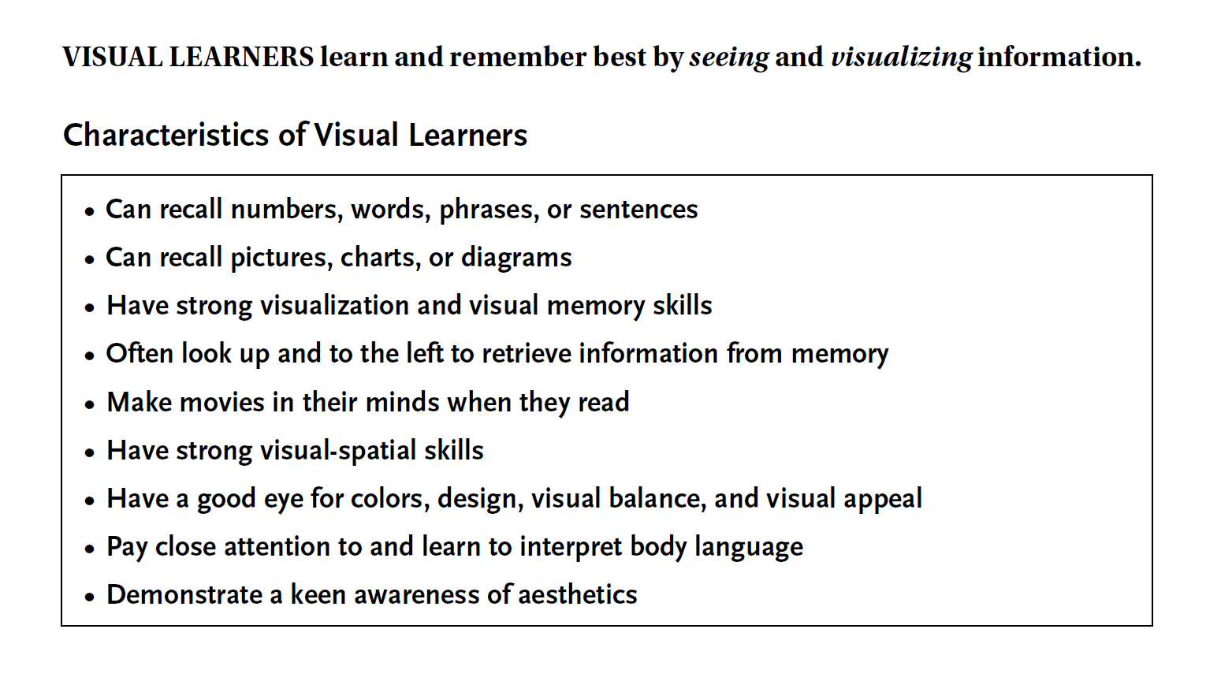

Slide 5
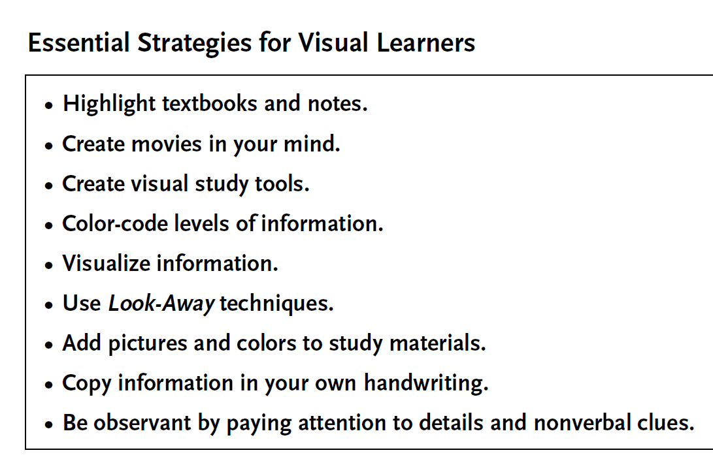

Slide 6
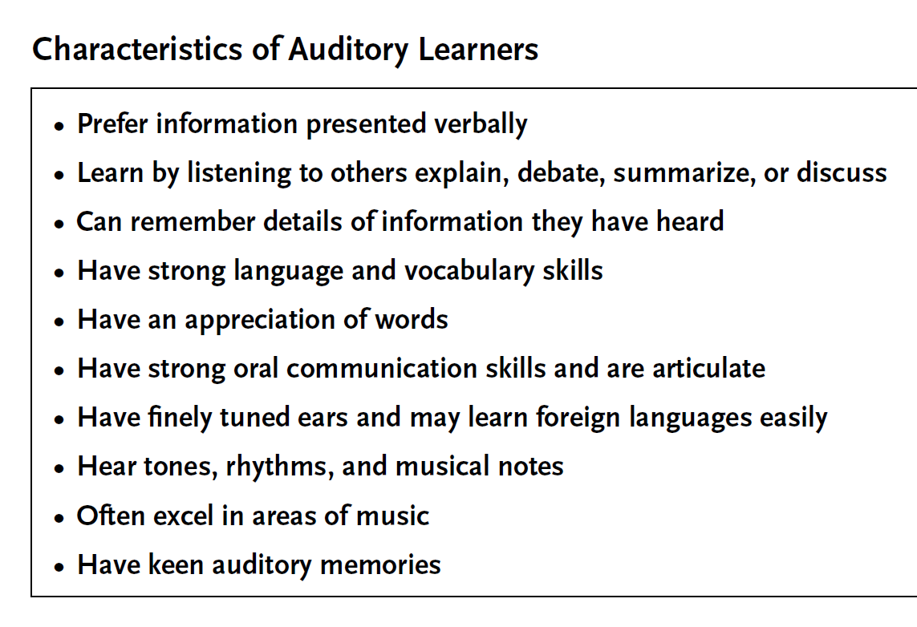

Slide 7
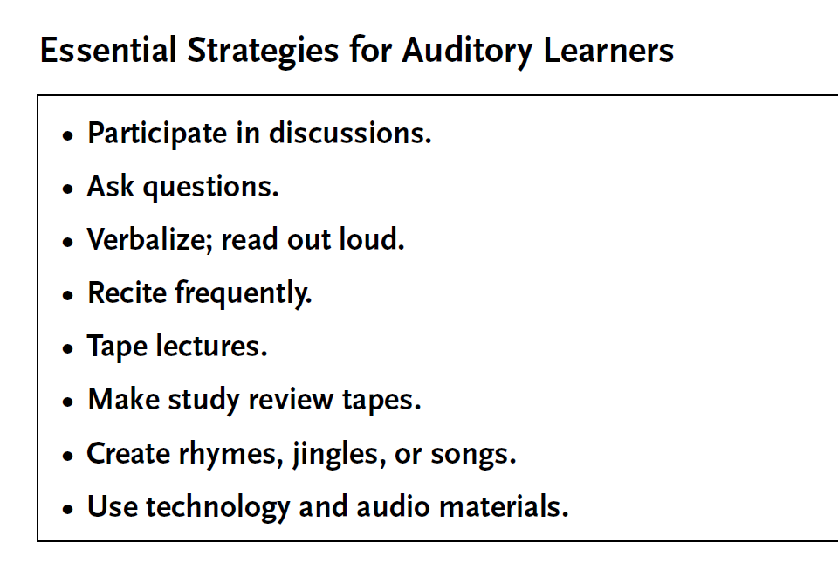

Slide 8
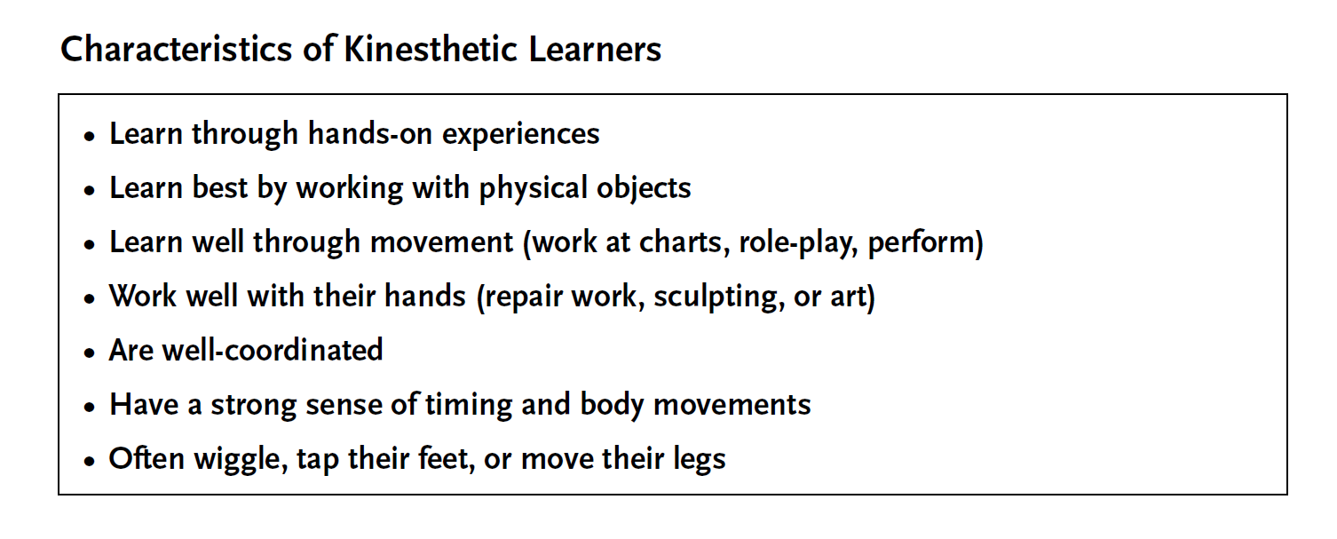

Slide 9
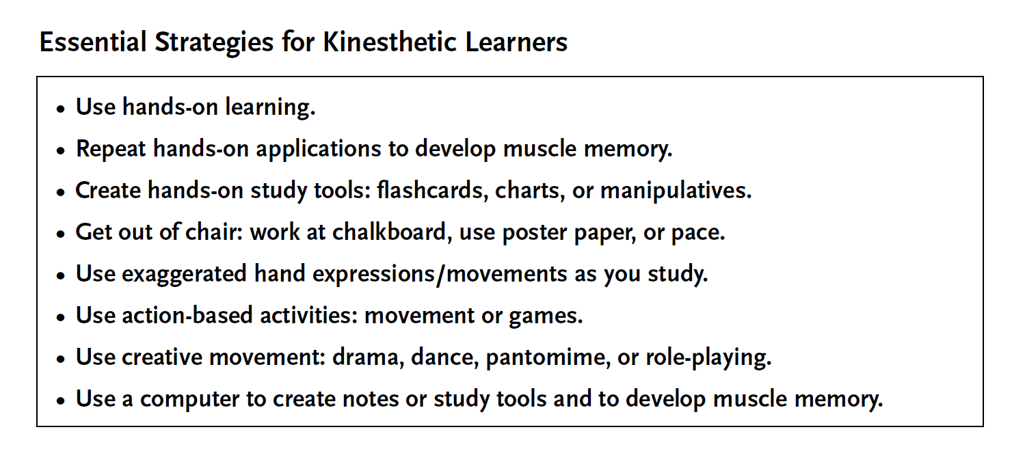

Slide 10
Can you spot someone
else’s learning style?

Slide 11


Slide 12


Slide 13


Slide 14


Slide 15
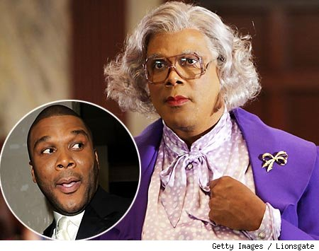

Slide 16


Slide 17
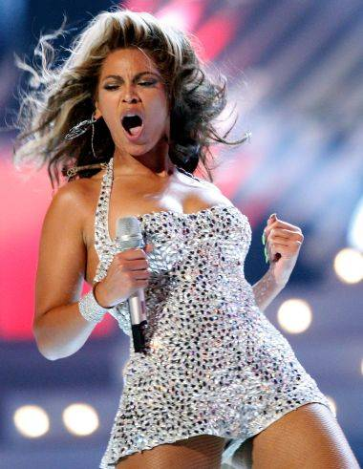

Slide 18
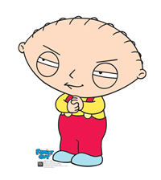

Slide 19
So, if I learn, does it really matter HOW?
See for yourself…

Slide 20
Put your heading (name, date, and block) on the Learning Styles Inventory worksheets, then complete the survey…
NOW!

Slide 21
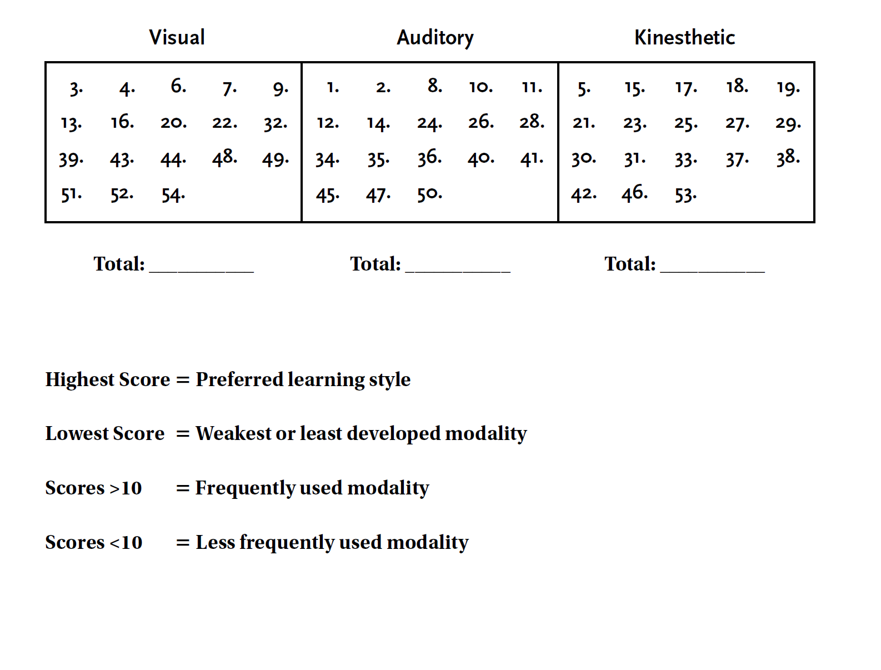
Tally your scores now!!!

Slide 22
Which order did the survey suggest for your results?
V-A-K
V-K-A
K-A-V
K-V-A
A-K-V
A-V-K

Slide 23
Now, find another person in the room that did NOT have the same results and sit next to them!

Slide 24
How would you each learn BEST with an assignment like studying new vocabulary?
DISCUSS FOR TWO MINUTES!!!

Slide 25
Did we learn
anything today?
With your partner, attempt to correctly answer the following questions!

Slide 26
1. Can you name the three learning modalities/styles?
Visual
Auditory
Kinesthetic

Slide 27
2. Which style requires good listening skills and strong vocabulary?
Auditory

Slide 28
3. Which style has good recall skills and tends to make “mental movies?”
Visual

Slide 29
4. Name one characteristic of a Kinesthetic Learner.
Hands-on
Good coordination
Works well with objects

Slide 30
5. Can you name one learning strategy for each style mentioned today?
Visual: highlight, create movies/pictures
Auditory: use audio, recite, discussions
Kinesthetic: muscle memory, study tools, games/roleplay

Slide 31
6. Learning is an individualized process affected by...
Background
Experience
Personality
Motivation

Slide 32
So, does it REALLY
matter how we learn?

Slide 33

WE think so!!!

Slide 34
AND FINALLY…
*Complete the reflection writing on the back page.
*Turn in your packet to the correct bin for 25 formative points. (Wahoo!!!)

Slide 35
Resources & Links:
Myers-Briggs Personality Indicator
http://kisa.ca/personality/
Research your test results
http://www.personalitypage.com/
Background on Myers-Briggs
http://en.wikipedia.org/wiki/Myers-Briggs_Type_Indicator

