Slide 1
Making Annotations: A User’s Guide

Slide 2
What is Close Reading?
Close Reading is the careful, sustained
analysis of a text that focuses on details,
patterns and that typically examines
some aspect of the text’s form and meaning.
Notes:
Has your literature instructor asked you to perform a close reading? If so, then you should plan and write an essay that offers readers the following (read definition). Basically, a close reading asks you to pay close attention to what the writer is saying and how s/he is saying it.
First you’ll need to choose a poem at which you want to look more closely.

Slide 3
Close Reading Goals
Overall, the goals of close reading are to…
Learn about language and rhetorical technique.
Gain a deeper understanding of a text.
Explore a specific theme or pattern within a text.
Understand how writers craft their work.
Notes:
Individual instructors may have different reasons for asking their students to close read a text. Here are some of the most common goals of performing a close reading.
When you read a text very closely, you pay more deliberate attention to how the writer is using language and to the creative ways in which language can work on the page.
Most commonly, performing a close reading can help you better understand and appreciate a text—both its craft and its significance.
You may find yourself interested in a particular pattern you notice throughout a text; exploring it can teach you about how a writer crafts his/her work and how he/she is communicating with us.
Ultimately, learning how texts are crafted will help your own writing; the techniques and creativity employed by other writers can often serve as inspiration for your own writing.

Slide 4
Tips for Reading Poems
When you first approach a poem:
Read the poem slowly
Read it at least twice
Read it aloud to yourself
Note important words, images and phrases.
Notes:
Once you choose a poem, you’ll need to read it carefully in order to connect with what the poet is doing. Here are some tips for reading poems. Since not all poems contain narratives (like prose), it can be helpful to approach them a little differently.
Read slowly: if you read too quickly, you’re likely to gloss over important things. Everything included in a poem is purposeful, even small things.
Read the poem more than once: give yourself an extra time through to notice things and get the meaning, or project, of the poem.
Try reading out loud to yourself. It’s often helpful to hear the poems aloud, though not every poem will lend itself to an oral performance. Remember to pay attention to line breaks and white space as you read!
Annotate the text: mark things—significant words, phrases, recurring images, line breaks—anything that seems interesting or unusual to you. Write your reactions or questions in the margins, highlight or underline important passages, etc.

Slide 5
If you’re struggling with a poem, try the
following steps:
Examine your beliefs about what poetry should be or do
Rewrite the poem as a prose paragraph
Read with your gut and your brain
Not all poems are logical and/or narrative
Notes:
Some poems are more difficult than others. If you feel like you’re still struggling to fully understand the poem, try some of the following tricks. First, ask yourself what you believe poetry should be or do. For example, many people think that all poems rhyme, while others believe that a poem should be beautiful (in subject or at least in language). Is it possible that the poem you’ve chosen doesn’t fit your beliefs about poetry? If it challenges any of your beliefs, how does it do so?
If the line breaks make it difficult for you to follow, try rewriting the poem into a prose paragraph. This might make the sentences clearer. This is also a great way to become more aware of the poem’s line breaks—what they emphasize and how the poem’s rhythm and flow change when they aren’t in place.
Last, remember that poetry demands some skills of a reader that prose may not. For example, not every poem tells a story (i.e. is narrative). Some are highly associative and even fragmented. Try to understand what the connections are among images, words, sounds, etc. This helps when you’re dealing with a non-narrative poem. Try to read with your gut and your brain, both the rational and irrational parts of your brain.

Slide 6
Close Reading: Step 1
Understand the poet’s project:
What subject(s) does the poem address?
Who is the speaker of the poem?
What is the poem’s larger context?
What genre or mode of poem are you dealing with?
Notes:
In order to begin close reading the poem you’ve chosen, you should ask some basic questions to make sure you understand the poet’s project—what s/he wanted to convey in the poem and how s/he wanted the reader to feel or react to the material presented. Determine whether there was a speaker in the poem. If there is, remember that it’s important not to assume that an “I” in the poem is automatically the poet him or herself. For example, the poet Ai writes dramatic monologues in which she speaks in the first person from the perspectives of characters like murderers. If there isn’t an obvious speaker in the poem, is there an omniscient observer?
It’s also important to consider what the larger context of the poem is. When was the poem written and published? Were there any significant historical events taking place at that time? Sometimes it’s also significant to ask what was going on in the poet’s own life (although not every poem is personal or deals with the poet’s emotions). How does the larger context affect the poem? For example, T.S. Eliot’s famous poem “The Wasteland” takes on more meaning and clarity when we know that it was written in response to WWI.
Sometimes it’s also important to understand what genre of poem you’re dealing with. Certain modes, like the ode, for example, or the elegy, have conventions the poet may use or challenge.

Slide 7
Close Reading: Step 2
Examine the poem’s form and structure:
Use of closed or nonce form
Stanzaic make-up
Devices like repetition, punctuation, or section divisions
Use of negative vs. positive space
How is the poem put together?
Notes:
Next, you’ll want to examine the poem’s structure, or how the poem is put together. Does it have an obvious form or a more organic one? What do the stanzas look like? If you had to describe the layout of the poem on the page, what would you notice about it? Negative space in a poem is most commonly referred to as white space, the space that is not occupied by text. Positive space refers to the poem, or text, itself. We’ll examine some of this in more detail.

Slide 8
Close Reading: Step 3
Look more closely at line within the poem:
Meter or rhythm within line
Line length and variation
Line break (white space)
Enjambed vs. end-stopped lines
Elements of line can be dictated by form.
Notes:
Line is an important feature in poetry and bears close examination. You’re probably familiar with meter if you’ve read Shakespeare’s sonnets, which are written in iambic pentameter and have a recognizable rhythm. But line length and variation, as well as whether or not lines are end-stopped or enjambed, influence a poem’s rhythm, speed, and flow a great deal. Let’s consider some of these features in more detail on the next slide.

Slide 9
Close Reading: Step 4
Look closely at the language the poet uses:
What kind of diction does the poet use?
What is the tone/mood of the poem?
Which images stand out and why?
Does the poet use figurative language?
Notes:
Now let’s pay closer attention to the language in the poem. Every word choice in a poem is deliberate and can tell us something about the poet’s project, the emotions and/or ideas embodied in the poem, or the subject matter. Start by asking these questions of the poem you’re writing about. Your earlier annotations should help you out here.

Slide 10
Close Reading: Step 5
Make a claim about how the poem works or what the poet is doing (your thesis).
What is the overall effect of the poem’s craft of all the poem’s craft elements?
Where does the poem take us (emotionally, intellectually, narratively, etc.)?
Notes:
Your final step is to make a claim about the poem’s project, some aspect of its craft, etc. In order to support your claim, or thesis, you’ll want to pull evidence from the text itself. Try to offer your reader something new about the poem so that his/her reading is deepened by your careful observations.

Slide 11
Annotating a Text
*This is a critical step in reading analysis, as it provides documented evidence of a person’s engagement with a written text.
→ first impressions may be forgotten or dismissed if not written down.
This includes adding notes, definitions, reactions, questions, and explanations to a text in order to record impressions and reactions while analyzing a work.

Slide 12
Here are some suggestions that will help you with your brainstorming.
• Vocabulary—define words or slang;
• Make connections to other parts of the book.
• Make connections to other works that you have read.
• Visual connections—include the artwork, photo, or drawing
• Rewrite, paraphrase, or summarize a part of the text.
• Make connections to your life.
• Give the historical context of situations described.
• Give an explanation of the text for clarity.
• Give an analysis of what is happening in the text.
• Do research on the Internet to see what others are saying it.
• Challenge yourself: Find some literary criticism on author/text

Slide 13
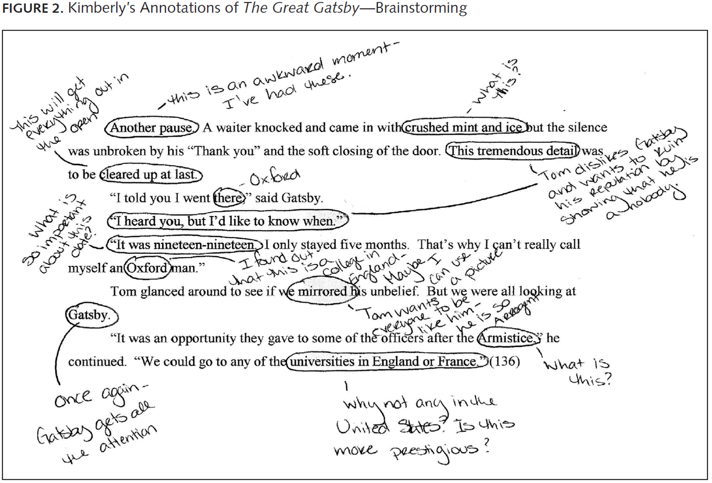

Slide 14
Annotation Practice #1: “If We Must Die”

Slide 15
If We Must Die
If we must die, let it not be like hogs Hunted and penned in an inglorious spot, While round us bark the mad and hungry dogs, Making their mock at our accursèd lot. If we must die, O let us nobly die, So that our precious blood may not be shed In vain; then even the monsters we defy Shall be constrained to honor us though dead! O kinsmen! we must meet the common foe! Though far outnumbered let us show us brave, And for their thousand blows deal one death-blow! What though before us lies the open grave? Like men we'll face the murderous, cowardly pack, Pressed to the wall, dying, but fighting back!
(Claude McKay 1919)

Slide 17
Annotation Practice #2: “Digging”

Slide 18
Digging
Between my finger and my thumb
The squat pen rests; snug as a gun.
Under my window, a clean rasping sound
When the spade sinks into gravelly ground:
My father, digging. I look down
Till his straining rump among the flowerbeds
Bends low, comes up twenty years away
Stooping in rhythm through potato drills
Where he was digging.
The coarse boot nestled on the lug, the shaft
Against the inside knee was levered firmly.
He rooted out tall tops, buried the bright edge deep
To scatter new potatoes that we picked,
Loving their cool hardness in our hands.
By God, the old man could handle a spade.
Just like his old man.

Slide 20
My grandfather cut more turf in a day
Than any other man on Toner’s bog.
Once I carried him milk in a bottle
Corked sloppily with paper. He straightened up
To drink it, then fell to right away
Nicking and slicing neatly, heaving sods
Over his shoulder, going down and down
For the good turf. Digging.
The cold smell of potato mould, the squelch and slap
Of soggy peat, the curt cuts of an edge
Through living roots awaken in my head.
But I’ve no spade to follow men like them.
Between my finger and my thumb
The squat pen rests.
I’ll dig with it.
Seamus Heaney

Slide 21
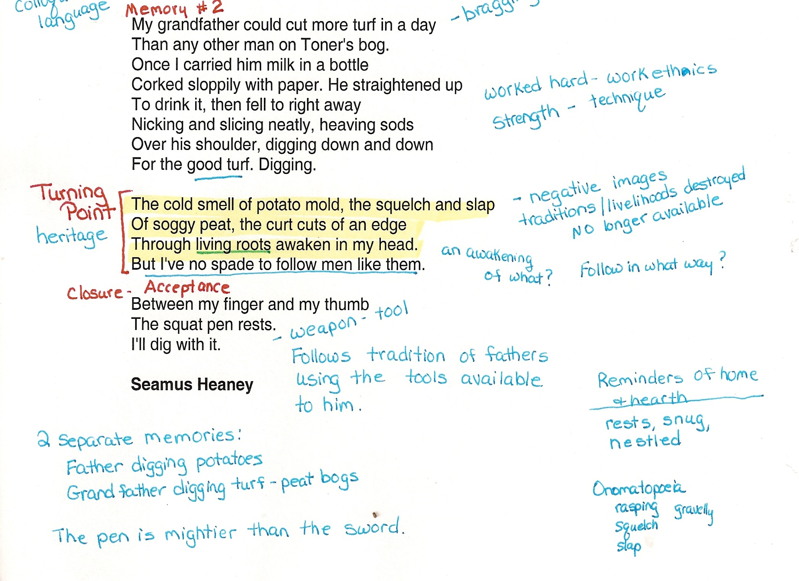

Slide 22
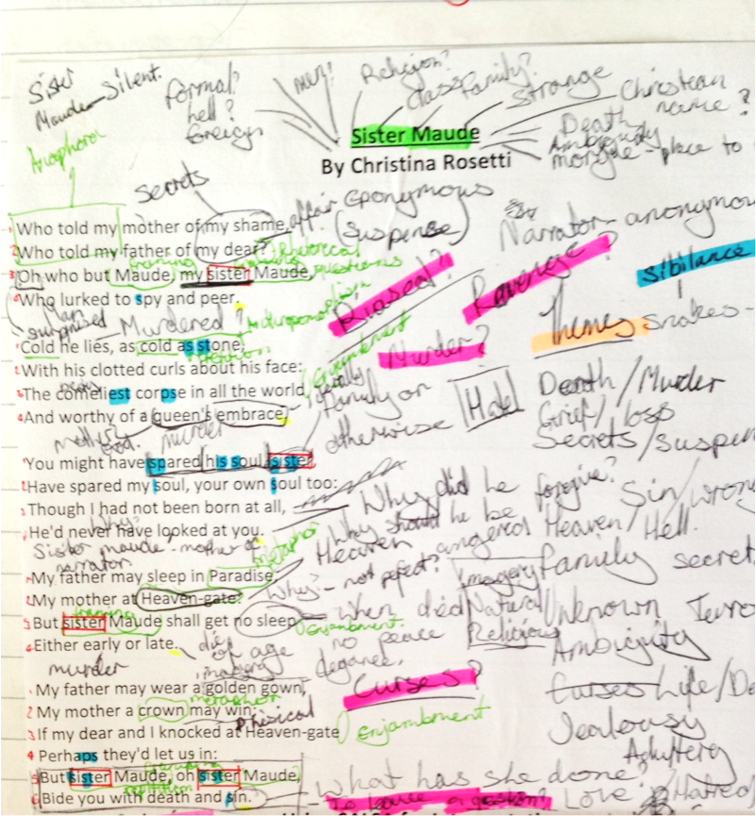
TOO MUCH Annotation!

