Slide 1
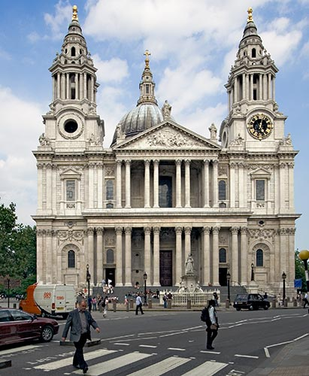
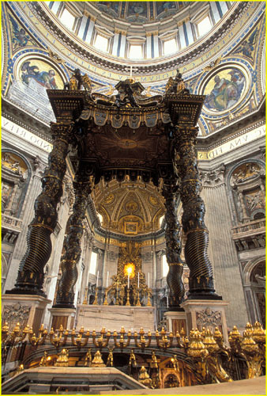
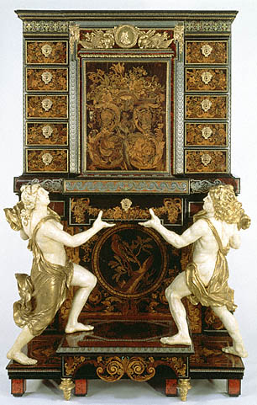
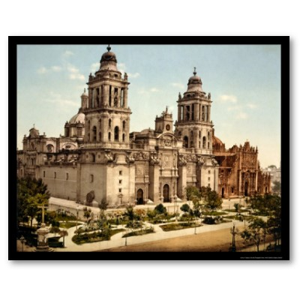
Baroque Architecture

Slide 2
The Baroque period began in 1600 in Rome when Catholic popes began to finance magnificent cathedrals and works to display their faith’s triumph after the Counter-Reformation.
The church wanted to attract new worshippers by overwhelming them with theatrical, “must see” architecture.

Slide 3
Baroque Architecture
Architecture affirmed the power of people with absolute authority through the structures and decorative programs of palaces, churches, public and government buildings, scientific and commercial buildings, & military installations.
Baroque Basics
When | 1600-1750
Where | Italy, Spain, Germany, Austria, France, England
Big Names | Bernini, Borromini, Wren, Vanbrugh, Le Vau
Style | Massive, opulent, colorful
Features | Broken contours, dramatic vistas, lavish ornament, dynamic effect
Patrons | Absolute monarchs, catholic church
Distinguishing Traits | Plastic treatment of surfaces, fusion of architecture and sculpture
Triumph | Creation of total environment for maximum emotional effect
Elements | Serpentine columns, irregular facades, oval plans

Slide 4
http://www.patoczka.net/Italy%201/images/16%20Bernini%27s%20canopy%20(Baldacchino)%20above%20St.%20Peters%20tomb,%20St.%20Peters%20Basilica,%20Rome.jpg

Slide 5
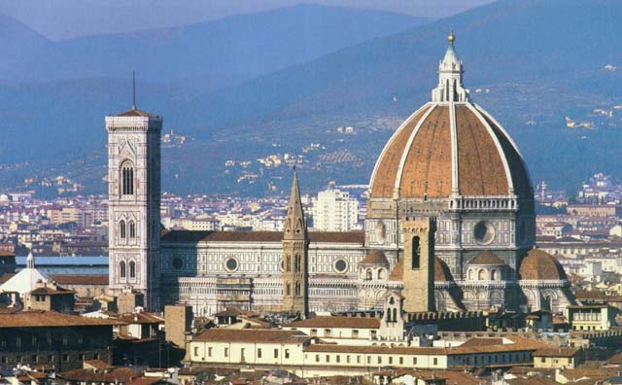
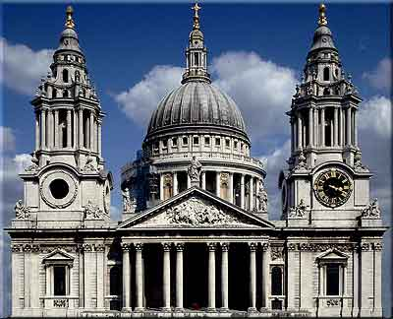
Renaissance vs. Baroque
http://www.dl.ket.org/humanities/arch/images/cupola_.jpg
http://londontravelogue.files.wordpress.com/2009/06/st-pauls.jpg
Since the Baroque architects now knew how to use the structures, they made them decorative.
B-arch’s emphasized the Renaissance’s use of symmetry and harmonious proportions, but their designs revealed a new sense of dynamism and grandeur.
Renaissance architects has sought to engage the intellect, with their focus on divine sources of geometry, while their successors aimed to overwhelm the senses and emotions.
Baroque mastered the unification of the visual arts.

Slide 6
Baroque
Homes

Slide 7
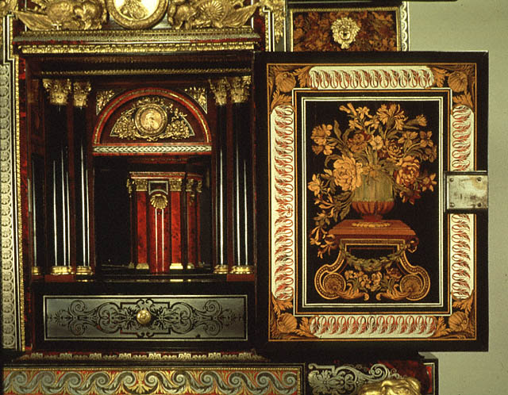
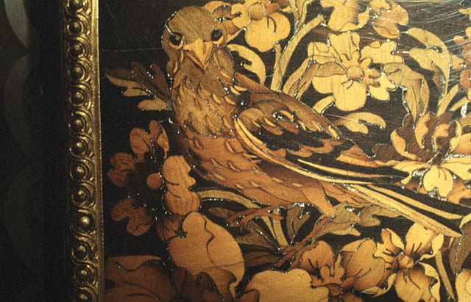
Baroque Furniture

Slide 8
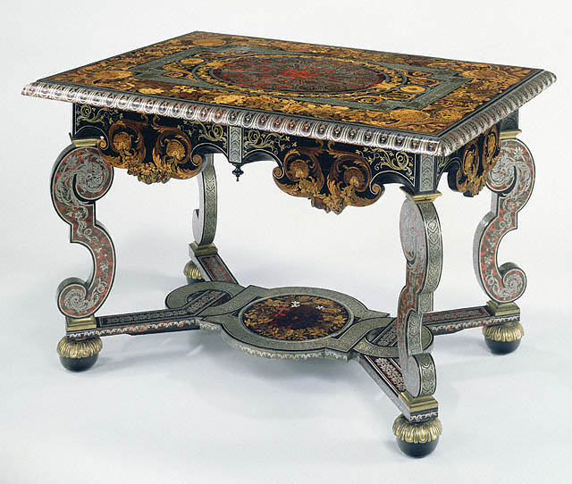
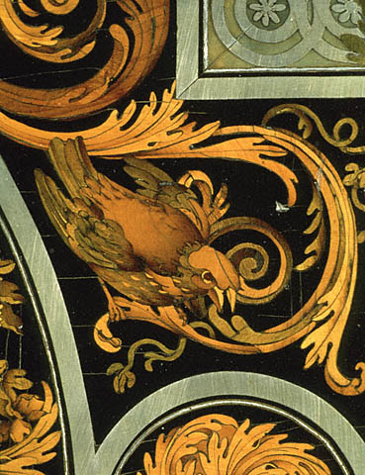
Baroque Furniture

Slide 9
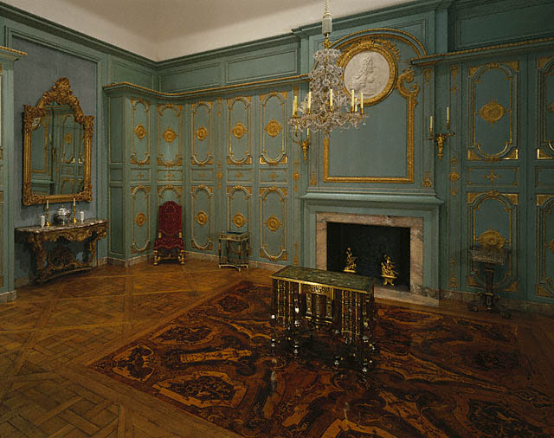
A Baroque Room

Slide 10
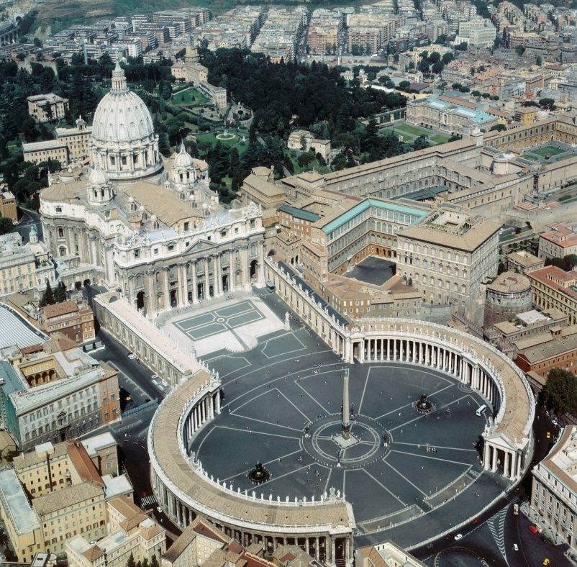
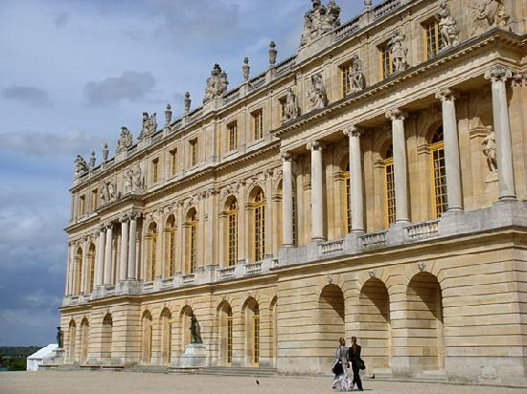
Baroque Architecture Activity
Items you must know:
Be able to identify the floorplan of the Escorial Palace
Be able to explain why the Hall of Mirrors from Versailles is Baroque
Be able identify the major architectural styles involved in St. Paul’s Cathedral
Each reading portion will be timed. 5 min.
http://media-2.web.britannica.com/eb-media/86/121386-050-4964D6D7.jpg
http://www.inetours.com/England/London/images/StPauls/St-Pauls_W_8926.jpg
http://rlv.zcache.com/cathedral_in_mexico_city_1899_poster-p228007265727699400qzz0_400.jpg
http://media-cdn.tripadvisor.com/media/photo-s/01/0d/52/53/versailles.jpg

Slide 11
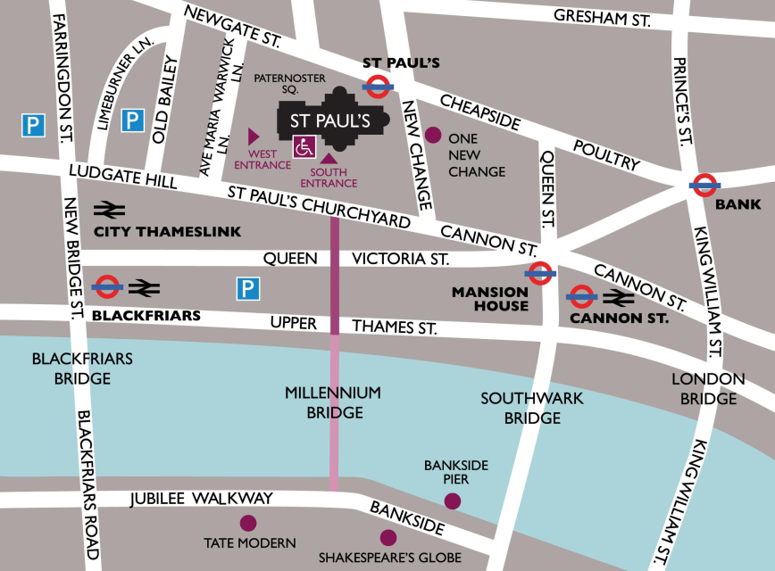
Baroque Application: St. Paul’s Cathedral London, England
Time Remaining:
http://www.youtube.com/watch?v=5JR6v3mLEo8

Slide 12
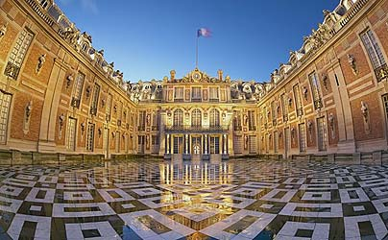
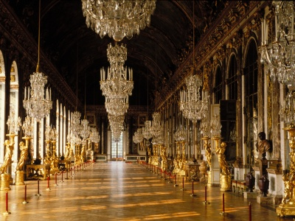
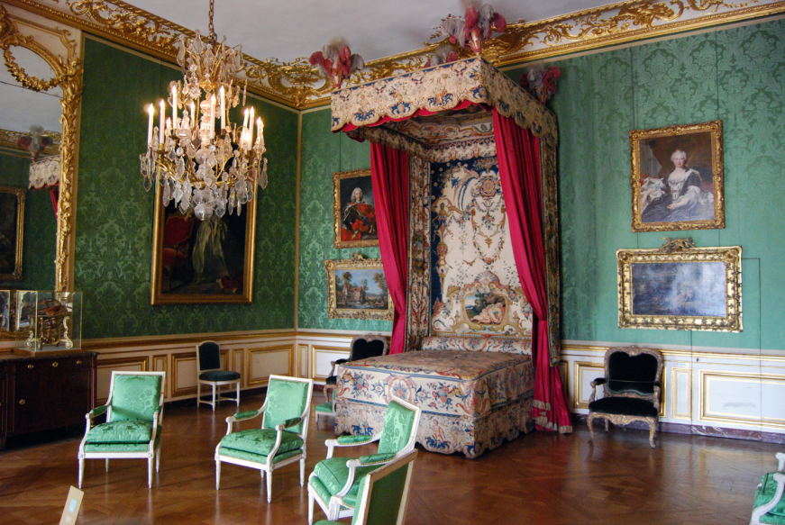
Baroque Application Versailles Palace Versailles, France
Time Remaining:
http://www.youtube.com/watch?v=vozzXRIEDhw

Slide 13
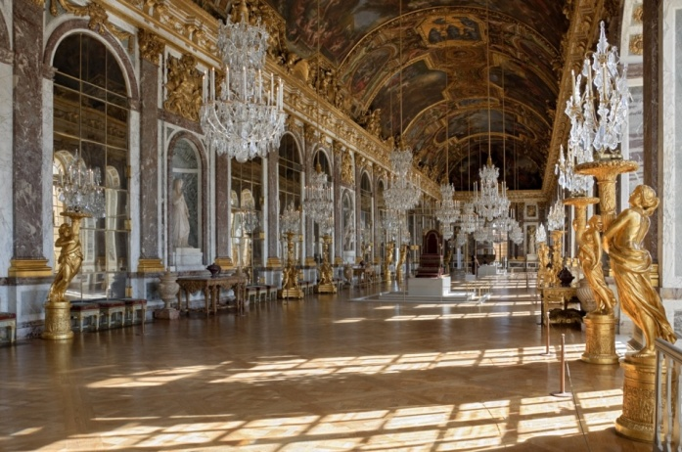
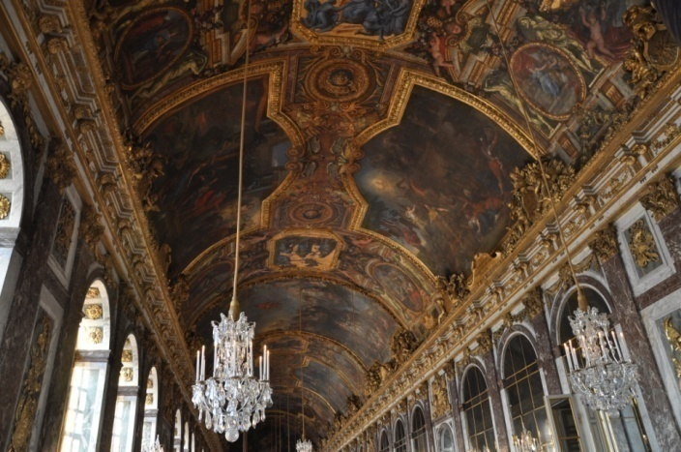
Baroque Application The Hall of Mirrors Versailles, France
Hall of Mirrors- Versailles
The 17 mirrored arches reflect windows overlooking the gardens, creating a feeling of light, drama and extravagance.
While watching the following clip, take notes on the following topics:
Baroque characteristics of the Hall of Mirrors
What ornamentation shows the power and influence of Louis XIV?
Cite specific information
http://www.youtube.com/watch?NR=1&v=0KfBBTtEmSk&feature=endscreen

Slide 14
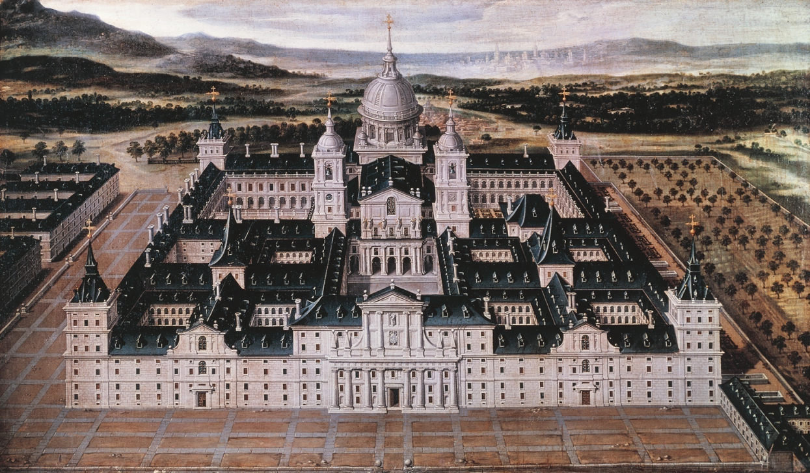
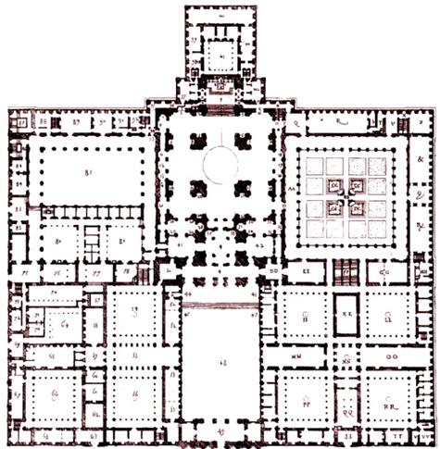
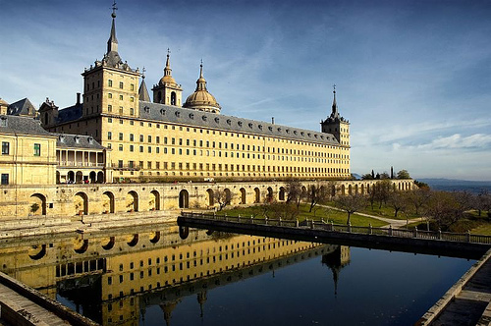
Baroque Application Escorial Palace Near Madrid, Spain
Time Remaining:
http://www.youtube.com/watch?v=_OUIKm8e7Y0

Slide 15
Baroque Architecture Application Activity
Objective: To demonstrate your knowledge of the characteristics of Baroque Architecture
Assignment:
You must design either a sacred or secular Baroque structure.
You must identify the patron of your structure
Requirements:
All appropriate characteristics must be labeled
Color must be used
Structure must fill entire space provided.
Due at the last 5 minutes of class

Slide 16
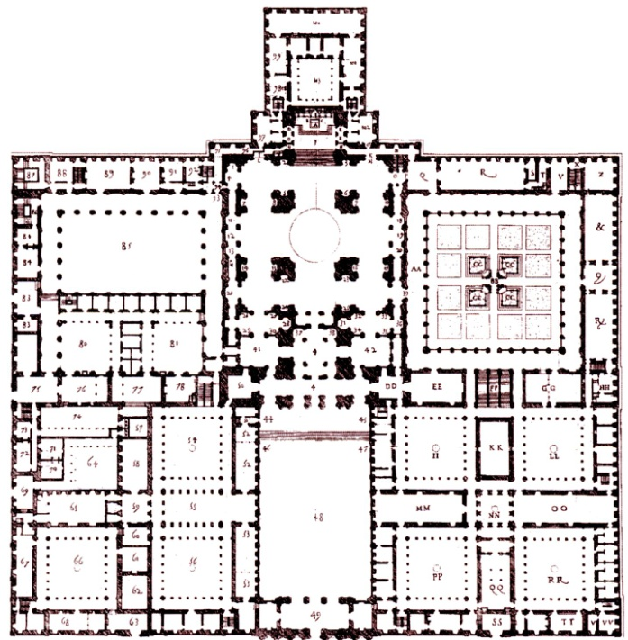
Exit Slip
Complete the following chart and questions on your
1)
2) How did Renaissance architecture differ from Baroque architecture?
3) What are the Baroque characteristics seen in the Hall of Mirrors?
How does this show the wealth and power of Louis XIV?
4) What are the architectural styles found in
St. Paul’s Cathedral?
5) Name the building pictured here:
Artist | Artwork | Description | Baroque Characteristics | Controversies or Cool Facts
Velazquez | Las Meninas

