Slide 1
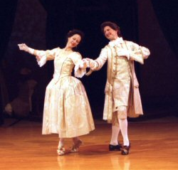
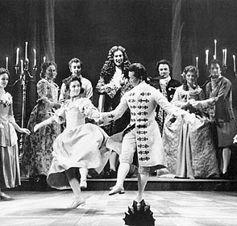
Dance During the Baroque Period

Slide 2
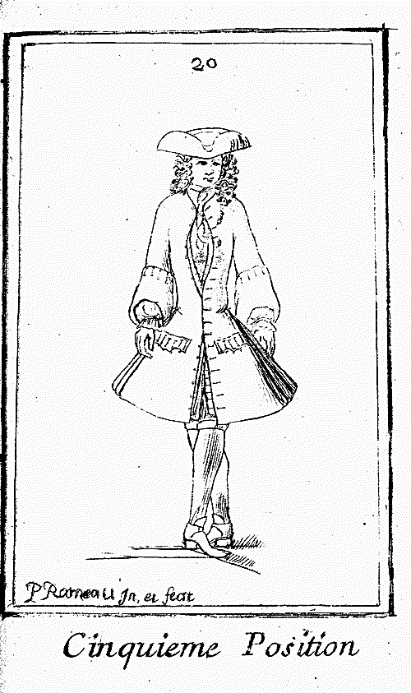
Ballet at the end of the 1600s in France
France was the center of the arts, leader of fashion, and standard for culture
Court extravaganzas
  features famous performers, poetry, song, dance, music and lavish costumes to create a theme
    King was a featured dancer
  included rituals, festivals, and carnivals
  indoors/outdoors

Slide 3
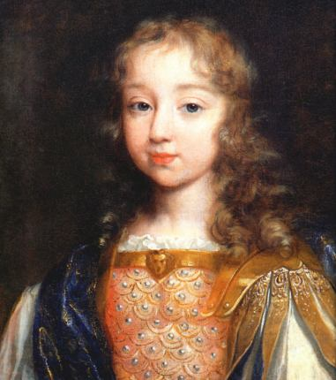
King Louis XIV
Succeeded his father on the throne at age 4.
Neglected as a child.
  Almost drowns in a pond at as a result.
At age 10 revolts left him angry at Paris, the nobility and common people.
Set up schools, or Academies, for the arts.
Chose the “Sun” as his emblem, reminiscent of Apollo.
  Remember from the Palace at Versailles?

Slide 4
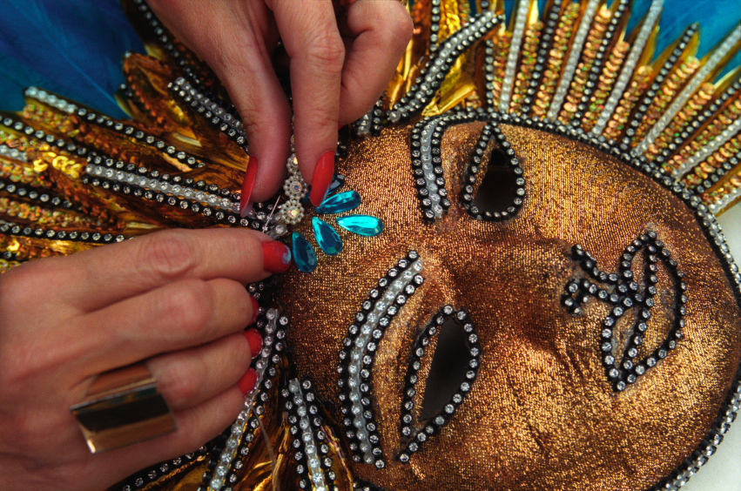
Ballet in the Court of Louis XIV
While watching the following clip, answer the question on the bottom of your learning guide.
  How did Louis XIV use ballet to assert his wealth and power?
    1. Provide a summary of the scene
    2. Cite specific references where the dance asserts wealth and power.
http://www.youtube.com/watch?v=PdeqbpfXaK8

Slide 5
The scene is of the first well-known ballet by Louis the XIV, future King of France, and shows how he got the name, Sun King.
It shows wealth by the gold costume and the creation of the entire stage for just this performance.
This scene shows power through the choreography of making the wealthy nobles bow down to Louis, as part of the dance, in front of the audience.

Slide 6
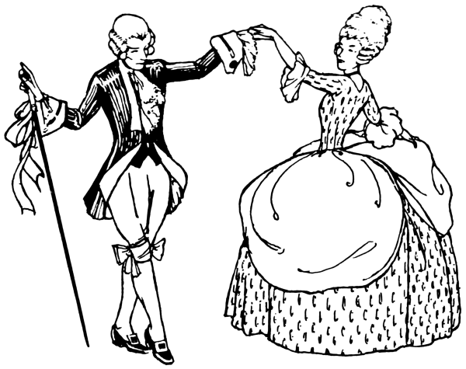
Social Dancing During the Baroque Period
The Minuet
  social dance of French origin for two people, usually in 3/4 time.
  Consists of short steps
    small, pretty, delicate
  At the period when it was most fashionable, it was slow, soft, ceremonious, and graceful.
http://www.youtube.com/watch?v=aUplaATIBjQ

Slide 7
Contributors to Ballet Activity
Read pages 96-98 and fill in the appropriate information on page 99 for each person.
You will have 3 minutes on each biography.

Slide 8
Exit Slip
1) Identify the title, composer, and form of the songs being played.
  A) Song One:
  B) Song Two:
  C) Song Three:
2) Name two individuals who were important to the development of ballet and name their contribution to ballet.
3) Do modern ballets resemble the ballets of the Baroque period? Why?
4) What social influences determine the characteristics of the minuet?

