Slide 1
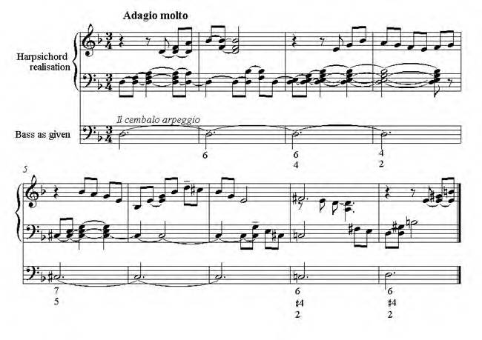
Baroque Music Vocabulary

Slide 2
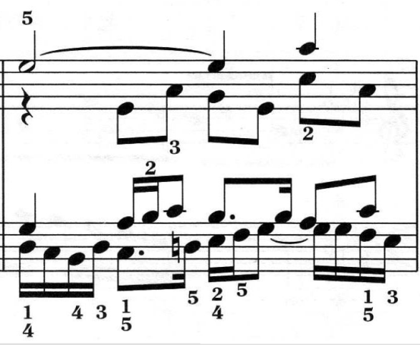
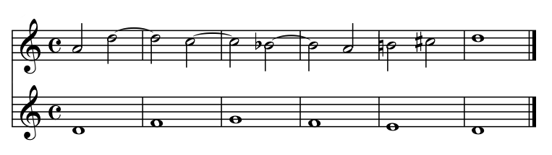
Counterpoint
Type of compositional technique in which two melodies combine to create the harmony, instead of one harmony and chords to accompany it.
Short example of "Third Species" counterpoint ( play MIDI )
http://en.wikipedia.org/wiki/File:Species4.png

Slide 3
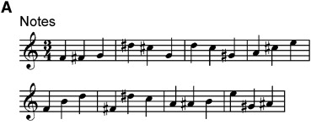
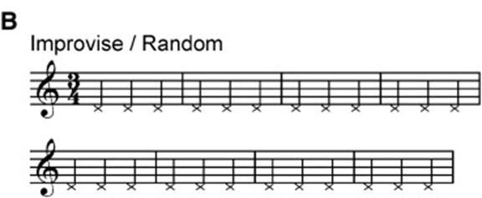
Improvisation
  Term referring to the spontaneous performance of music without previous preparation or any written notes.
  Improvisation can be seen in music of the Baroque era, where ornamentation and realization of figured bass was common.

Slide 4
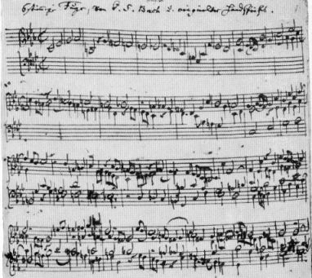
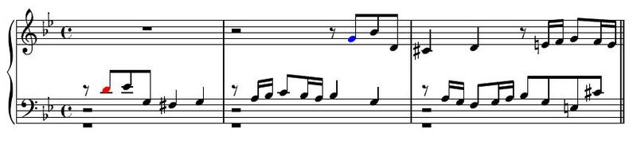
Fugue
A form of composition in which a theme or subject is introduced by one voice, and is imitated by other voices in succession.
  Usually only the first few notes of the subject are imitated exactly, then each voice deviates slightly until the next time it enters again with the subject.
  Generally the voices overlap and weave in and out of each other forming a continuous, tapestry-like texture.
Example of a tonal answer in J.S. Bach's Fugue No. 16 in G Minor, BWV 861, from the Well-Tempered Clavier, Book 1. ( Listen )
The first note of the subject, D (in red), is a prominent dominant note, demanding that the first note of the answer (in blue) sounds as the tonic, G.
http://en.wikipedia.org/wiki/Fugue

Slide 5
Figured Bass
The bass part -generally of a Baroque composition-
that is marked so as to indicate the harmonies that
should go with each note.
The bottom staff shows the figured bass, the Grand Staff above shows what the musician could play!

Slide 6
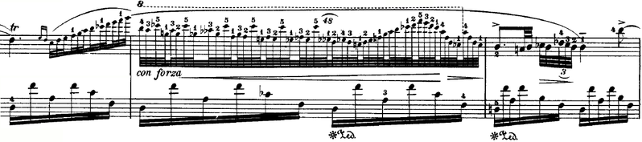
Ornamentation
Decorative notes of short duration added to compositions to emphasize certain notes and to add flavor to the composition.
  Ornamentation is particularly prominent in the music of the Baroque era and is not limited to specific instruments, but may be performed on almost any instrument, including the voice.
An extreme example of ornamentation as a fioritura from Chopin's Nocturne in D flat major.
http://en.wikipedia.org/wiki/Ornament_(music)

Slide 7
Genre
Style, manner
  The genre originated in the 16th century (Renaissance period) and developed to its peak during the Baroque period.
  Renaissance genres? Motet, Madrigal, Mass
  Baroque? Sonata

Slide 8
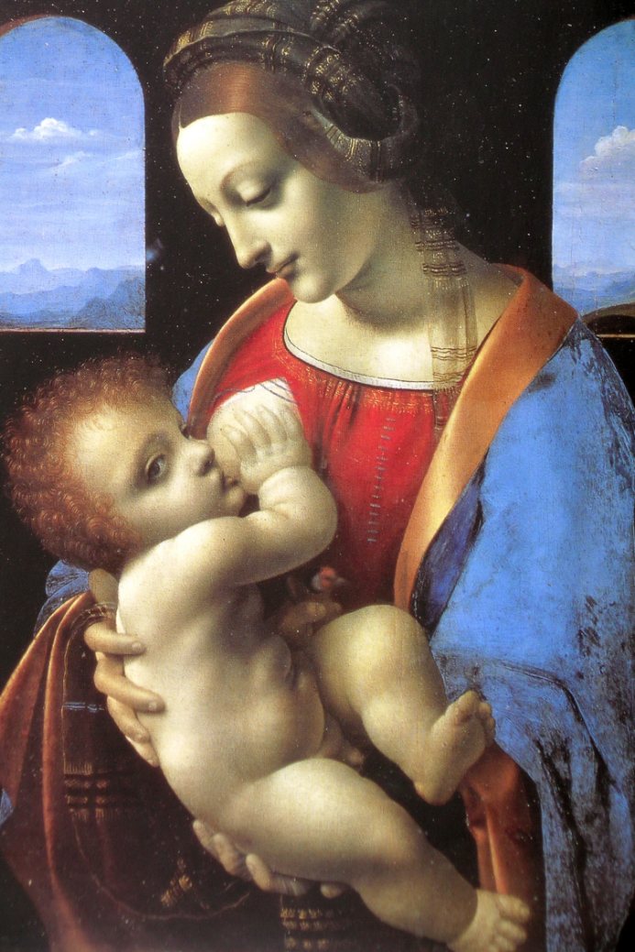
Oratorio
Large scale dramatic composition with text usually based on religious subjects.
  Oratorios are performed by choruses and solo voices with an instrumental accompaniment, and are similar to operas but without costumes, scenery and actions.
http://www.youtube.com/watch?v=c-Jkktpp9QI
Joseph Haydn, The Creation (1798)

Slide 9
Opera
A drama set to music, usually sung throughout, originating in 17th century Italy. Opera is a combination of music, drama, scenery, costumes, dance, etc., to create a complete art form.
  Opera became a very important vehicle for composers during the Baroque period.
  http://www.music.vt.edu/musicdictionary/
Bizet’s Carmen by the Royal Opera Company
http://www.youtube.com/watch?v=Gd0FNpiBDyA

Slide 10
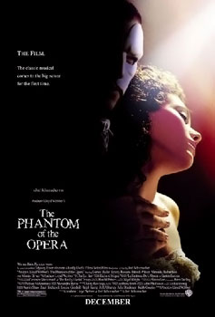
Aria
song meant for a soloist and an orchestra
“Think of Me”- Phantom of the Opera
http://www.youtube.com/watch?v=XfTgCPUJwRk

Slide 11
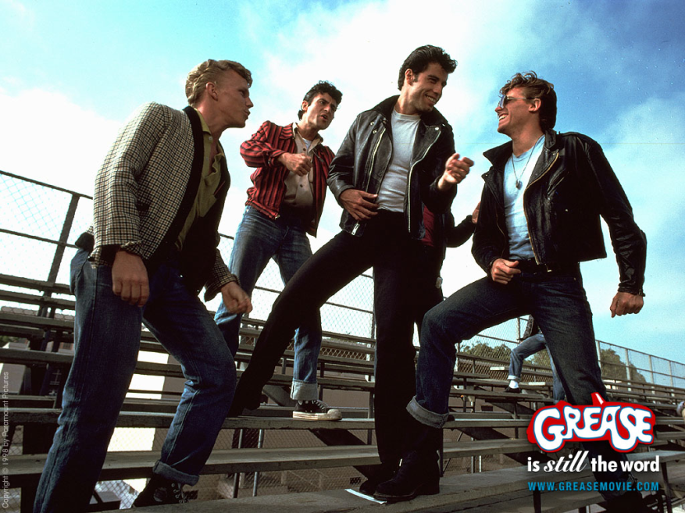
Recitative
sung conversation between characters to advance the storyline
“You’re the One that I Want” - Grease
http://www.youtube.com/watch?v=PKX9J2ENXTs

Slide 12
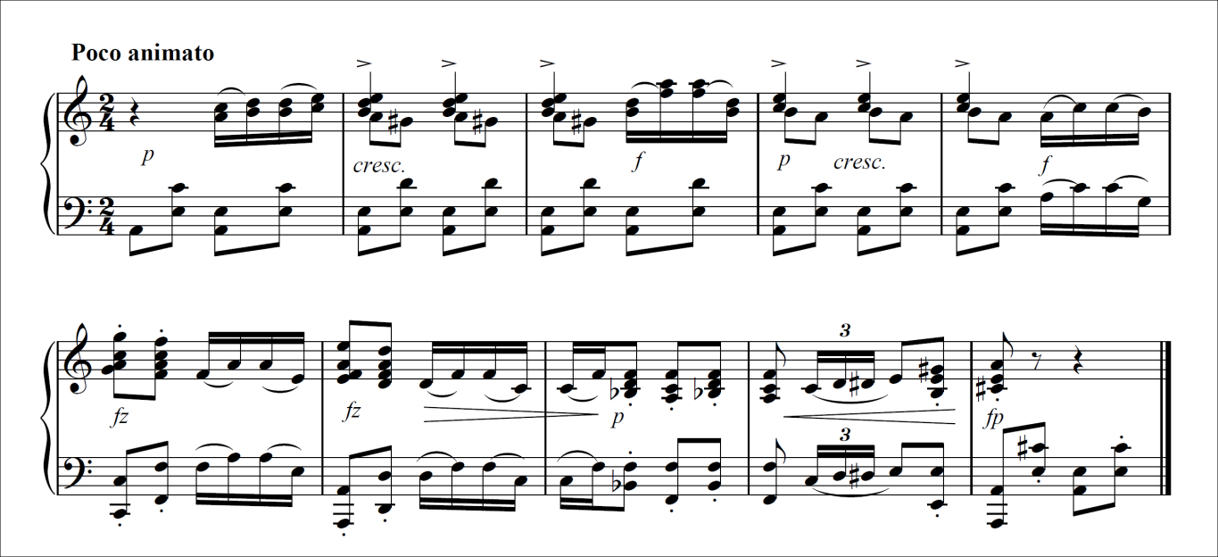
Concerto
a composition for one or more principle instruments, with orchestral accompaniment, now usually in symphonic form.
Schoenberg’s Piano Concerto
http://www.youtube.com/watch?v=rZlB2tRyvQw

