Slide 1
Opening Agenda
Things to Get:
The 2 handouts from the table in the front of the room
Notebook paper
Things to Do:
Opener: Preview of Baroque Art
Notes: Baroque art and artists
Exit Slip: Characteristics and Controversies of Baroque Art in Review

Slide 2
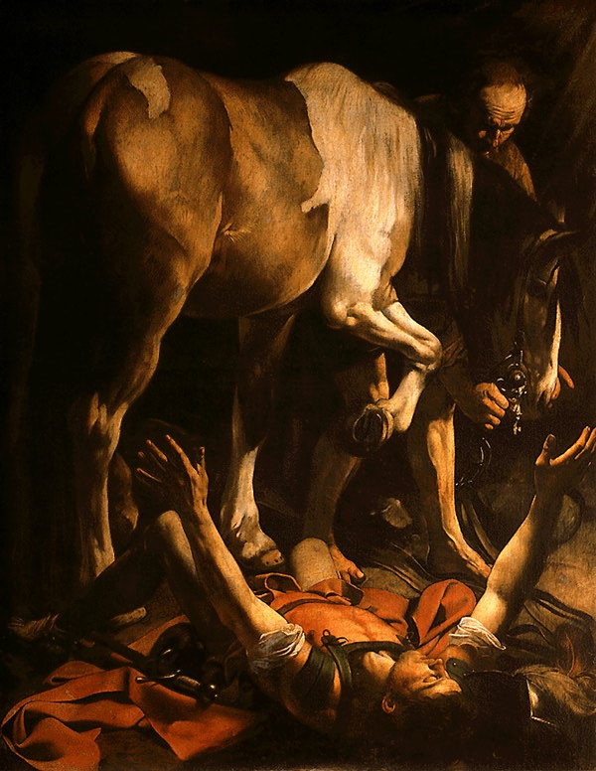
Opener
Using the article provided, answer the questions on your learning guide provided.
The Conversion of St. Paul, 1601
http://www.americancatholic.org/features/saints/saint.aspx?id=1271#tagAudio

Slide 3
Baroque 1600-1750
The Baroque period began in 1600.
The church wanted to attract new worshippers by overwhelming them with theatrical, “must see” architecture.

Slide 4
The Baroque Era-What’s happening in the world?
30 Years War
Started out as a religious war between the Catholics & Protestants in the Holy Roman Empire but changed to a political war involving the following countries and regions: the Ottoman Empire, Austria, Poland, the Netherlands, Germany, Denmark, France, Spain, & Sweden
Results: Treaty of Westphalia and a rise in nationalism
Protestant Reformation/Catholic (Counter) Reformation
Martin Luther “thesis” against the Catholic Church
Influences Art:
Catholic- religious subject matter
Popes wanted to remake Rome as the cultural center of the western world.
Council of Trent suggested that religious art: be directed toward clarity, realism, and emotion to increase understanding, make it more meaningful to everyday life, and to arose piety and fervor.
Protestant- avoids religious subjects in favor of landscapes, etc.
Increased Trade
New desires- growth of slavery
New wealth= new patrons beyond courts and churches
New Science theories
Sun at the center of the universe

Slide 5
Baroque Period Visual Art
* Introduction
Caravaggio, Rembrandt, Bernini & Velasquez

Slide 6
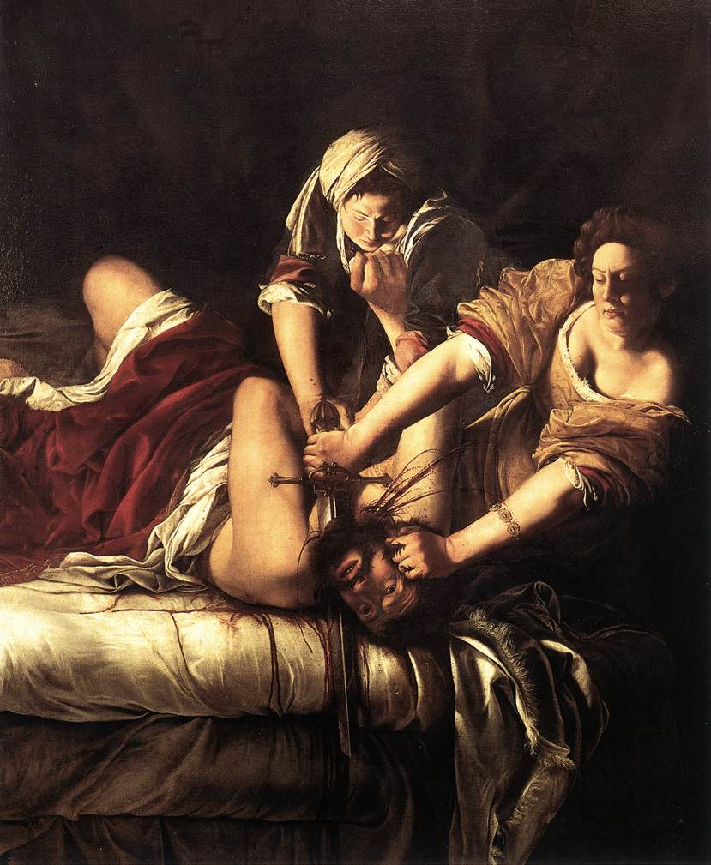
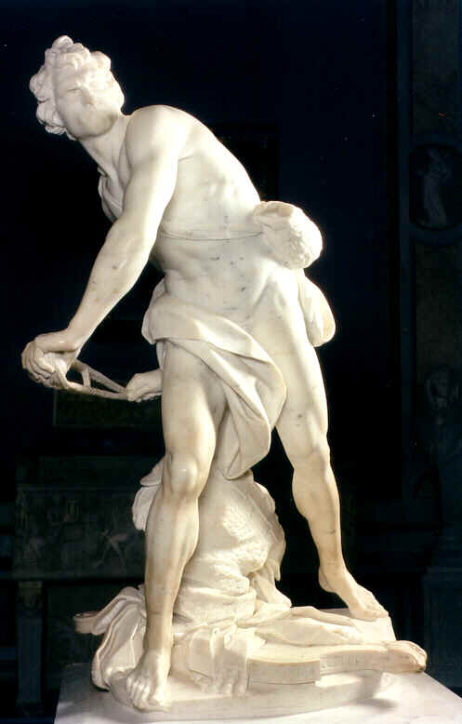
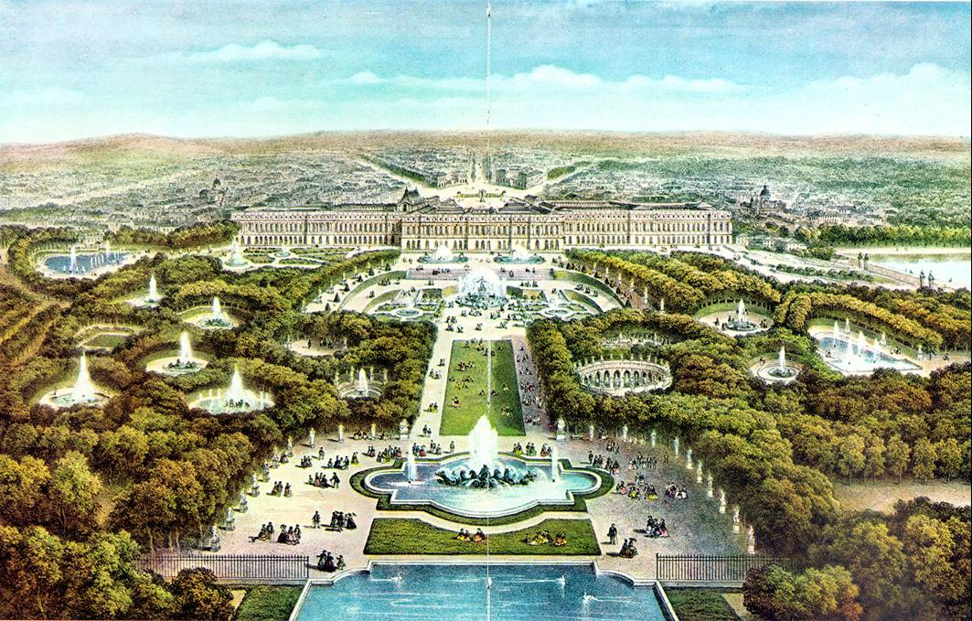
Baroque 101- Art Style
Most sumptuous and ornate in the history of art
Art was expanded into everyday life.
Light was used to create an emotional impact.
Classical elements were used without classical restraint
Visual art was supposed to speak to the illiterate rather than the well-informed.
http://clancyslover.com/wp-content/uploads/2009/03/judith-slaying-holofernes.jpg
http://www.michaelarnoldart.com/bernini_david.jpg
http://www.students.sbc.edu/gregg09/Versailles%20images/Versailles%203.jpg

Slide 7
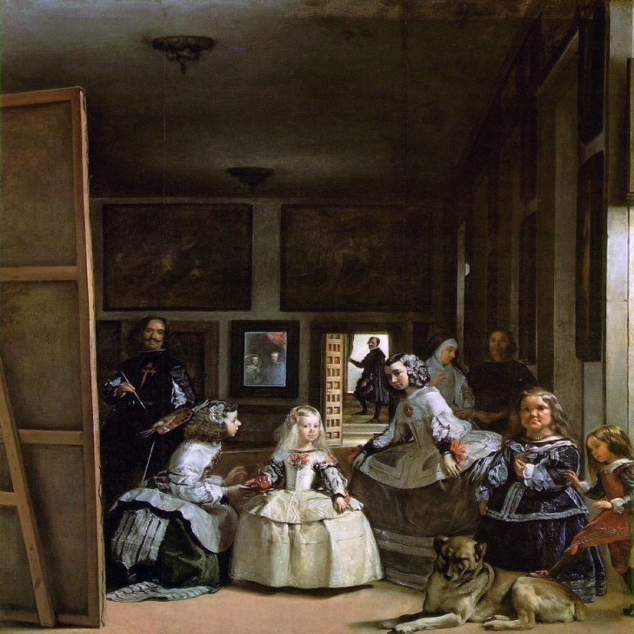
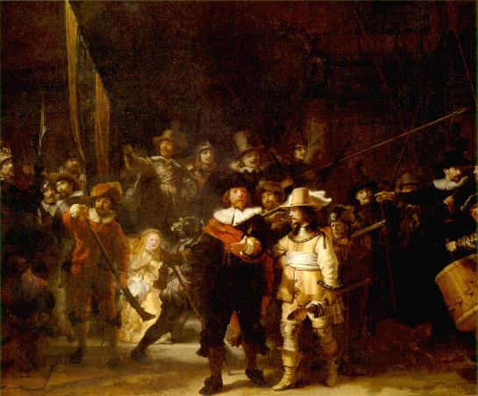
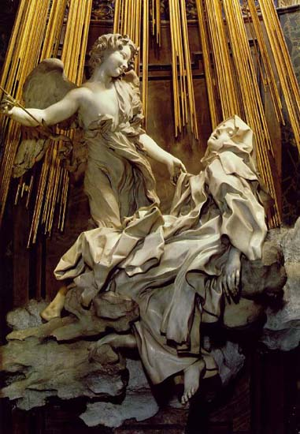
The Conversion of St. Paul
Las Meninas
Ecstasy of St. Teresa
The Night Watch

Slide 8
Baroque Visual Art Overview
Baroque:
Started in Italy
Comes from the term “barrocco”
A Portuguese word meaning “irregularly shaped pearl”

Slide 9
Baroque Visual Art
Although started in Italy, became an international phenomenon
Mercantile class and Absolute monarchs are the patrons outside of Italy
Catholic Church:
Wanted to establish Rome as the cultural center of the Western world
Role of art: Art should be used to teach to the illiterate
Protestants:
Role of Art: Worshippers should rely on the Bible to learn about the gospel… not art.

Slide 10
Baroque Visual Art: Function and Characteristics
Most sumptuous and ornate in the history of art
Art was expanded into everyday life.
Visual art was supposed to speak to the illiterate rather than the well-informed.
Light was used to create an emotional impact.
Chiaroscuro
Italian for “light-dark”
a bold contrast between light & dark.
Tenebrism
Italian for "murky"
It creates the look of figures emerging from the dark.
which is a heightened form of chiaroscuro.

Slide 11
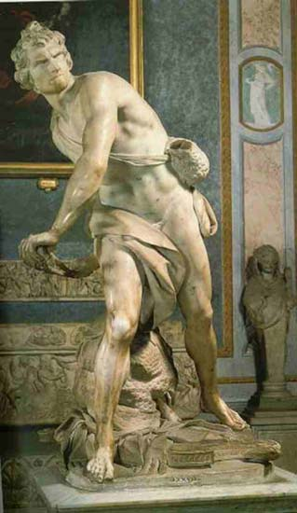

Slide 12
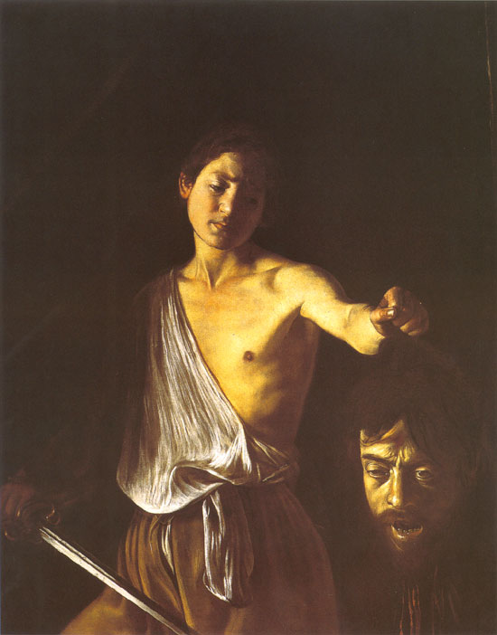
Michelangelo Merisi da CARAVAGGIO 1573-1610
http://static.artbible.info/large/carav_david_goliath.jpg

Slide 13
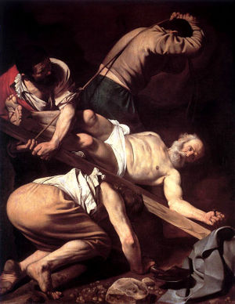
Michelangelo Merisi da CARAVAGGIO 1573-1610
Probably the most revolutionary artist of his time
Characterized by his temper
imprisoned for several assaults and for killing a man
Received pardon and died two days later
He did not idealize the human and religious experience.
Considered profane/vulgar
Orphaned at age 11, went to Rome in 1588, and found a patron in Cardinal Francesco del Monte.
First commissions: scenes of the life of St. Matthew
The Crucifixion of Saint Peter, 1601

Slide 14
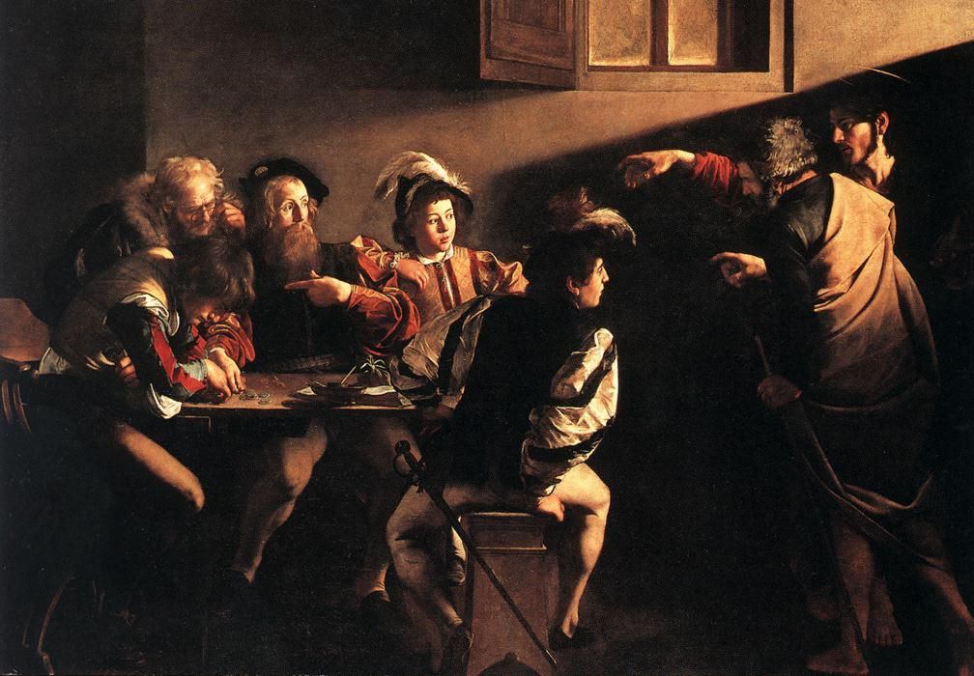
Caravaggio
The Calling of St. Matthew- 1509-1602
http://www.shafe.co.uk/crystal/images/lshafe/Caravaggio_The_Calling_of_St_Matthew_1599-1600.jpg
The works caused public outcry because of their realistic and dramatic nature.

Slide 15
The Conversion of St. Paul, 1601
Notes:
- differed from previous showed images where Pharisee Saul was converted from Christ’s voice when he was atop a throne surrounded by angels.

Slide 16
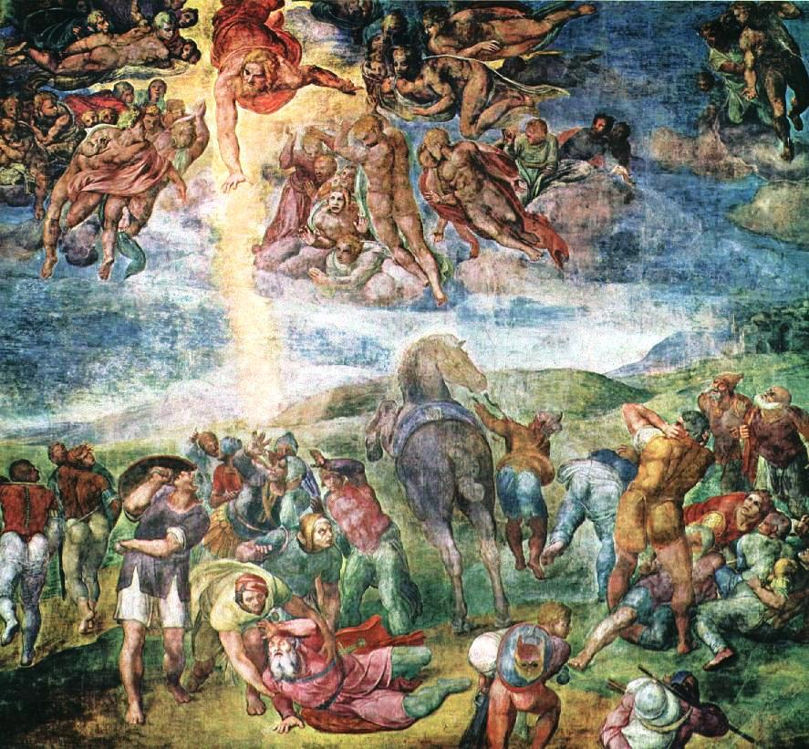
Michelangelo’s Conversion of Saul

Slide 17
The Conversion of St. Paul
Subject:
St. Paul hears the word of God; falls off his horse and is blinded by the bright light of God
Significance:
Religious art was secularized
Saints and miracles appeared to be ordinary events
Elements and Principles of Art:
The audience is brought into the action through the use of chiaroscuro, tennebrism, and perspective.
Controversies
“down and dirty” style
St Paul is on the ground, and you see the horse’s rear

Slide 18
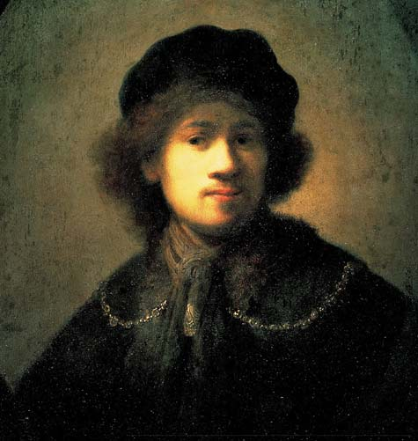
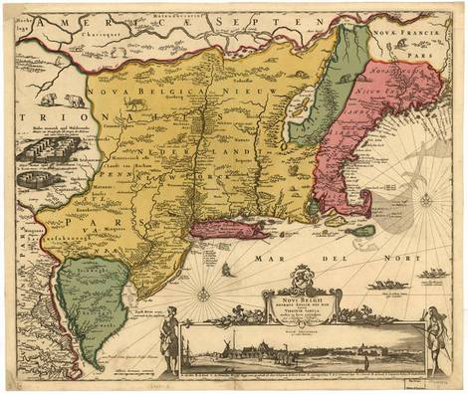
Rembrandt HARMENSZOON VAN RIJN 1606-1669
http://www.liverpoolmuseums.org.uk/picture-of-month/graphics/large/rembrandt_self-portrait.jpg

Slide 19
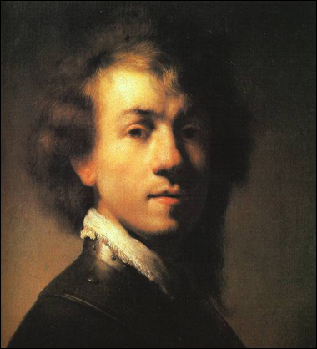
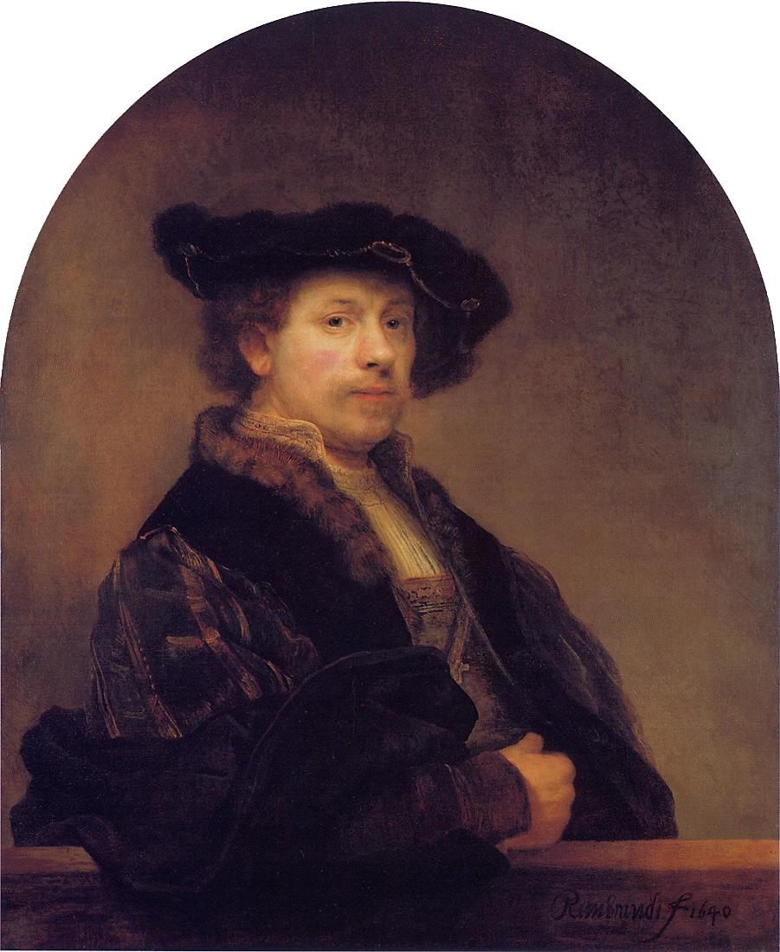
Biography
1629
1606-1669
Born in Leyden; son of a miller
1634: Marries Saskia van Ulenborch
1634-1642: extremely successful
1642: Saskia dies -> turning point in art
His paintings are characterized by luxurious brushwork, rich color, and a mastery of chiaroscuro
http://emptyeasel.com/wp-content/uploads/2007/02/rembrandt-self-portrait-1629.jpg
1640
http://www.mystudios.com/rembrandt/works/rembrandt-sp-1640.jpg

Slide 20
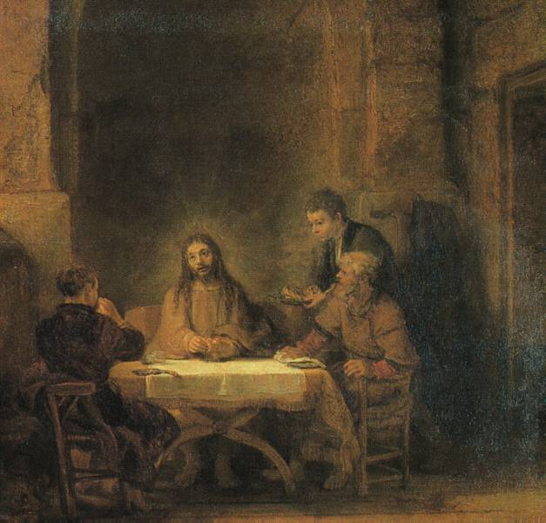
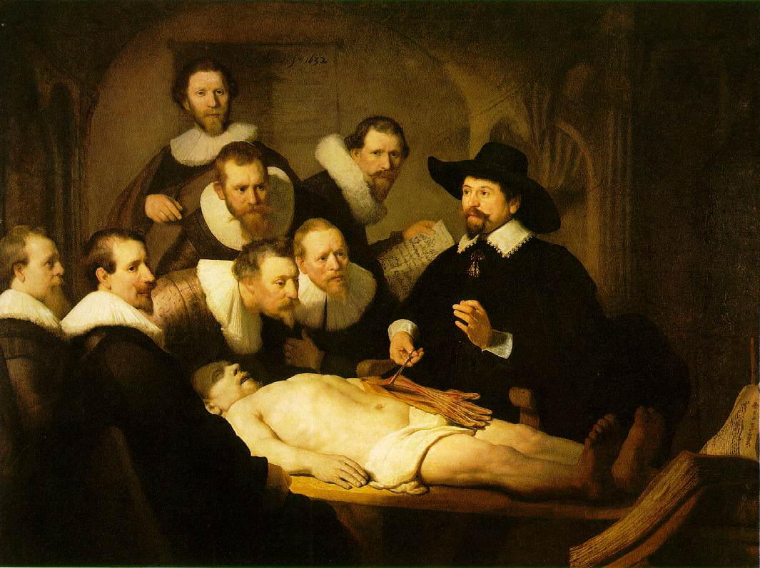
Characteristics of Art work
the greatest artist of the Dutch school
Painter, draftsman, and etcher of the 17th century;
His paintings are characterized by luxurious brushwork, rich color, and a mastery of chiaroscuro
Numerous portraits and self-portraits exhibit a profound penetration of character.
Between 50-60
Early career:
He received many commissions for portraits as well as for paintings of religious subjects
Supper at Emmaus (1648)
The Anatomy Lesson of Dr. Nicolaes Tulp (1632)

Slide 21
Rembrandt
Rembrandt was at his most inventive in this work, popularly known as The Night Watch, 1642.
Complete the questions on your learning guide as you travel around the room to read the articles covering the Night Watch.
The Militia Company of Captain Frans Banning Cocq

Slide 22
Rembrandt
Rembrandt was at his most inventive in this work, popularly known as The Night Watch, 1642.
Each man is painted with the care that Rembrandt gave to single portraits, yet the composition is such that the separate figures are second in interest to the effect of the whole.
The Militia Company of Captain Frans Banning Cocq

Slide 23
Rembrandt
The Militia Company of Captain Frans Banning Cocq
The Night Watch: 1642
Subject summary:
Shows Cocq’s company welcoming Marie de’ Medici’s (Queen of France) morning arrival at Amsterdam’s city gate
Elements of Art:
painting moves in diagonals (figures walking toward the center- implied movement)
Controversies:
Patrons contributed equally to the cost of the painting; however, not all are represented equally
Original title was Captain Frans Banning Cocq Mustering His Company but called the Night Watch in 1700’s because it had darkened with age
Connection to Artist:
Turning Point: Declining interest in his work and financial problems

Slide 24
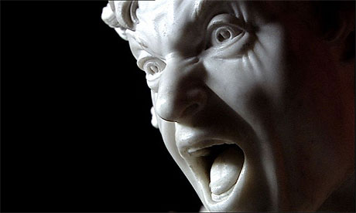
Gianlorenzo Bernini 1598-1680
http://blogs.guardian.co.uk/art/bernini460.jpg

Slide 25
Italian Baroque Art/Architecture
Gianlorenzo Bernini
-1598-1680
-sculptor/architect
-last of great artists to work for the popes
-Major works:
- St. Peter’s Piazza
- David
- Ecstasy of St. Teresa (and Cornaro Chapel)

Slide 26
Cornaro Chapel

Slide 27
Ecstasy of St. Teresa An Angel and a Nun.

Slide 28
The Ecstasy of St. Teresa 1645-52
The entire chapel is designed to show this sculpture off (there are painted balconies on the wall with spectators).
The sculpture depicts St . Teresa when she sees a vision and hears voices (notice her face).
The saint and angel appear to be on swirling clouds, light created on the side of the wall, the marble quivering…
The entire pieces shows emotion, drama, and passion.

Slide 29
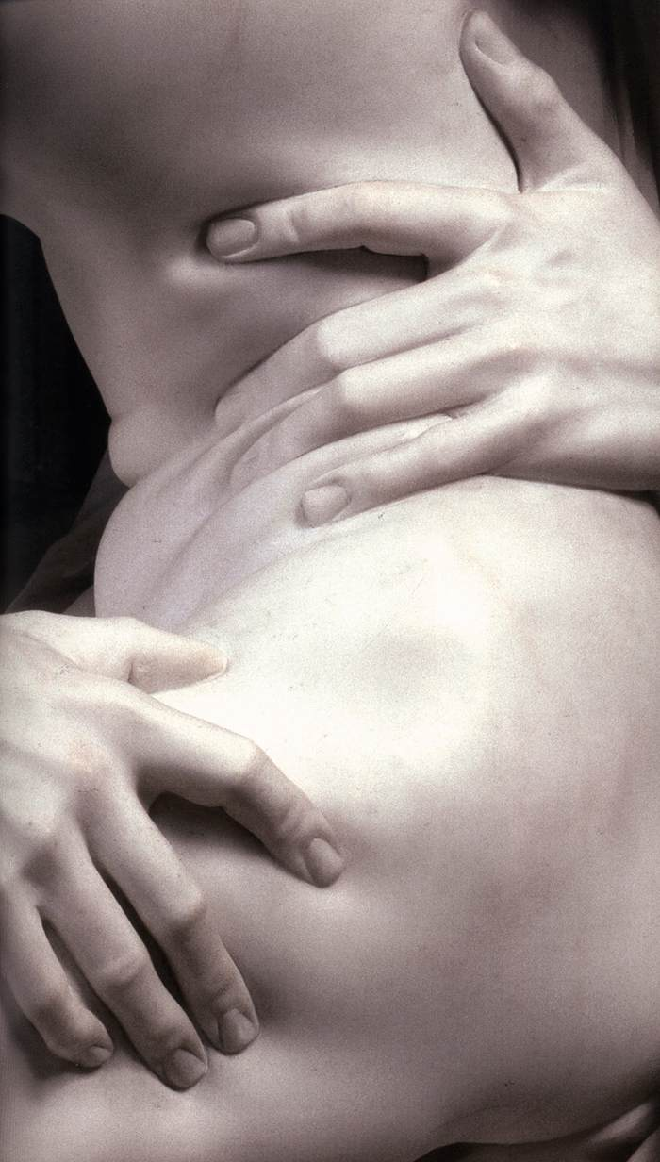

Slide 30
Exit Slip
Complete the chart you began for your opener using the notes you took during this class.
Artist | Artwork | Subject | Baroque Characteristics | Controversies or Cool Facts
Caravaggio
Rembrandt
Bernini

