Slide 1
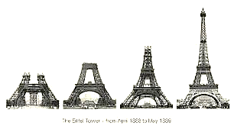
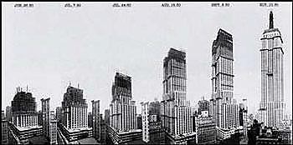
Architecture: Basic Structures

Slide 2
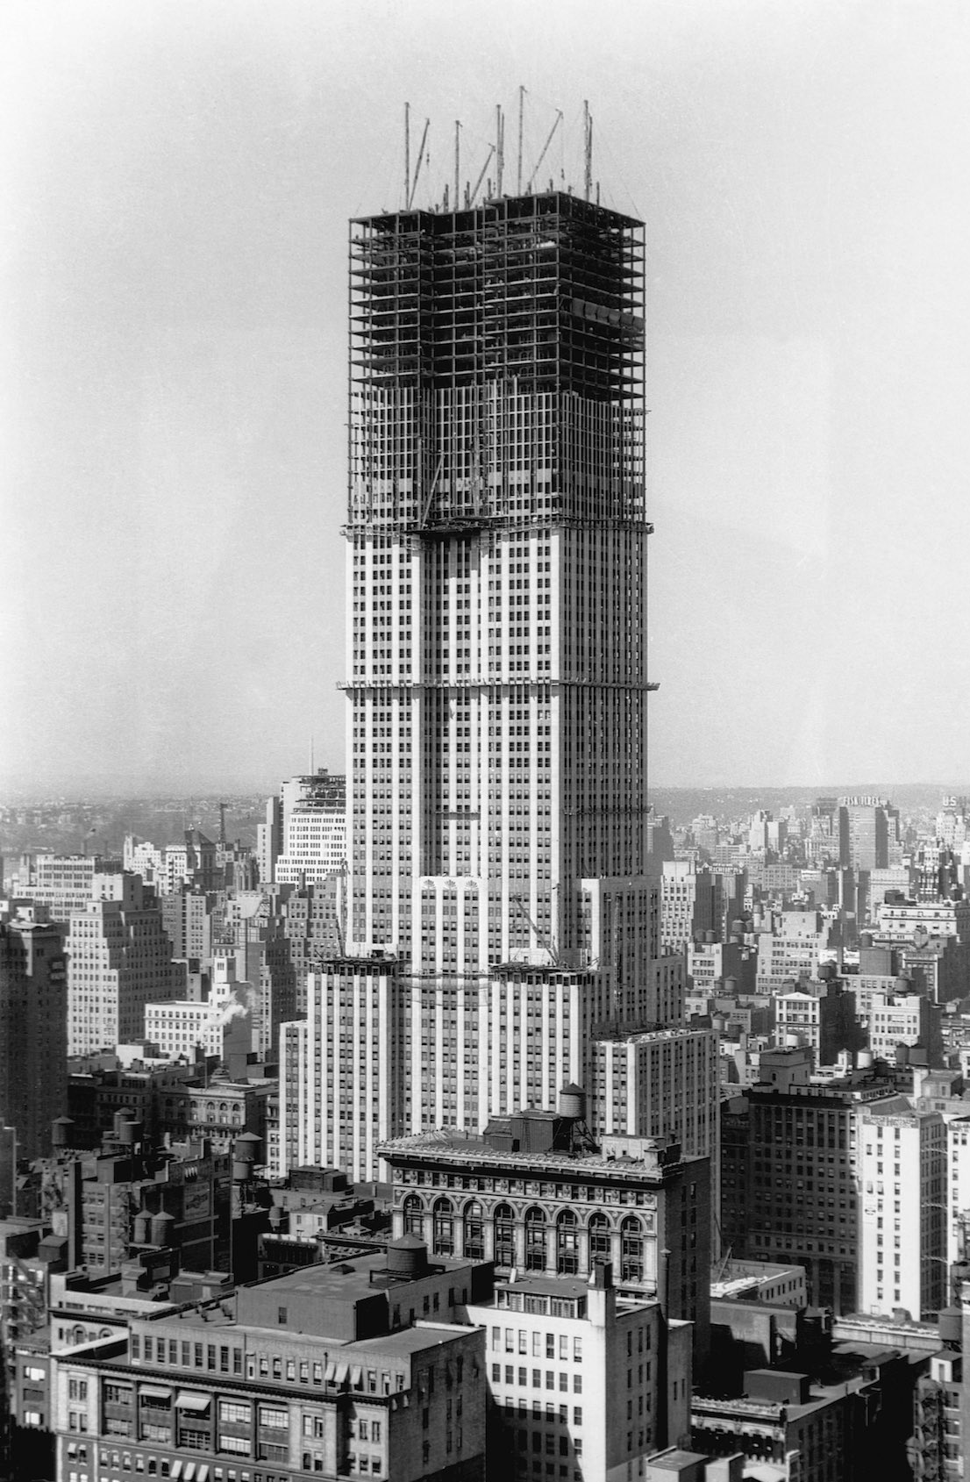
What basic structures do architects include in their designs?

Slide 3
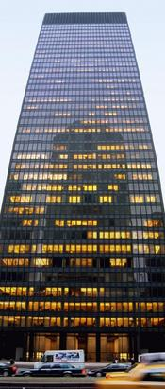
1. Structure
Anything built or constructed and has a plan.
Seagram Building (NYC)

Slide 4
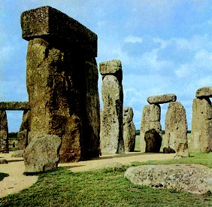
2. Post and Lintel
Method of construction in which vertical posts support horizontal lintel or beam.
Stonehenge (England)

Slide 5
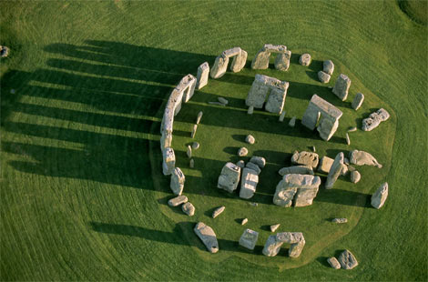
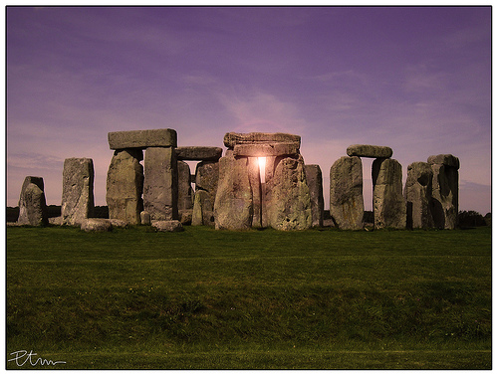

Slide 6
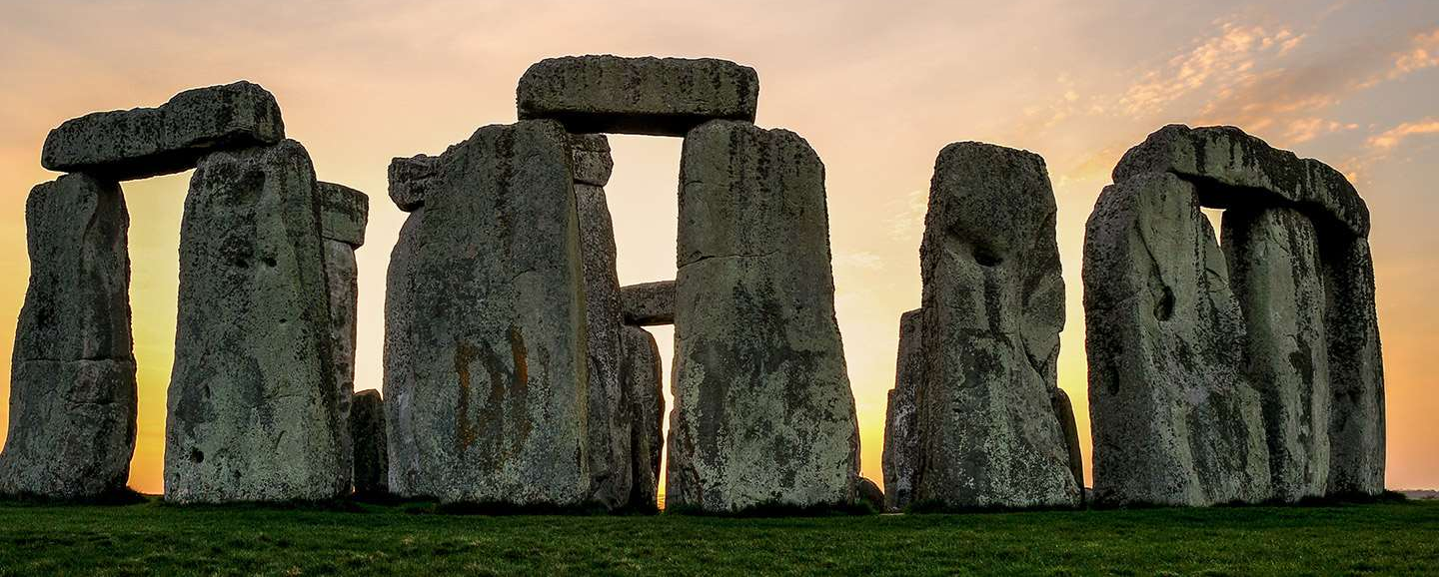
The lintel rests halfway across each post, thereby leaving room for another lintel to fall in place and link the form together. The distance spanned is very short due to a low tensile strength.

Slide 7
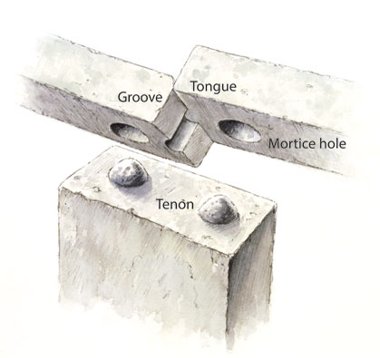
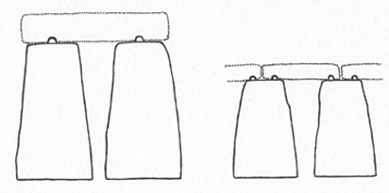
Lintel stones were held in place by mortice and tenon-joints.

Slide 8
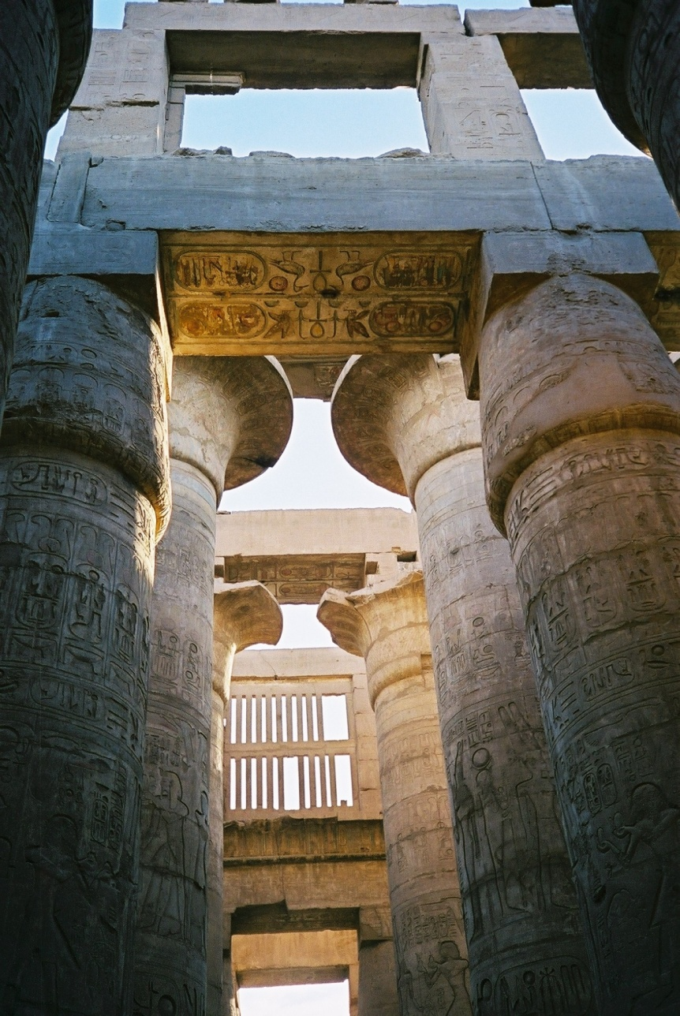
Egyptians also used post and lintel construction in their temples.

Slide 9
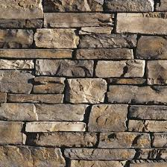
3. Dry Joint Block
Dry laid stone with a high compressive
strength – (ability to withstand crushing).
Foundation stones were dense granite;
stones above were lighter, such as
sandstone or limestone.

Slide 10
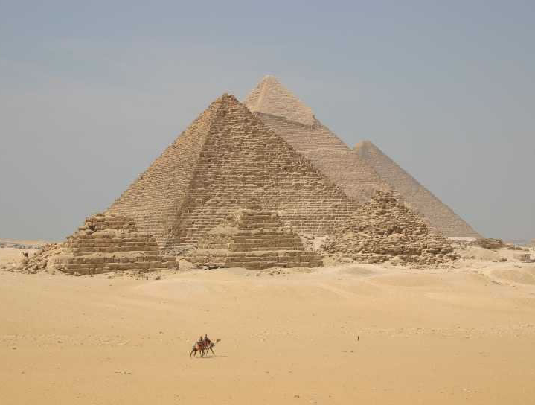
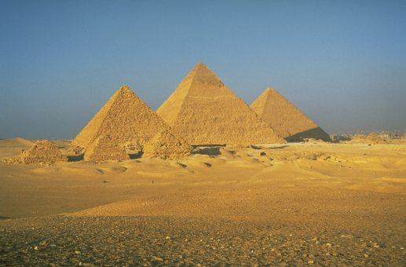
The Pyramids at Giza (Egypt)

Slide 11
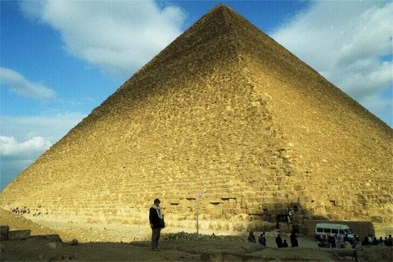
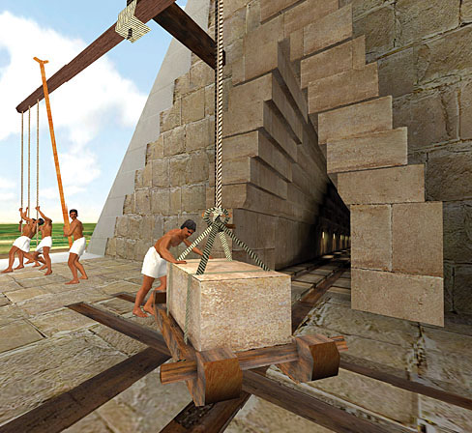
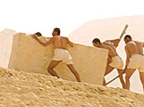
Stones are stacked without the use of mortar; weight and gravity keep them in place.

Slide 12
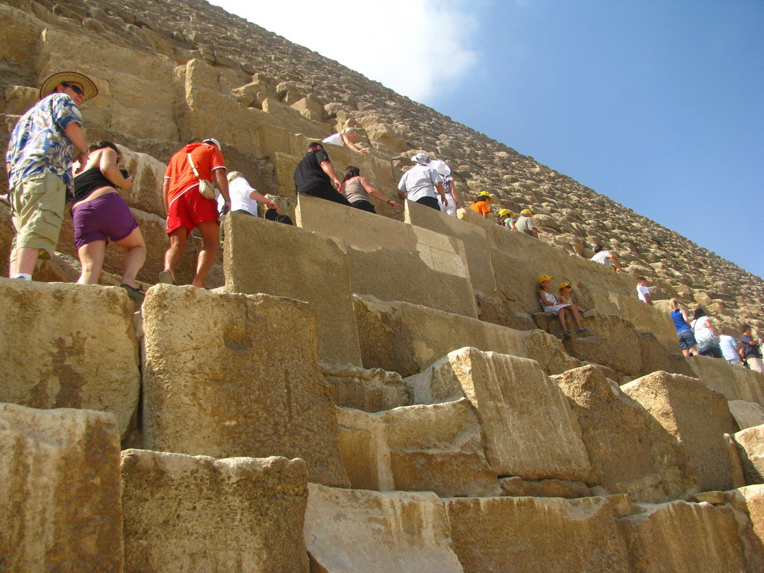
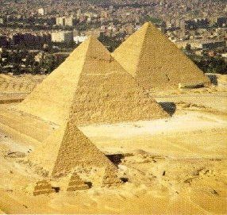
481 feet tall
2,300,000 blocks of stone
avg. block of stone 2.5 tons each!
756’ at its base
Likely took 15-20 years to build

Slide 13
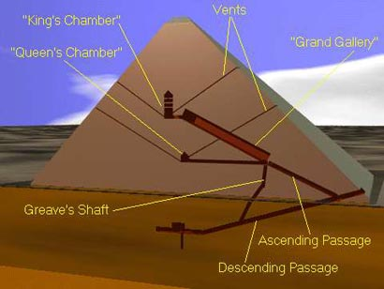
Function: tombs for the pharaohs

Slide 14
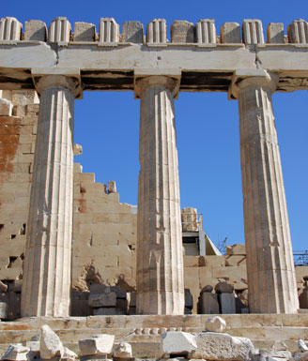
4. Columns
Vertical, round pillar that supports an arch or entablature
Parthenon (Greece)

Slide 15
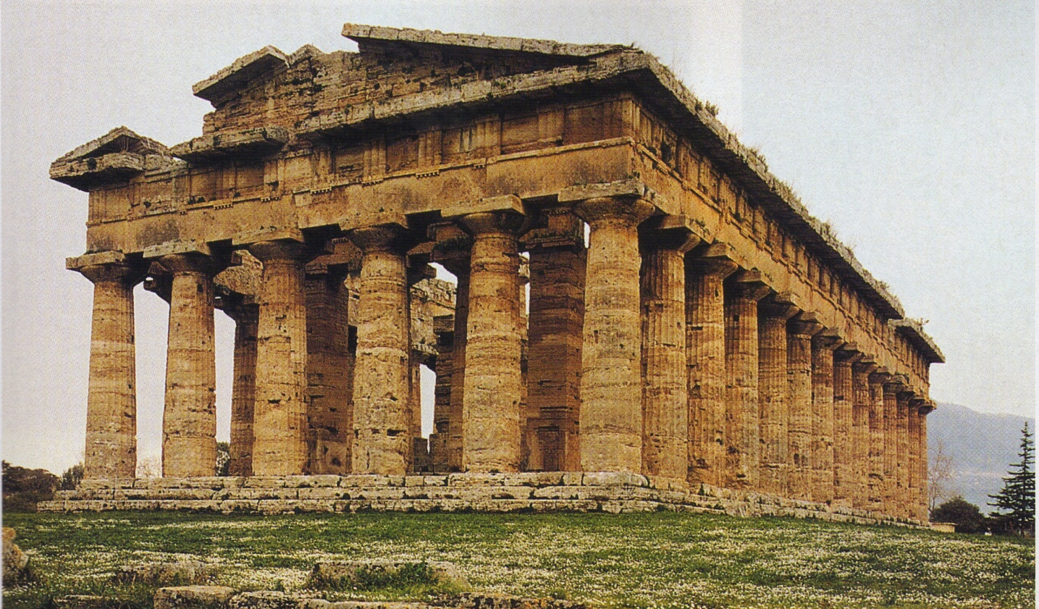
The Parts of a Greek Temple
STEPPED FOUNDATION
COLUMNS
ENTABLATURE
PEDIMENT (triangular façade of the roof)
4
3
2
1

Slide 16
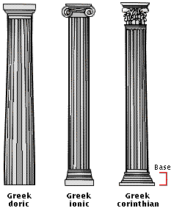
Capital
Shaft
Column
Base

Slide 17
There are 3 “orders” or styles of Greek Temple Architecture

Slide 18
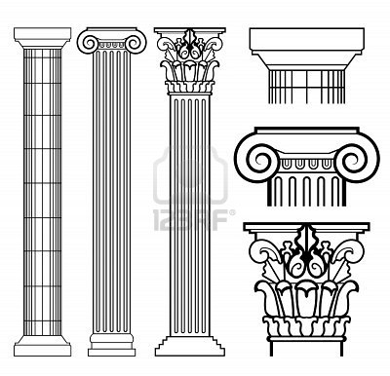
Types of Greek Columns
Doric Column (simple)
Ionic Column (scrolled)
Corinthian Column (fancy)

Slide 19
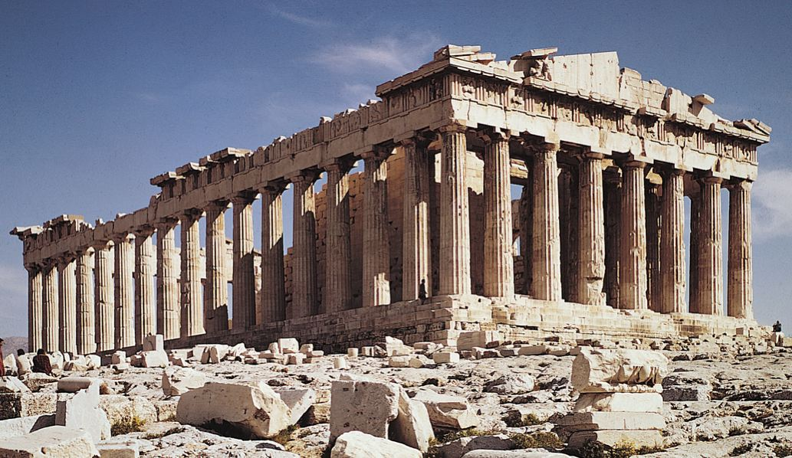
5. Colonnade
Line of arches or columns bearing a horizontal entablature.
Parthenon (Greece) 500 B.C.

Slide 20
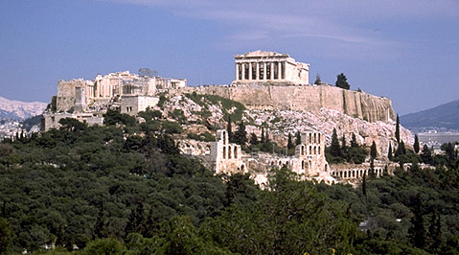
Acropolis

Slide 21
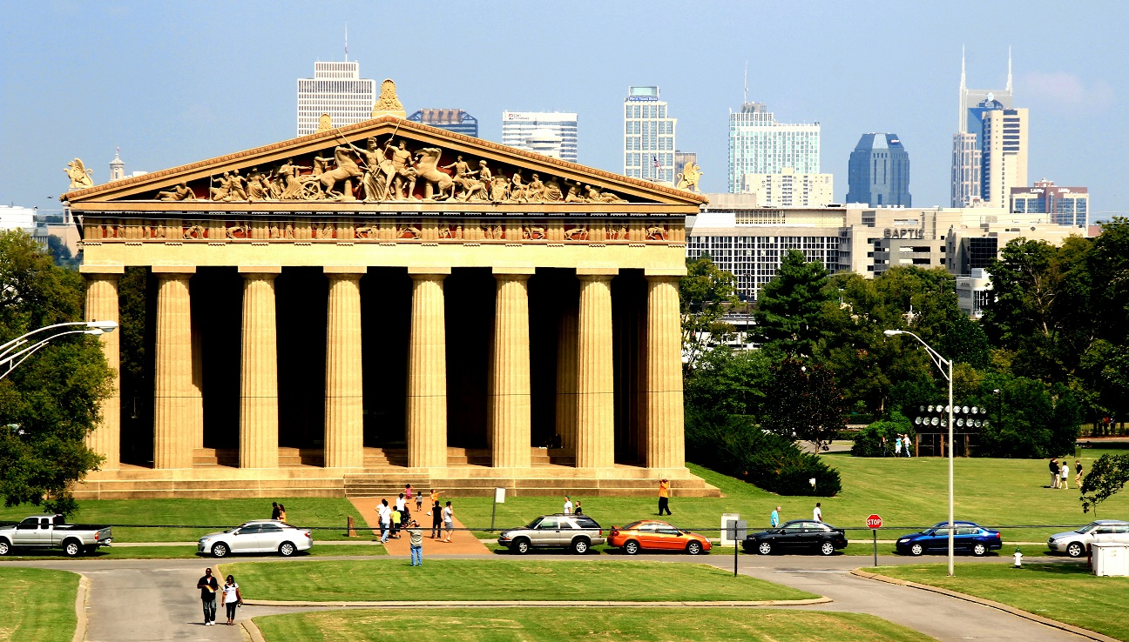
Parthenon Replica
(Nashville, TN)

Slide 22
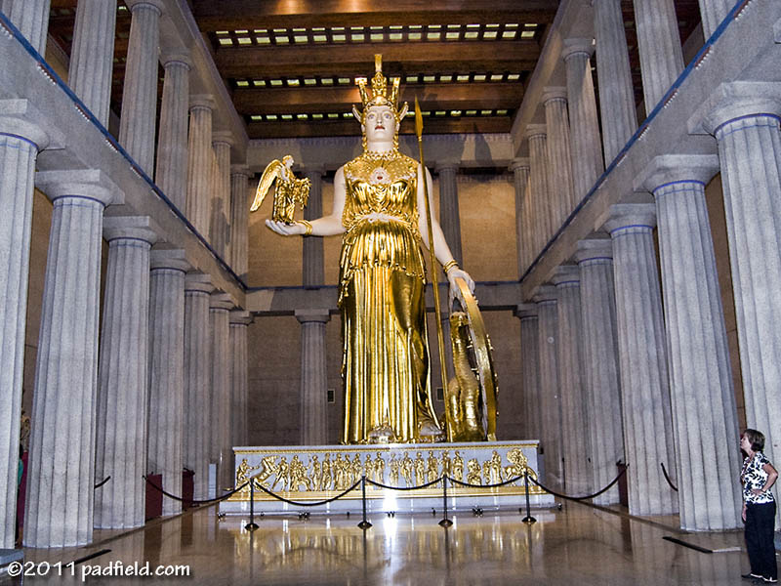
Statue of Athena

Slide 23
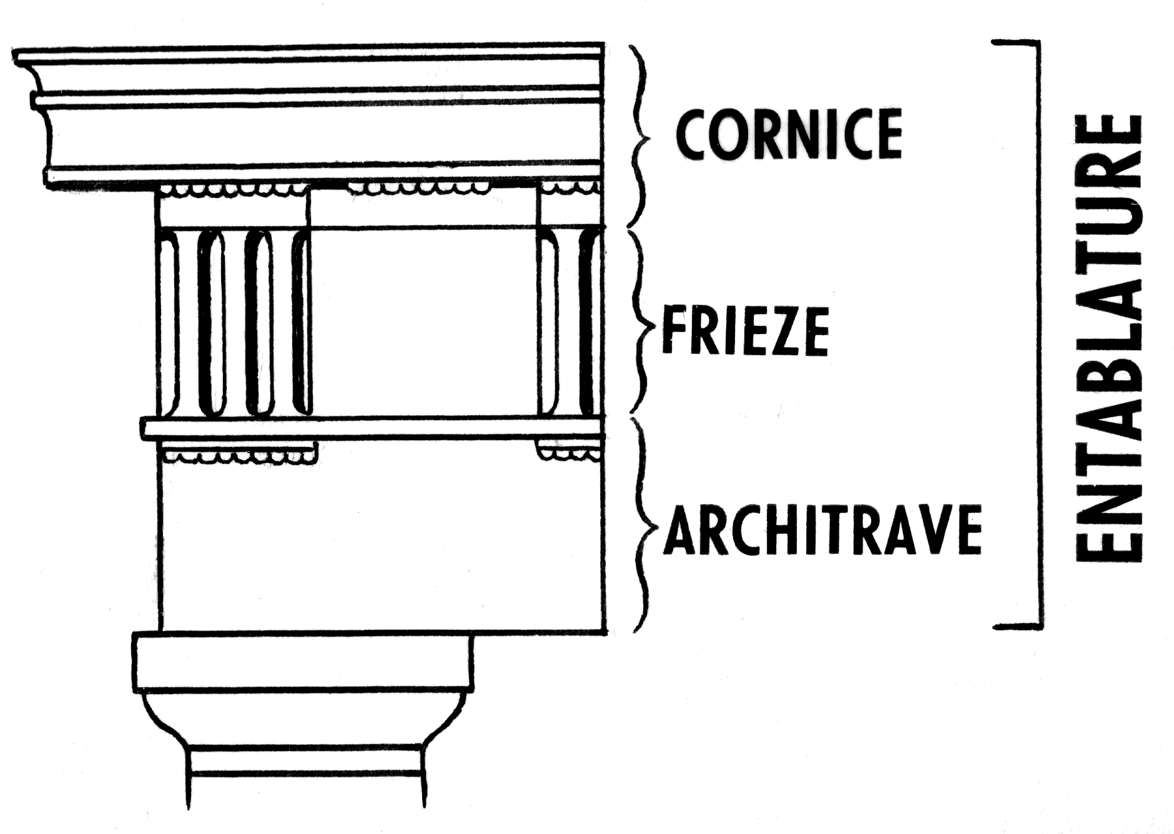
6. Entablature
The parts of an order between the column capital and the roof or pediment.
It is divided into three parts: architrave, frieze, and cornice.

Slide 24
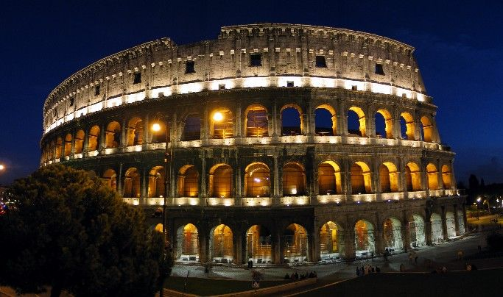
7. Arch
Vaulted wall opening that can span large spaces. Uses dry block construction with a keystone.
Roman Coliseum

Slide 25
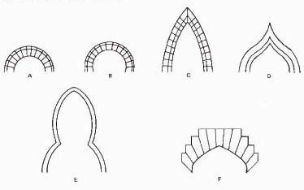
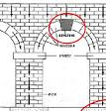
Types of Arches
keystone
Notes:
a. Round roman b. horseshoe moorish c. lancet or gothic d. ogee e. trefoil f. tudor

Slide 26
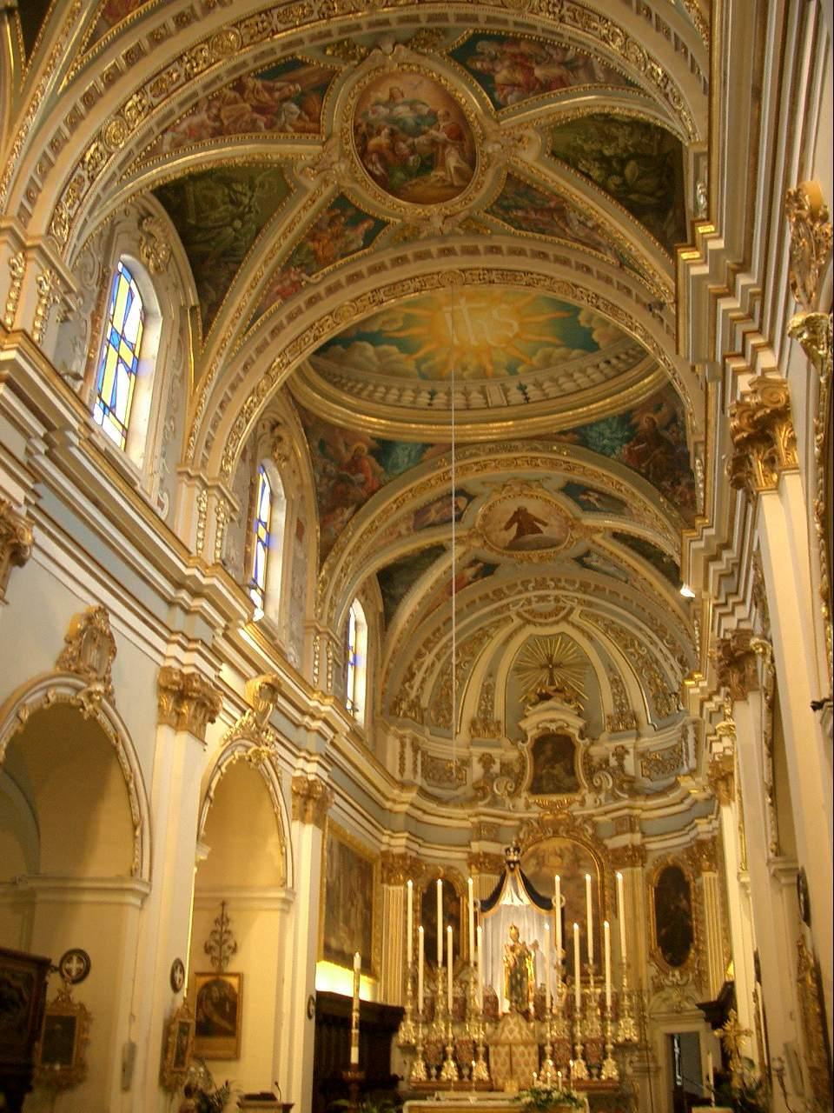
St. Paul’s Cathedral -
1,000 years after the invention of the arch!

Slide 27
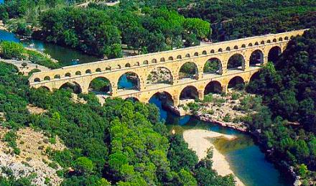
Pont du Gard

Slide 28
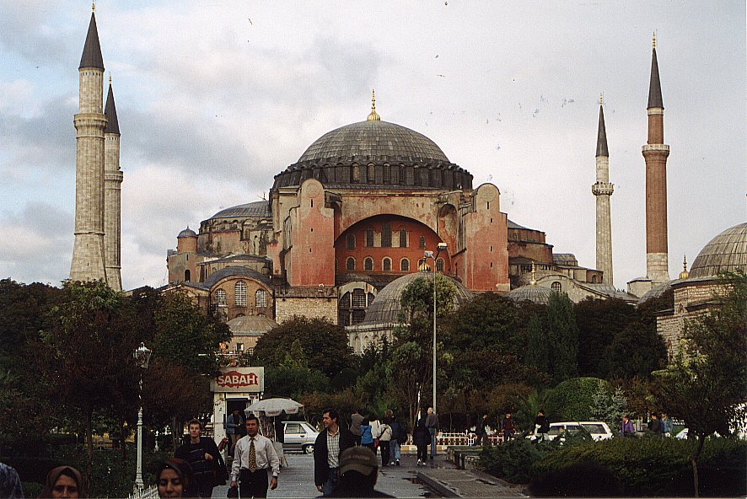
8. Dome
-a large hemispherical roof or ceiling
-arches are jointed at the top and legs form a circle
-creates more expansive space inside a structure
-base can be circular or angled
Hagia Sophia (Istanbul, Turkey)

Slide 29
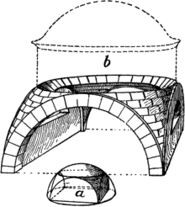
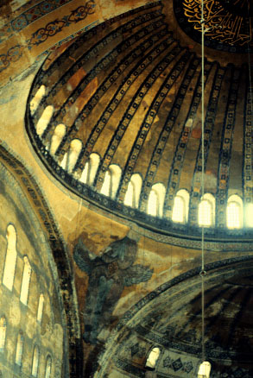
*Pendentives
-dome with a square base
-triangular space between dome and arches
-transfer weight/stress

Slide 30
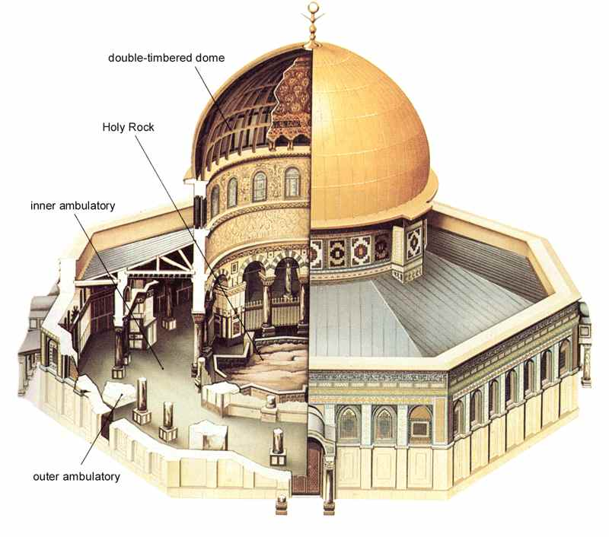
Dome of the Rock
Circular Base

Slide 31
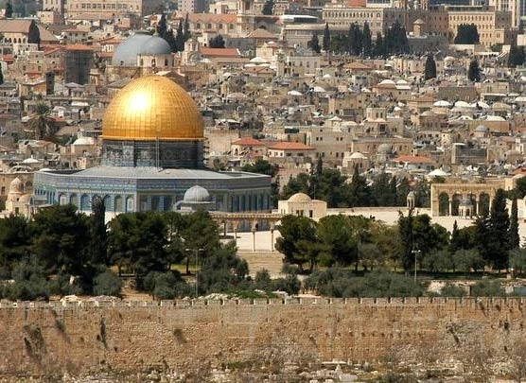

Slide 32
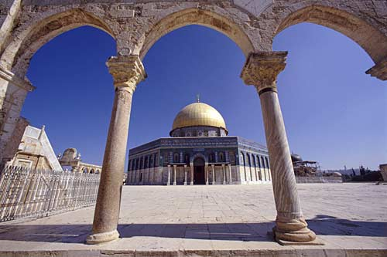

Slide 33
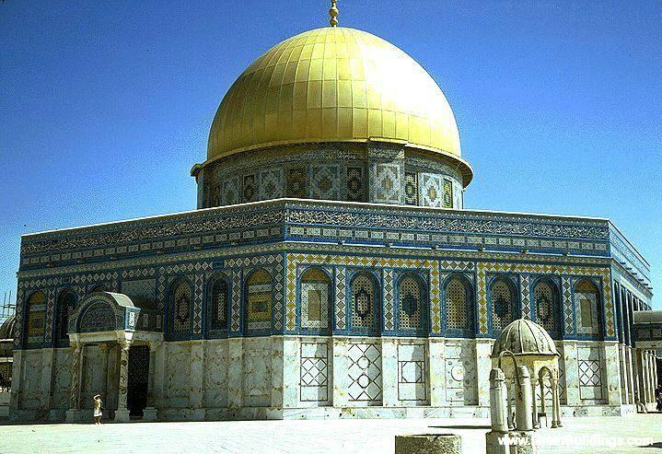

Slide 34
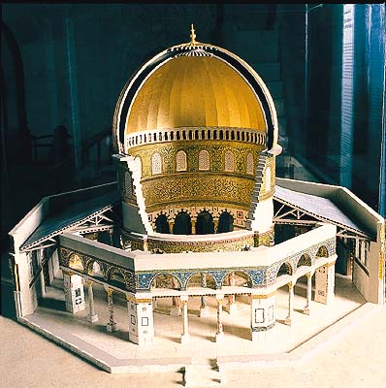

Slide 35
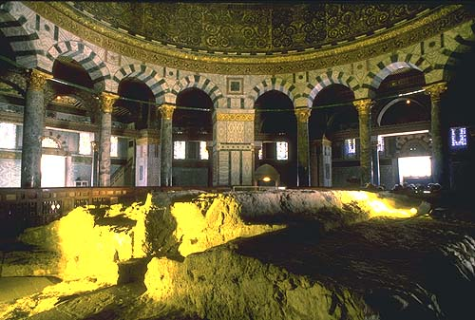

Slide 36
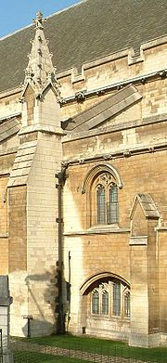
9. Buttress
A projecting structure for support to give stability to a load-bearing wall.
Counteracts lateral thrust.
Sometimes referred to as a “pier buttress”

Slide 37
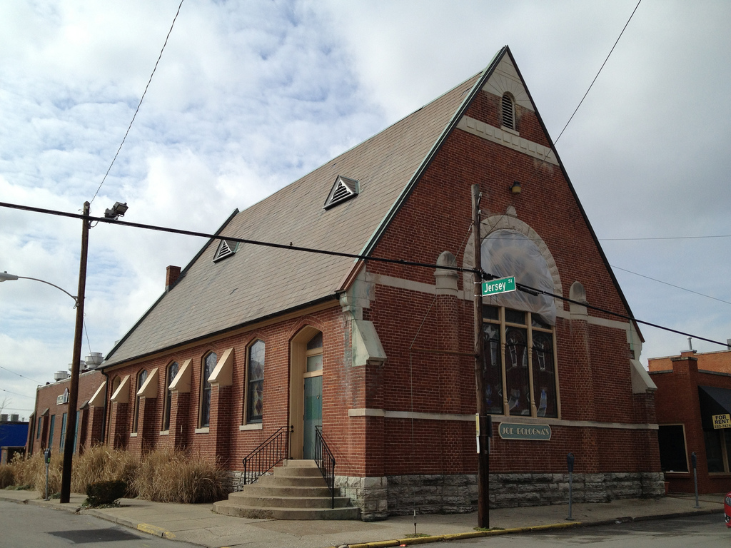
Joe Bologna’s (Lexington, KY)

Slide 38
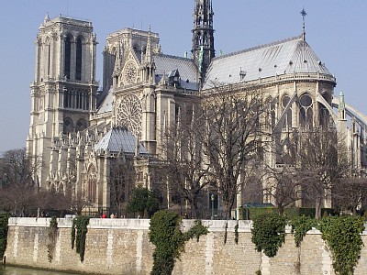
10. Flying Buttress
Arch commonly seen on the exterior of Gothic cathedrals
Used to support high stone walls by transmitting force to an exterior support.
Counteracts lateral thrust.
Notre Dame – Paris, France
Notes:
Look to the right side of the picture. The flying buttresses are in between the windows at the rear of the cathedral.

Slide 39
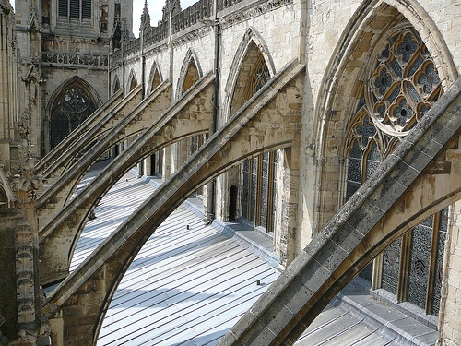

Slide 40
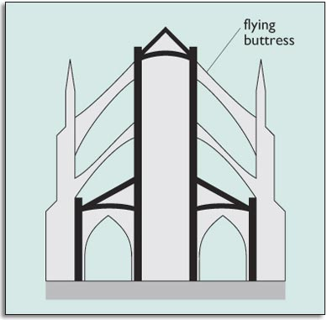

Slide 41
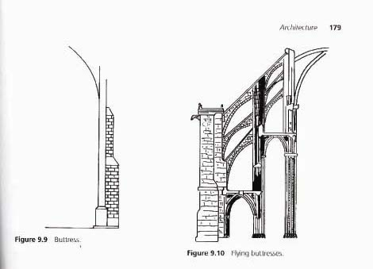
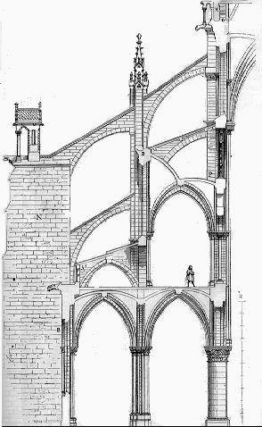
Buttress Flying Buttress

Slide 42

11. Spire
a tapering roof or pyramidal construction surmounting a tower
Salisbury Cathedral (England)

Slide 43

12. Cantilever
Horizontally projecting beam or part of a structure supported only at one end. Modern style that requires steel supports inside concrete to fight the effects of gravity.
Falling Water

Slide 44

Cantilever

Slide 45
BUZZER-BEATER
Review
First person to stand up must identify the structure in the image!

Slide 46

spire

Slide 47

cantilever

Slide 48

Corinthian Column

Slide 49

flying buttresses

Slide 50
dome

Slide 51

colonnade

Slide 52

column (ionic)

Slide 53
post and lintel

Slide 54

arch

Slide 55

columns (ionic)

Slide 56
Go To Element Slide

Slide 57
Can you create a structure that uses three basic structures of architecture?
On a blank sheet of paper create a building that uses three of the basic structures of architecture that you learned about today.
Before starting decided if
  the building will be symmetrical or asymmetrical
  sacred or secular
  label each structure
Label each structure
No larger than half a page.
Give your building a name (based on function!)
Time allowed: 15 minutes/ 15 points

Slide 58
Exit Slip
1) Which of the following terms refers to “where two parts come together”?
Cantilever b. Entablature c. Line d. Colonnade
2) This term can be used on the outside or the inside of the building and it can help add emphasis and detail to a structure’s design.
Line b. Color c. Texture d. Buttress
3) How is contrast used in a building?
a. Through a gradual change in elements.
b. Through the repeated use of an element.
c. Through the use of differing elements.
4) The year is 5839 A.D. and archeologists have just re-discovered the Pantheon. All written records of this building have been destroyed, yet they have hired you to determine the cultural context of the building. Based on what you know about Roman architectural designs, structures, materials, and innovations, prove that this structure in Roman. Support your answer using three facts about the building.

Slide 59

Exit Slip Directions
On the bottom/back of your opener
Number your paper 1-5
Identify the images you see on the following slide!

Slide 60




1. Put on the back of 115
3.
4.
2.
5.

Slide 61
Body Check!
DON’T SIT DOWN!
Get into groups of three or four
Create the structure I name using your bodies.
Creative examples will receive extra credit

Slide 62
1.
3.
4.
2.
5.

Slide 63
Extended Activities

Slide 64
Architecture Olympics
Complete the following activities, as your teacher describes them, to demonstrate your knowledge of basic architectural structures.
I will read out the directions and take pictures of you once you’ve made your structures to determine who is the gold medalist!

Slide 65

Application:
Tower made out of newspaper?
What's the tallest tower you can build using only two sheets of newspaper, two half sheets of paper, and five pieces of tape?
Here's the challenge: getting the newspaper to stand up with only the materials mentioned above (no staples, glue, or other materials). You can bend, fold, or tear the paper itself.
Requirements
Your structure must have at least three structures that you learned about today. These structures must be easily visible.
Try It Out
1. Now construct your tower. If you think you can make it taller, keep redesigning it until you can't go any higher.
2. When you are finished building, measure the height of your tower.
Time Allowed: 15 minutes

Slide 66
Could you earn a million dollars being an architect?
Today, you will be working in assigned groups to build a structure out of spaghetti and marshmallows. A structure, as you know, is anything that is built or constructed. Your structure is due at the end of class and must meet the requirements listed below:
1) You must build a complete structure.
      This means, if you were a tiny, tiny person who could live in a marshmallow and spaghetti house, you would have a roof and four walls to protect you from the outside elements.
    2) You are to choose three basic structures from the list below to include in your structure:
    - Post and Lintel - Colonnade
      Columns - Arch
      Buttress - Flying Buttress
      Dome - Spire
      Cantilever
    3) DO NOT EAT your building materials!
      In order to earn your million dollar pay check, you need to provide your tiny, tiny person who could live in a marshmallow home with a home! How could you leave someone homeless?!? If you happen to, even inadvertently, eat even one of the building materials, you will be required to write a letter of apology to your tiny, tiny person who could live in a marshmallow home. I’m VERY serious about this!

