Slide 1
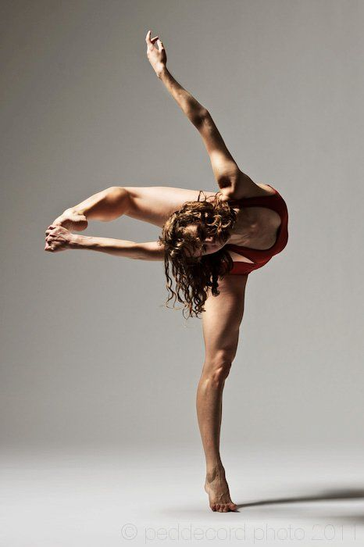
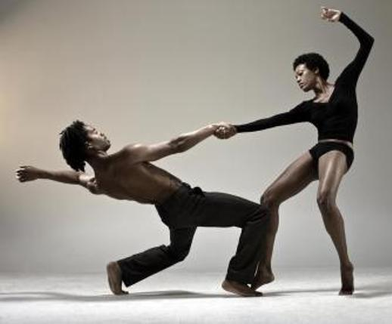
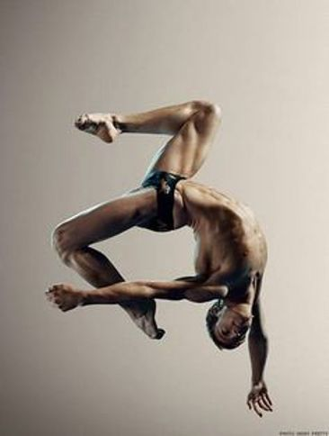
DANCE PRE-TEST

Slide 2
1. This term refers to how fast or slow the dance or movement is performed. a. Time b. Accent c. Tempo d. Pulse

Slide 3
2. This is a movement or shape performed in such a way as to give emphasis to a certain part of a dancer’s body or overall movement. a. Accent b. Beat c. Phrase d. Duration

Slide 4
3. This term can be described as “sharp” or “smooth.” a. Dynamics b. Force c. Flow d. Energy

Slide 5
4. This term expresses how a dancer travels forward, backwards, sideways, up or down. a. Level b. Direction c. Pathway d. Size

Slide 6
5. This term can be described as “heavy” or “light.” a. Space b. Time c. Weight d. Flow

Slide 7
6. When a choreographer wants to show that two people are affectionate towards each other, he or she will have them share which element of dance? a. General Space b. Level c. Shape d. Personal Space

Slide 8
7. A flow of movement having regular accented beats is known as what? a. Duration b. Rhythm c. Phrase d. Call and Response

Slide 9
8. This term refers to the patterns made across the floor as a dancer travels. A dancer can travel in circles or diagonal lines to demonstrate this term. a. Tempo b. Alignment c. Direction d. Pathways

Slide 10
9. This term is described as open/closed, angular/curved, symmetrical/asymmetrical. a. Size b. Level c. Shape d. Locomotor

Slide 11
10. Which term refers to “The degree of muscular tension and use of energy while moving?” a. Alignment b. Force c. Weight d. Time

Slide 12
11. A dancer’s height, in relation to the floor, refers to what element property or concept in dance? a. Energy b. Level c. Force d. Dynamics

Slide 13
12. This is the most basic unit of rhythm. a. Pulse b. Rhythm c. Beat d. ABA

Slide 14
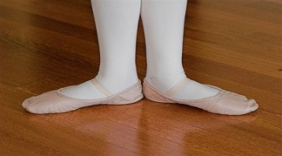
13.
a. First position b. Fourth position c. Second position d. Fifth position

Slide 15
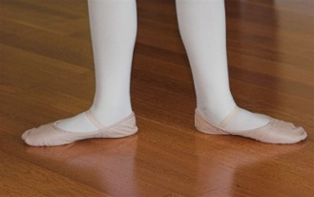
14. a. First position b. Second position c. Fourth position d. Fifth position

Slide 16
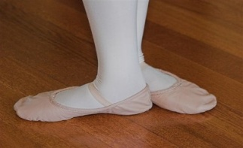
15.
a. Fifth position c. Fourth position b. Second position
d. Third position

