Slide 1
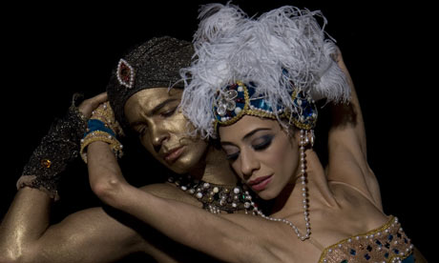
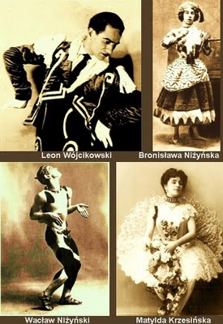
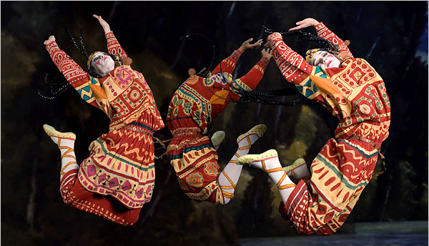
Diaghilev’s Ballet Russe The Preeminent Russian Ballet Company

Slide 2
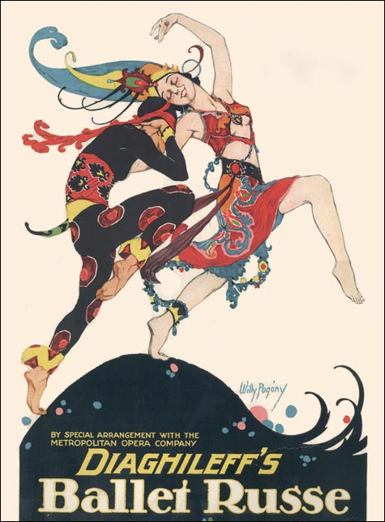
Diaghilev’s Ballet Russes
One of the most influential ballet companies of the 20th century
Known for ground-breaking artistic collaboration among
contemporary choreographers
Composers
Artists
dancers
Created in 1909 by Serge Diaghilev
Choreographers included
Marius Petipa
Michel Fokine
Vaslav Nijinsky
George Balanchine
It created a sensation in Western Europe because of the great vitality of Russian ballet compared to French dance
When company disbanded after Diaghilev’s death in 1929, many artists moved to America
Famous Work: The Rite of Spring
Notes:
Extra facts:
Debuted in 1911 in London with 13 members

Slide 3
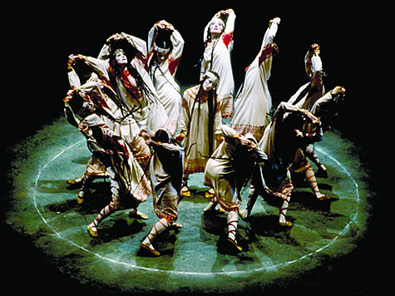
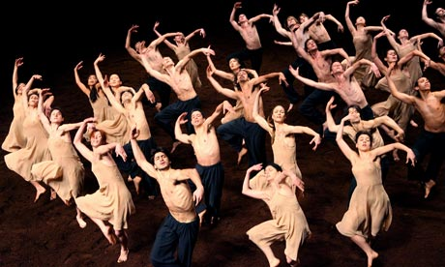
The Rite of Spring
Choreographed by
Vaslav Nijinsky
Composed by
Igor Stravinsky
Date of Premiere
May 29th, 1913
Original Ballet Company:
Ballets Russes
Designs by
Nicholas Roerich
Setting:
Russia
Genre:
Russian Modernism Ballet
Duration:
33 mins
Storyline:
A pagan ritual in which a young girl dances herself to death

Slide 4
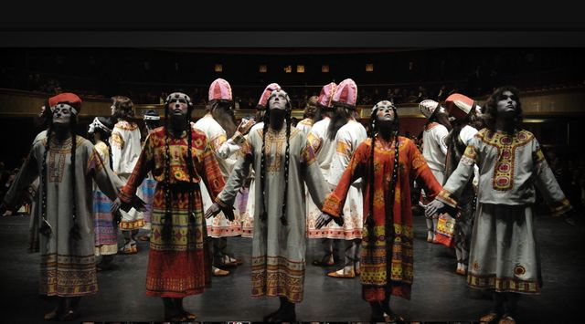
The Rite of Spring
Viewing Analysis
Part One: Show Until 2:35
http://www.youtube.com/watch?v=adDhN12KG5M&fb_source=message
Part Two: Show Until 6:00
http://www.youtube.com/watch?v=9AKpJ1NqyeM
Part Three: Show until 1:00
http://www.youtube.com/watch?v=C_7ndqgwxcM&feature=related
Notes:
Question 6 goes with part two

