Slide 1
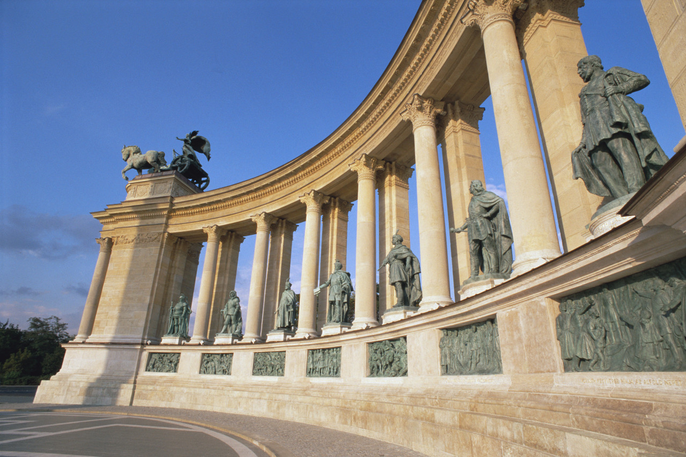
Elements and Principles of Architecture: The Basics of Beautiful Design

Slide 2
Function
original purpose of the building may change over time but the original purpose still dominates the design.

Slide 3
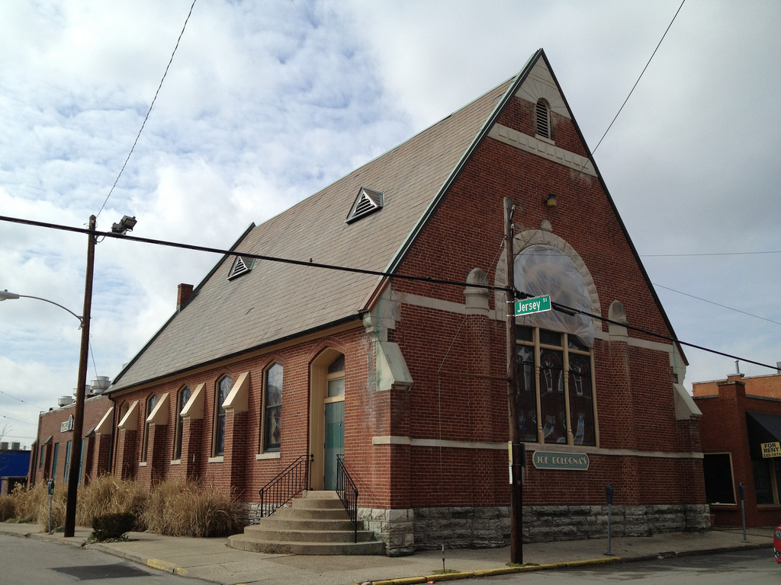
Joe Bologna's
(Lexington)

Slide 4
Physical Context
The area on which the building is constructed.
When considering the context of a building, you must also look at the environment.

Slide 5
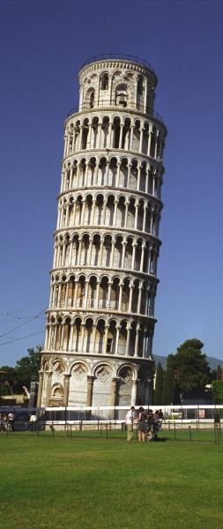
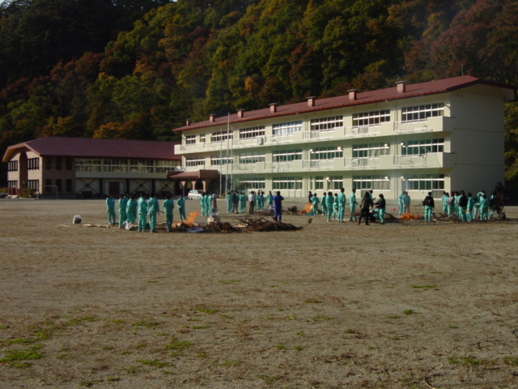
Leaning Tower of Pisa
Japanese School

Slide 6
Cultural Context
time, place, and culture that influenced the building.

Slide 7
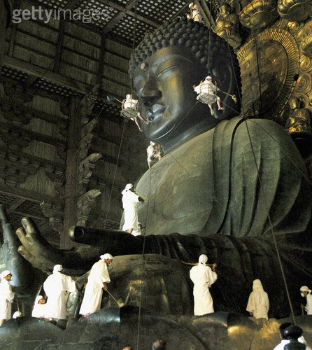
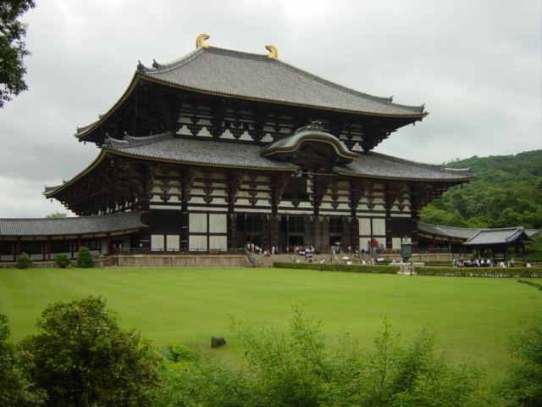
Todaji Buddhist Temple (Nara, Japan)

Slide 8
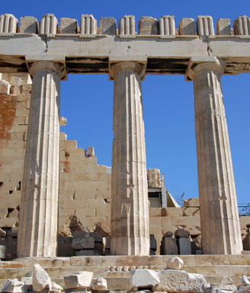
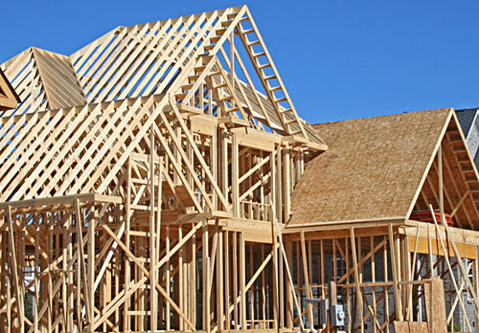
Media or Materials
what the structure is made from

Slide 9
The Elements of Architecture

Slide 10
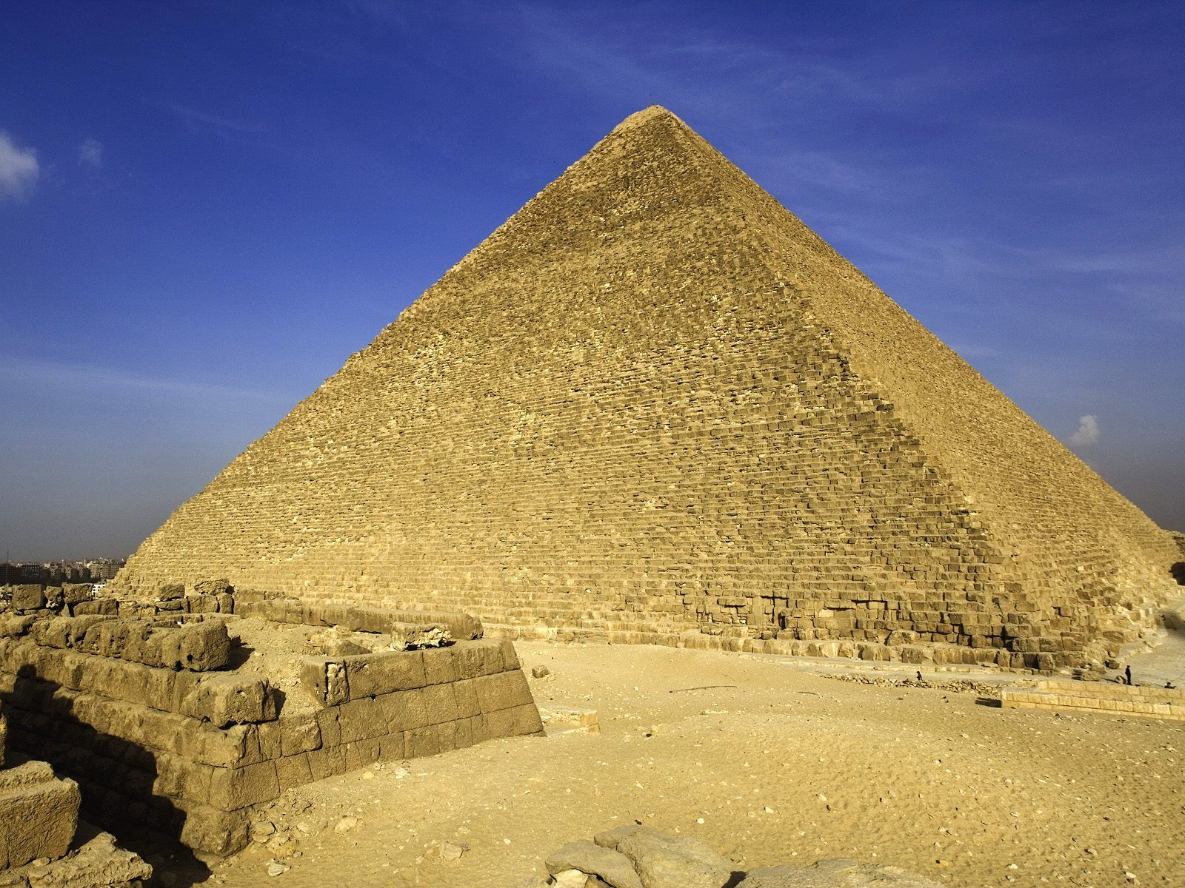
Line
Where two parts come together
Great Pyramid of Giza (Egypt)
Notes:
On the picture provided, highlight the most important lines of the Great Pyramid using a marker.

Slide 11
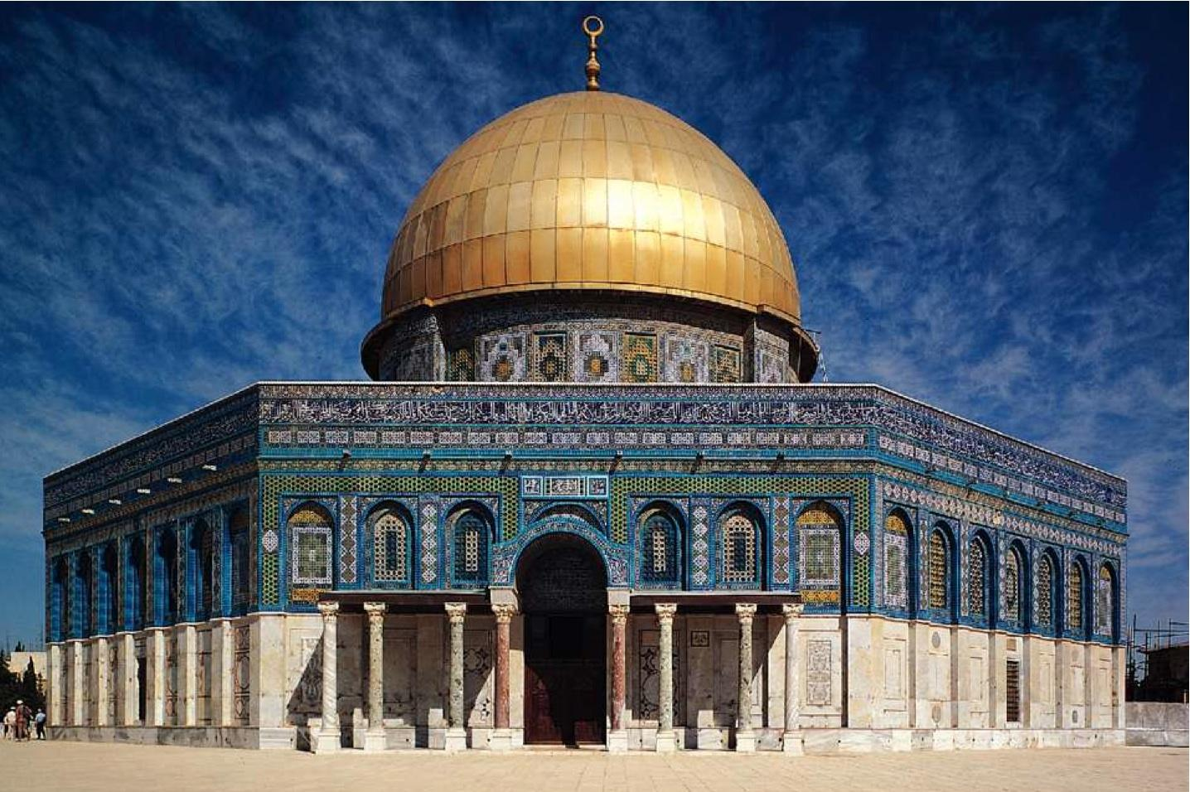
Color
interior or exterior
Dome of the Rock (Jerusalem)
Notes:
The Dome of the Rock uses lots of color. Why would lots of color be used on a building? How does it show the wealth and power of the individual or organization that built it?

Slide 12
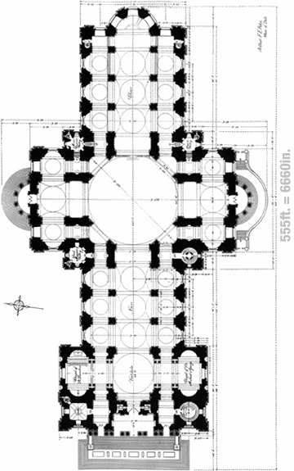
Shape/Form
outline if viewed from above - cruciform
St. Paul’s Cathedral - aerial view
Notes:
Draw the shape of St. Paul’s Cathedral from an aerial view.

Slide 13
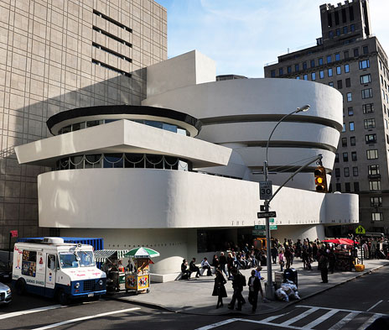
Texture
how it feels or looks
interior or exterior
Notes:
If the Guggenheim Museum in NYC is made of painted concrete, why does this building have smooth texture?

Slide 14
The Principles of Architecture

Slide 15
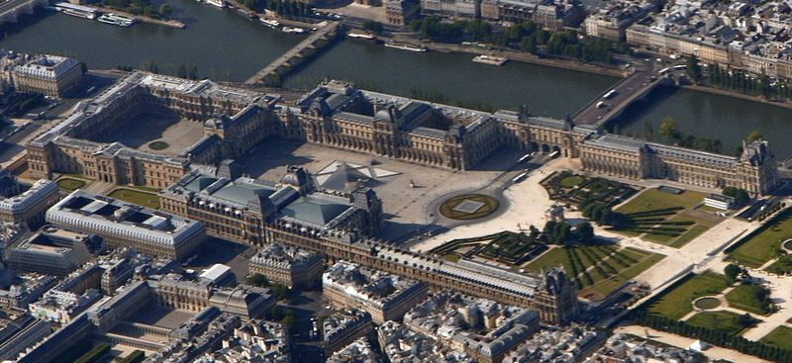
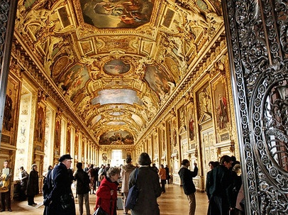
Space
The area in and around a building
Louvre (Paris)
Notes:
How do the images of the interior and exterior space of the Louvre show that this building was a palace for the King of France? Hint: Think about what important buildings are supposed to show.

Slide 16
Balance
Distribution of weight
Eiffel Tower
Notes:
Identify and explain the type of balance of the Eiffel Tower. In your explanation, support your answer with a description of this structure.

Slide 17
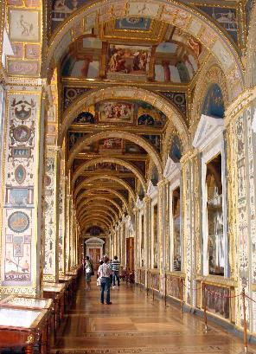
Rhythm/
Repetition/
& Pattern
Repeated use of an element
Raphael’s Loggia
Notes:
What elements and basic structures of architecture are repeated in Raphael’s Loggia to create rhythm and pattern?

Slide 18
Emphasis
Calling attention to one part
Notes:
What basic architectural structure gets emphasis in the Dome of the Rock?
What element of architecture makes it possible for this structure to receive emphasis?

Slide 19
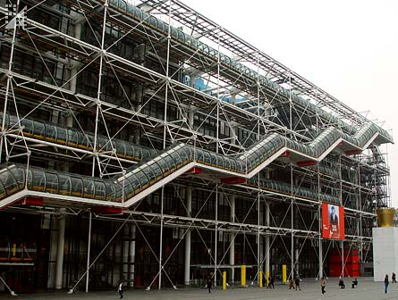
Variety/Contrast
differing elements create a focal point
Pompidou Center

Slide 20
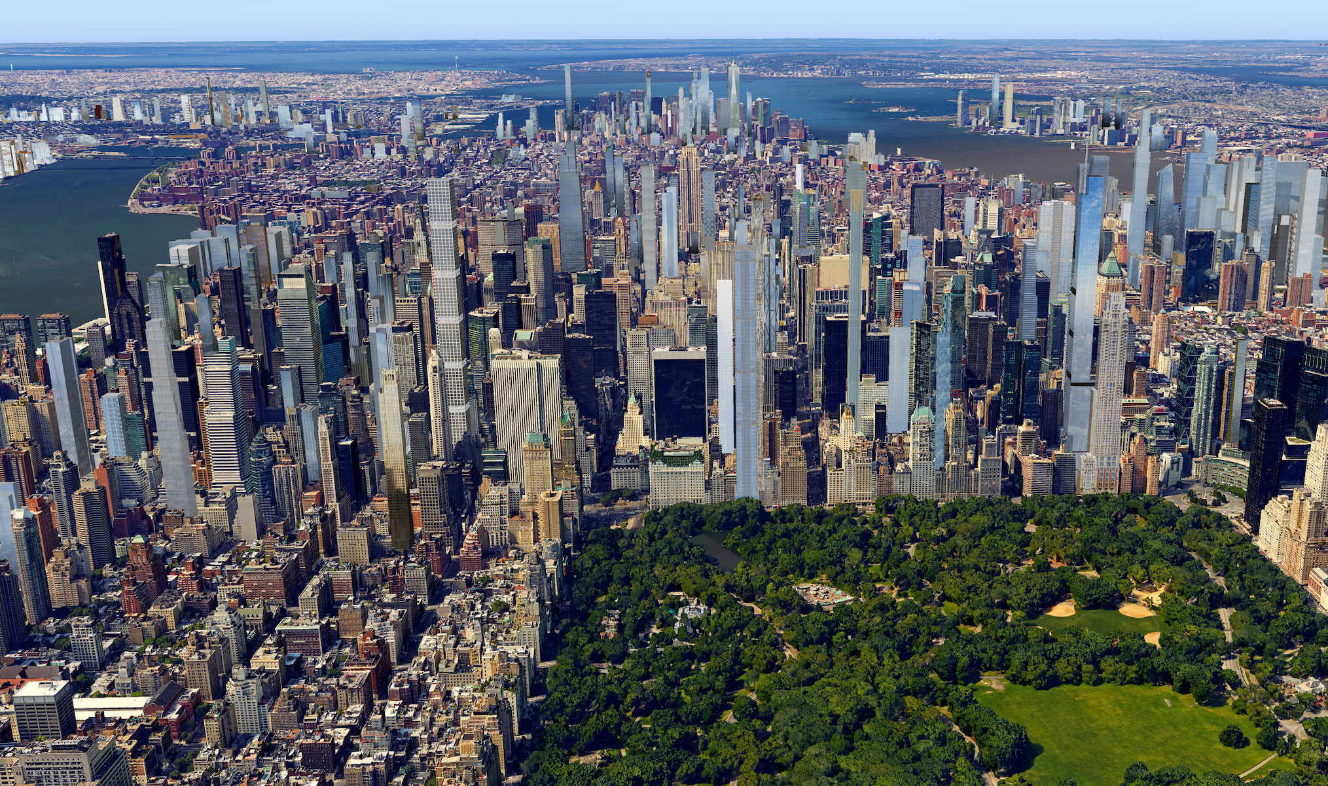
Proportion
comparing size of parts and to the whole
Notes:
This is an image of New York City from the 1920’s. How does the proportion of the buildings in this image support this fact? In other words, how does the proportion of 1920’s New York differ from the proportion of modern New York?

Slide 21
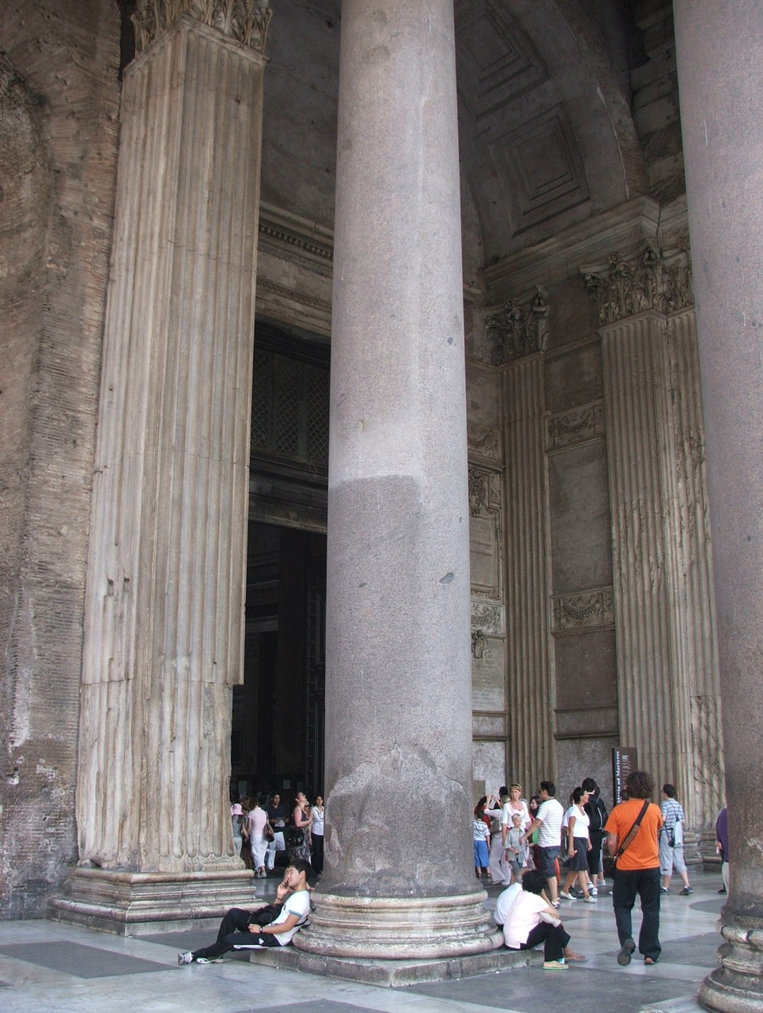
Scale
sized compared to people
Pantheon (Rome)
Notes:
What is the scale of the man in the orange shirt to the column? What about the scale of Ms. G. to the Pantheon?

Slide 22
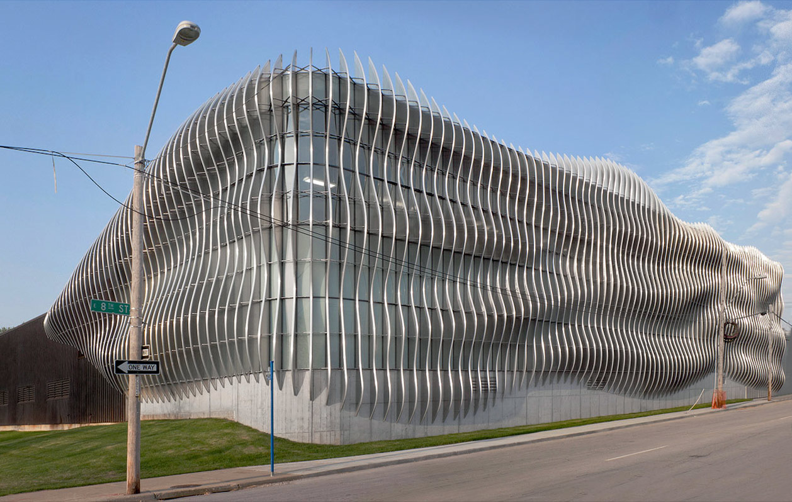
Unity
Using similar elements to tie a work together
Notes:
Name all of the basic structures and elements of architecture found in the Leaning Tower of Pisa to create unity.

