Slide 1
FINAL EXAM – SPRING 2017
55 multiple choice
20 Painting ID (artist & title)
- Renaissance (14)
- Baroque (15)
- Neoclassical (9)
- Romantic, Realism, Impressionism, Post-Impressionism (17)

Slide 2
Time Periods
Renaissance – 1400-1600
Baroque – 1600-1750
Neoclassical – 1750-1800
Romantic – 1800-1850
Isms – 1850-1900
-- Realism
-- Impressionism
-- Post-Impressionism

Slide 3
Renaissance Art
Realism and Expressionism
Geometric Arrangement of Figures
Classicism (nudity and S-Curve)
Chiaroscuro - high contrast of lights and darks
Sfumato - blurring of edges and shading
Anatomy
Use of Perspective
Religious Subject Matter (but not always!)

Slide 4
Baroque Art
Tennebrism (extreme contrast of light/dark)
Catholic Christian Imagery (Italian Counter-Reformation)
Action
Drama
Ornamentation/Highly decorated
Sacred painted as secular (to gain new Catholic followers)

Slide 5
Neoclassical Art
Order and Reason
Symmetry
Outlines of objects
Architecture symbolized new government in America
“new” classical style – recycling Greek and Roman ideas (again)
Art as propaganda (French Revolution and Napoleon)

Slide 6
Romantic Art
ANY type of emotion
Fantasy
Interest in nature
Imagination
Idealism

Slide 7
Realism
Attempt to make images REALISTIC
Subjects were normal, poor, every day people
Influenced by the camera
(Color became more important)

Slide 8
Impressionism
Rapid, sketchy brushstrokes
Immediate sensations
Focus on how light changes color of objects (scientific!)

Slide 9
Post-Impressionism
En Plein Air – painting outdoors/natural light/”true” color
Individualized Style:
-- Van Gogh – short, thick layers of paint
-- Gauguin – solid colors, island scenes (Primativism)
-- Seurat – painting with dots (Pointillism)

Slide 10
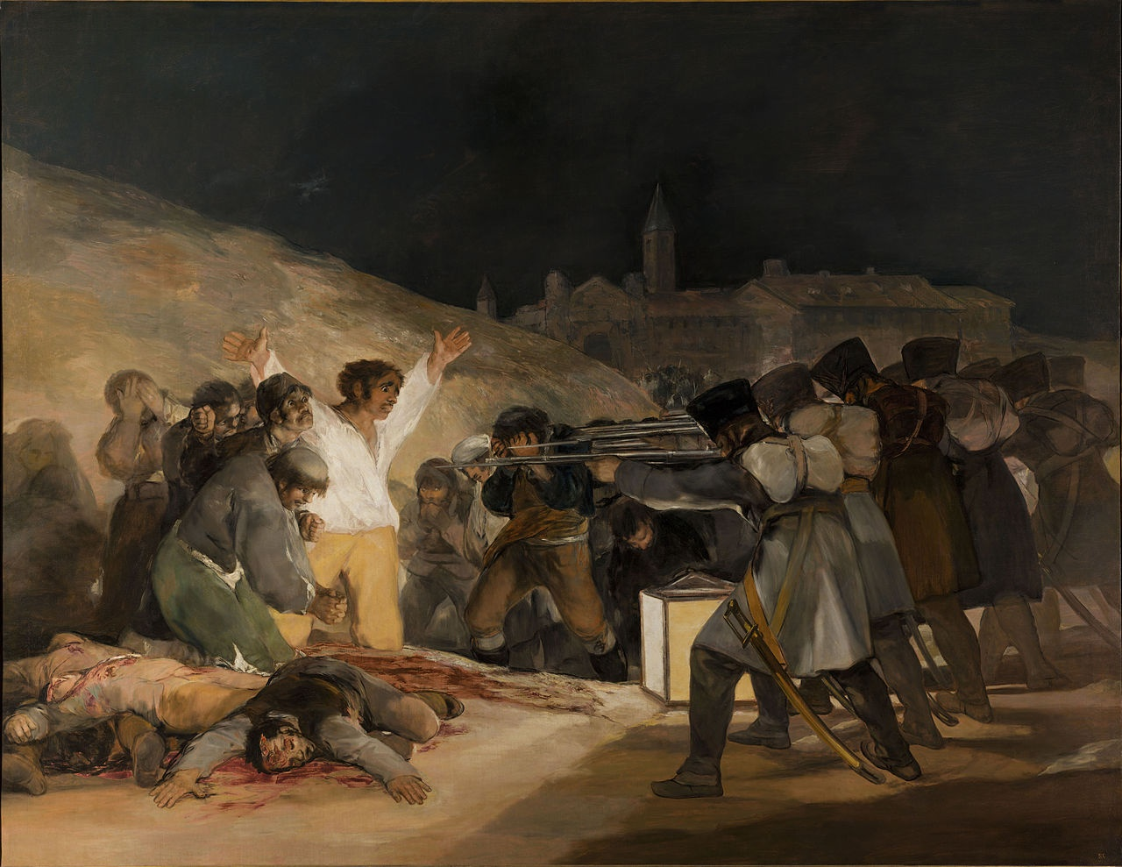
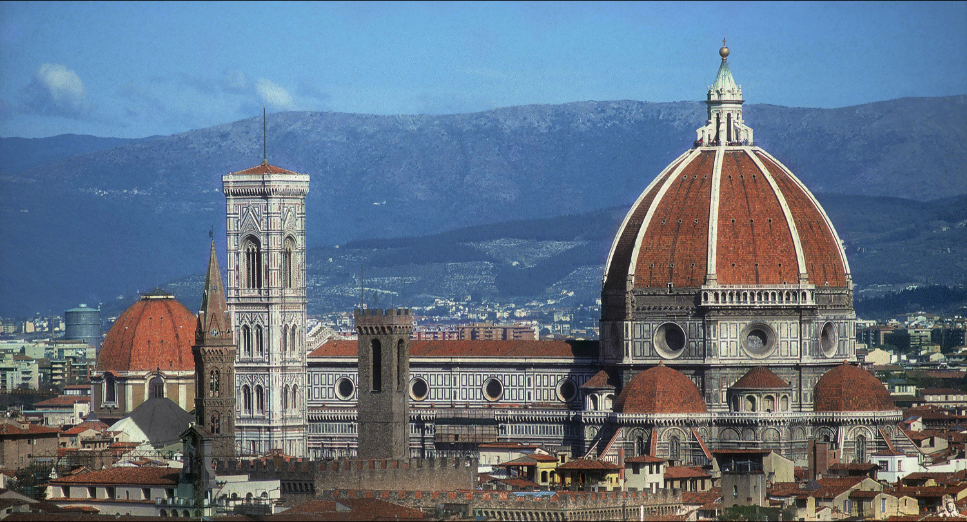
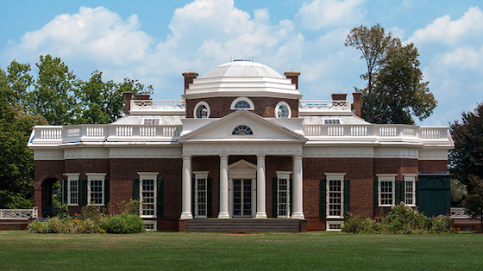
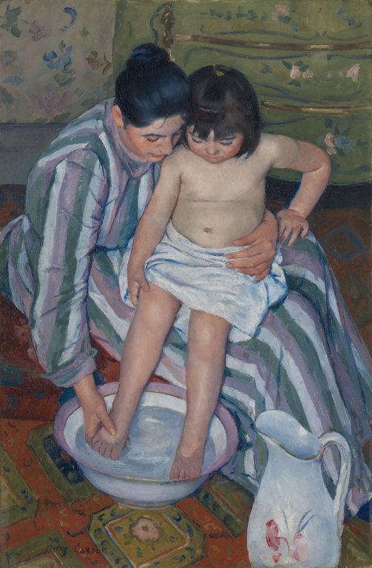
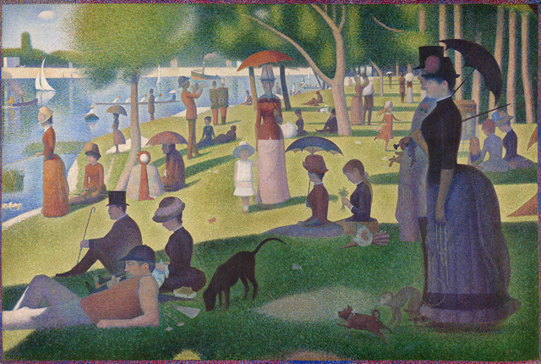
Goya
3rd of May, 1808
Romantic
Brunelleschi
Il Duomo (Florence)
Renaissance
Jefferson
Monticello
Neoclassical
Seurat
Sunday Afternoon on la Grande Jatte
Post-Impressionism
Mary Cassatt
The Child’s Bath
Impressionism

Slide 11
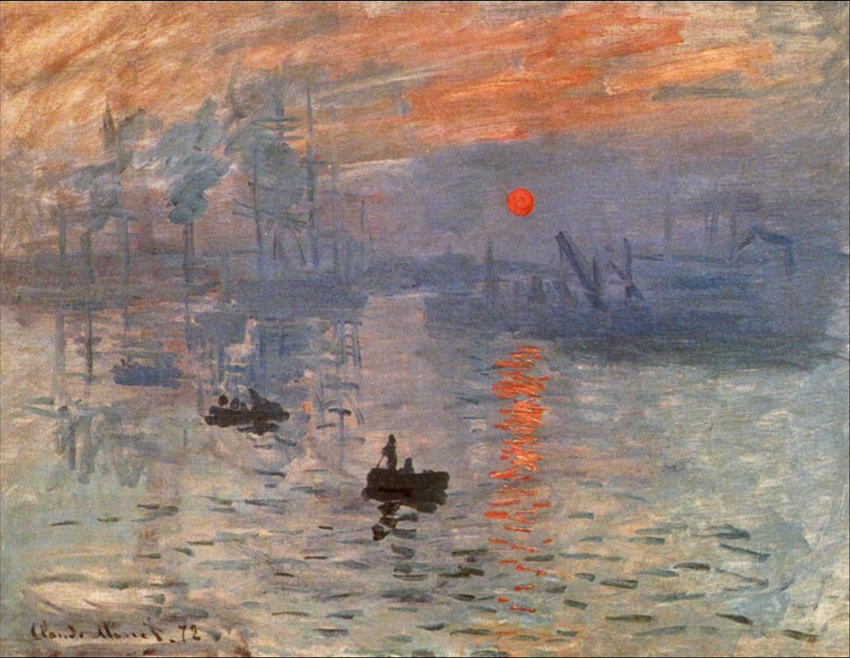
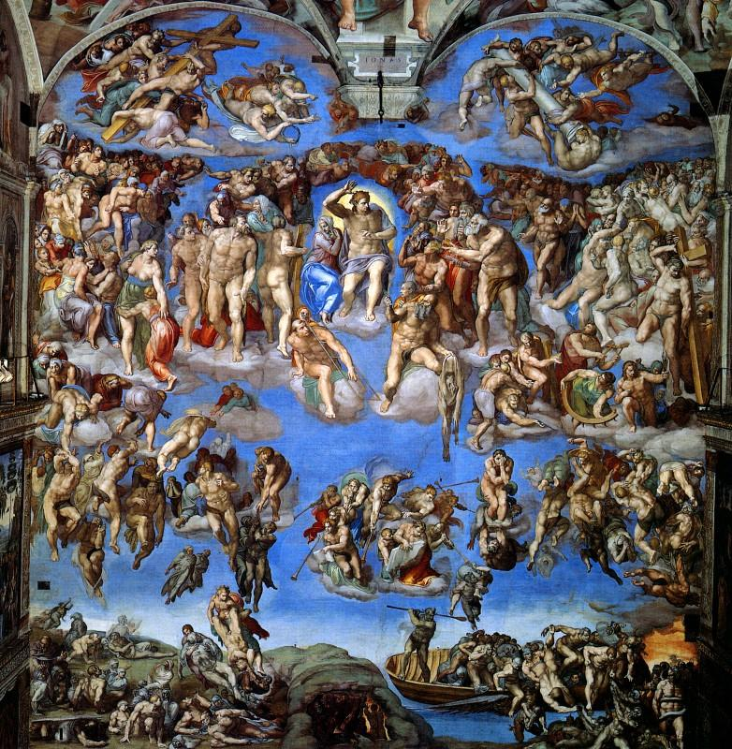
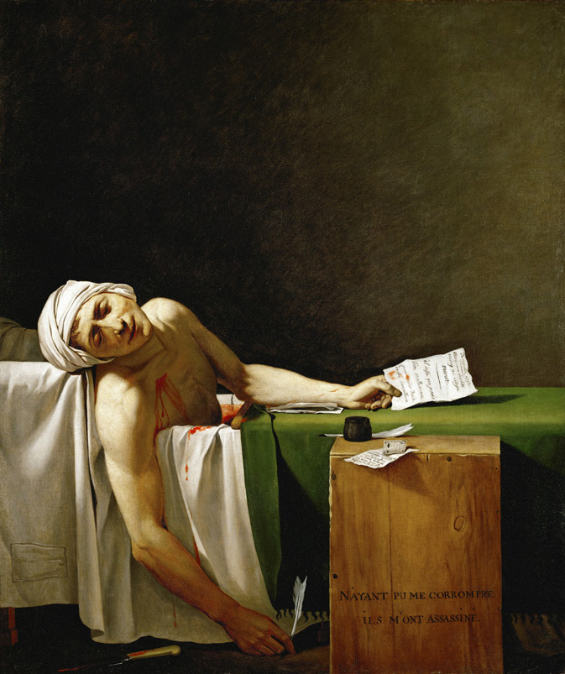
Michelangelo
The Last Judgment
Renaissance
Monet
Impression Sunrise
Impressionism
Jacque-Louis David
Death of Marat
Neoclassical

Slide 12
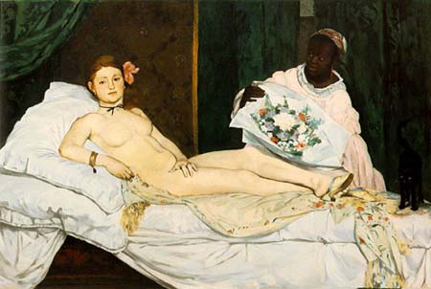
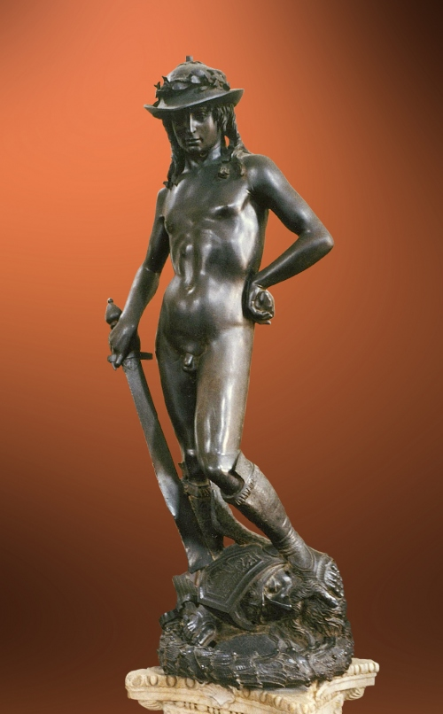
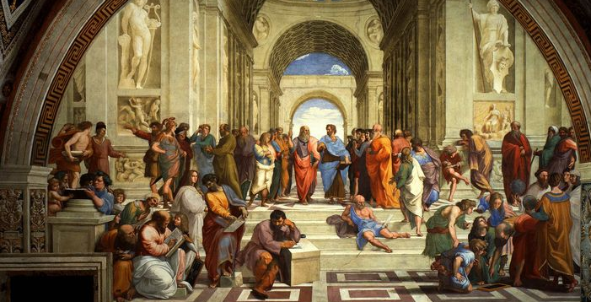
Donatello
David
Renaissance
Manet
Olympia
Realism
Raphael
School of Athens
Renaissance

