Slide 1
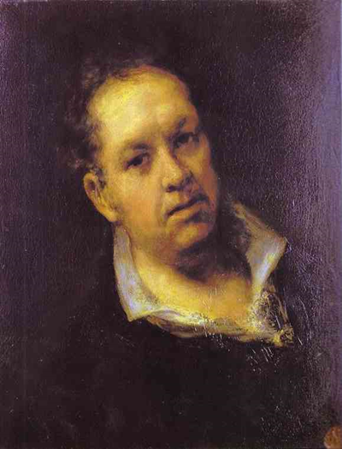
Francisco Goya
1746-1828 Born in Aragon, Spain
Court painter at the peak of his career
He went deaf beginning in 1792 which had a dramatic effect on his art.
He did not stick to one genre but instead painted portraits, still lifes, landscapes, etc. Characteristics of his work:
Created nightmarish visions exposing the evil side of human nature
Considered the most truthful of the artists while using supremely beautiful techniques.
Painted dark subconscious of the human psyche that exposed the truth of the human condition.

Slide 2
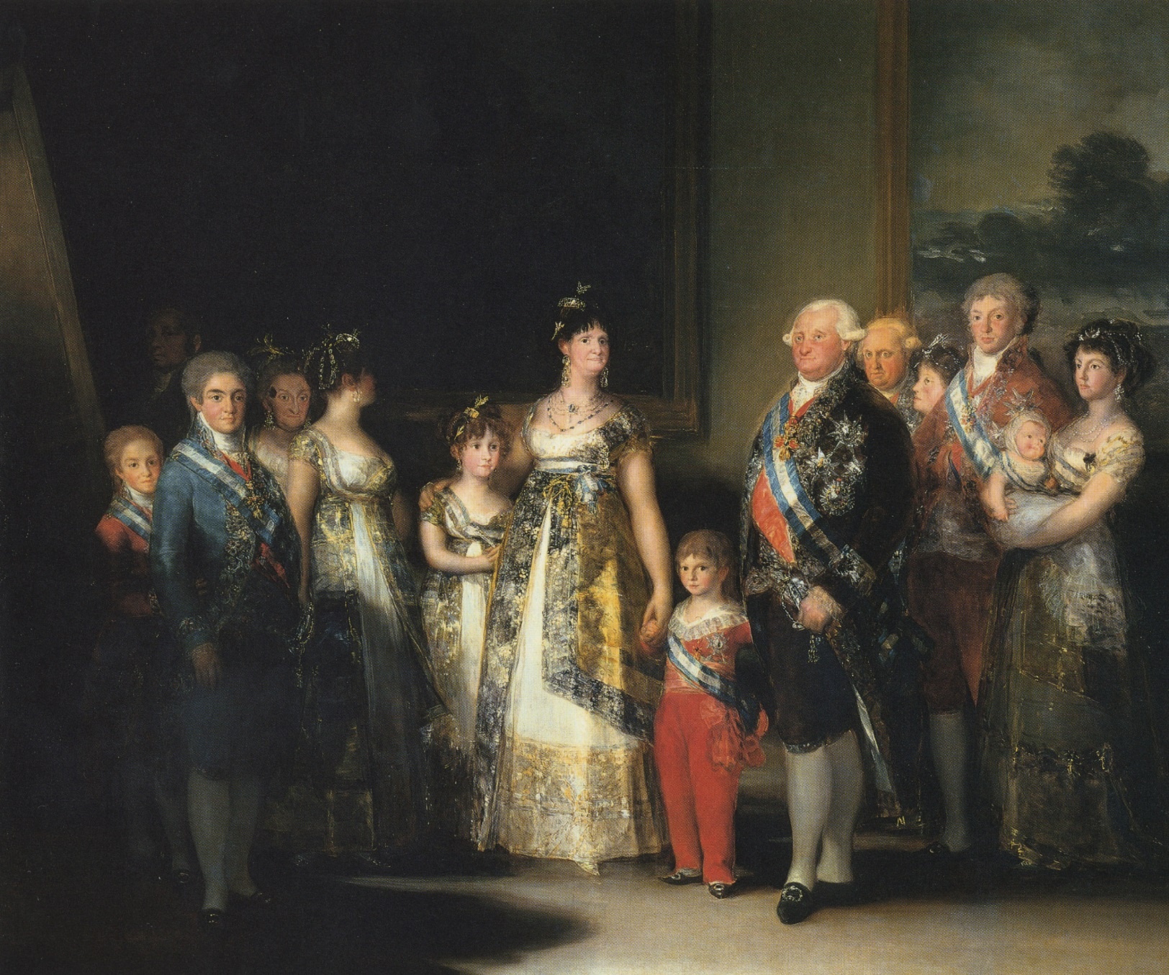
Carlos and His Family, 1800
Goya’s response to Velasquez’s Las Meninas. Goya himself is in the back left at the easel painting the family.
The family is less idealized, but still regal in their clothing.
They are somewhat cluttered and puzzled looking, leading to the impression that Goya was not the King’s #1 fan. Post-Revolutions many monarchies seemed unsure of their future.

Slide 3
Los Caprichos
Meaning « the caprices » or follies of the human condition.
A series of prints which were a critique of the Pre-Enlightenment practices of the Monarchy such as pre-arranged marriages, superstitions, and a powerful church.
BUT they were not satire because his point of view is not masked in humor. He was angry and blunt about his opinions. He thought humans were grotesque creatures.

Slide 4
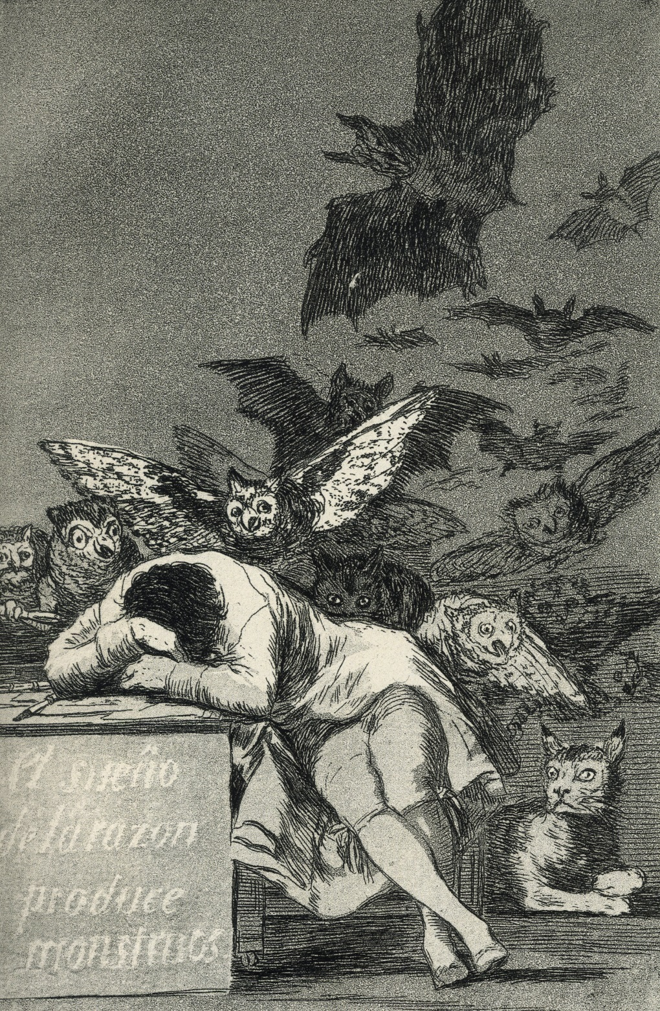
Los Caprichos
The Sleep of Reason Produces Monsters
Direct reaction to the « reason » of the Neoclassical by critiquing the use of reason.
The well educated man has fallen asleep at his desk while all his subconscious fears and inner demons haunt him.

Slide 5
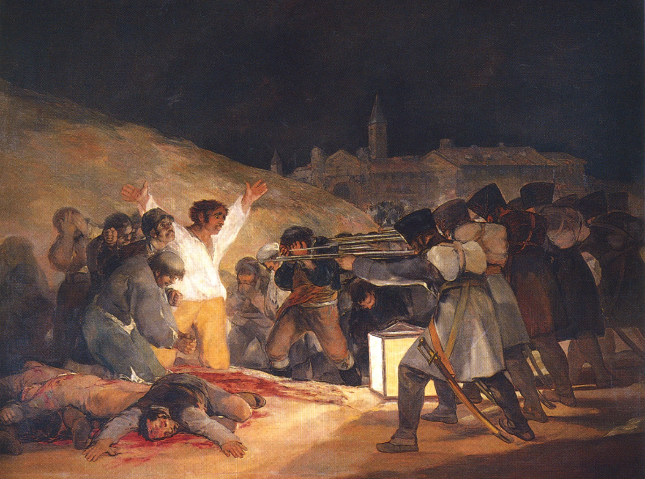
3rd of May, 1808
Napoleon seized control of Spain in 1807 after tricking Charles IV into allowing French troops to pass the Spanish border. Napoleon usurped the throne and installed his brother as ruler. A bloody uprising occurred where Spaniards were slaughtered in both cities and countryside villages.
Goya’s paintings capture the slaughter of those innocent Spaniards.

Slide 6
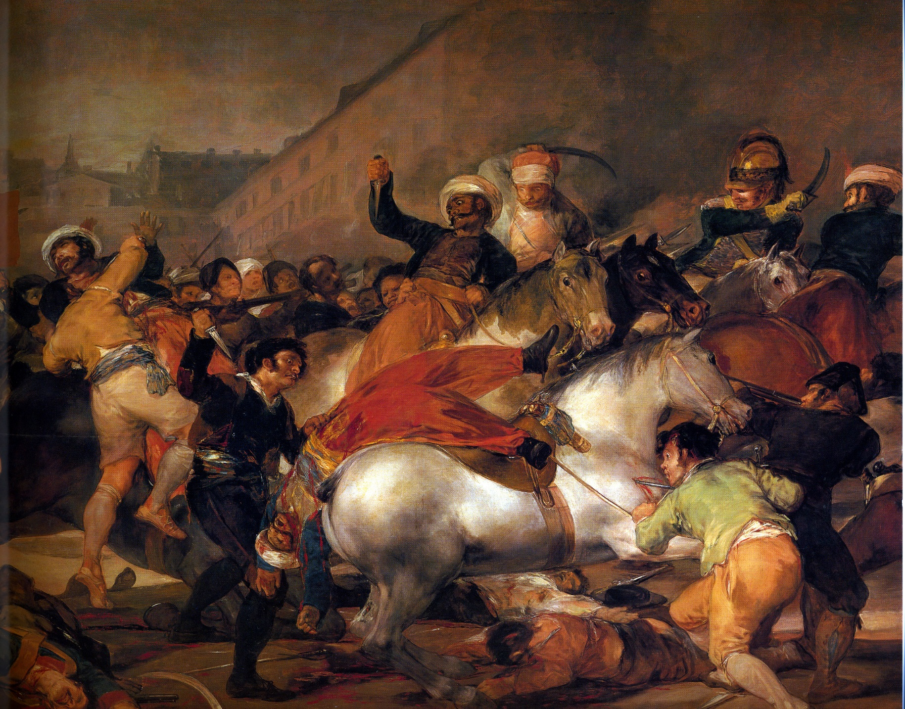
2nd of May, 1808
The 3rd of May also has a companion painting which shows the Spaniard peasants uprising the day before on May 2.
The paintings hanG side by side.
In these paintings, the gore and inhumanity stand in stark contrast to the heroism and idealism of the paintings of Jacques-Louis David.

Slide 7
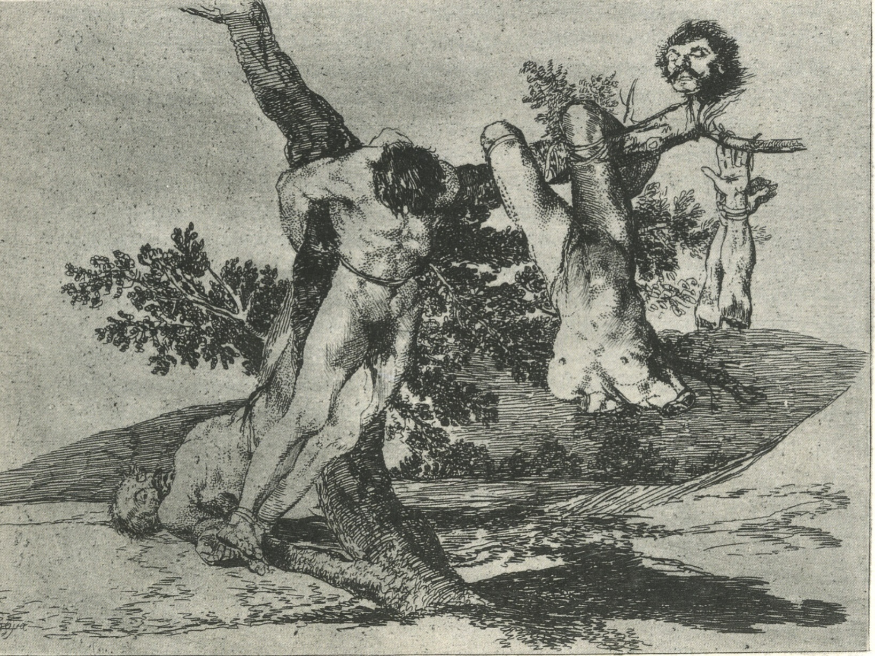
Disasters of War
Goya created the series of prints known as The Disasters of War from 1810-1820. The 82 (!!!) images are a visual protest against the French occupation of Spain by Napoleon.
The series was not printed until 35 years after Goya’s death when it was safe for his political beliefs to be known.

Slide 8
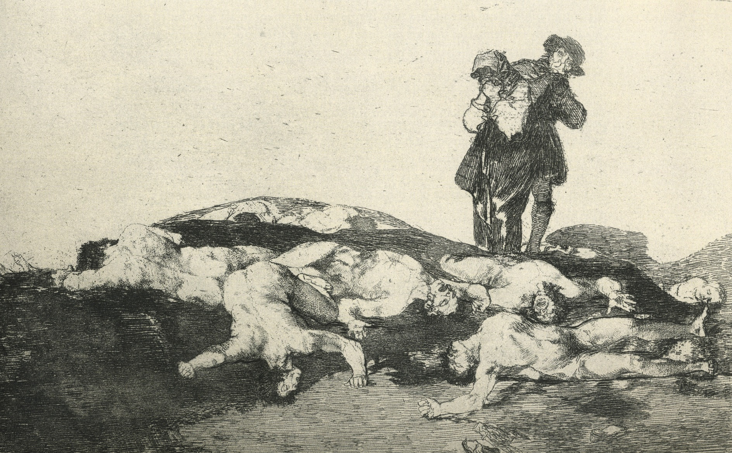
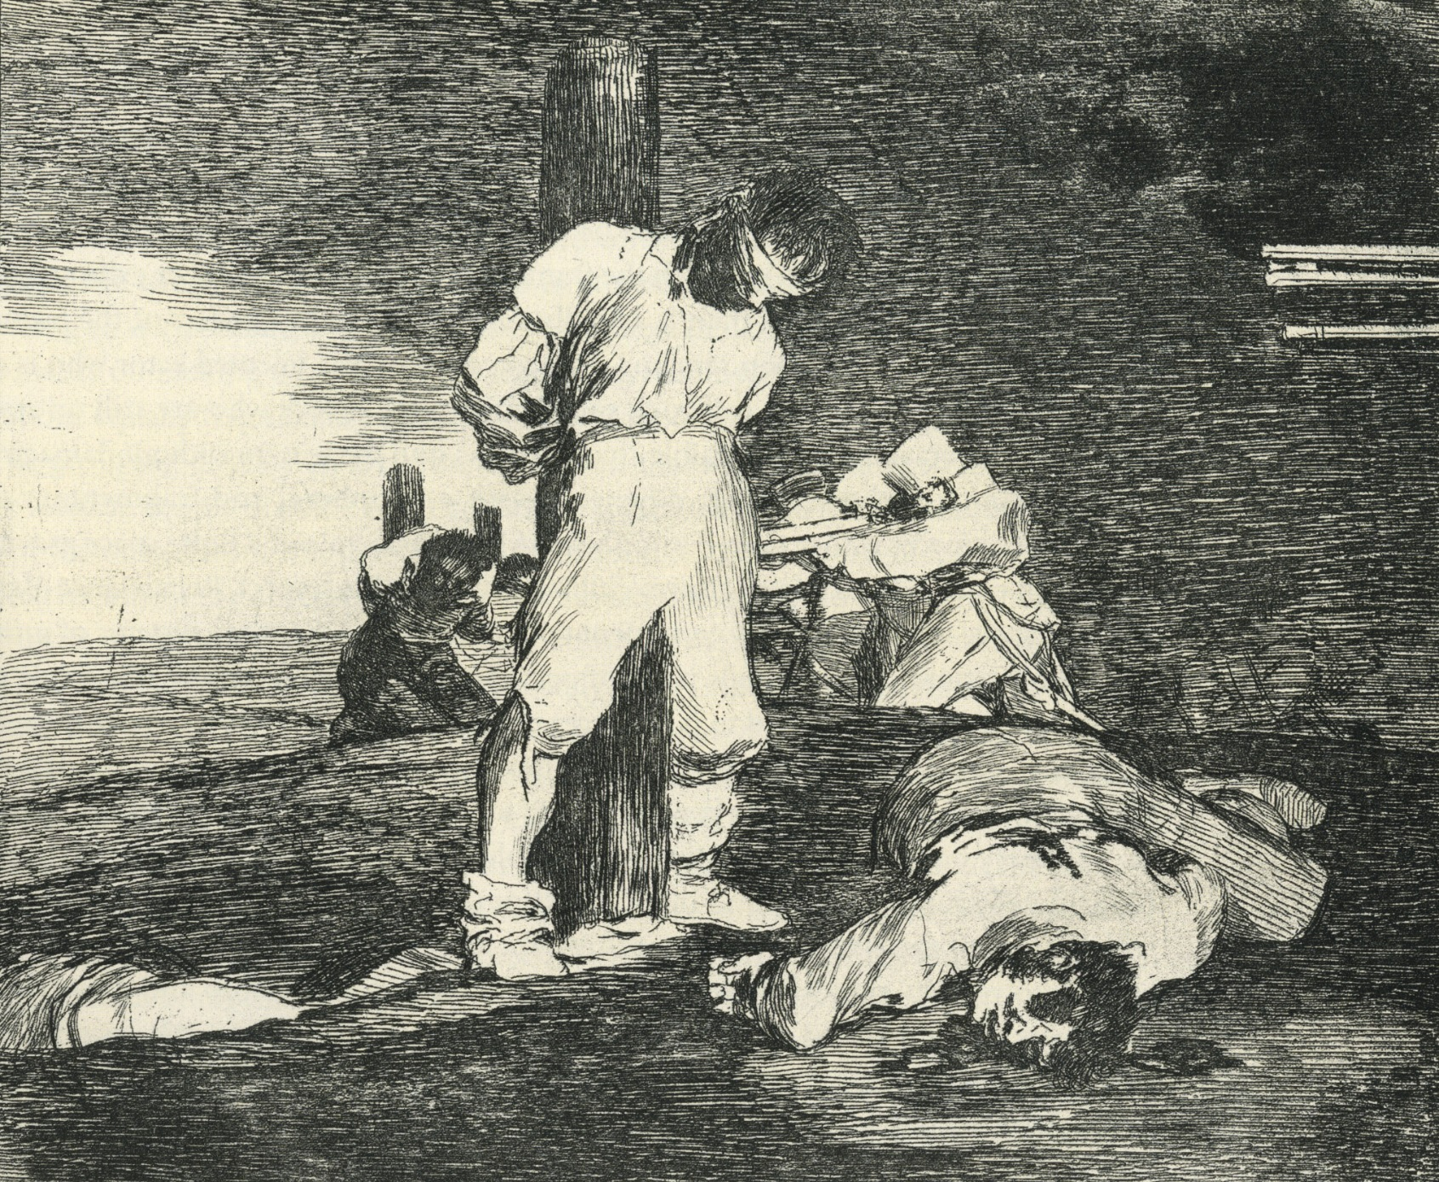
Disasters of War

Slide 9
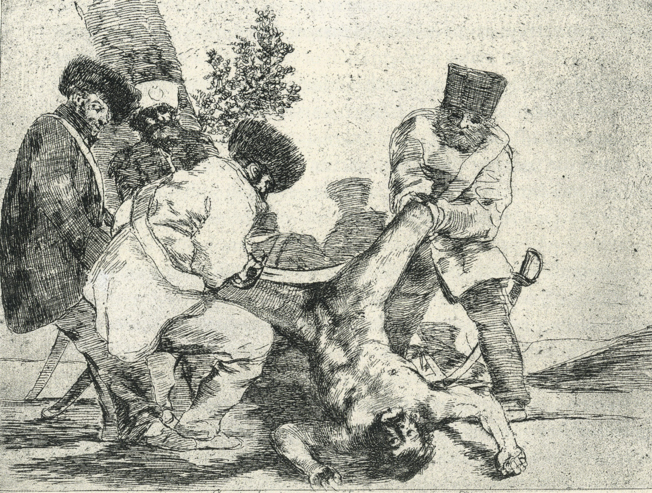
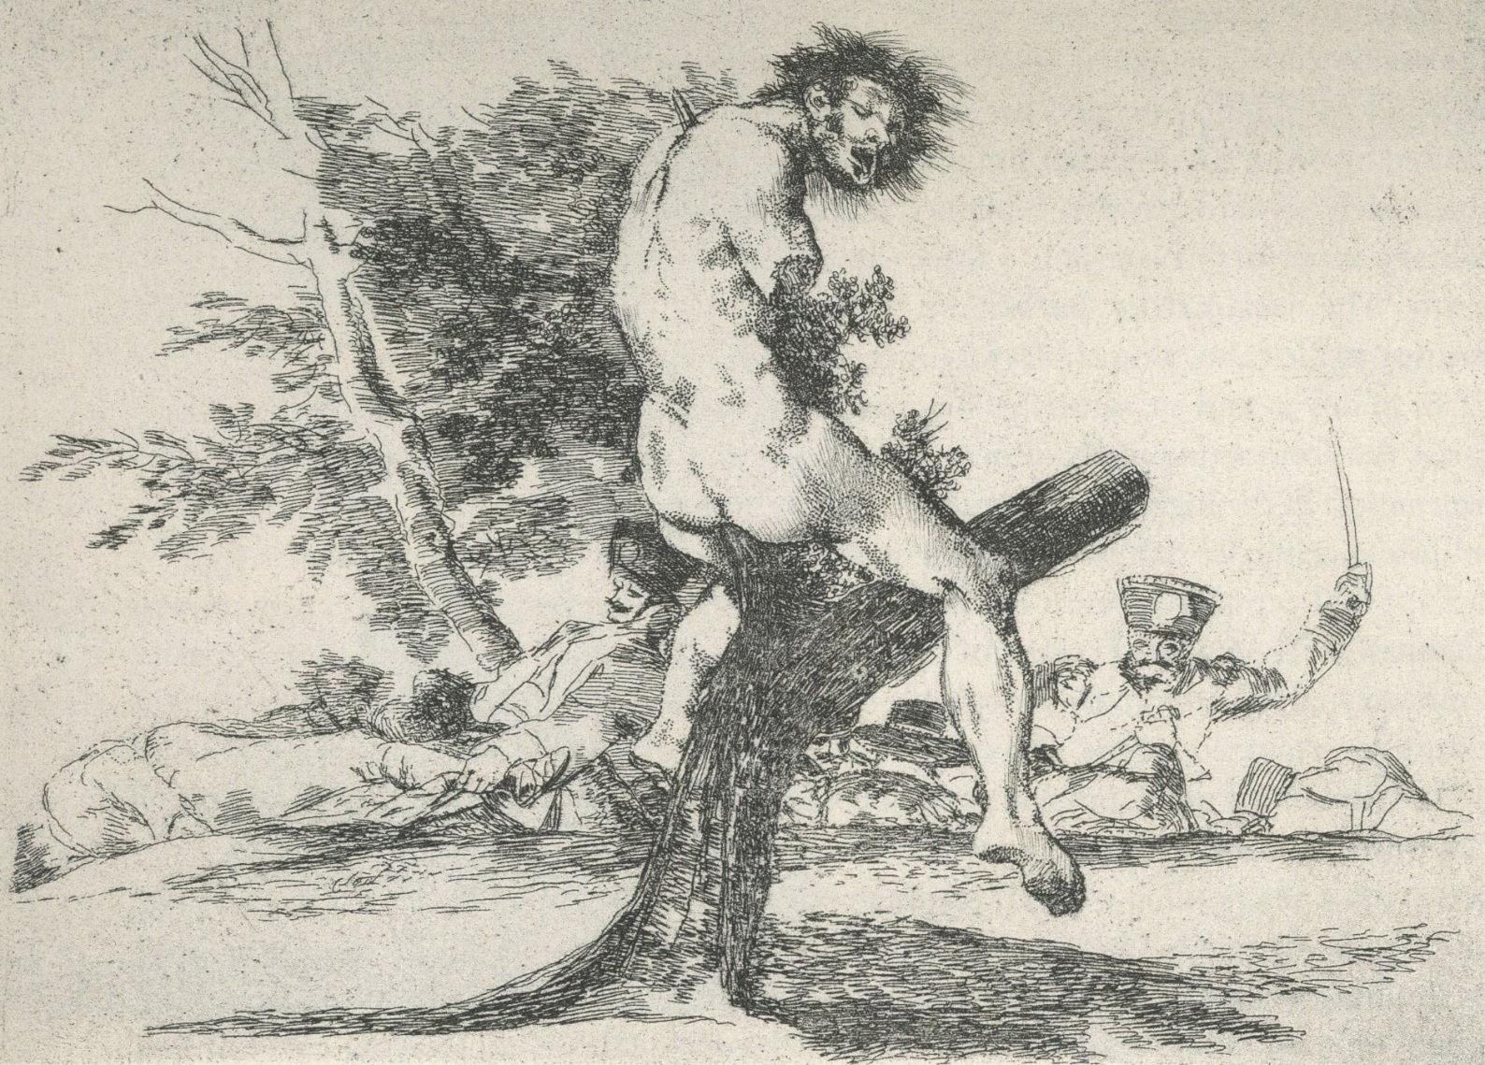
Disasters of War

