Slide 1
BAROQUE ART
Introduction to visual art

Slide 2
KET Baroque Article Questions
What are the characteristics of the Baroque period identified at the beginning of your reading?
The reading states “the Baroque period reflected the turmoil of the time.” Describe at least two events causing this “turmoil”.
What is Rococo?
What additional characteristics were brought about from the diversity of the period?
Describe how and why Caravaggio can be named MVP of the Baroque period using at least one example:
Define chiaroscuro
What was the subject mater of Velasquez? Painting characteristics?
Why is Rembrandt a significant painter of the Baroque period?
Describe the characteristics of the painting, sculpture and architecture of the period:
What are the common characteristics you have read about with all of these artists?

Slide 3
What are the characteristics of the Baroque period identified at the beginning of your reading?
LIGHT, ACTION, DRAMA

Slide 4
The reading states “the Baroque period reflected the turmoil of the time.” Describe at least two events causing this “turmoil”.
30 years war & Reformation

Slide 5
What is Rococo?
FINAL PHASE OF BAROQUE

Slide 6
What additional characteristics were brought about from the diversity of the period?
PASSION, INTELLECT, SPIRITUALITY

Slide 7
Describe how and why Caravaggio can be named MVP of the Baroque period using at least one example.
ABANDONED IDEALIZATION AND RELIGIOUS EXPERIENCE (The Calling of St. Matthew)

Slide 8
Define chiaroscuro
Contrast of light and dark

Slide 9
What was the subject mater of Velasquez? Painting characteristics?
Landscapes, mythological subjects, genre pictures. He merged color, light, space, line, and mass.

Slide 10
Why is Rembrandt a significant painter of the Baroque period?
Over 600 paintings

Slide 11
Describe the characteristics of the painting, sculpture and architecture of the period:
Dramatic use of light; expression of tension; elaborate columns and arches

Slide 12
What are the common characteristics you have read about with all of these artists?
[ student answers may vary ]

Slide 13
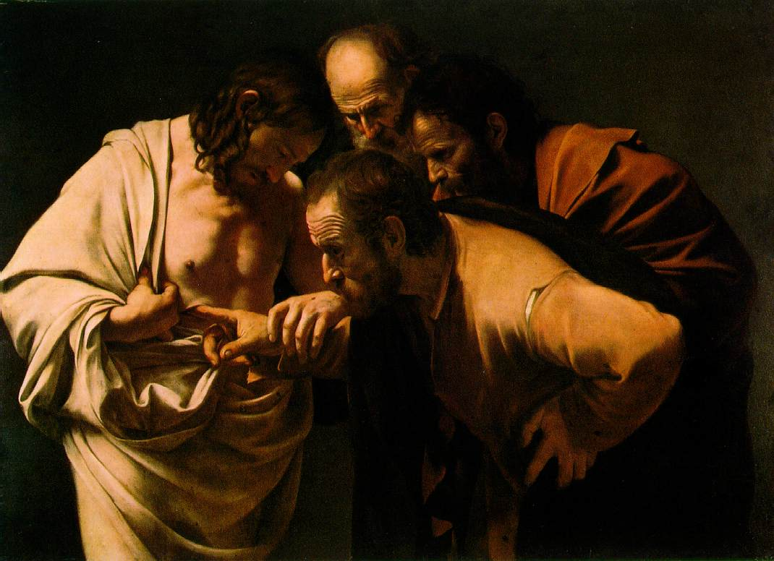
LOOKING AT BAROQUE ART
Jesus after returning from the dead.
One of his disciples is poking his finger into the wound in his torso to show that he indeed died. (mortal wound)

Slide 14
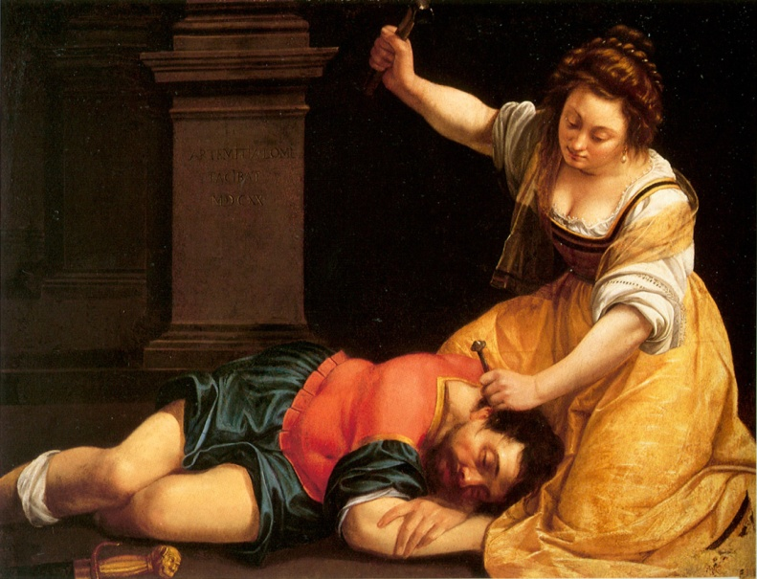
LOOKING AT BAROQUE ART
Jael lures Sisera into her tent and then drives a stake into his head.

Slide 15
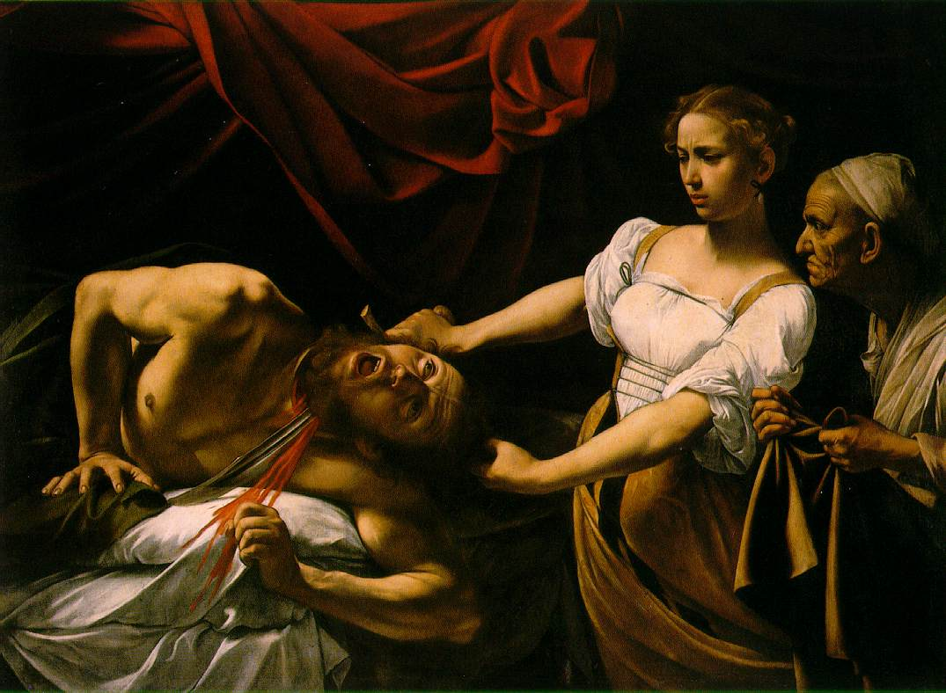
LOOKING AT BAROQUE ART
Judith slaying Holofernes, the Assyrian General who once held Israel. Judith beheads the General after he has passed out drunk.

Slide 16
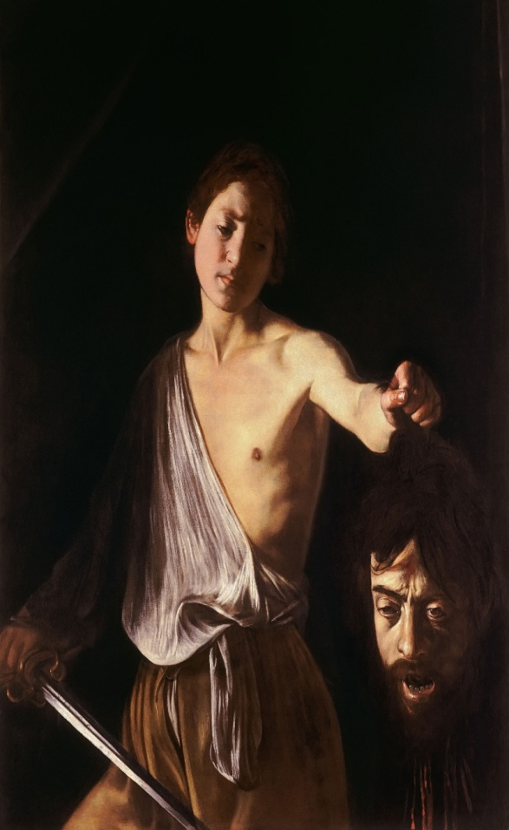
LOOKING AT BAROQUE ART
Judith beheads the General after he has passed out drunk.

Slide 17
LOOKING AT BAROQUE ART
What is similar about all these images?

Slide 18
The Baroque Period
The Baroque period began around 1600.
The Church wanted to attract new worshippers with intriguing architecture in cathedrals and basilicas.

Slide 19
The Baroque Period: What’s going on?
During the Baroque period, these things were happening…
- 30 Years War (religious war between Catholics and Protestants in the Holy Roman Empire.)
- Protestant Reformation (Martin Luther’s “Thesis” against the Catholic Church)
- Increased trade and the growth of slavery (new wealth created among elite)
- New Science Theories (sun at the center of the universe)

Slide 20
The Baroque Period: What’s going on?
How did these things effect art?
- religious subject matter became predominant (Pope wanted to make Rome the cultural center of the Western world)
- Council of Trent suggested religious art be directed towards clarity, realism, and emotion to increase understanding among every day people
- Protestants avoid religious subject matter in favor of landscapes
- increased trade meant increased wealth which meant more art patrons

Slide 21
The Baroque Period: ART101
The “Baroque” Style:
- considered the most “sumptuous” and “ornate” of most art periods
- Art was expanded into everyday life
- Light was used to create an emotional impact
- Classical elements were used without classical restraint (not afraid to show violence)
- Art was meant to speak to the illiterate masses instead of the well-informed wealthy

Slide 22
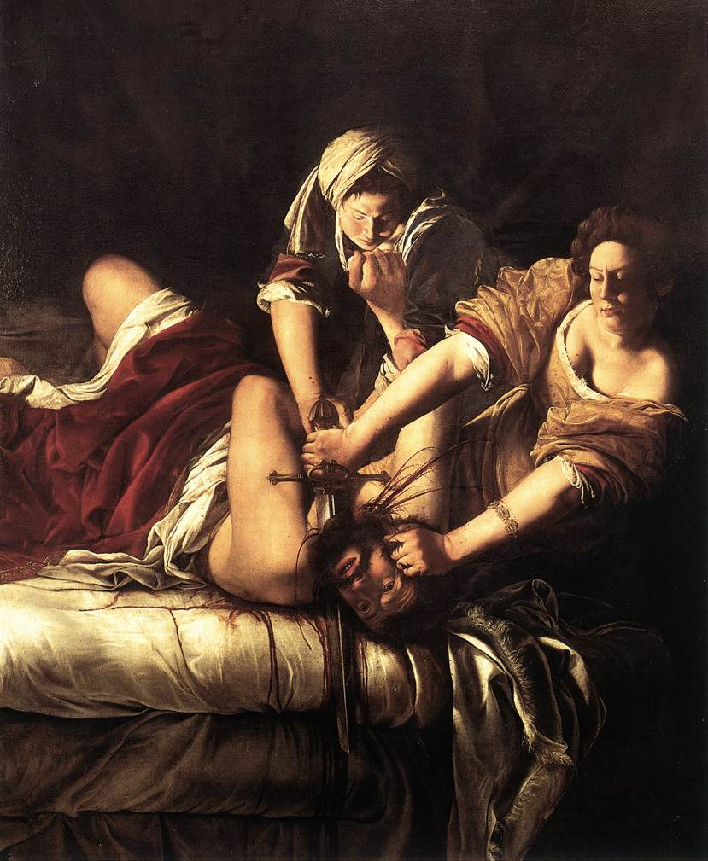
The Baroque Period: ART101

Slide 23
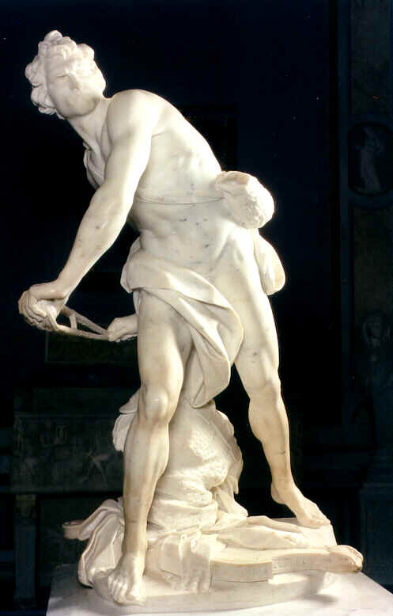
The Baroque Period: ART101

Slide 24
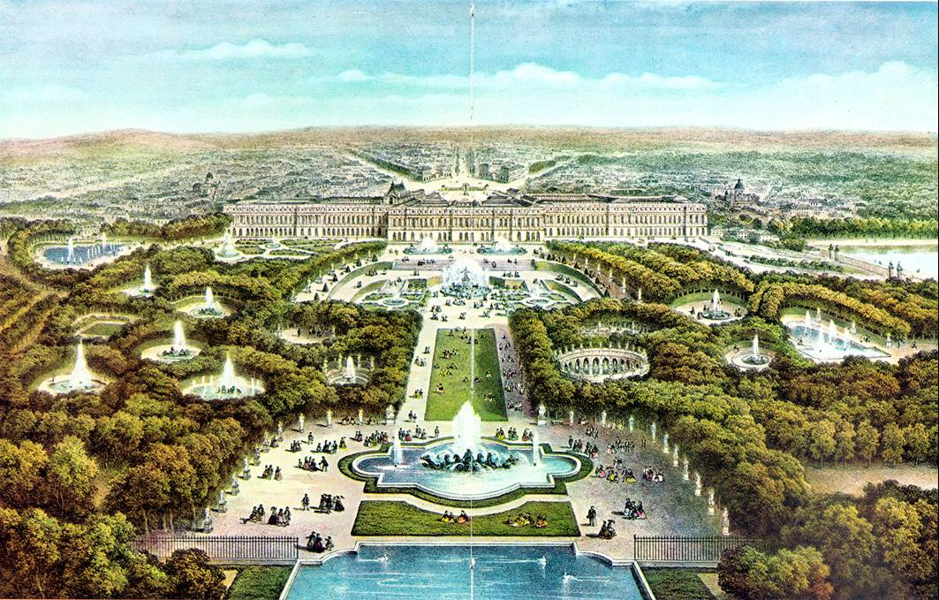
The Baroque Period: ART101

Slide 25
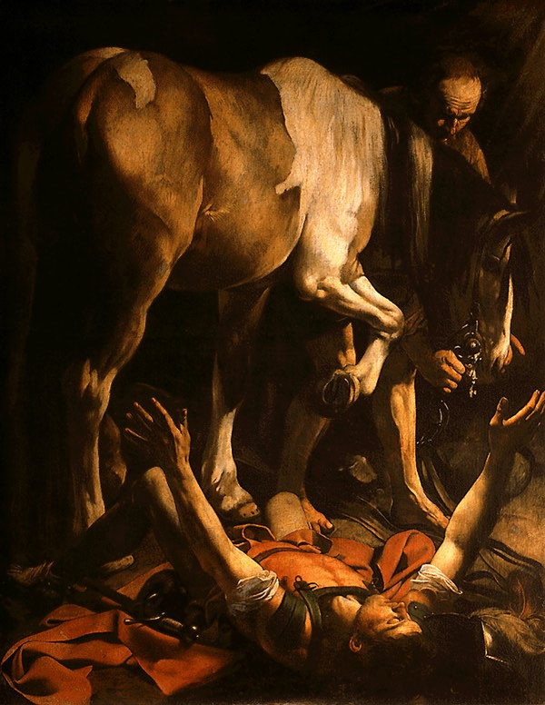
The Baroque Period: ART101
The Conversion of St. Paul
Caravaggio

Slide 26
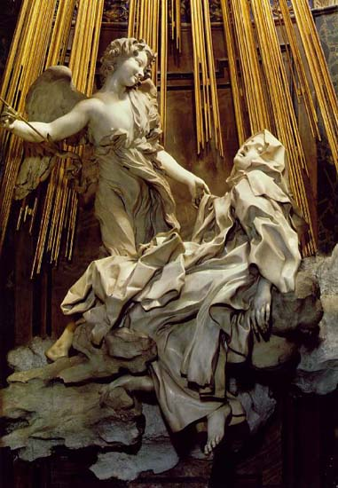
The Baroque Period: ART101
The Ecstasy of St. Theresa
Bernini

Slide 27
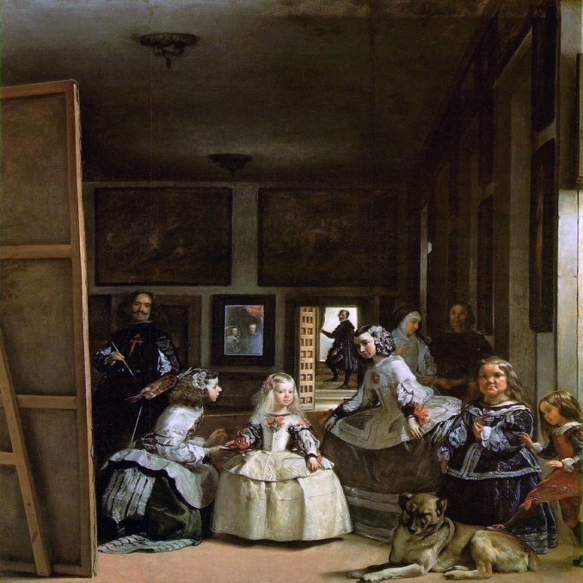
The Baroque Period: ART101
Las Meninas
Velazquez

Slide 28
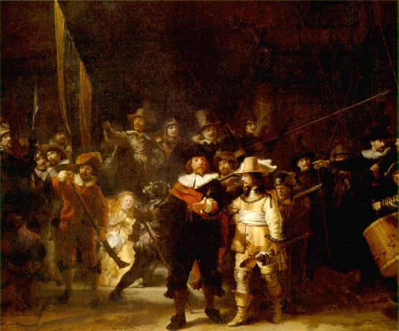
The Baroque Period: ART101
The Night Watch
Rembrandt

Slide 29
The Baroque Period: ART101
The “Baroque” Style:
-Started in Italy
-Comes from the term “barrocco” which means “misshapen pearl” in Portuguese
-Became an international phenomenon
-Catholics used baroque art to teach the illiterate about the Church
-Protestants thought that worshipers should reply on the Bible and not any artist’s interpretation of the gospel;
-Imperfections seen as beautiful (all God’s creations are beautiful)

Slide 30
The Baroque Period: Functions and Characteristics
Chiaroscuro
-invented during the Renaissance
-perfected and widely used during the Baroque
-Italian for “light-dark”
-a bold contrast between light and dark
Tennebrism
-Italian for “murkey”
-creates a look of figures emerging from the dark
-heightened form of chiaroscuro

Slide 31
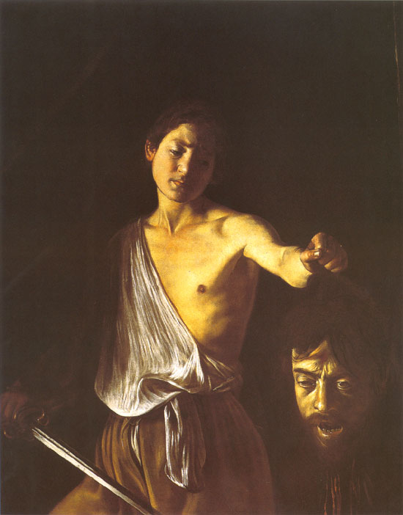
The Baroque Period: Caravaggio
Michelangelo Merisi da Caravaggio,1573-1610
-Most revolutionary artist of his time
-Characterized by his temper
-imprisoned for assaults and murder
-died 2 days after his pardon
-Did not idealize the human form or religious experience
-he was considered somewhat vulgar/profane
-Orphaned at age 11, went to Rome at age 15 and found
a patron, the Cardinal Francesco del Monte
-his first commissions were scenes of the life of Saint
Matthew commissioned by the Cardinal

Slide 32
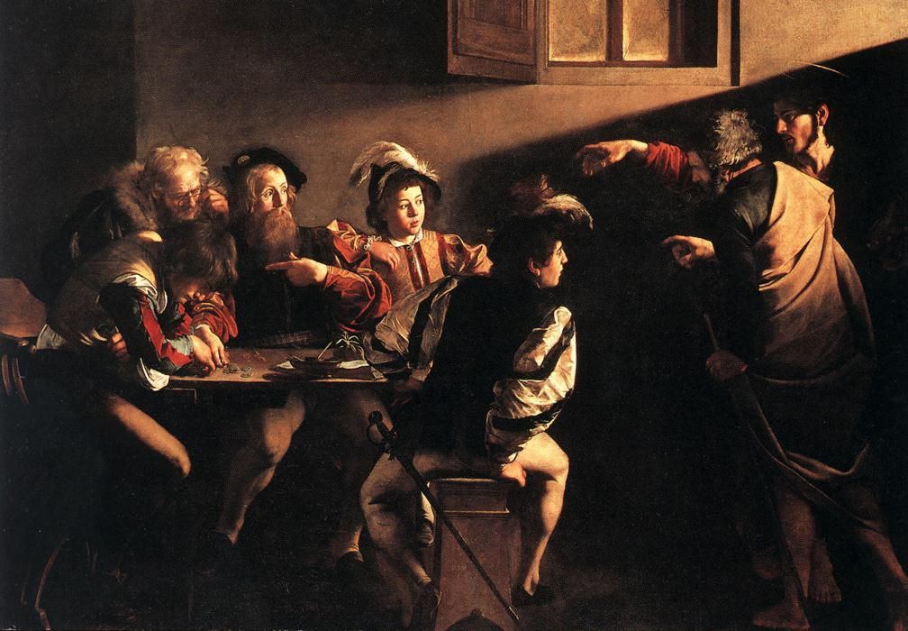
The Baroque Period: Caravaggio
The Calling of St. Matthew 1602. It caused outcry because of its realistic and dramatic nature.

Slide 33
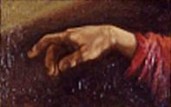
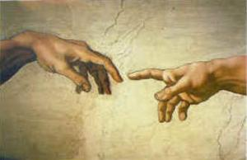
The Baroque Period: Caravaggio
What other painting does this painting allude to?

Slide 34
The Baroque Period: Caravaggio
The Conversion of St. Paul, 1601
Different than other versions of this scene as Jesus is not atop a throne surrounded by angels while he is converting Paul.

Slide 35
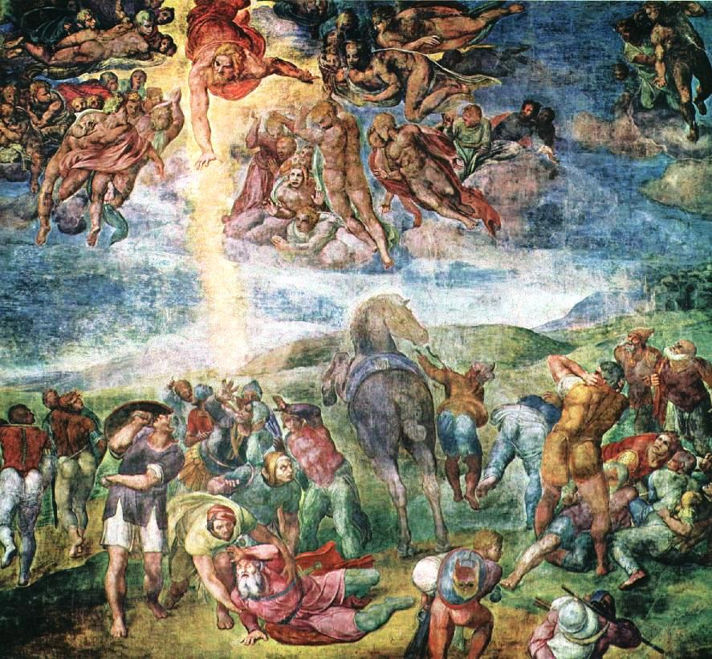
The Baroque Period: Caravaggio
Michelangelo’s Conversion of Saul vs. Caravaggio’s Conversion of Saul

Slide 36
The Conversion of St. Paul
Subject
-St. Paul hears the word of God, falls off his horse, and is blinded by the bright light of God
Significance
-religious art was secularized
-Saints and miracles depicted as ordinary events
Elements and Principles of Art
-Audience is brought into the action through chiaroscuro, tennebrism, and perspective.
Controversies
-Saint depicted on the ground instead of elevated status
-showing the horse’s butt!

Slide 37
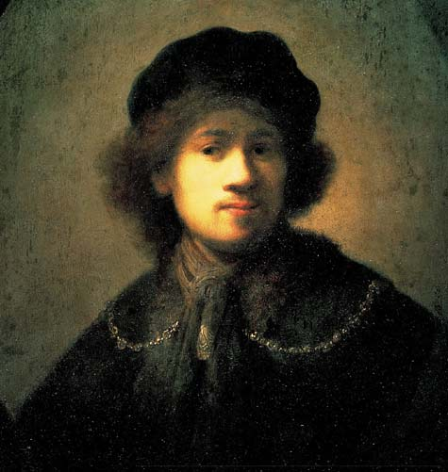
The Baroque Period: Rembrandt
Rembrandt Harmenszoon Van Rijn
1606-1669
-Born in Leyden, Denmark
-Son of a miller
-Married Saskia van Ulenborch in 1634
-1634-1642 period of greatest success
-Saskia dies in 1642, turning point in his art
-Paintings characterized by luxurious brushwork , rich color, and a mastery of chiaroscuro

Slide 38
The Baroque Period: Rembrandt
Characteristics of Rembrandt
-Considered greatest Dutch artist
-painter, draftsman, and etcher
-numerous portraits and self-portraits (over 50)
-commissioned for portraits and religious subjects

Slide 39
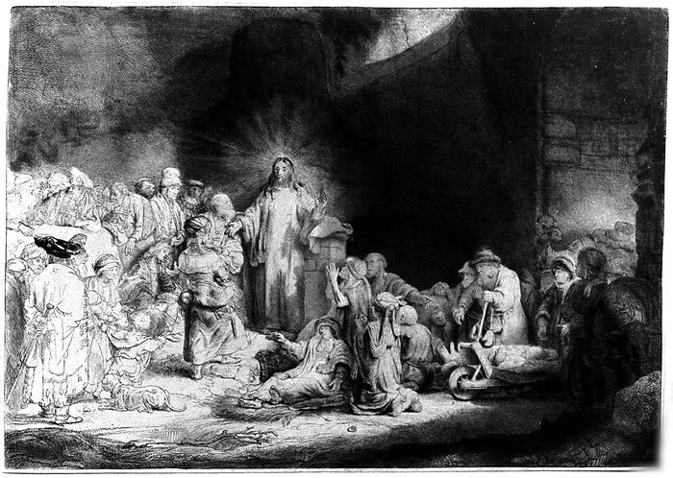
The Baroque Period: Rembrandt
Christ Healing the Sick
etching

Slide 40
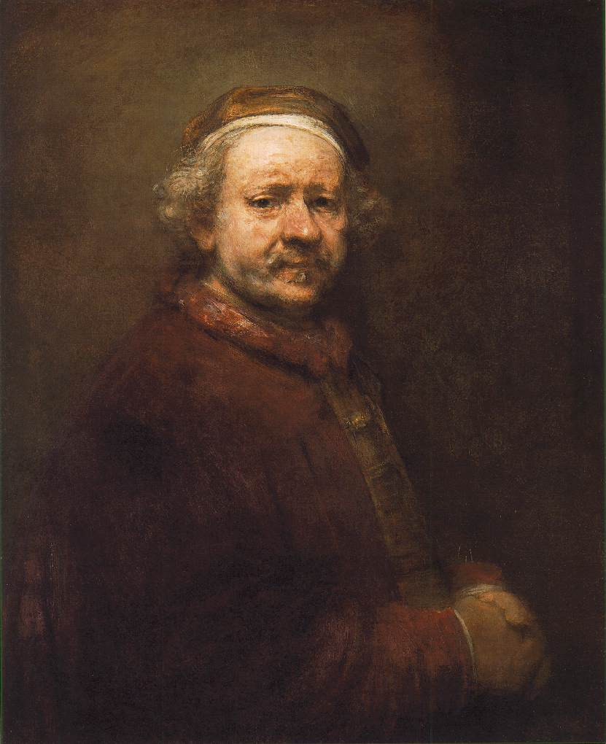
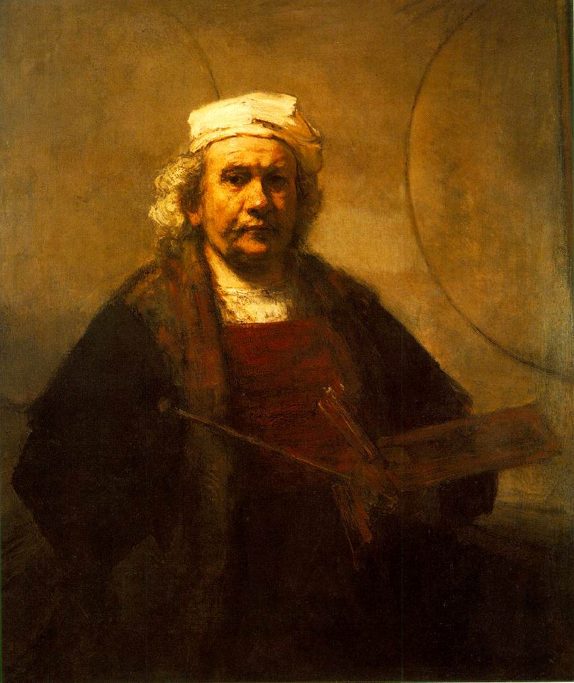
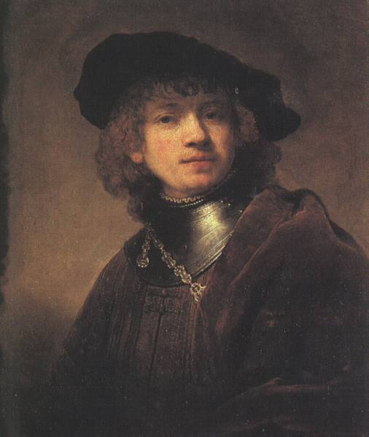
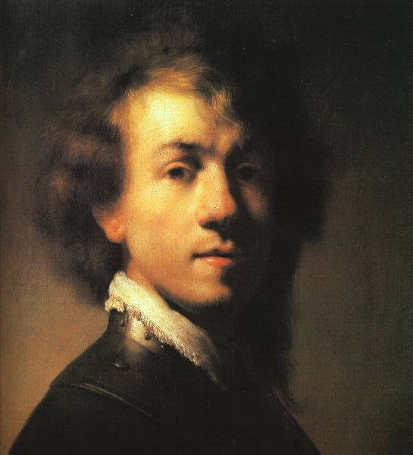
The Baroque Period: Rembrandt
Self-Portraits

Slide 41
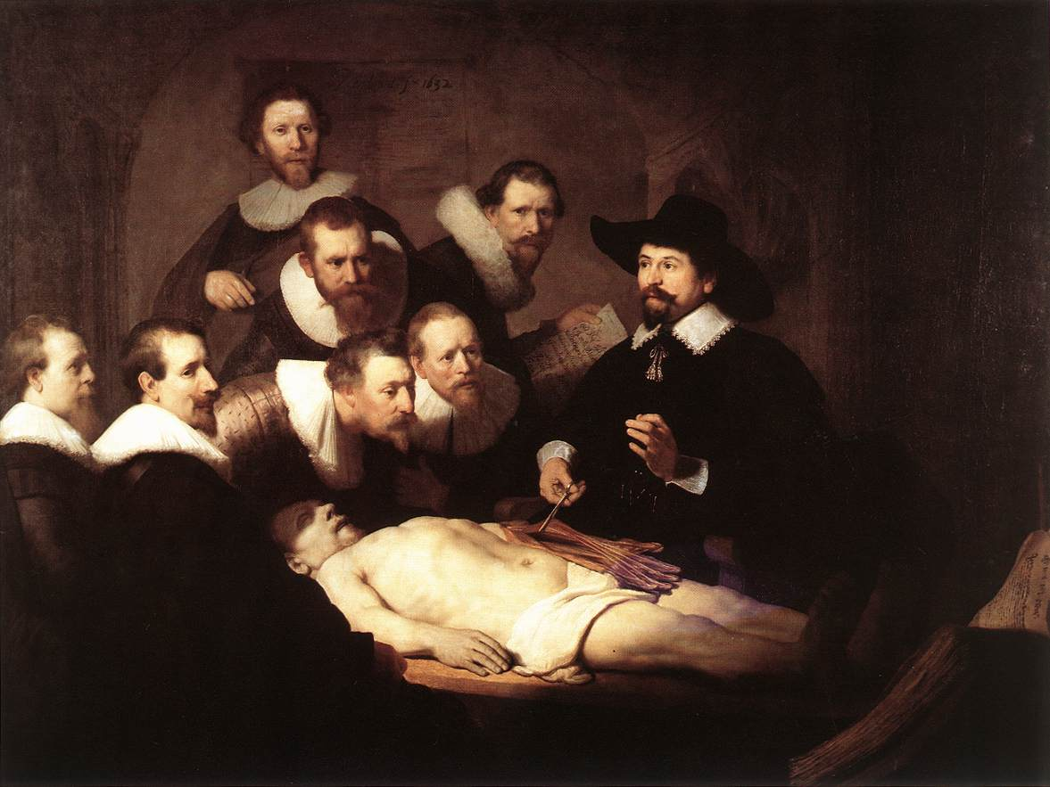
The Baroque Period: Rembrandt
Anatomy Lesson of Dr. Tulip

Slide 42
The Baroque Period: Rembrandt
Most inventive work:
The Night Watch, 1642
Each man is painted with the detail of an individual portrait
Depicted the Militia Company of Captain Frans Banning Cocq

Slide 43
The Baroque Period: Rembrandt
The Night Watch, 1642
Subject:
-shows Cocq’s company welcoming Marie de Medici’s (Queen of France) arrival at the Amsterdam gate
Elements and Principles of Art:
-painting moves in diagonals (figures moving from the corners towards the center)
Controversies:
-Patrons contributed equally to the painting but were not painted equally
Artist Connection:
Right during the turning point of his career

Slide 44
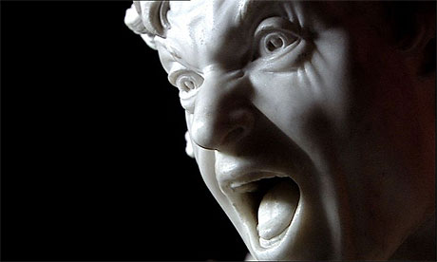
The Baroque Period: Bernini
Gianlorenzo Bernini, 1598-1680
-sculptor/architect
-last of the “great” artists to be commissioned by Popes
Major Works:
-St. Peter’s Piazza
-David
-Ecstasy of St. Theresa
-Cornaro Chapel

Slide 45
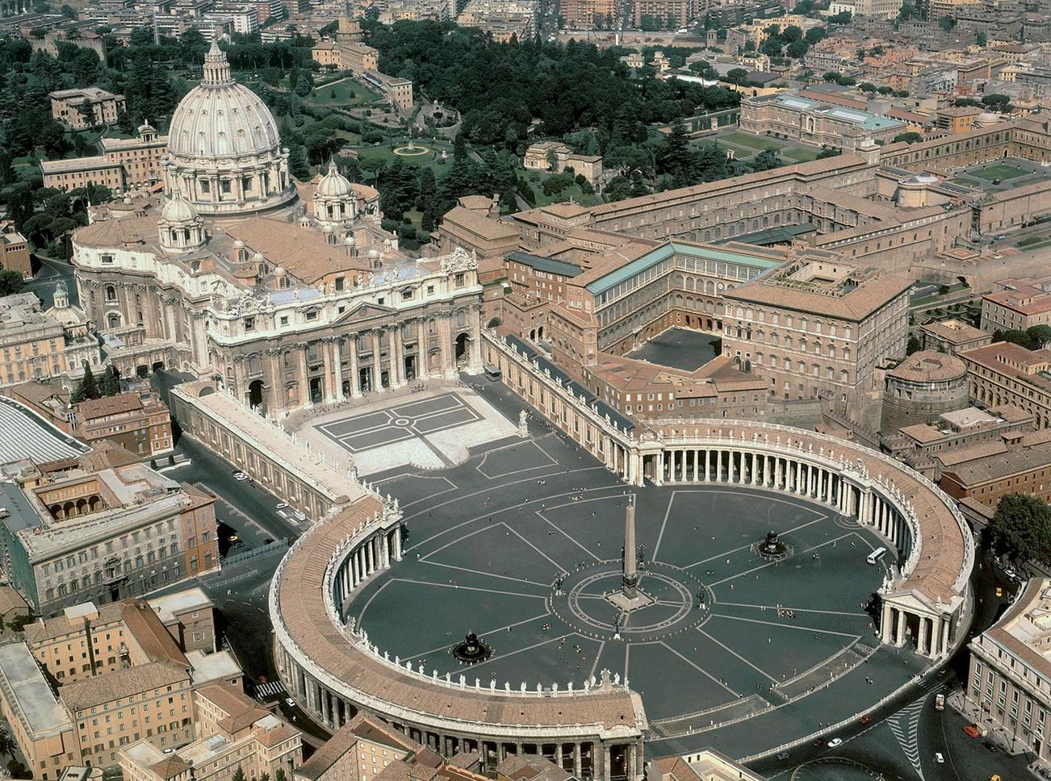
The Baroque Period: Bernini
St. Peter’s Piazza

Slide 46
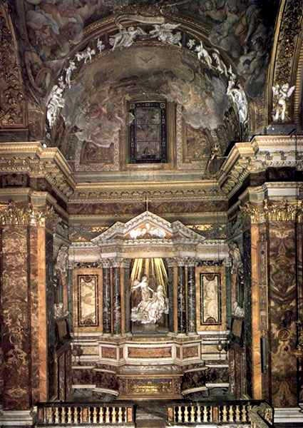
The Baroque Period: Bernini
Cornaro Chapel

Slide 47
The Baroque Period: Bernini
Ecstasy of St. Teresa
(in Cornaro Chapel)

Slide 48
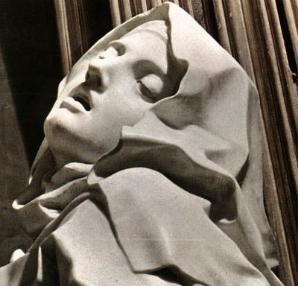
The Baroque Period: Bernini
Ecstasy of St. Teresa

Slide 49
The Baroque Period: Bernini
Ecstasy of St. Teresa, 1645-1652
-The entire chapel is designed to highlight this sculpture
-Balconies are painted with spectators viewing the sculpture
-depicts St. Teresa when she sees a vision and hears voices
-The saint and angel appear to be on swirling clouds
-the entire piece shows emotion, drama, and passion

Slide 50
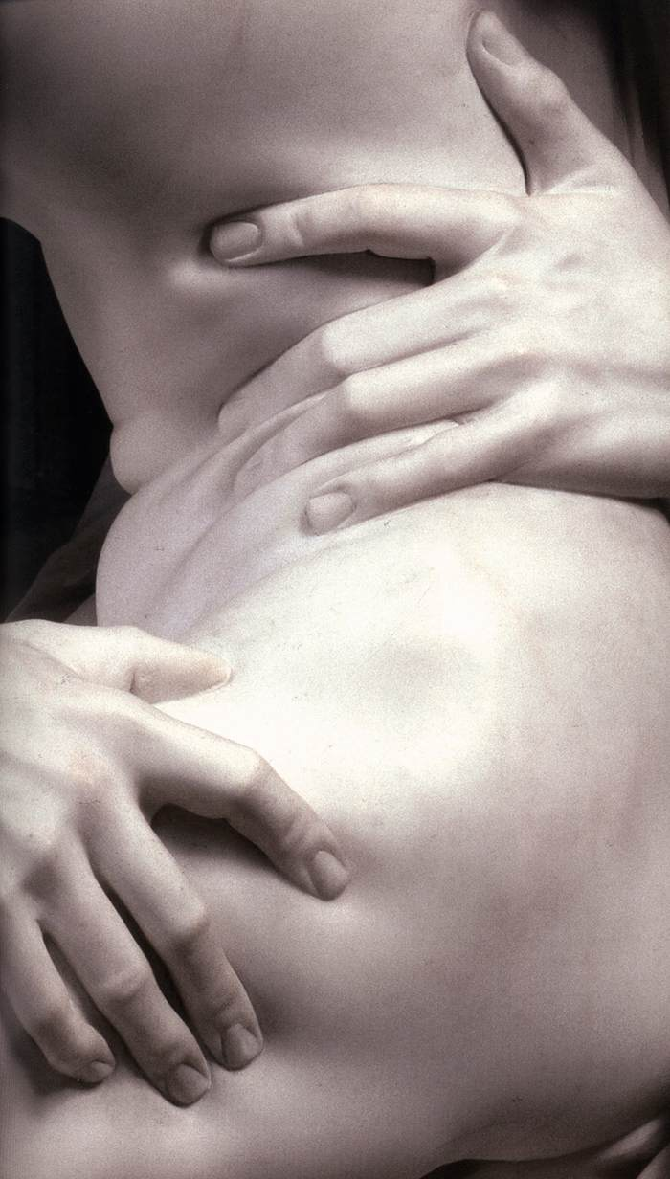
The Baroque Period: Bernini
Marble into Flesh

Slide 51
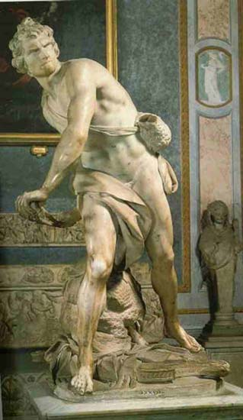
The Baroque Period: Bernini
Bernini’s David

Slide 52
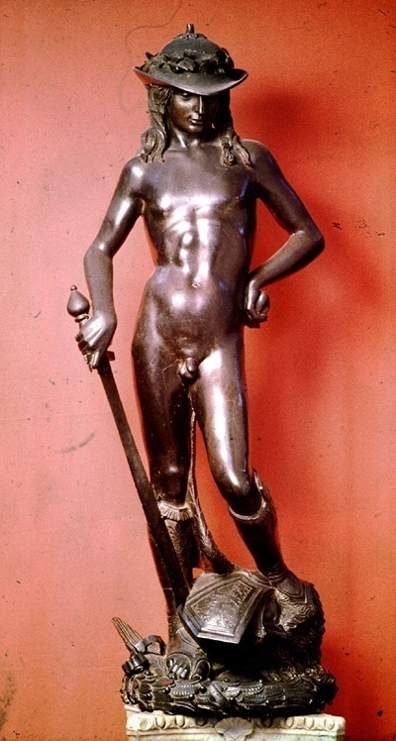
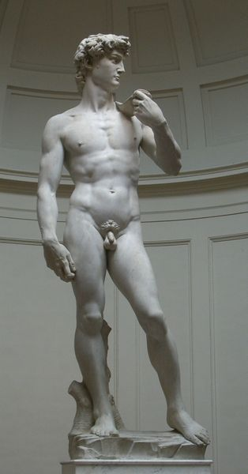
The Baroque Period: Bernini
After fight!
Before fight!
During fight!
Donatello, 1409, 6 ft
Michelangelo, 1504, 16 ft
Bernini, 1623, 6 ft

Slide 53
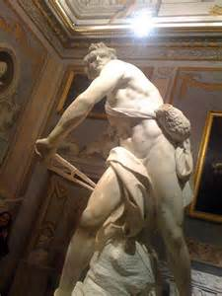
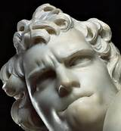
The Baroque Period: Bernini
Bernini’s David

Slide 54
The Baroque Period: Bernini
How is Bernini’s David more emotional?
What changes can you see (via Bernini’s David) that the Baroque period developed from the Renaissance?

Slide 55
The Baroque Period: Caravaggio, Rembrandt, Bernini
Artist | Artwork | Subject | Baroque Characteristics | Controvery or Cool Fast
Caravaggio
Rembrandt
Bernini

Slide 56
BAROQUE POEMS
At your table, pick one of the three artists we studied today.
Write a 10 line poem together about that artist’s personal life and/or art work.

