Slide 1


DRAMA
The Literary Elements

Slide 2
Things you need for today:
  2 Handouts from the front of the room
  Class work:
    1) Literary Elements of Drama Notes
    2) Application: Theater Viewing Guide
    3) Group Writing Activity
  Exit Slip
    Do you understand plot structure?

Slide 3
Drama Opener
Assignment:
  Read the article entitled, “The Benefits of Drama Education” and create a caricature of someone who studies drama.
Knowledge required:
  Caricature definition:
    Visual art or descriptive writing that greatly exaggerates certain features of a subject to create a comic or absurd effect
Example:
  If studying drama makes someone really tall, you would then draw a really tall person.
Requirements:
  Title your sketch “The Benefits of Studying Drama”
  FIVE benefits of studying drama must be included!
  Use color throughout your design
  Label all caricature features (if your figure is really tall, the label would read “makes students taller.”
Notes:
Article Possibilities:
http://www.dramaed.net/benefits.pdf
http://www.ccm.org/learning-center/start/the-arts/the-value-of-teaching-drama
Caricature definition: http://grammar.about.com/od/c/g/Caricature-term.htm

Slide 4
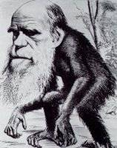
Example
A 19th-century caricature of Charles Darwin (Hornet magazine, 1871)
  http://grammar.about.com/od/c/g/Caricature-term.htm
Why is Charles Darwin shown as being half animal?
Time allotted:
15 minutes

Slide 5
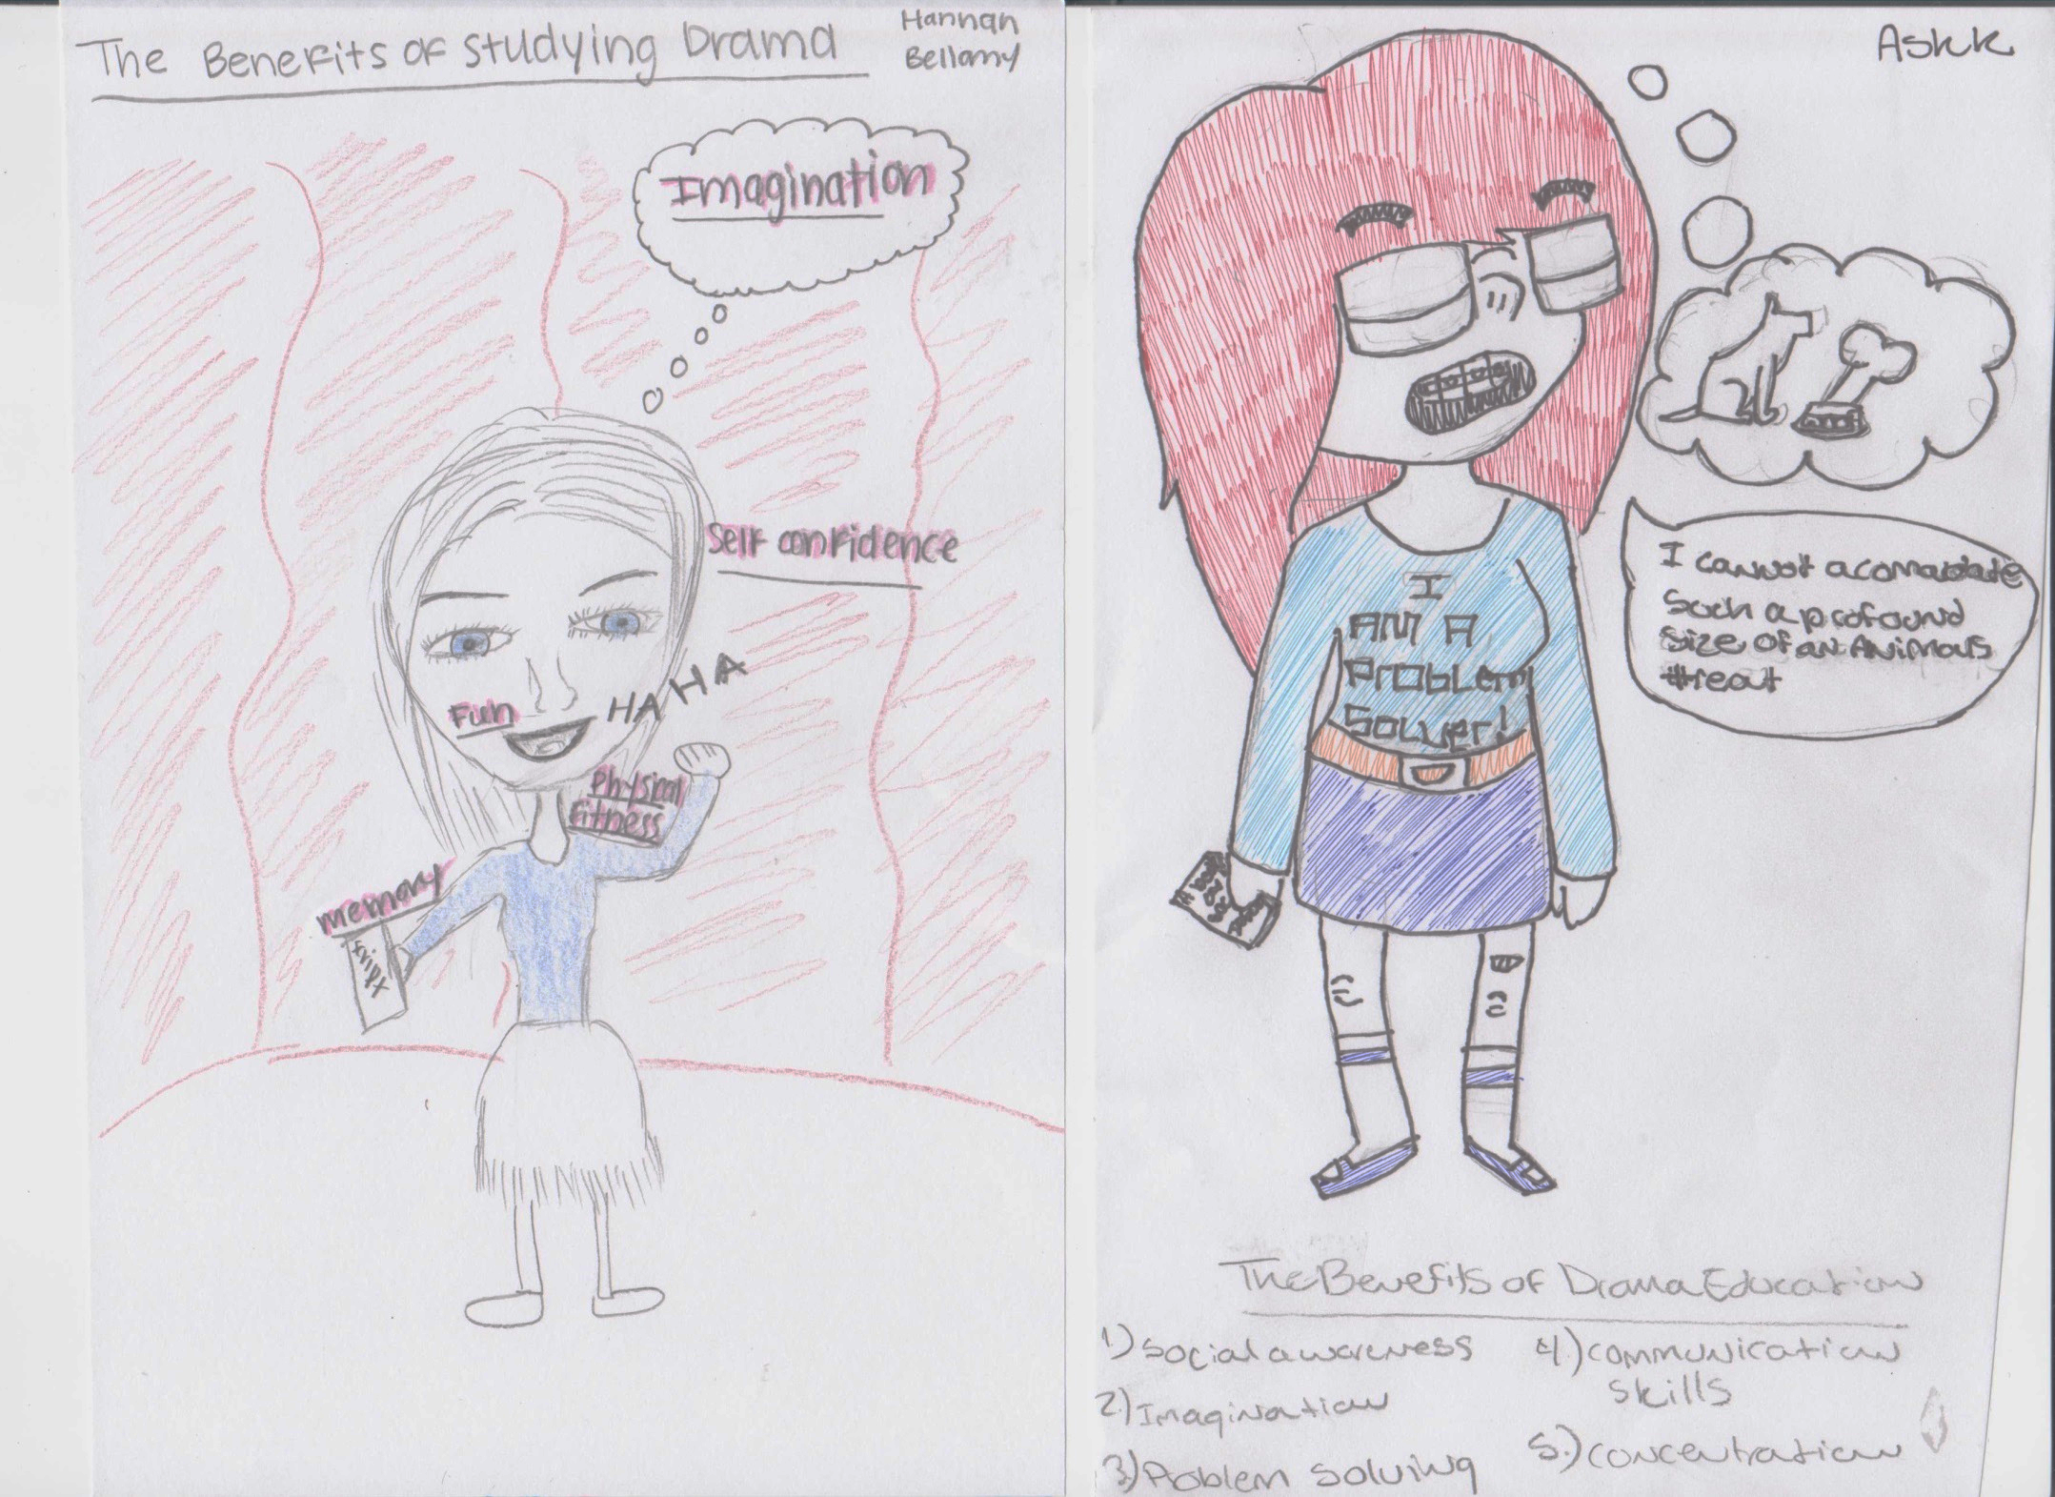

Slide 6
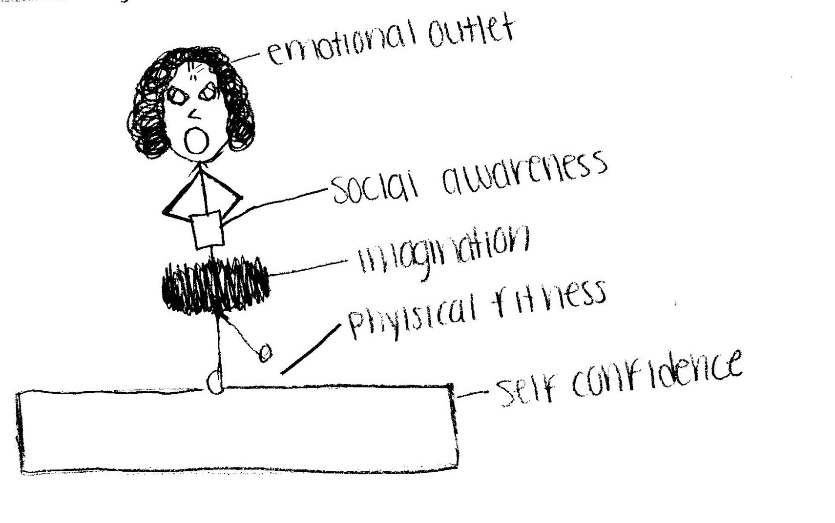
Benefits of Studying Drama

Slide 7
The Literary Elements of Drama… why do these words look familiar?
The Literary Elements of drama might sound familiar because you have studied these terms in your English classes.

Slide 8
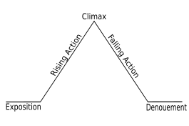

Freytag's Pyramid
Initial Incident
Conclusion

Slide 9
Plot Structure:
Here are the terms that are associated with plot structure:
Exposition- introduction of the main characters and setting (time and place); characters build relationships and there is an initial incident that begins a conflict between them.
Rising Action- characters make decisions regarding the initial incident; suspense builds; action becomes more complicated.
Climax- point of highest emotion; turning point; characters change and make decisions
Falling Action- resolution of character’s crisis
Denounment- “untying of the plot”; the resolution
Conclusion- the restoration of power; a celebration; unity; whatever the plot calls for; usually depends on the genre (tragedy/comedy)

Slide 10
Freytag's Pyramid
Initial Incident
Conclusion
Draw this in your notes!

Slide 11
Suspense:
How does this word apply to drama?
The state of being undecided, uncertain, or doubtful.
A state of tension.
Needed to sustain interest in drama.

Slide 12
Theme:
What does this word mean?
The underlying meaning of the story
A universal truth
A significant statement that the story is making about society, human nature or the human condition

Slide 13
Language and Style:
Don’t we all speak English?
The way the words are put together to create the story.
The way the words are put together to define the character.
Some characters speak in a dialect which is difficult to read when spelled the way the playwright was it to sound; however, it is easier for actors to interpret.
Conversational style/language is informal language; the way most people usually speak

Slide 14
Monologue:
This means one what?
A lengthy speech by a character who is revealing his/her thoughts.
Can be delivered alone to the audience or to another character
Soliloquy is different; it is alone and innermost thoughts only

Slide 15
Dialogue:
Is that what you do when you’re trying to call someone?
Speech between two or more characters onstage.
Lines are preceded by each other’s name in a script.

Slide 16

Application of
Literary Elements
Get out your theater viewing guide!

Slide 17
Theater Viewing Guide
TVG Information:
  Name of Work:_Raiders of the Lost Ark_
  Author: _George Lucas and Philip Kaufman_
  Date:1981 /set in the 1930’s
  Place:_Hollywood / set in South America
  Director: __Steven Speilberg__
  Genre: _Action Adventure_
    Main Performer(s): _Harrison Ford_
Directions:
  As you watch the following clip, complete Freytag’s triangle.

Slide 18
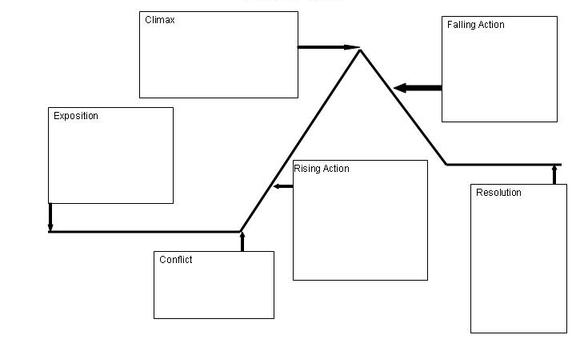

Slide 19
Article Response: (one-page)
“The Benefits of Drama Education”
→ Pick two characteristics from the article in your packet, and then…
→ Write about a play or movie that you know of that connects, or teaches to the audience about this value/characteristic.

Slide 20
Performance Assessment Activity Explanation
Day One – Literary Elements – 25 minutes
Find a partner and think of a song that you know. Be sure the lyrics are school appropriate or ensure that you can alter the lyrics to have the same meaning without being offensive.
Write down the lyrics to the song.
Take out any repeated chorus, introduction, or conclusion to the song that is not important to the story being told.
Your version must contain the following theatrical concepts:
  Theme – the meaning has to be clear to your audience
  Language and Style – you must alter this from the original song version
  Suspense – there has to be some sort of tension and release within your performance
  You are creating a monologue and/or dialogue with your performance
Have this written by the end of class.

Slide 21

Unifying the Elements!
Things to Consider over the next two classes:
  Sound –what will add to the presentation of your monologue?
  Lighting - adjust for the mood of your monologue
  Costumes – These must convey the meaning of the monologue - make sure you have these with you next class.
  Props – These must convey the meaning of the monologue - make sure you have these with you next class. Set and hand props must both be utilized!
  Stage Directions: Five must be included in your script!

Slide 22
Script Example
Script Writing
  (Mr. Broderick, a middle-aged teacher with a scruffy beard and thick southern accent, greets his students as they come into class)
  Mr. Broderick: Hey ya’ll, what…is…uuuup? Ya’ll have a good weeekeeend? Ja’ll go to any cruuuunk paar-ties?
  (Mr. Broderick looks around but no one responds; the room is totally quiet.
  Mr. Broderick: Oh, I seee, ya’ll play-in the qui-et game, huh?

Slide 23
Script example
Dialogue:
  WADE: (walking downstage towards Dora) You have coffee on?
  DORA: (holding a cup of coffee) Coffee? Aren’t you a little young for coffee? I can make you some tea.
  WADE: Tea is for old ladies.
  DORA: (shouts) And mouthy teenagers.
  WADE: Skip it. I’ll have a coke. (Moves upstage and exits stage right)
Monologue/Soliloquy format: (note- the content and characters onstage will be different)
  Hamlet: To be, or not to be, that is the question:
  Whether 'tis nobler in the mind to suffer
  The slings and arrows of outrageous fortune,
  Or to take arms against a sea of troubles, …
Notes:
http://www.scriptfrenzy.org/howtoformatastageplay

Slide 25

Literary Elements Exit Slip:
Directions:
Using the passage below, complete Freytag’s triangle.
Passage:
  “Little Miss Muffet sat on a tuffet, eating her curds and whey. Along came a spider, who sat down beside her, and scared little Miss Muffet away.

Slide 26
Additional Activity if Time
Surprise Script Writing

Slide 27
Application of Literary Elements- Activity
I will put you into groups of 7
Each of you need a blank sheet of paper
  Exposition
  –Initial Incident
  Rising Action
  Climax
  Falling Action
  Denouement
  Conclusion

Slide 28
Exposition
Introduce 1-3 characters by name and have them doing something.
Pass to your right

Slide 29
Initial Incident
Read what was written before and then add an event or conflict. This has to be something strange, tragic, unusual, interesting, etc. Be sure you use the characters names.
This is where the reader will get interested!
Fold over the exposition so the next person will only read what was written before.
Pass to the right.

Slide 30
Rising Action
Only read the initial incident.
Write something that builds suspense based on the initial incident.
Be sure you use the characters names.
Fold over the initial incident so the next person will only read what was written before and pass to the right.

Slide 31
Climax
Read the rising action and then create and event that releases the suspense.
Be sure to use the character’s names.
Fold over the rising action so the next person will only read what was written before and pass to the right.

Slide 32
Falling Action
Read the climax and have the characters react or figure out how to fix, change, get away from, etc. whatever event happened in the climax.
Be sure to use the character’s names.
Fold over the climax so the next person will only read what was written before and pass to the right.
Fold it over and pass to the right

Slide 33
Denouement
Read the falling action and have the characters discover something new about their situation.
Be sure to use the character’s names.
Pass to the right without folding.

Slide 34
Conclusion
Read ONLY the falling action and denouement and create a conclusion for the characters.
Be sure to use the character’s names.
Fold it over and pass to the person who created the exposition.

Slide 35
Read it to your group!
Open your paper and take turns reading the plot diagrams. Pick the best one of your group to share with the rest of the class.

