Slide 1
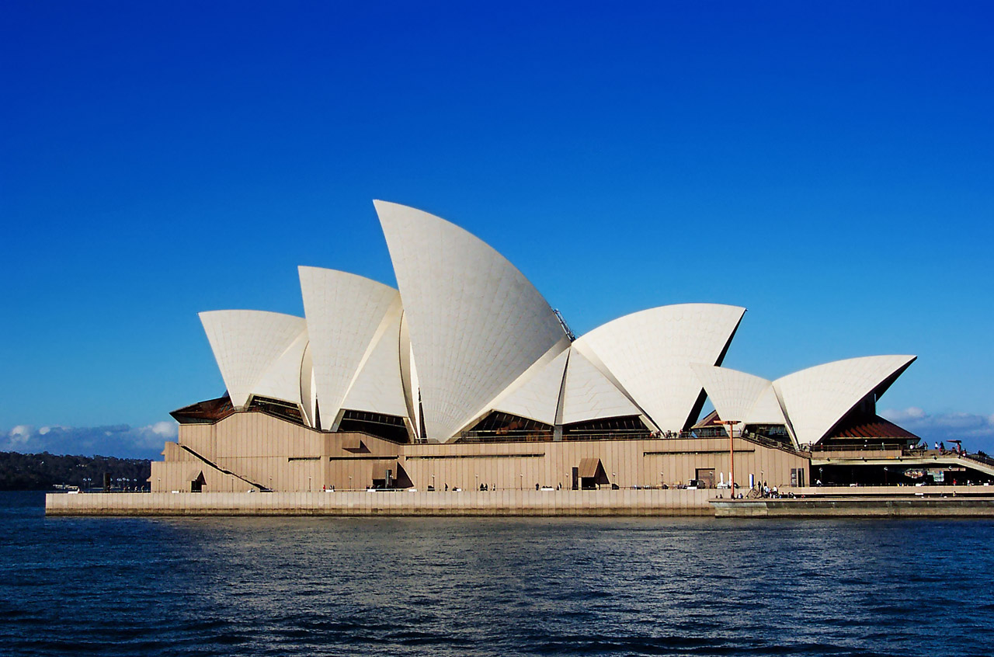
Modern Architecture

Slide 2
The Annotated Arch (pg. 126-129)
1) The most famous architect of the twentieth century is Frank Lloyd Wright. What did he invent?
2) Why did Wright’s mother give her son maple blocks?
3) Describe the Robie house. Include a description of the interior and exterior of this building.
4) Complete this sentence: ___________ became a sculptural element that could be ______________ ____________________________________.
5) How did Prairie houses reflect the prairie?
6) How did Wright create rooms in homes that were room-less?
7) What was Wright’s masterpiece?
8) Why is Fallingwater an example of organic architecture?
9) The Johnson Wax Administration Building is an ideal workspace where __________________. The interior of the Johnson Wax Building is all ___________.
10) What did Wright call the skyscraper?

Slide 3
Answer Key
1) the open plan
2) “So he could learn the basic geometric shapes underlying natural and man-made structures”
3) long /low roof lines, central stone fire place
4) “Space became a sculptural element that could be shaped”
5) low slung roofs, deep eaves, and horizontal massing
6) partitions of furnishings / level changes
7) Fallingwater
8) 1) It’s over the waterfall
9) “space…egalitarian principles; all curves
10) “the tree that escaped the forest”

Slide 4
Modern Architecture
Characteristics:
a rejection of historical styles and ornamentation
materials and functional requirements determine the result
utilitarian design
simplification of form---“form follows function”
elimination of unnecessary detail
https://www.youtube.com/watch?v=PQ6-6zsVstc

Slide 5
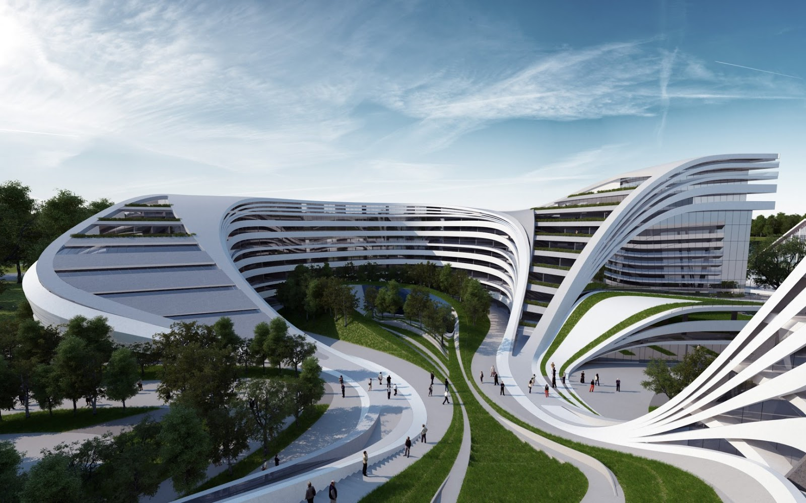
“Modern architecture is the idea of eliminating the containment which is the box, reaching out and amplifying space, dragging things in from the outside.”

Slide 6
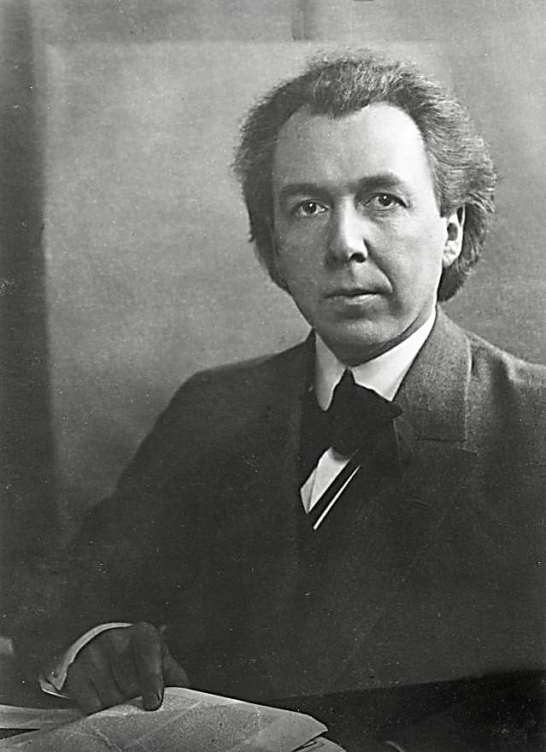
Frank Lloyd Wright
1867–1959 Illinois
architect, interior designer, writer, educator, and philosopher
Designed over 1,000 projects
→ 500 completed works
Objective: To create a distinctive form of American Architecture
Innovations:
→ open floor plans
→ organic structures
→ designed homes to patrons’ needs
https://www.youtube.com/watch?v=FtnSy1t2TuE

Slide 7
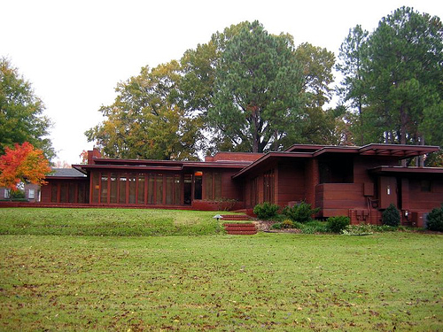
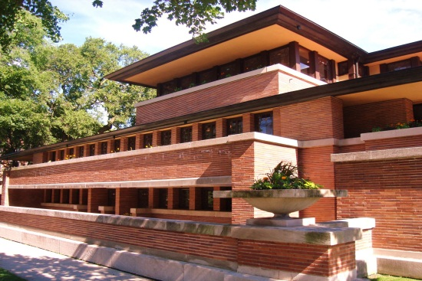
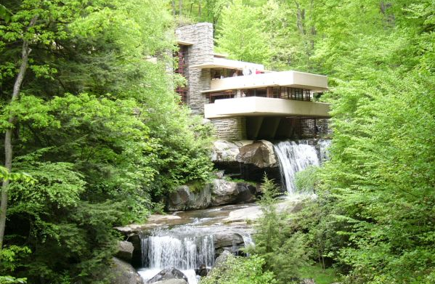
F. L. Wright’s Styles
Usonian
Prairie
Organic

Slide 8
1) Usonian Style
small, single-story dwellings offered as a low-cost home for middle income families
no garage, attics or basements
L-shaped to fit odd/cheap lots
native materials
environmentally conscious
flat roofs
cantilevered overhangs for natural heating, cooling & lighting
→ Examples: Rosenbaum House

Slide 9
Rosenbaum House
1938 Florence, Alabama
Usonian style, single-family house
built for newlyweds Stanley & Mildred Rosenbaum
built on a two acre plot in an L-shape
natural materials: cypress wood, brick, and glass
multilevel low-rising steel-cantilevered roofs
center of the house is the "service core”
rooms have their own door to the outside

Slide 10
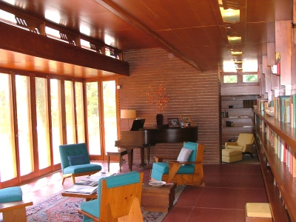
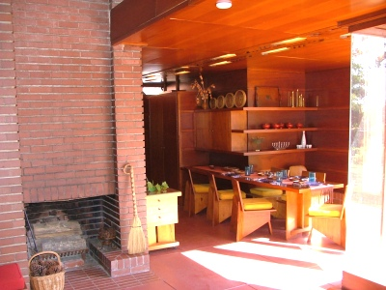

Slide 11
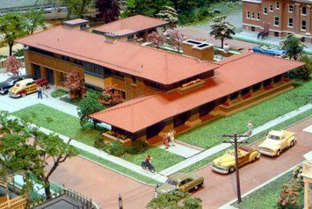
2) Prairie Style
flat or hipped roofs with broad overhanging eaves
windows -- horizontal bands
integration with the landscape
solid construction
Ornamentation through repetition
horizontal lines related to the native prairie landscape
→ Examples: Robie House Martin House
Notes:
Show Japanese sand/volcanic lake sculpture here – discuss matching buildings, bushes, to landscape shapes.

Slide 12
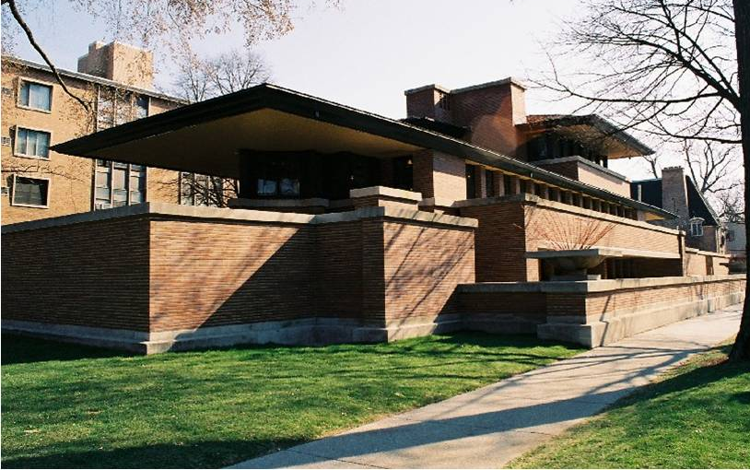
Robie House
1908-1909 Chicago, Illinois
built for Frederick C. Robie
low-proportioned, horizontal profile which gives it the appearance of spreading out on the flat prairie
A chimney mass containing four fireplaces rises through the center of the house acting as the anchor to which the house is designed
framing creates interior spaces that are absent of posts & walls
open flowing interiors symbolizes the openness of the American prairie
https://www.youtube.com/watch?v=gmjw_c_T-EM

Slide 13
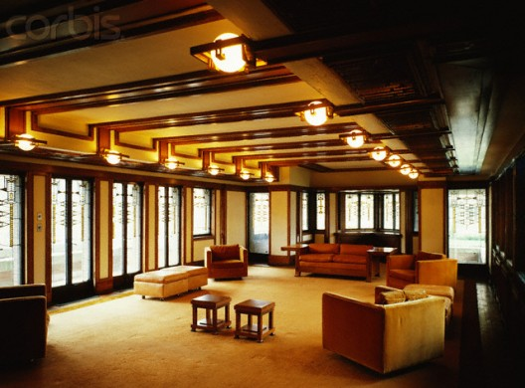
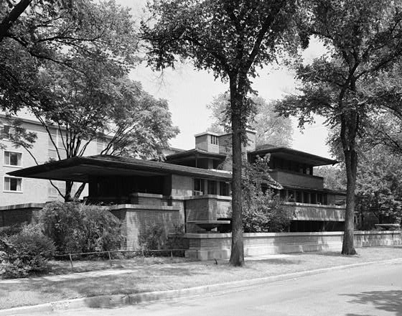
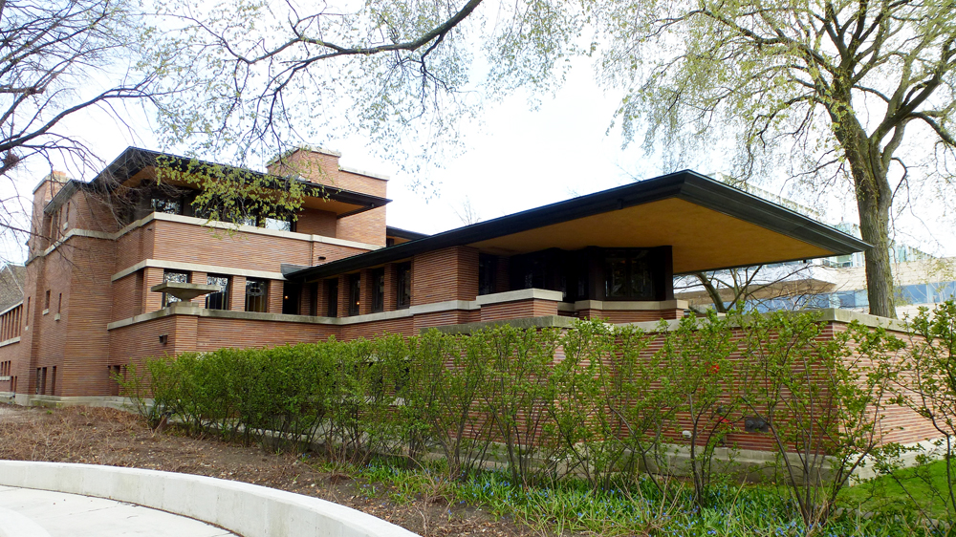

Slide 14
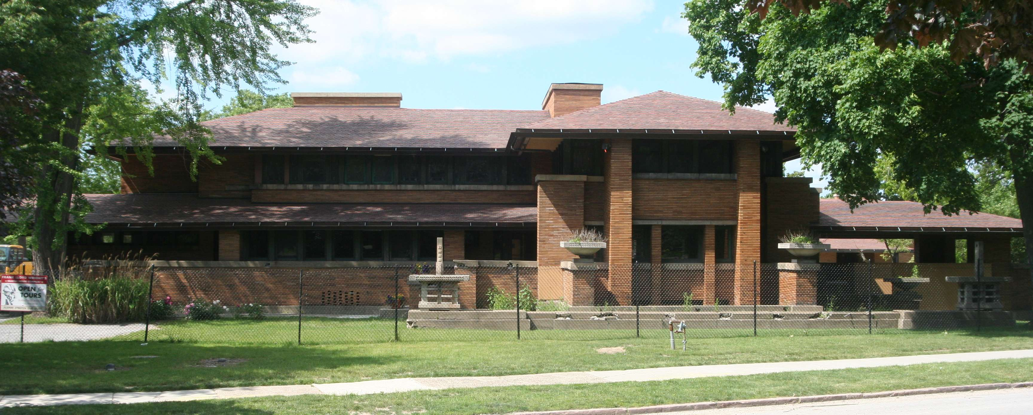
Martin House
1904 Buffalo, NY
Designed for Buffalo businessman Darwin D. Martin
Open Plan—no central axis (not walled-in, and the entrance is disguised); nature (lots of glass used to bring light in)
consists of six interconnected buildings designed as a unified composition, including; the main Martin House and a pergola that connects it to a conservatory and carriage house with chauffeur’s quarters and stables, the Barton House, a smaller residence for Martin’s sister and brother-in-law, and a gardener’s cottage added in 1909
The complex contains 394 examples of Frank Lloyd Wright-designed art glass, including the famed “Tree of Life” window.
https://www.youtube.com/watch?v=xUufAdNNOiU

Slide 15
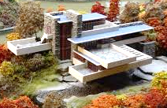
3) Organic Style
Constructing with limited man-made materials
Use of natural surroundings (water, stone, trees)
→ Examples: Falling Water House
Guggenheim Museum
Notes:
Show Japanese sand/volcanic lake sculpture here – discuss matching buildings, bushes, to landscape shapes.

Slide 16
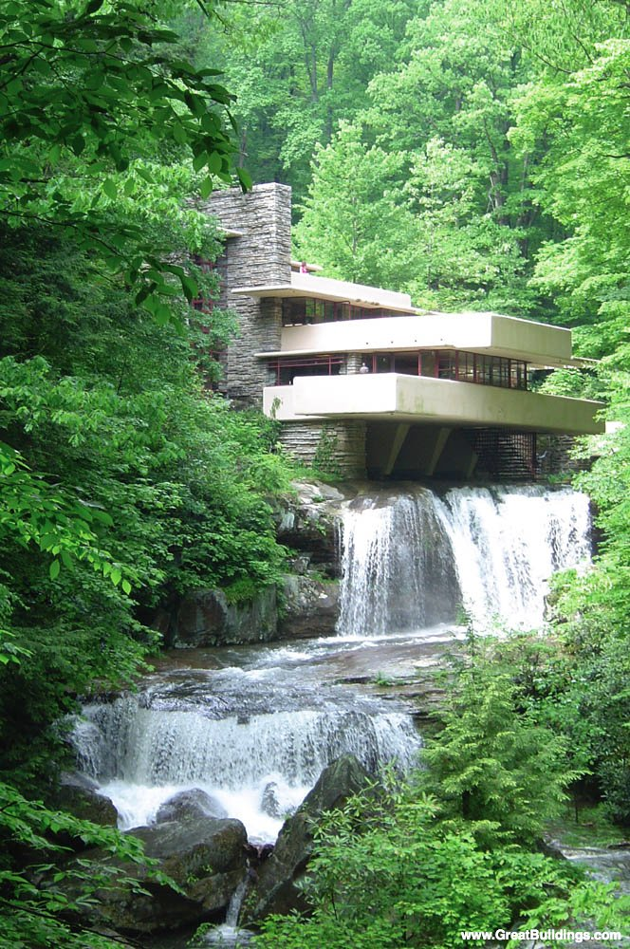
Falling Water House
1935 Pittsburgh, Pennsylvania
there is no metal frame; rather, the glass is caulked directly to the stone
built partly over a waterfall; it can be heard constantly throughout the house
composed of boulders found on site; they also protrude through the living room floor
Small bedrooms small, low ceilings, encourage people, few closets
http://www.youtube.com/watch?v=pSbjVgpXDoA

Slide 17
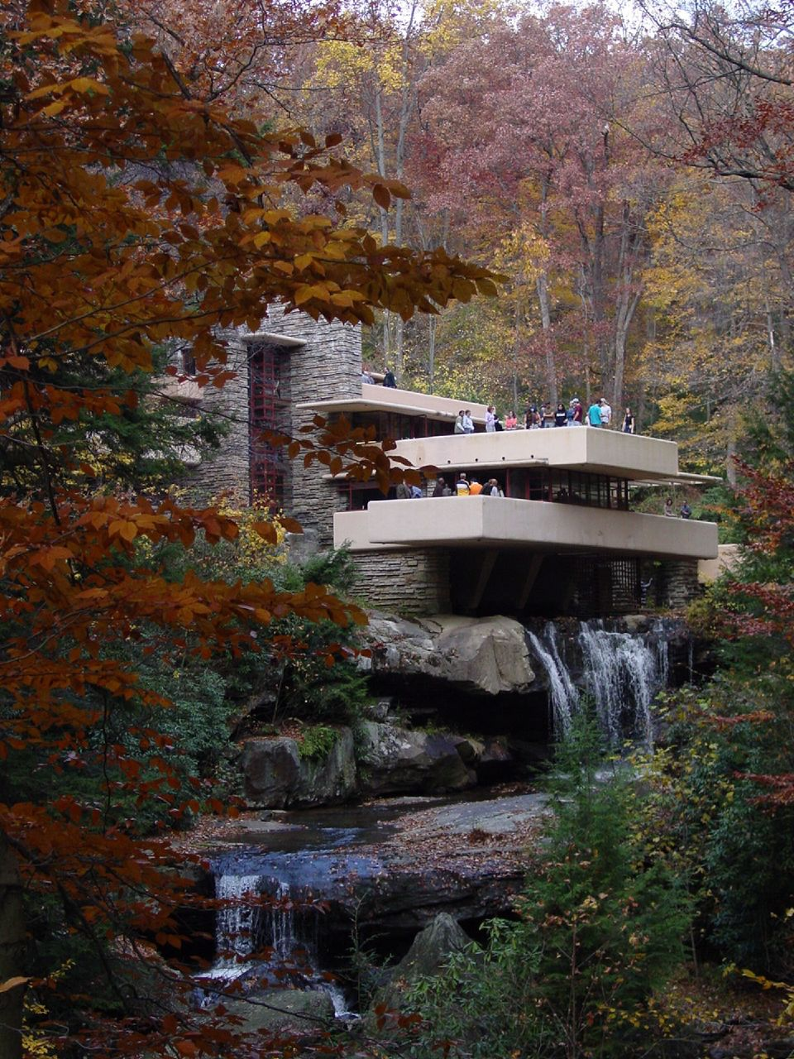
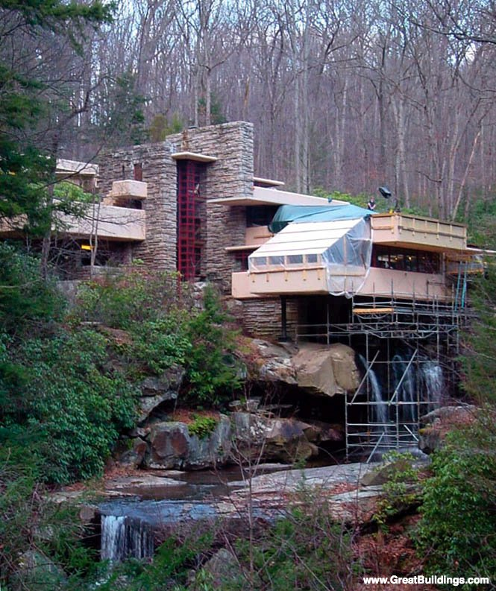

Slide 18
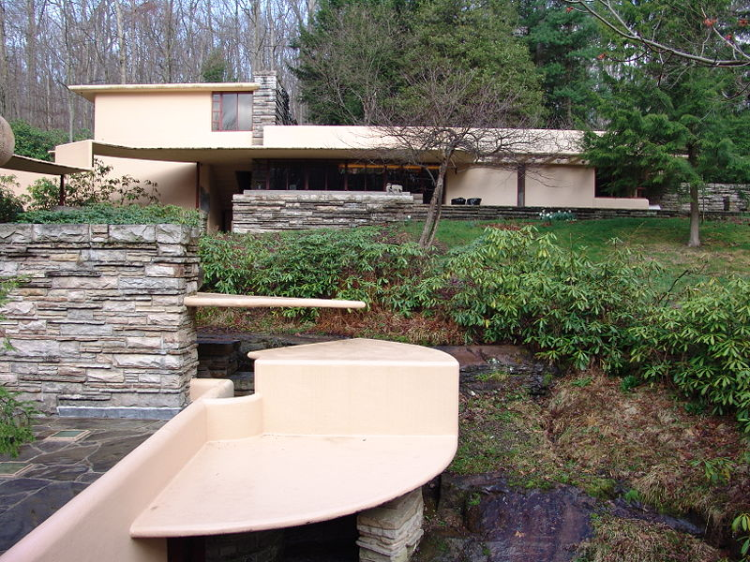
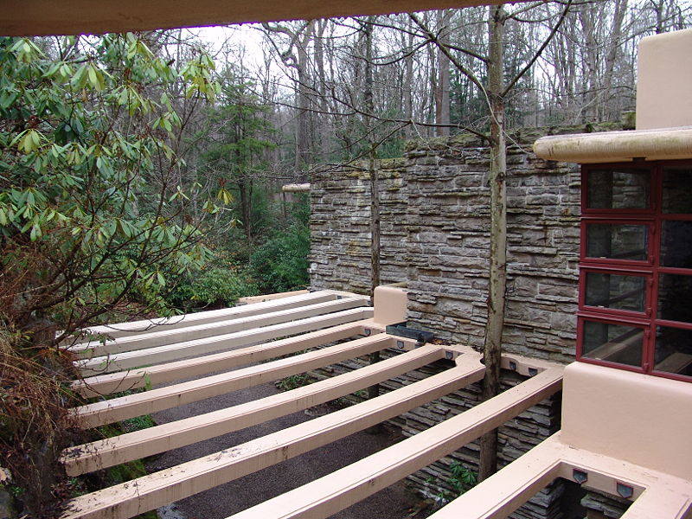
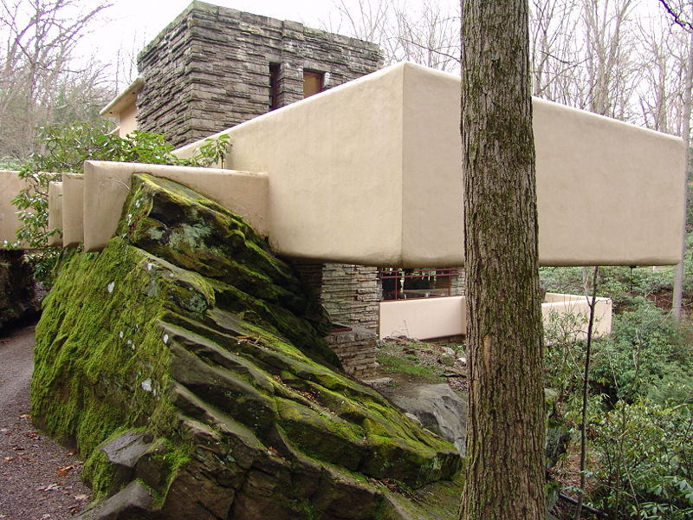
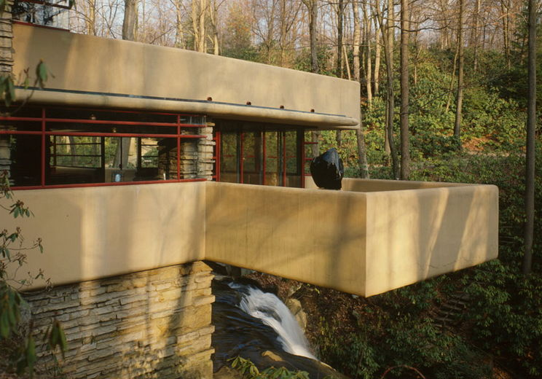

Slide 19
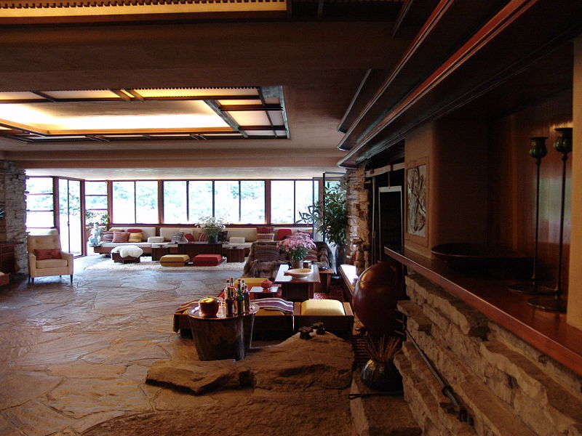
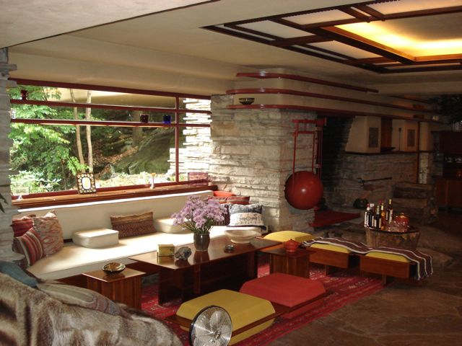
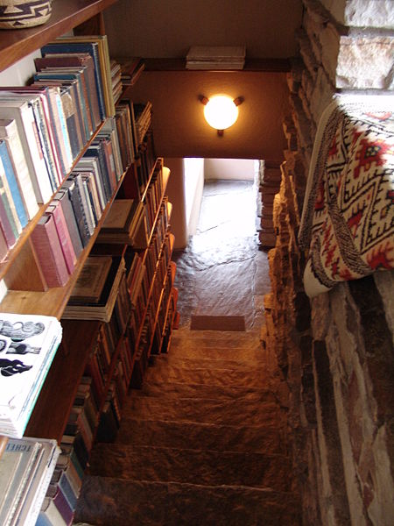

Slide 20
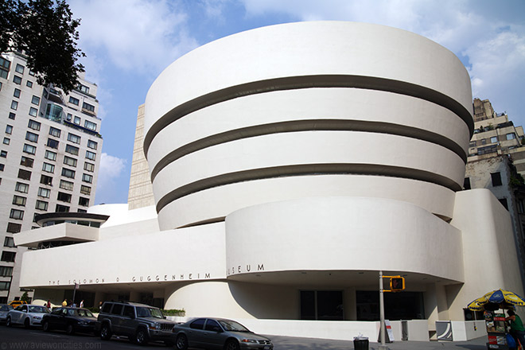
Guggenheim Museum

Slide 21
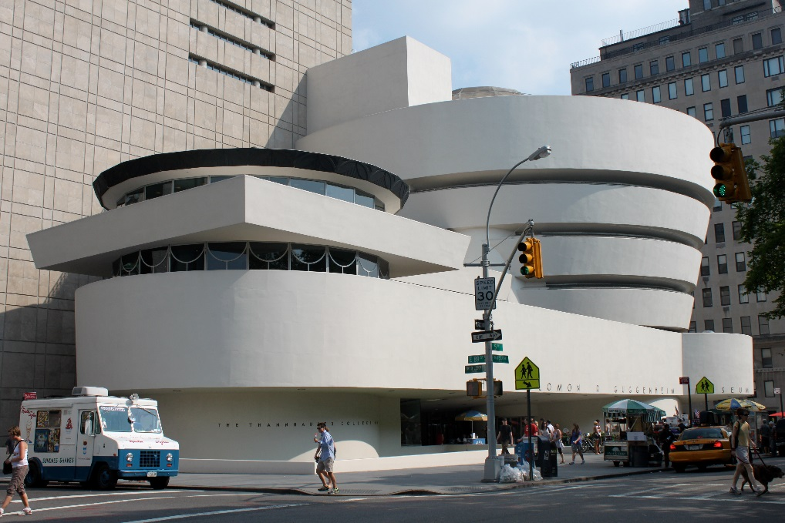
Guggenheim Museum
19?? New York
built for
Nature not only provided the museum with a respite from New York’s distractions but also leant it inspiration. The Guggenheim Museum is an embodiment of Wright’s attempts to render the inherent plasticity of organic forms in architecture. His inverted ziggurat (a stepped or winding pyramid of Mesopotamian origin) dispensed with the conventional approach to museum design, which led visitors through a series of interconnected rooms and forced them to retrace their steps when exiting. Instead, Wright whisked people to the top of the building via elevator, and led them downward at a leisurely pace on the gentle slope of a continuous ramp. The galleries were divided like the membranes in citrus fruit, with self-contained yet interdependent sections. The open rotunda afforded viewers the unique possibility of seeing several bays of work on different levels simultaneously. The spiral design recalled a nautilus shell, with continuous spaces flowing freely one into another.
Some people, especially artists, criticized Wright for creating a museum environment that might overpower the art inside. “On the contrary,” he wrote, “it was to make the building and the painting an uninterrupted, beautiful symphony such as never existed in the World of Art before.” In conquering the static regularity of geometric design and combining it with the plasticity of nature, Wright produced a vibrant building whose architecture is as refreshing now as it was more than half a century ago.
—Matthew Drutt
https://www.youtube.com/watch?v=JVm-ePTIKR4

Slide 22
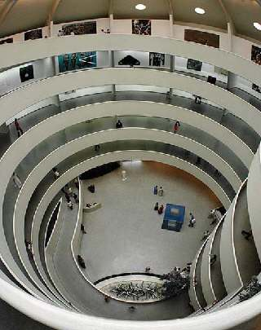
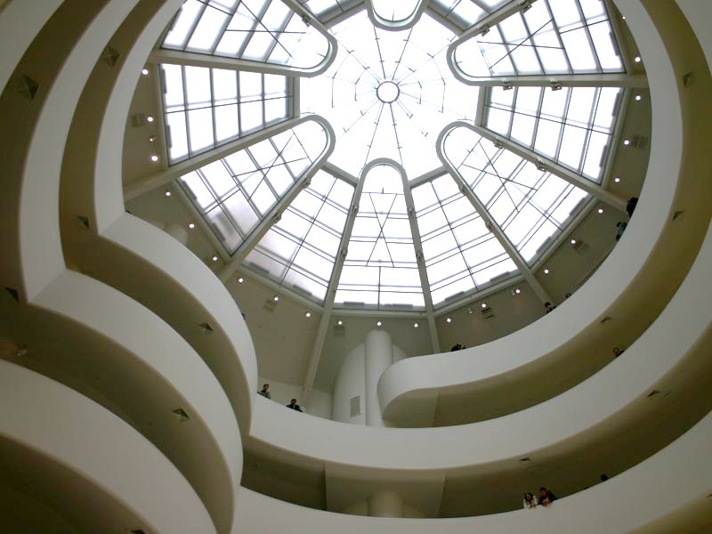
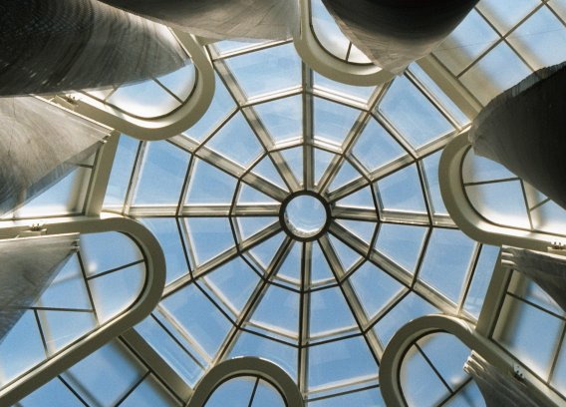
http://www.youtube.com/watch?v=icErgB_ZmFM

Slide 23
