Slide 1
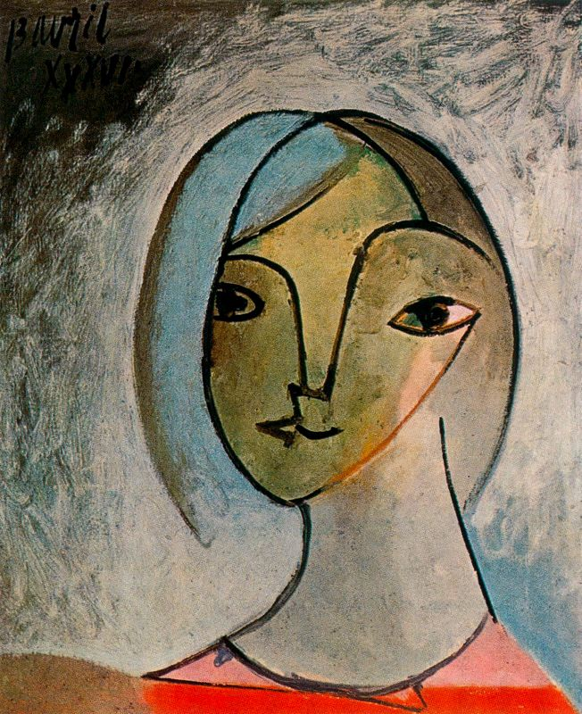
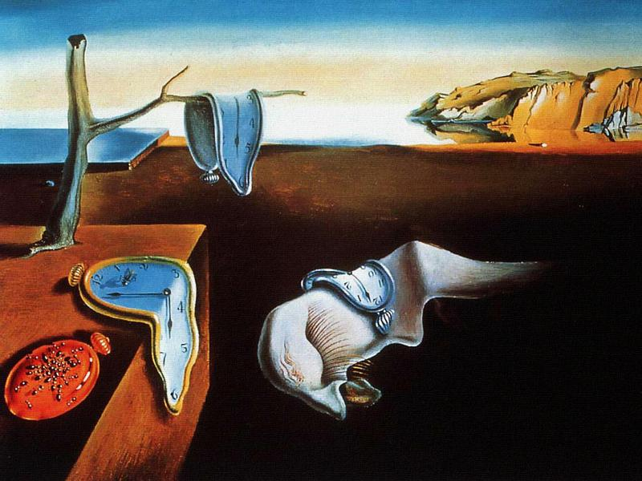
~ Modern Art ~
Picasso & Dali

Slide 2
Major events of the Modern period:
Objective: to understand the dramatic changes in the world from 1900 to 2000
Assignment:
  While watching the following video, you are to write down an event that can be applied to the following categories:
    1) War
    2) The Women’s Rights Movement
    3) The Civil Rights Movement
    4) Commercialism
    5) Technological Advances
    6) Globalization
  You must include the event/object name and date
http://www.youtube.com/watch?v=E8lrRvuwczk

Slide 3
What is the main idea of Modern Art?
The three main characteristics are:
  Breaks with or redefines the conventions of the past.
  Uses experimental techniques.
  Shows the diversity of society and the blending of cultures.

Slide 4
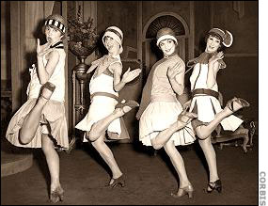
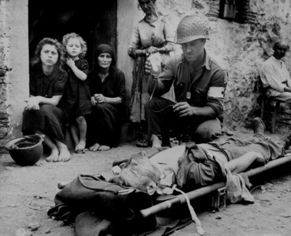
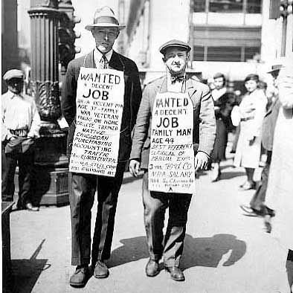
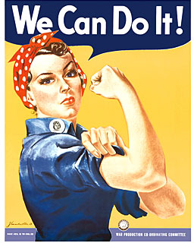

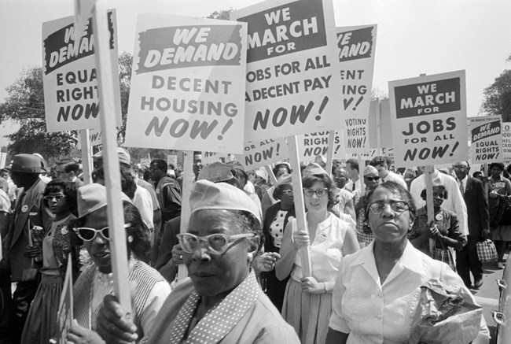

Slide 5
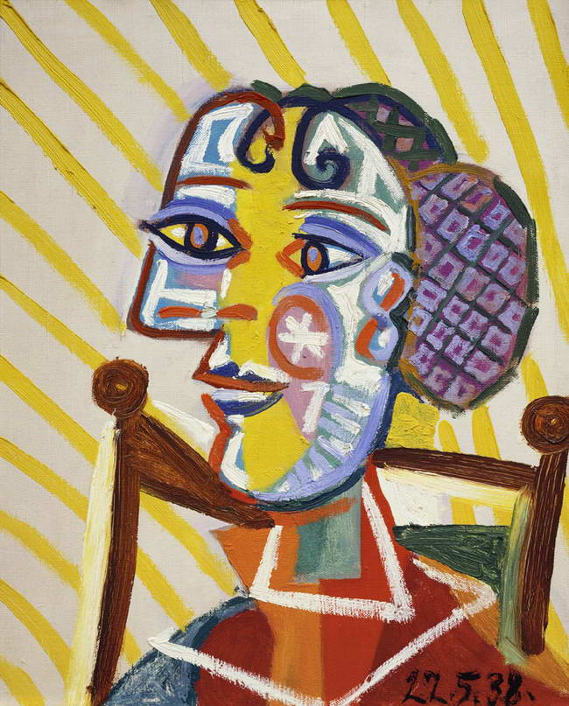
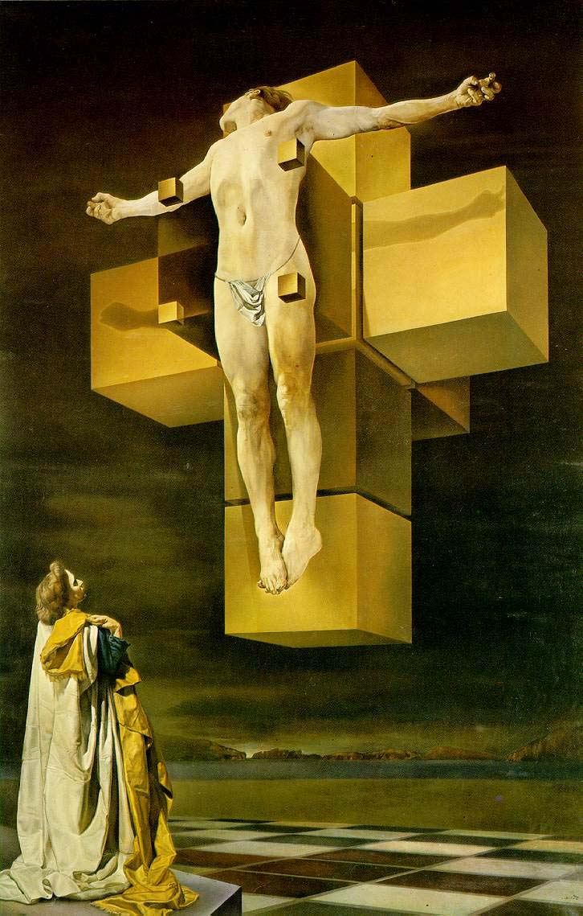
The effect on modern art?
Instead of creating artwork that was pretty, modern artists began to create artwork that attempted to change society and express emotion.
Picasso
Dali

Slide 6
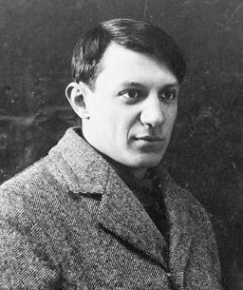
Pablo Picasso
1881-1973 Spain
Son of an art and drawing teacher, Picasso was an art student practically from birth; he lived, worked, and studied in Paris.
22,000 works in various mediums: sculpture, ceramics, mosaics, stage design, and graphic arts.

Slide 7
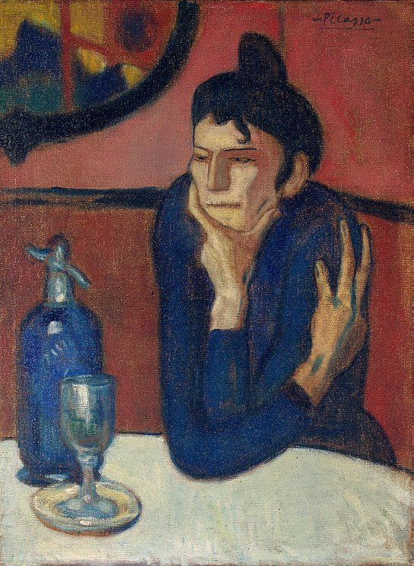
Parisian Influence
While in Paris, Picasso became friends with a group of young, avant-garde artists, collectively know as Modernists - known for their interest in symbolism in art and social causes (including the urban underprivileged).
Picasso would chose to paint the poor or disenfranchise: the prostitutes, the beggars, street musicians, etc. He felt that these individuals understood him and his pain.
Absinthe Drinker,
1901

Slide 8
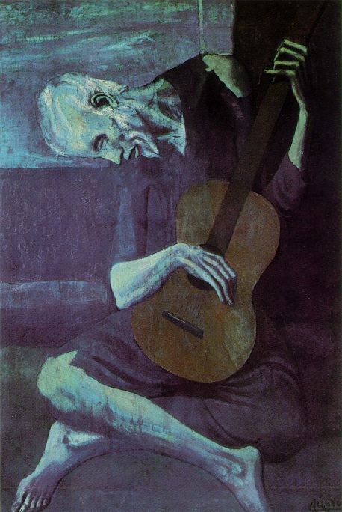
The Blue Period
Characteristics:
  All works are in monochromatic blue
  Represented melancholy and despair
Examples of Influence in Work:
  It is completely done in blues
  Sadness is shown by the man’s face
The Old Guitarist, 1903

Slide 9
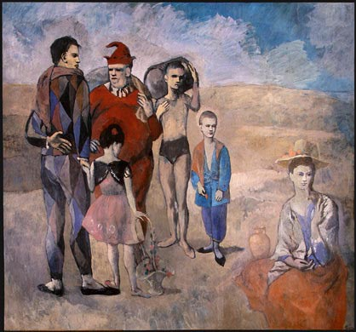
The Rose Period
Characteristics:
  Works were completed in different shades of red
Examples of Influence in work:
  The paintings have a faint red tint
  During this period, Picasso’s subjects were mainly circus and fair performers (mainly a migrant community of acrobats, musicians, and clowns- saltimbanques).
  These subjects were usually shown in relaxed, happy settings.
Family of Saltimbanques, 1905

Slide 10
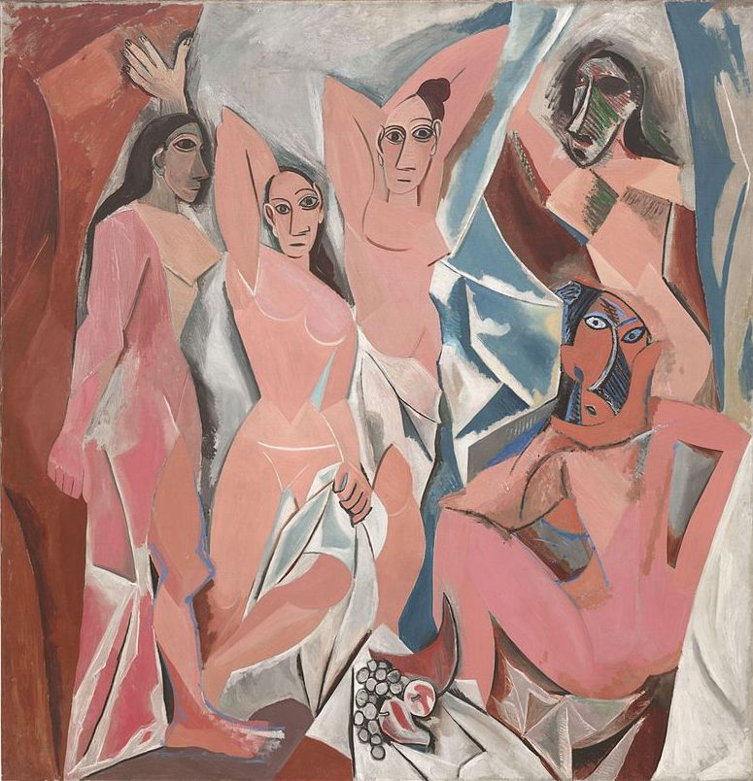
The African Influence
Characteristics:
  African masks allowed Picasso to learn how to show one subject from multiple perspectives.
Examples of influence in work:
  Three women have on African masks
Les Demoiselles d'Avignon, 1907
https://www.youtube.com/watch?v=XyLNPumMMTs

Slide 11
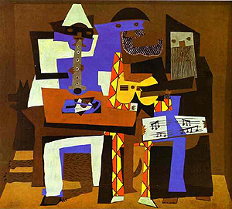
The Cubism Period
Characteristics:
  Cubism- natural forms were reduced to fractured, geometric structures, or “little cubes.”
Examples of Influence in Work:
  All subject matter is made by arranging shapes (looks like ZZ Top)
Became the first movement toward abstract art.
Three Musicians, 1921
https://www.youtube.com/watch?v=DSZMlfm1Ln0&index=12&list=PLXVuKomahjzdNOrden8thb8HWbvJZK71w

Slide 12
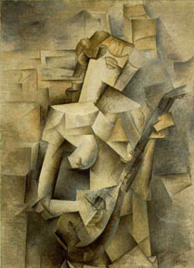
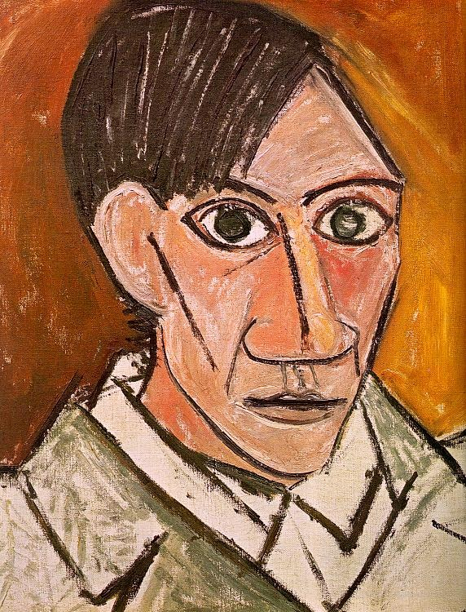
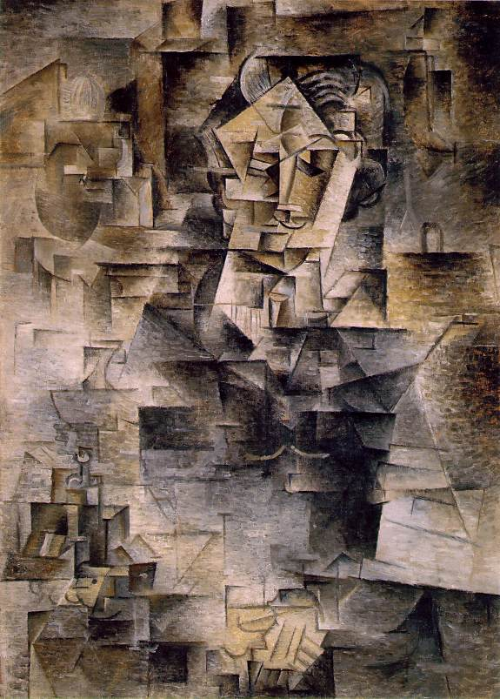
Best known for: Looking cross-eyed through a kaleidoscope, suggesting their feelings through neutral color and geometric forms
Two phases of Cubism:
  Analytic: artists tried to depict an object from many different angles at once
  Synthetic: builds a picture from a combination of abstract signs and visual elements

Slide 13
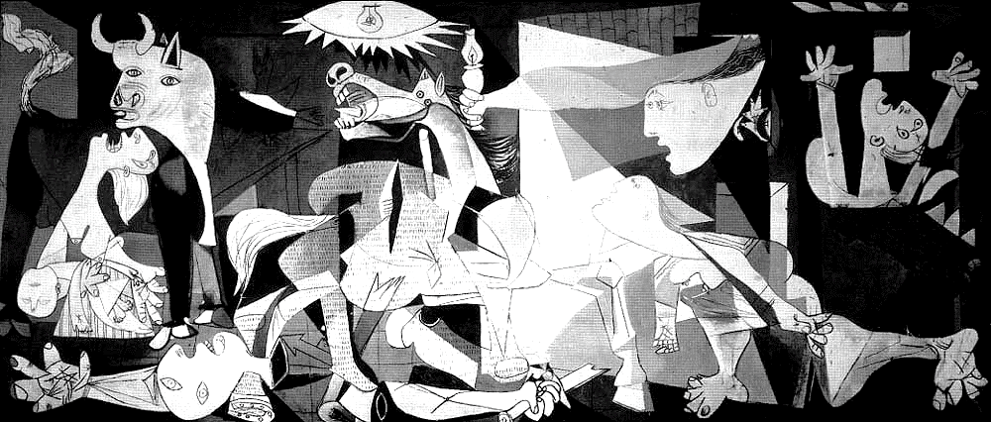
Guernica (1937)
It is regarded as Modern art’s most powerful anti-war statement.
Commissioned by the Spanish Republican government for the Spanish pavilion at the 1937 World’s Fair in Paris.

Slide 14
Guernica (1937)
Commemorates the Nazi bombing of Gernika, Spain on April 27, 1937 during the Spanish Civil War. Gernika burned for three days due to the brutal Nazi attack; this small village was not a logical choice for bombing-why?
Sixteen hundred civilians are killed or wounded.

Slide 15
Symbolism in Guernica
The soldier’s left hand:
  There is a “stigmata” present---the spot on Jesus’ hand where he was nailed to the cross. This doesn’t mean that the solder was a martyr; it means that he died for Spain, but there was no glory in it. It is also a reference to Goya’s “Third of May, 1808.”

Slide 16
The woman and child on the left:
  Represents the innocent civilians who were ruthlessly murdered at Gernika.

Slide 17
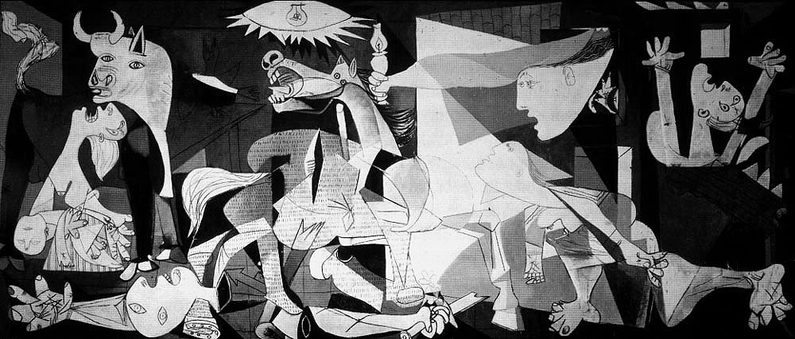
The Minotaur:
  Is a half man, half bull figure from Greek mythology. He hunted people in the labyrinth and killed them. Here, it represents the Nazis. After all, it is the Minotaur who creates all of the destruction.

Slide 18
The Soldier’s Face:
  The soldier died in pain. He is not a glorified soldier of the state. War is terrible and painful; you can see it in his face. He symbolizes the brutality of war.

Slide 19
The cut in the horse’s side:
  It is a very deep cut that will kill the horse. It shows that nothing good can come from war; war destroys society.

Slide 20
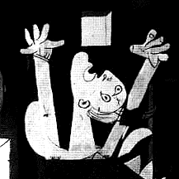
The screaming person on the right:
  Represents the brutality of the killings. It is important to note that this figure is a woman because women did not.

Slide 21
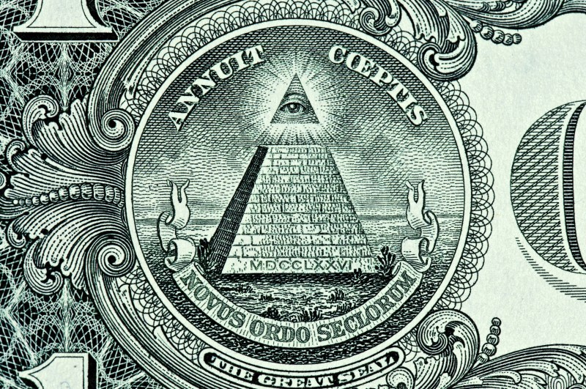
The light hanging from the ceiling:
  Also known as the evil eye. It represents torture and the propaganda that people follow during war time. Figures in the painting are reaching towards it; however, it is the false light to follow.

Slide 22
The light in the person’s hand:
  The light that people should follow: it will lead them out of war (think of the symbolism in the Statue of Liberty- her torch light should bring all people to America).
https://www.youtube.com/watch?v=jUpcyM-EK7Y
http://www.youtube.com/watch?v=jc1Nfx4c5LQ

Slide 23
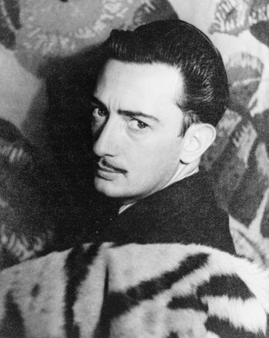
Salvador Dalí
1904 – 1989 Spain
skilled draftsman
known for bizarre and beautiful images of surrealistic work
painted from his dreams
He grew up in a lake district in northern Spain in a village of fishermen.
Famous Work:
The Persistence of Memory

Slide 24
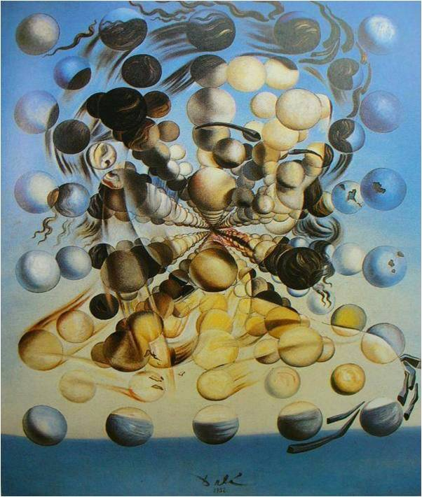
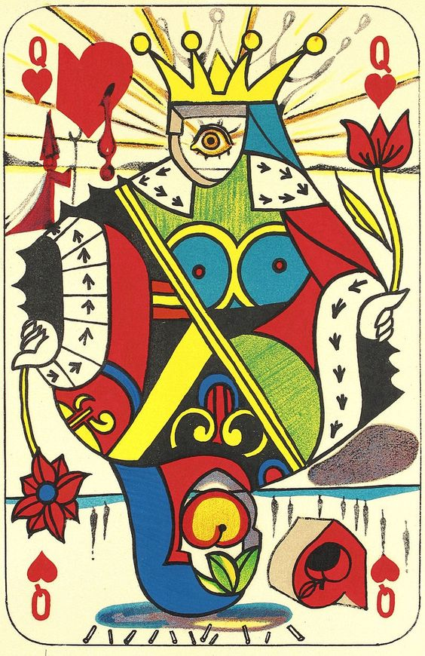
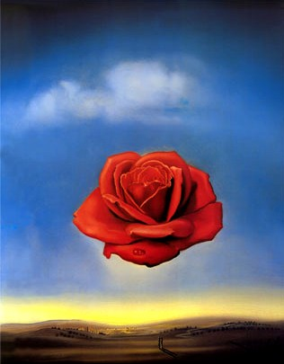
Surrealism
A dream-like portrayal of an irrational arrangement of forms found in the subconscious mind. In true surrealist style, ordinary things are placed in mysterious relationships to each other.
https://www.youtube.com/watch?v=UI0U0lQRbug

Slide 25
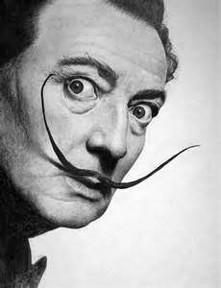
“The fact that I myself, at the moment of painting, do not understand my own pictures, does not mean that these pictures have no meaning; on the contrary, their meaning is so profound, complex, coherent, and involuntary that it escapes the most simple analysis of logical intuition.”
VIDEO: Dalí – The Basics
While watching the following video, answer the questions found in your Guided Notes.

Slide 26
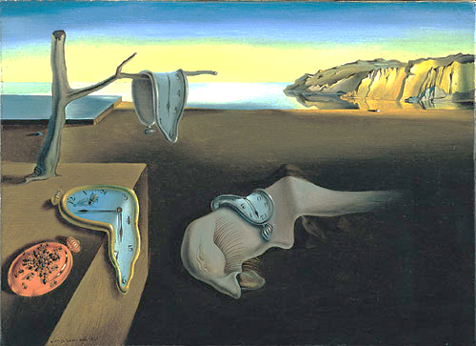
The Persistence of Memory

Slide 27
The Persistence of Memory
In the image we see his childhood remembrances of the lake district with a warm glow of light over the water.
The tree in the foreground is dead—ants and flies on the clocks signify decay.
https://www.youtube.com/watch?v=6mp-fBJNQmU&app=desktop

Slide 28
The painting is about the remembrance of childhood—when Dalí was free—with no stress or worries. Now as an adult, the “pangs” of time and adulthood remind him of age, stress and death (hence the clocks).
A person’s persistent memory is one of the happier times in life, but it gets further and further away from us.

Slide 29
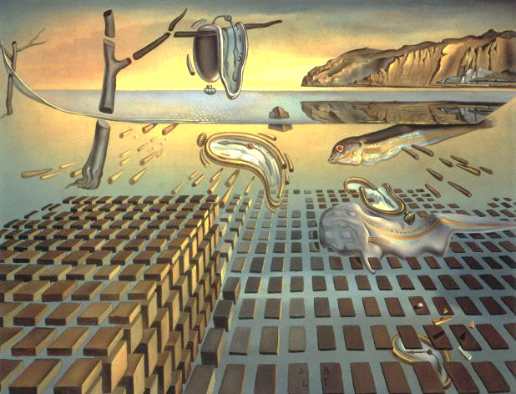
Disintegration of Persistence of Memory

Slide 30
Disintegration of Persistence of Memory
World War II- experimentation with nuclear painting
These paintings sought to unify or forge connections between the object and images that would have been deliberately juxtaposed in his Surrealist works.
The original painting is pulled back to reveal an underlying structure that gives shape, definition, and direction to the once formless watches and eerie landscape

Slide 31
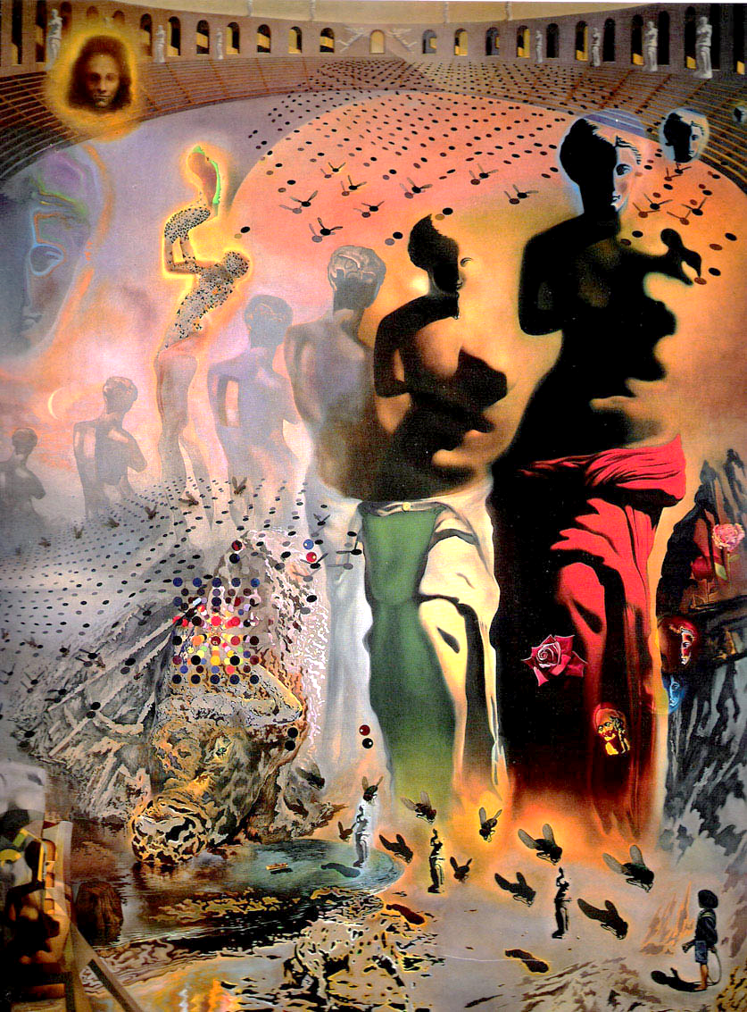
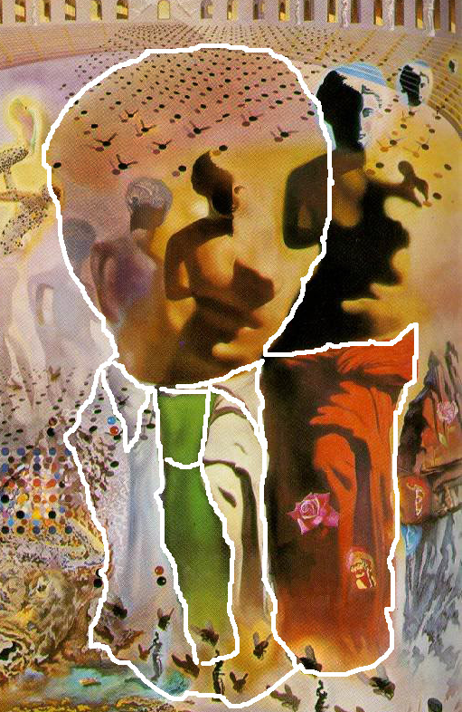
The Hallucinogenic Toreador, 1969

Slide 32
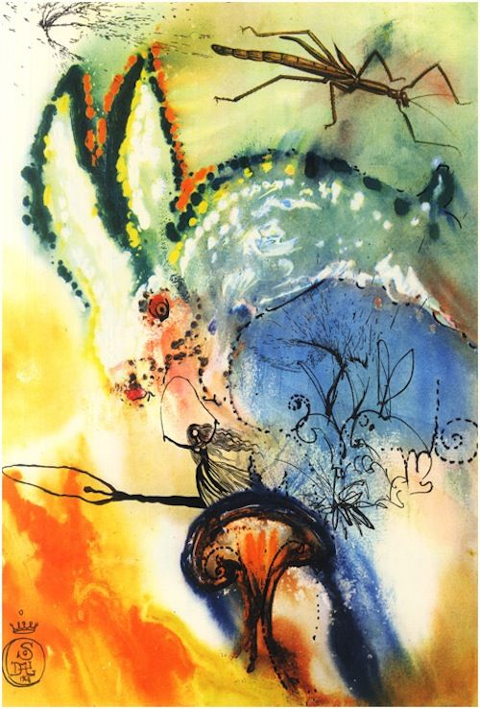
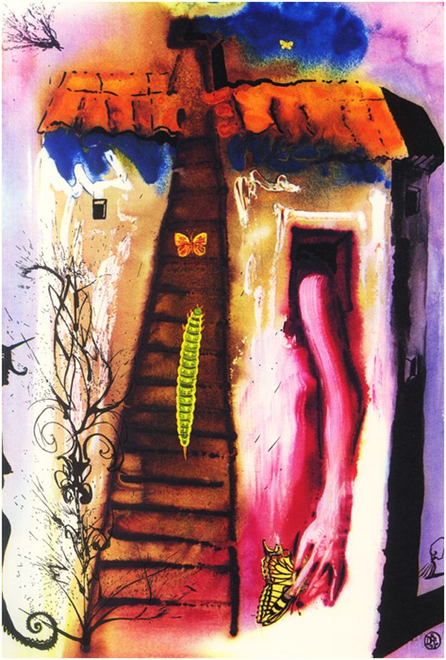
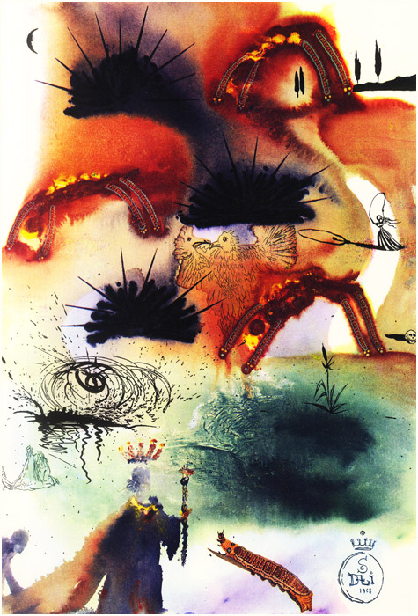
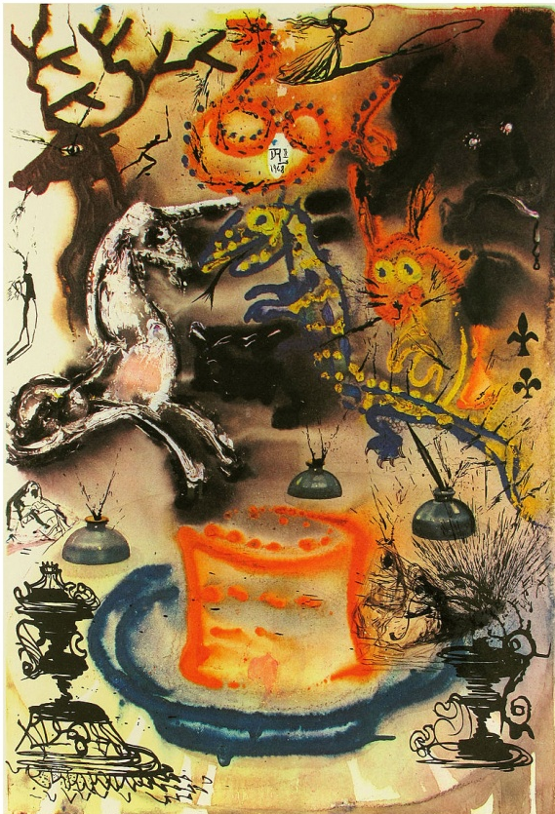
Alice in Wonderland, 1969

Slide 33
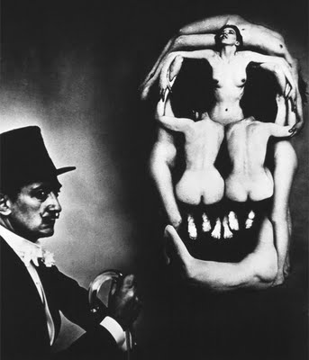
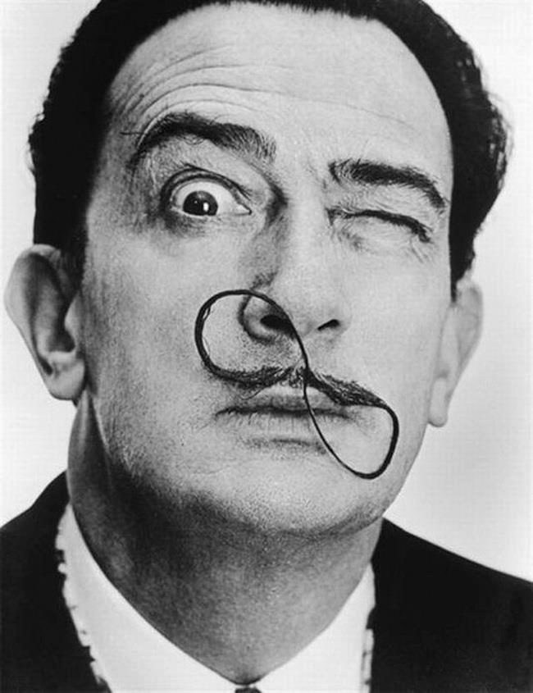
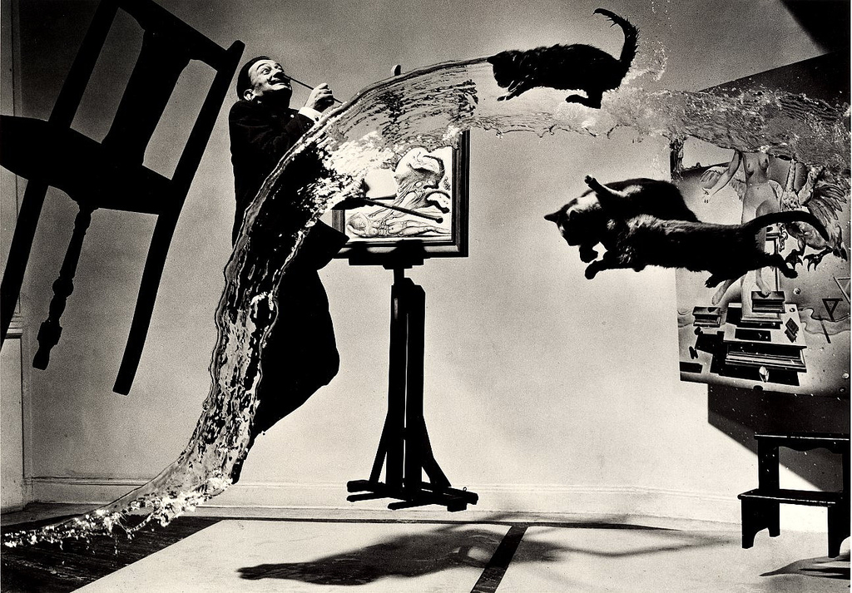
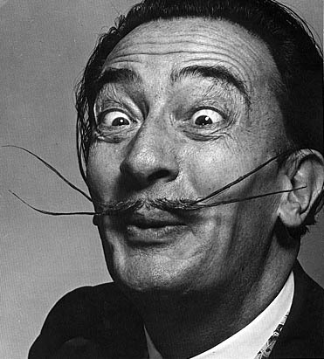

Slide 34
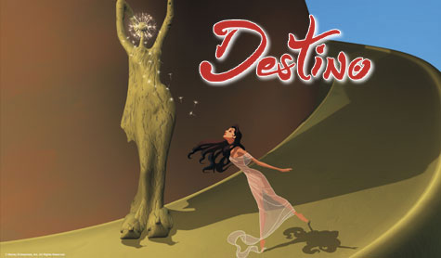
Destino, 2003 (Disney & Dalí)
Animated short film released in 2003 by Walt Disney; its production originally began in 1945. The project was originally a collaboration between Walt Disney and surrealist painter Salvador Dalí.
https://en.wikipedia.org/wiki/Destino
https://www.youtube.com/watch?v=aXa8s9R7-24

Slide 35
DRAWING ACTIVITY: cubism/surrealism
1. Using a pencil, draw an organic or geometric shape, filling three fourths of the page.
2. Understanding that Picasso drew from multiple vantage points, draw a profile down the center of the shape noting brow line, nose, lips, chin.
3. To ensure the drawing resembles the style of a cubist, add details and different views of specific parts of the face. (i.e. possibly draw a profile of the eye on one portion of the face, and a straight on view on the other.)
4. Tie the portrait together: go over the pencil lines with a black marker using only smooth, solid continuous lines.
5. Complete by shading in each area with colored pencils and erase any pencil lines that might be showing.

Slide 36
