Slide 1
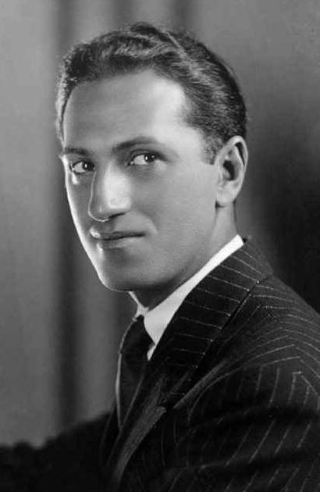
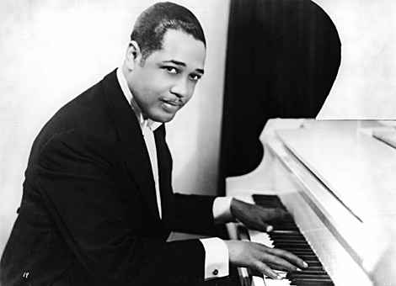
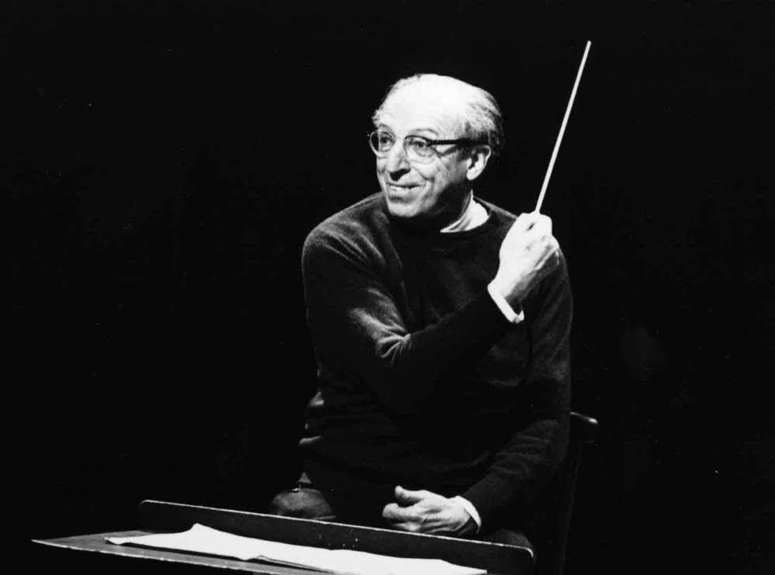
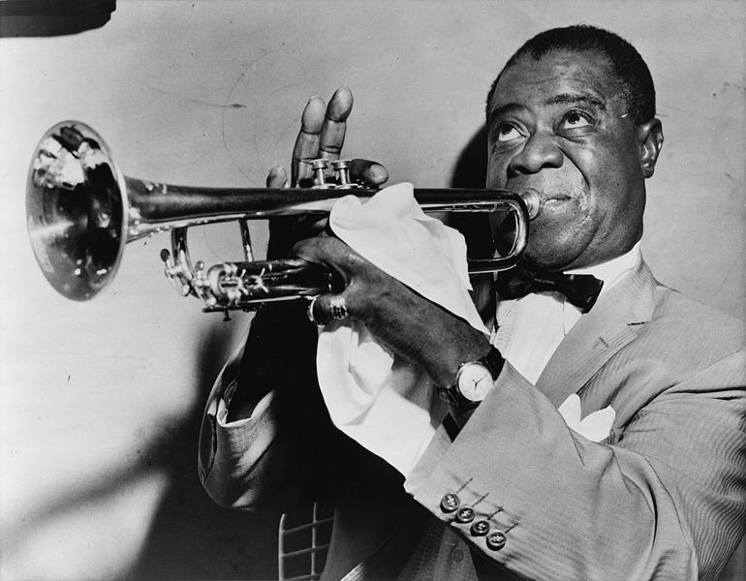
Modern Music

Slide 2
The Early 20th Century
Radio gave greater exposure; no longer limited to concerts and clubs.
New media/technologies were developed to record and distribute music.
Exposure to a wider range of music - concept of World Music developed.
New freedom/experimentation with musical styles/forms
Transportation innovations allowed musicians and fans to travel further/quicker

Slide 3
The Modern Evolution
George Gershwin combined classical and jazz styles
Increased use of dissonance for more educated audience; had to be trained in music to understand/enjoy.
Aaron Copland collected and used folk themes and simplified music to met demands of the public.

Slide 4
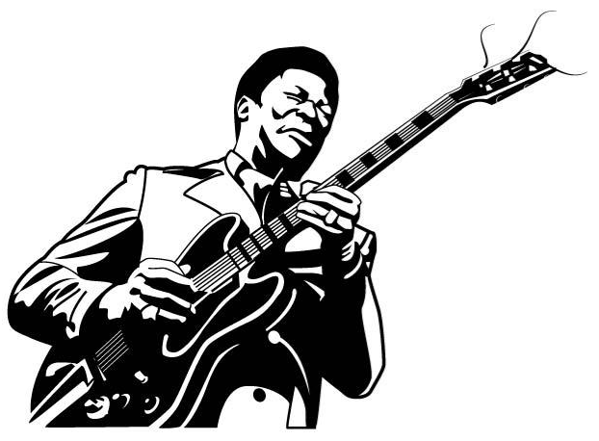
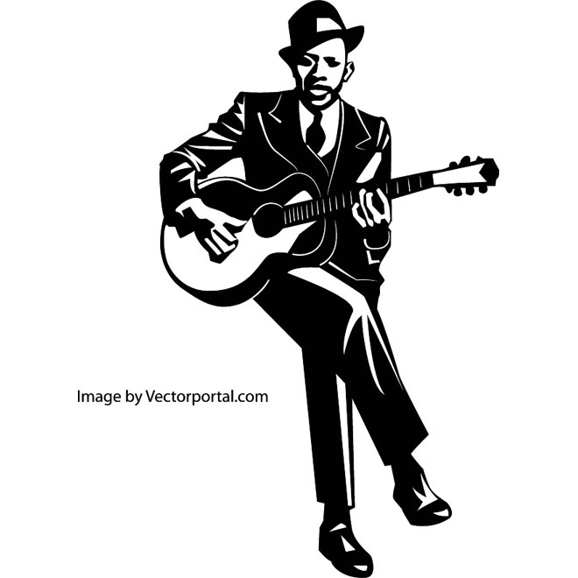
BLUES

Slide 5
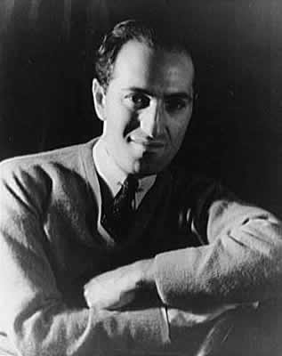
George Gershwin
1898-1937 New York
dropped out of school and began playing piano professionally at 15.
composed jazz, operas and popular songs in collaboration with his brother, Ira.
Gershwin died immediately following brain surgery on July 11, 1937, at age 38.

Slide 6
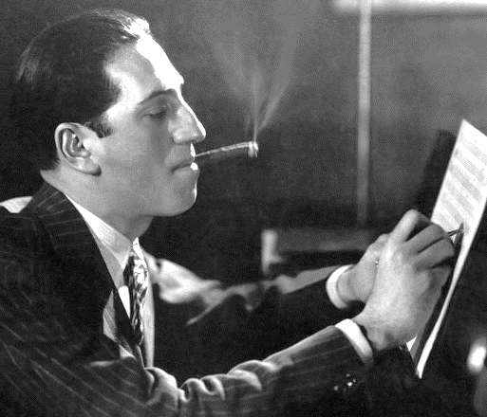
George Gershwin
The Standards:
“Someone to Watch over Me”
“Let’s Call the Whole Thing Off”
“They Can’t Take That Away from Me”
Composed in 1928, An American Paris inspired a 1951 Oscar-winning movie musical.
In 1935, Gershwin debuted Porgy & Bess calling it a “folk opera,” it is considered one of the most important 20th century musicals.

Slide 7
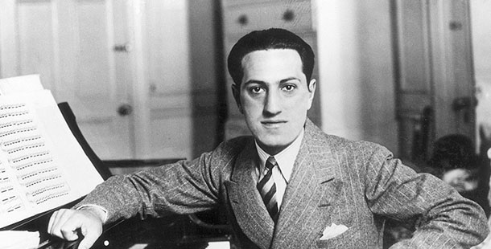
Listening Examples
  “Rhapsody in Blue”
    Can you tell what music genre influenced the development of this piece?
  “Summertime” (from Porgy & Bess)
    lives of poor blacks South Carolina
    longest work; an opera

Slide 8
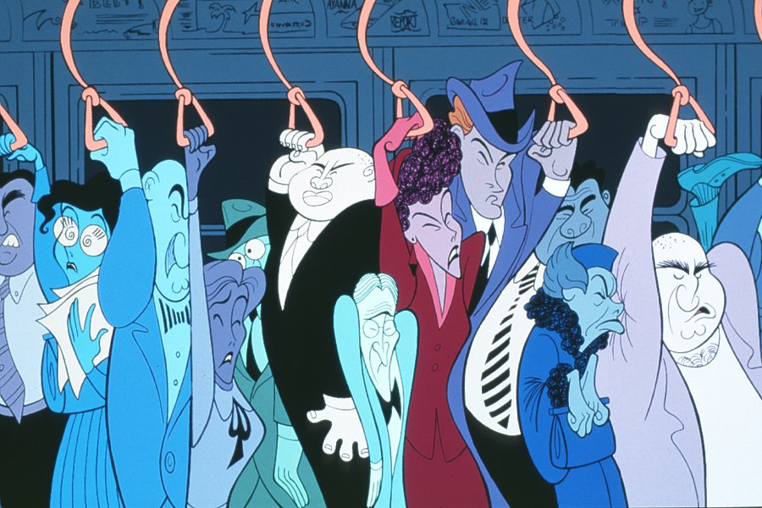
When/How does art and music merge?
Watch a portion of “Rhapsody in Blue” (Fantasia 2000), then discuss the answer to the question above.

Slide 9
JAZZ

Slide 10
Jazz Overview
An original American art form
Essential Forms:
  Blue notes: is a note sung or played at a slightly lower pitch than that of the major scale for expressive purposes
  Syncopation
  Improvisation
  Poly-rhythms: simultaneous sounding of two or more independent rhythms – originated in African drum circles
  Swung Notes: performances practice, in which some notes with equal time values are performed with unequal durations, alternating long and short.
African and European Influences

Slide 11
Jazz Music Influences
How have these five factors contributed to the development and evolution of jazz?
  1. AFRICA
    - culture, music and rhythms, collective function, individual expression
  2. EUROPE
    - instruments, musical forms
  3. NEW ORLEANS
    - a melting pot of cultures
  4. DEMOCRACY
    - each musician develops a unique, individual voice to contribute to the greater effort.

Slide 12
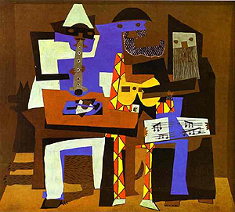
Jazz Styles
Ragtime
Classic Jazz
Hot Jazz
Chicago Style
Swing
Kansas City Style
Gypsy Jazz
Bebop
Vocalese
Mainstream
Cool
http://www.apassion4jazz.net/jazz_styles.html

Slide 13
“If you have to ask what jazz is, you’ll never know.”

Slide 14
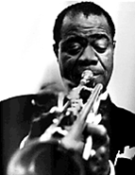
Louis Armstrong
1901-1971 New Orleans
jazz trumpeter/singer
grandson of slaves
born into a very poor family
shifted focus from collective improvisation to solo improvisation
influenced by Creole music

Slide 15
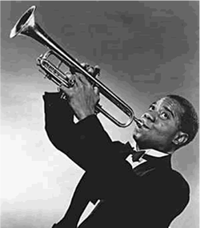
Listening Examples
Listening Example:
  “When the Saints Go Marching”
Viewing Example:
“Dinah”

Slide 16
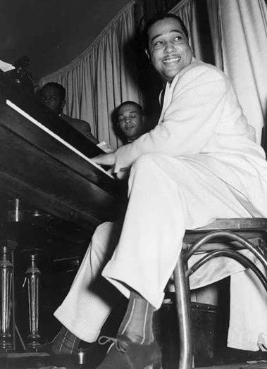
“By and large, jazz has always been like the kinda of man you wouldn’t want your daughter to associate with.”

Slide 17
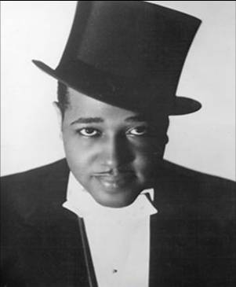
Duke Ellington
1899-1974 Washington, D.C.
composer, pianist, and band leader
Called his style "American Music,” not jazz.
Often composed music specifically for the skills of individuals in the band.
One of the best-known African-American celebrities of 20th century.
Toured the United States and Europe regularly before and after World War II.

Slide 18
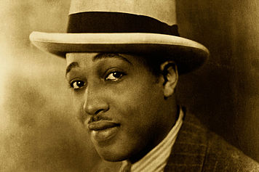
Listening Examples
Listening Example:
  “In a Sentimental Mood”
Viewing Example:
“Concerto for Cootie”

Slide 19
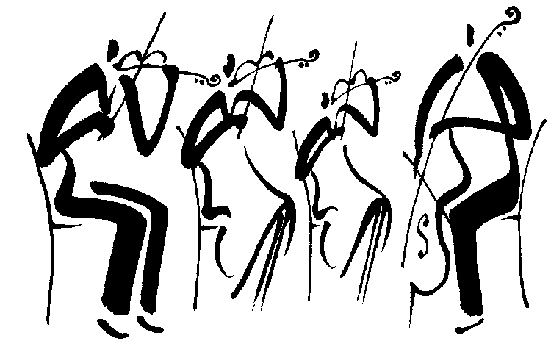
CLASSICAL

Slide 20
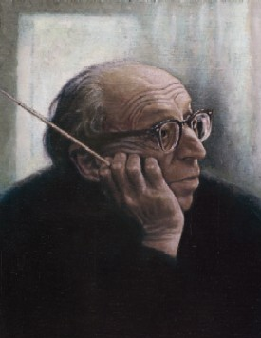
“A melody is not merely something you can hum.”

Slide 21
Aaron Copland
1900-1990 New York
composer & pianist of concert/film
1921 went to Paris, France
- stimulating atmosphere
- lasting influence
styles included: jazz, hymns, cowboy songs
ballet compositions of American folklore
- Appalachian Spring & Billy the Kid
Copland’s name synonymous with “American” music

Slide 22
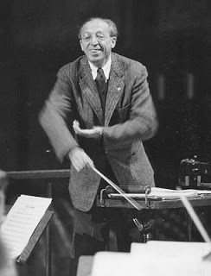
Listening Examples
Listening Example:
  “Simple Gifts” was written by Elder Joseph at a Shaker community in Maine, 1848.
Viewing Example:
“Appalachian Spring” (Martha Graham Dance Co.)

Slide 23
Exit Slip
Name the artist and title of the song played:
  Song One
  Song Two
  Song Three
2) What was the story line of Gershwin’s opera entitled Porgy and Bess?
a. It was an opera where a man and a woman start a life on the American frontier.
b. It was an opera based on the story of a Firebird and her love of a prince.
c. It was an opera about poor blacks from South Carolina.
d. It was an opera that showed a poor immigrant family coming to America.
3) Jazz music is a mix of what two cultural influences?
a. African and European b. Middle Eastern and Eastern European
c. Latin and Western d. African and Latin
4) What famous composer wrote pieces specifically for the style and skills of individuals in the band?
a. Duke Ellington b. Aaron Copland
c. Louis Armstrong d. George Gershwin
5) What jazz musician is famous for his “scatting” (where he made his voice sound like an instrument) abilities that he illustrated through the use of improvisation?
a. Duke Ellington b. Aaron Copland
c. Louis Armstrong d. George Gershwin

