Slide 1


What is music?
As you watch the following clips, I want you to ask yourself the following question:
What is music to you?
Listen to the following testimonials to help put your thoughts into words.
http://www.whatismusic.org/
http://www.whatismusic.org/iron-braydz/
http://www.whatismusic.org/sarah-sayeed/
http://www.whatismusic.org/mister-batlow/
Your opener will begin after a short introduction.

Slide 2
Music and You
Complete the following questions on the handout provided.
1) What is music for you? What functions does it serve in your life? Are there times when you prefer to listen to one genre over another? Why? Give an example and explain.
2) Read the article entitled, “Music tastes link to personality” and answer the following questions.
a. What is a personality trait of someone who likes classical music?
b. What is a common personality trait between people who like classical music and those who like heavy metal?
c. How was this research conducted?
d. What does your favorite genre say about your personality according to this article?
e. Do you agree? Why or Why not? Be specific.

Slide 3
Music Terminology
Elements and Forms of Music

Slide 4
An interesting fact…
Italian is the language of music.
  Many of the terms used to describe the elements of music are from the Italian language (presto, largo, sonata).

Slide 5

Melody
An intentionally organized succession of musical tones.
Think of the melody as the part of the song that you hum or think of whenever you’re thinking of the song.
http://www.youtube.com/watch?v=SkyfRu-dpvc

Slide 6
Theme
The melodic idea of a piece.
Variations
When the melodic idea is stated and then varied in a piece.
http://www.youtube.com/watch?v=tLfrdRgpKfI

Slide 7
Listening Check
Identify the form of the following clips being played on your learning guide or in class discussion.
Melody:
  Nelly in Just a Dream
  Indiana Jones Orchestration (Trumpets)
Theme:
  Darth Vader Theme
  Bob Dylan- Forever Young
Variation:
  Will.i.am- Forever Young

Slide 8

Form
The structure and design of a composition, incorporating repetition, contrast, unity, and variety.
In other words, form is everything you hear but don’t realize your hearing when you listen to any song.

Slide 9
Form- Types
AB: 2 contrasting sections
ABA: 3 sections with contrast in the middle
Call and Response: one voice or instrument plays or sings a phrase, followed by a responding phrase played or sung by a different voice or instrument.
Closed: the song has a clear ending- the song stops.
Open: the ending of the song fades out.
Rondo: A composition consisting of a recurring theme alternating with contrasting sections.
  Usually occurs in the last movement of a symphony, since it is fast in tempo and merry in mood
Notes:
AB
Part One: http://www.youtube.com/watch?v=nT7_IZPHHb0
Part Two: http://www.youtube.com/watch?v=oqSulR9Fymg&playnext=1&list=PL7D223A69CEBE1300&feature=results_video
ABA
http://www.youtube.com/watch?v=3aKgKHmZ9WI

Slide 10
Listening Check
Identify the form of the following clips being played on your learning guide or in class discussion.
AB
  Moonlight Sonata
ABA
  Always Be My Baby
Call and Response:
  Boom Boom
  When the Saints Go Marching In
Closed: Moonlight Sonata
Open: Canon in D Minor

Slide 11
Rhythm
Rhythm is the way music paces itself and moves through time. Music can flow gently or forcefully, smoothly or roughly.
It can be rapid or slow, deliberate or tentative.

Slide 12

Can you perform different rhythms with your right hand, left hand, and right foot?
Follow teacher demonstration for the beat. When told, tap your foot on one.
While your right foot continues to tap on one, use your left hand to tap regular beats of four. Tap these four beats on your desk. Make sure you accentuate the first beat.
Use your right hand to sound a beat at double the speed of your left hand (this means you’ll play 8 beats). In your head, think the eight beats by counting to either silently as you play.
Do as a round for whole group instructions.

Slide 13
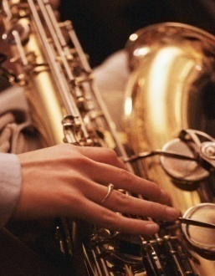
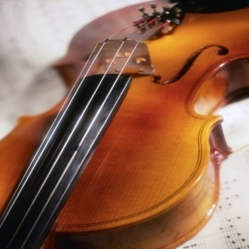




Timbre
Aerophones: sound is made when wind travels through the instrument.
Class example: clarinet
Idiophones: sound is made whenever the instrument is struck.
Class example: triangle
Membranophones: sound is made when a skin is rubbed or struck.
Class example: bongos
Chordophones: sound is made when a cord is struck.
Class example: Harp
Electrophones: sound is made from electricity.
  Class example: Synthesizer/ any electronic instrument

Slide 14
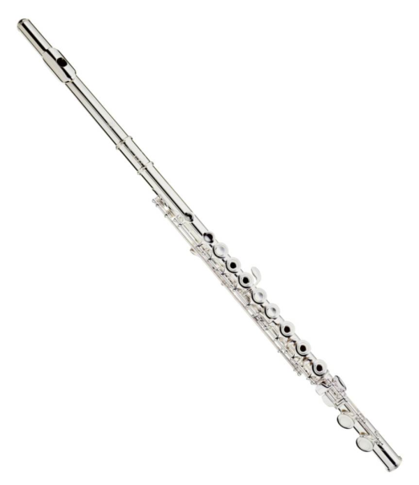
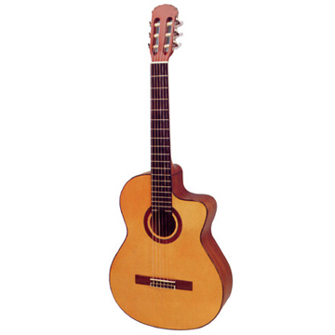
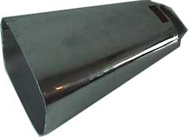
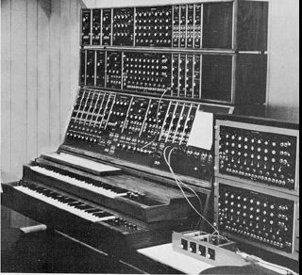
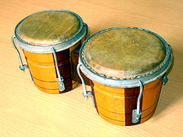
Use these images to identify the timbre category
1
4
5
3
2

Slide 15
Can you identify an instrument’s timbre?
http://www.youtube.com/watch?v=uOtFR5WG9K8
1) While watching a clip from Fantasia, name three musical instruments and identify its timbre category.
    For example, clarinet is an aerophone.
    By the way, you can’t use the example. ☺
2) What color was the instrument?
3) What effect does this instrument have on the piece being played?
  (In other words, how does this instrument sound in the piece and what effect does this have on the audience?)
http://www.youtube.com/watch?v=uOtFR5WG9K8

Slide 16
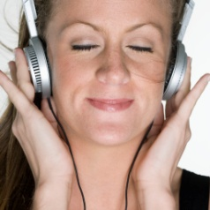
Texture
Harmony:
    The combination of simultaneous notes of different tones.
ex. Boyz to Men- Yesterday
Consonance:
  created when notes that sound good together are played
Ex. Weezer- My Eveline
Dissonance:
  created when notes that DON’T sound good together are played
    Done on purpose to create a mood, contrast, or emphasis
Ex. Halloween Theme
http://www.youtube.com/watch?v=gMLPnk9-6MM

Slide 17
Texture: Cont’d
There are multiple layers found in music:
Monophony:
  everybody sings the same parts
Ex. The Byrds- Turn, Turn, Turn
Homophony:
  same rhythm, different pitches
Ex. Pink- I Have Seen the Rain
Polyphony:
  two parts that are totally different at the same time
Ex. Kyrie- Pope Marcellus Mass

Slide 18
Listening Check
Identify the texture of the following clips being played on your learning guide or in class discussion.

Slide 19

Tempo
The pace with which music moves.
  In other words, how fast do you bounce your head to the song?
  Below, are the terms for the “speed of the beat”
  allegro: rapid, happy
  Andante: flows at a walking speed
  Adagio- dancing pace
  Moderato: moderate pace
  Presto: extremely rapid pace
  Largo: extremely slow pace

Slide 20

Tempo Body Check
Objective:
  To demonstrate your knowledge of tempo
Directions:
  When the teacher announces tempo term move your body at that rate.

Slide 21
Listening Check
Identify the tempo of the following clips being played on your learning guide or in class discussion.
Largo- Xerxes Largo
Adagio- Hotel California
Andante- Pomp and Circumstance
Allegro- Hazy Shade of Winter
Presto: Flight of the Bumblebee

Slide 22
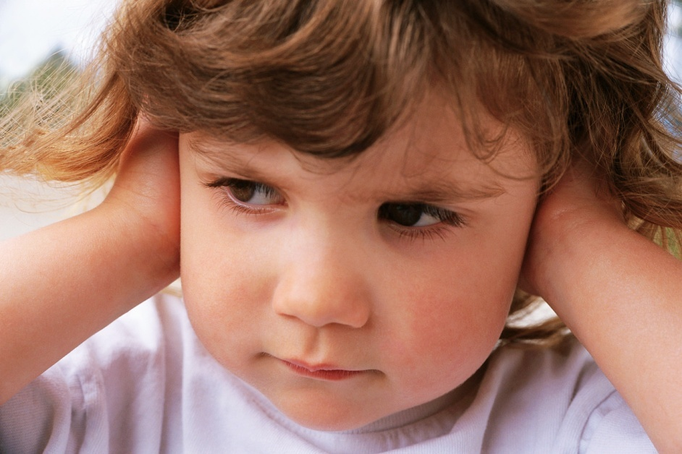

Dynamics
The volume of the musical passage.
Dynamic markings:
  (<) crescendo- gradually get louder
  (>) decresecendo- gradually get softer
The Degrees of Loudness:
  Forte (f): loud
  Piano (p): soft
  Fortissimo (ff): very loud
  Pianissimo (pp)= very soft
  Mezzo (medium)=
    (mf) mezzo-forte
    (mp) mezzo-piano
http://www.youtube.com/watch?v=JE-dqW4uBEE

Slide 23
Dynamics Learning Check
Objective:
  To demonstrate your knowledge of dynamics by reading a passage
Directions:
  Either as a whole class or individually, you will read the given passage using the dynamic given
Passage:
  Mary Had a Little Lamb

Slide 24

Dynamics Reading Passage
Mezzo-forte
Mary had a little lamb,
Little lamb, little lamb,
Mary had a little lamb,
Its fleece was white as snow
Everywhere that Mary went,
Mary went, Mary went,
Everywhere that Mary went
The lamb was sure to go
Mezzo-piano
Forte
Mezzo-forte
Piano
Forte
Pianissimo

Slide 25
Listening Check
Identify the dynamics of the following clips being played on your learning guide or in class discussion.

Slide 26
Exit Slip- What is music?
Write to Demonstrate Your Learning
  On the handout provided, you must answer the following question using all of the categories of your music terminology. For each category, you must use one term to explain and support your statement.
  Melody, Form, Timbre, Texture, Tempo, Dynamics

Slide 27
Dynamics and Tempo Reading Passage
Mezzo-forte
Largo
Jack and Jill went up the hill
To fetch a pail of water.
Jack fell down and broke his crown
And Jill came tumbling after.
Up Jack got, and home did trot,
As fast as he could caper;
To old Dame Dob, who patched his nob
With vinegar and brown paper
Mezzo-piano
Allegro
Forte- Adante
Presto
Mezzo-forte
Moderato
Piano- Largo
Forte- Presto
Pianissimo
Adante

