Slide 1
Music Notation: Day 2 Time Signature and Note Names

Slide 2
Agenda
Things to Get:
Handouts from the front
Things to Do:
Opener:
Review of time signatures, note and rest values
Class work:
Music Notation:
Note Values Rest Values application
Note Names
Exit Slip:
Review of music notation

Slide 3
Opener- B2
Complete the following on a half sheet of paper.
1) How many quarter notes are in a whole note?
2) How many sixteen notes are in a whole note?
3) How many quarter rests are in a half rest?
4) What is 4/4 time? What note gets one beat?
5) What is the time signature of the music below?
6) Draw a staff on your paper. Next, draw four measures that use 4/4 time, and have three different types of notes and rests.
Once you have completed this opener, complete the handout entitled: “Time Signatures and Completing Measures with Rests>”
If you have finished the handout above, you need to complete the bottom of your opener.

Slide 4
Opener- Part 2
1) Draw the following notes and rests:
A) Quarter Rest B) Half Note
C) Sixteenth Note C) Whole Rest
2) How many quarter notes are in a whole note?
3) How many sixteen notes are in a whole note?
4) How many quarter rests are in a half rest?
5) What is 4/4 time? What note gets one beat?
Once you have finished your opener, get out the sheet entitled, “Time Signatures and Completing Measure with Rests.”

Slide 5
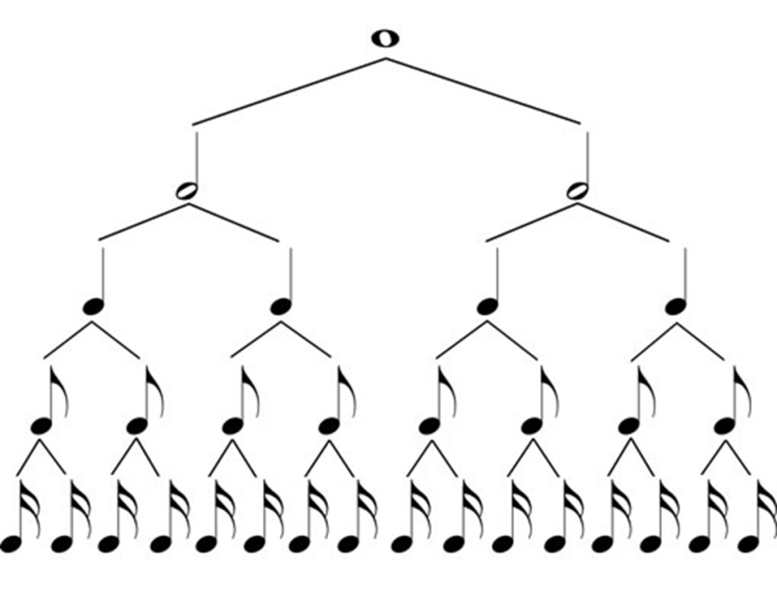
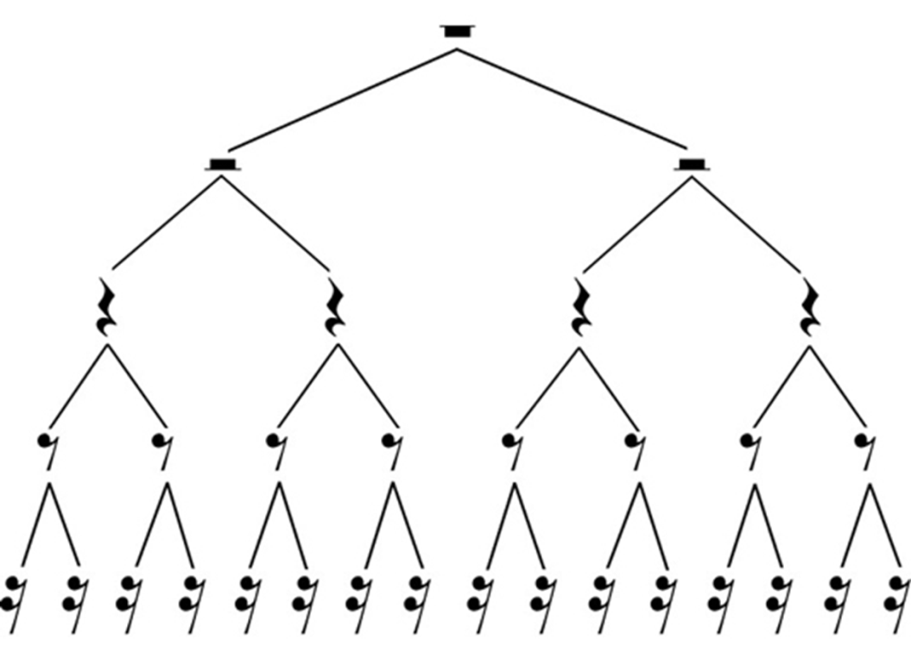

Slide 8
Activity: Can you read music?
Practice student compositions by clapping the rhythm as a class.

Slide 9
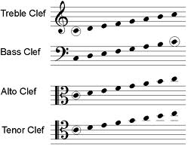
Music Notation- How to Read Music
Music Clefs: symbol used to indicate the pitch of written notes.

Slide 10
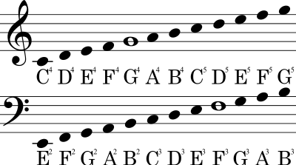
Notes on the Staff
Complete the activities on the handout entitled, “Notes on the Bass Clef.”
Complete the activities on the handout entitled “Notes on the Treble Clef”

Slide 11
Treble Clef Packet
Treble Clef
Lines:
Every Good Boy Does Fine
Every Good Boy Deserves Fudge
Spaces:
FACE
Bass Clef
Lines:
Good Boys Do Fine Always
Good Boy Deserves Fudge Always
Spaces:
All Cows Eat Grass
Follow this rule for notes that are off of the staff:
If the note is on a line, you count four spaces into the staff.
If the note is on a space, you count four lines into the staff.

Slide 12
Lesson 6 Student Assignment:
Clef ID:
1) Treble
2) Bass
3) Treble
4) Treble
5) Bass
6) Treble
7) Bass
8) You may pick the staff and then name the notes.
Next, create five measures of music by adding measure lines.
Use the information above to help you complete your music notation exercises!

Slide 13
Exit Slip: Complete the review of music notation
Due to the box by the end of the period.

