Slide 1
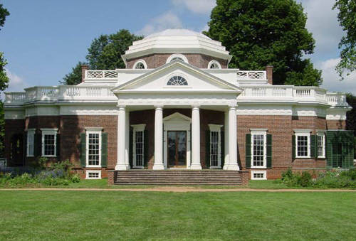
~~~ Jefferson’s Monticello ~~~

Slide 2
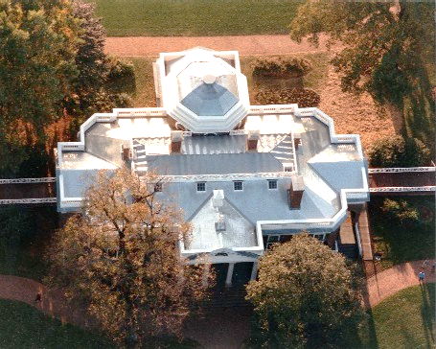
Aerial View

Slide 3
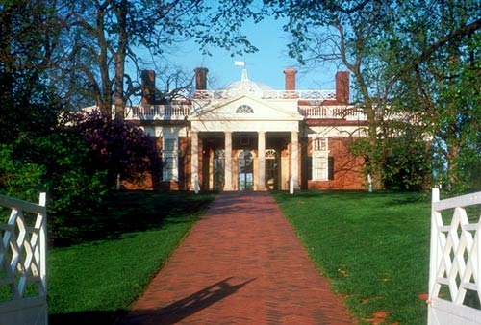
Main Entrance – Why in the rear?

Slide 4
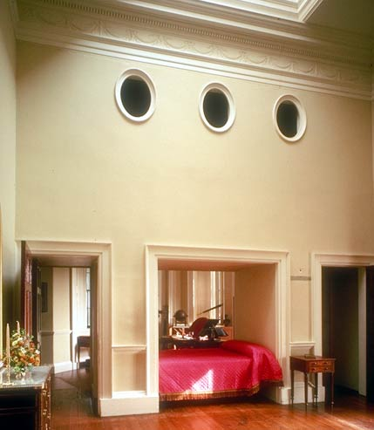
A bed in the wall conserved space.
The “portholes” provided ventilation for off-season wardrobe.

Slide 5
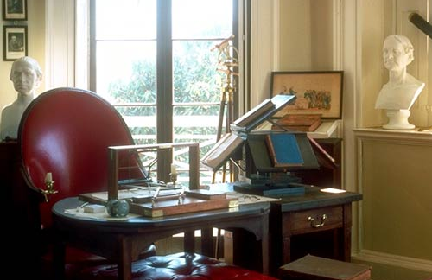
Desk with letter copier

Slide 6
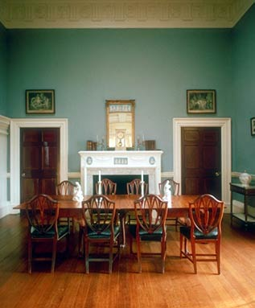
Dining Room

Slide 7
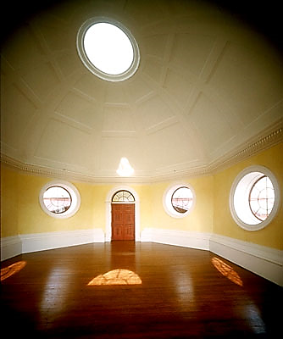
2nd floor octagonal room with an oculus.
Does this look familiar?

Slide 8
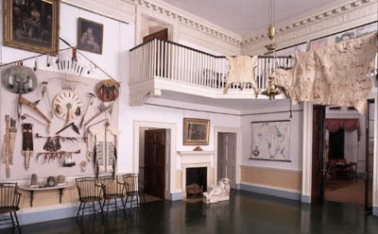
Access to upper rooms by balcony

Slide 9
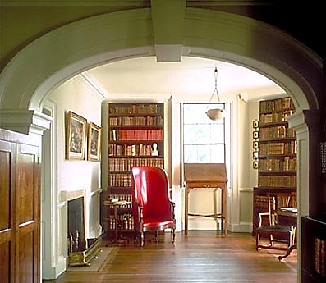
When the Library of Congress burned he donated his book collection to re-start the library.

Slide 10
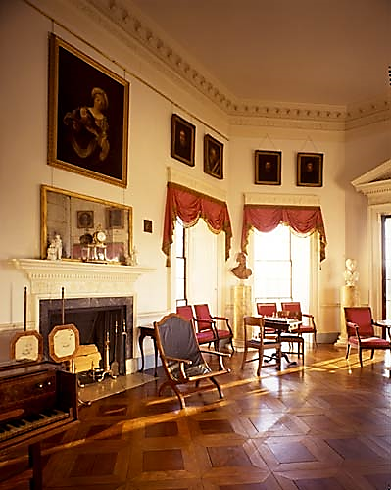
Sitting room with a harpsichord.
This room is below the 2nd floor room with the dome!

Slide 11
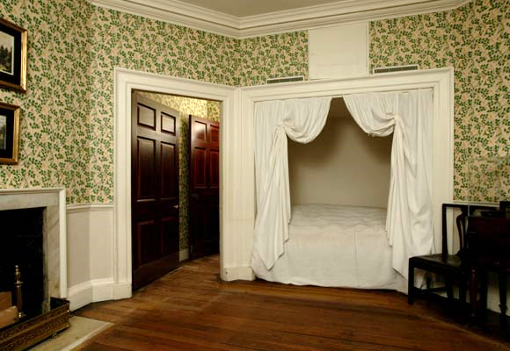
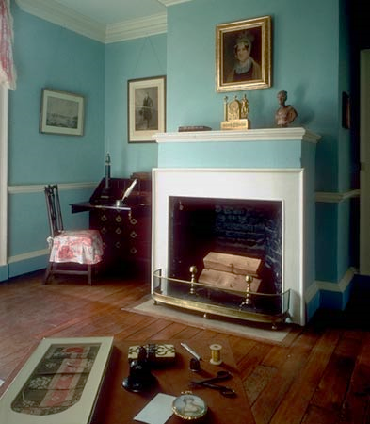
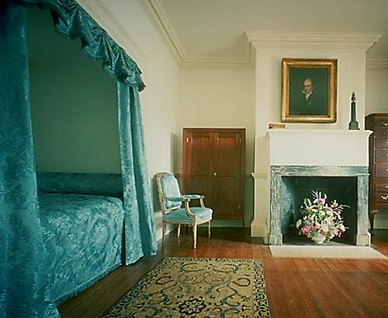

Slide 12
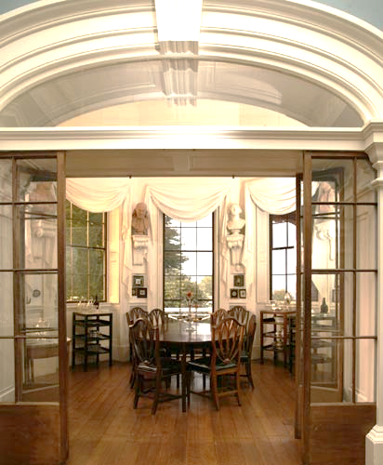
The breakfast nook was closed off in the winter to conserve heat.

