Slide 1
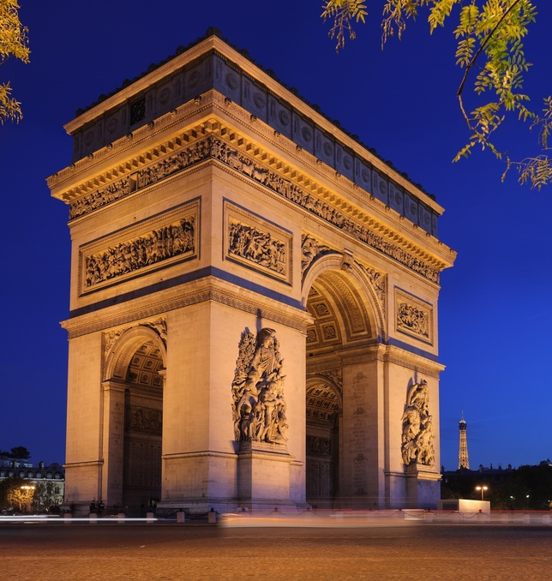
~~ Neoclassical Architecture ~~
Arc de Triomphe
Paris, France

Slide 2
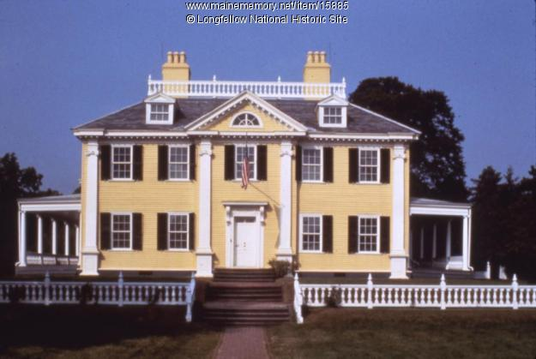
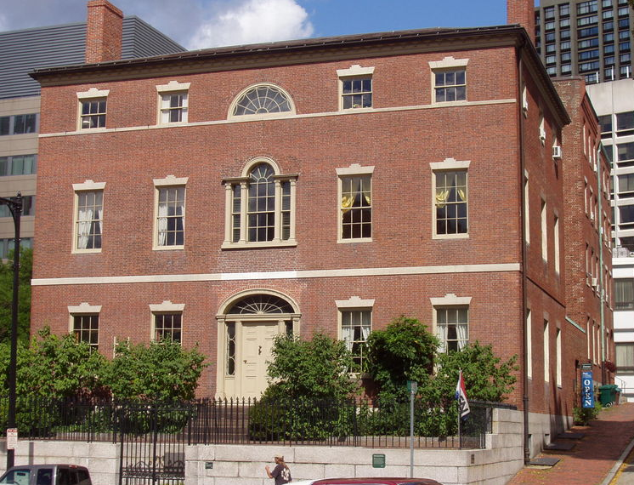
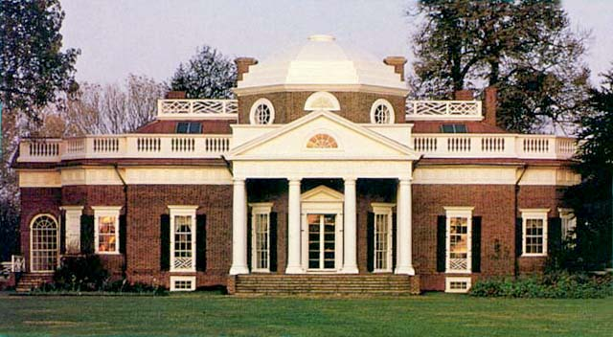
Focused on balance, order, and symmetry
Use of Greek and Roman Structures
GREEK
Columns
Ionic/Doric
Pediments
Portico
ROMAN
Domes
-Rejection of Baroque ornamentation
Characteristics of Greek and Roman governments
“A rational human should have a voice in government”

Slide 3
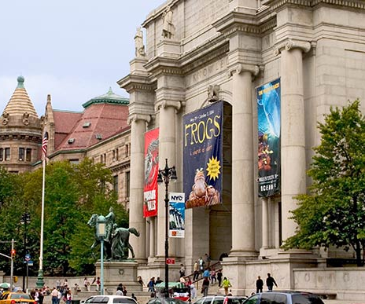
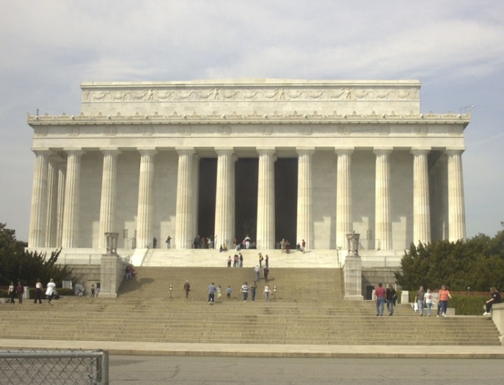
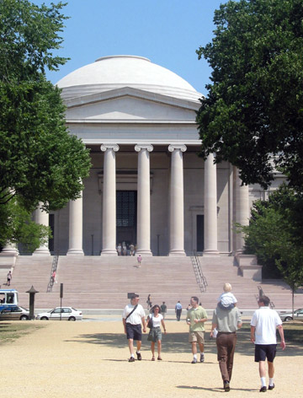
American Renaissance Movement
*A Neoclassical expression in Beaux-Arts architecture.
National Gallery of Art
Lincoln Memorial
American Museum of Natural History

Slide 4
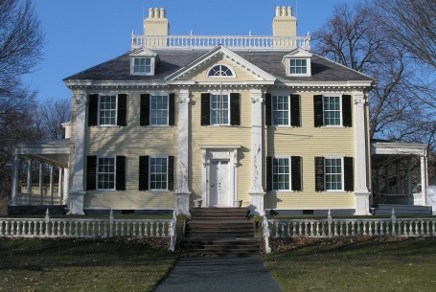
The “Georgian Style” in America
Georgian style definition:
Simple, two-story box homes with doors and windows symmetrically arranged.
Typically, had a pediment over the door and a cupola on the roof
Roof was usually flattened at the top with a wooden balustrade to form a terrace

Slide 5
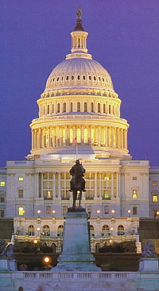
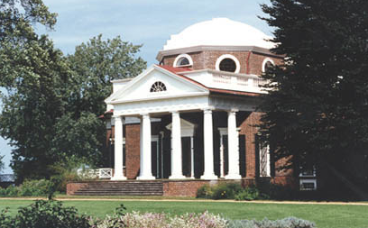
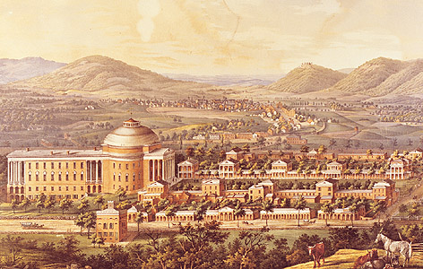
The “Federal Style” in America
* Thomas Jefferson’s influence 1780 – 1820.
Monticello, VA
University of VA
U.S. Capitol

Slide 6
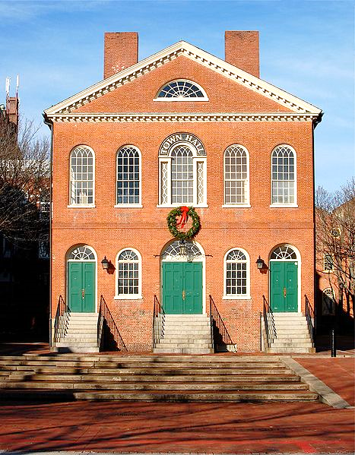
Federalist style definition:
As it applies to homes…
Boxlike structures of brick or clapboard siding that showed the influence of the Renaissance and Palladio with flashy interiors
“Fancy decoration,” on the exterior, was limited to the doorway
Entrances were usually framed by columns or side windows, with a fanlight above the door

Slide 7
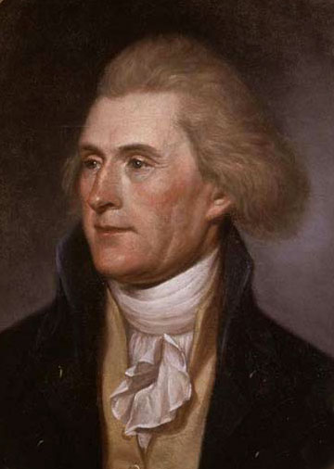
Thomas Jefferson
- 1743-1826
- helped write Declaration of Independence
- 3rd President
- founded UVA (University of Virginia)
- neoclassical architect
- ambassador to France in 1780’s

Slide 8
*Read the article, “The Annotated Arch”- Jefferson: Statesman/Architect, then answer the following questions:
1) Jefferson designed his own home. What was it’s name and what does the name mean?
2) How does his house reflect his personality? What are some of its quirky inventions?
3) Why is the central dome of Jefferson’s house significant?
4) What was Jefferson’s goal as a designer?
5) What did Jefferson use as a reference for his own designs?
6) What is important about Jefferson’s design of the Virginia State Capitol?
7) Why did Jefferson emphasize architecture?
8) Give an example of how Jefferson mixed old and new.
9) What started appearing in American architecture in the 18th century?
10) How is Neoclassic architecture propaganda for the US?

Slide 9
“The Annotated Arch” – ANSWERS!
1) Jefferson designed his own home. What was it’s name and what does the name mean? Monticello – Little Mountain
2) How does his house reflect his personality? What are some of its quirky inventions? Curiosity and love a classical architecture. Bed in a wall, disappearing beds, shutter openers
3) Why is the central dome of Jefferson’s house significant? First in the U.S.
4) What was Jefferson’s goal as a designer? “improve the taste of my countrymen.”
5) What did Jefferson use as a reference for his own designs? Roman models
6) What is important about Jefferson’s design of the Virginia State Capitol? First function public building, based on a Roman design, in thousands of years
7) Why did Jefferson emphasize architecture? Because it could be an instrument of education as well as social reform.
8) Give an example of how Jefferson mixed old and new. Classical temple forms with local Virginia brick
9) What started appearing in American architecture in the 18th century? European models with American ideals
10) How is Neoclassic architecture propaganda for the US? Balanced, symmetrical buildings to show balanced, symmetrical government.

Slide 10
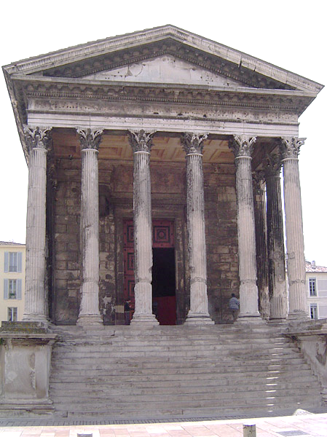
Virginia State Capitol
Maison Carree

Slide 11
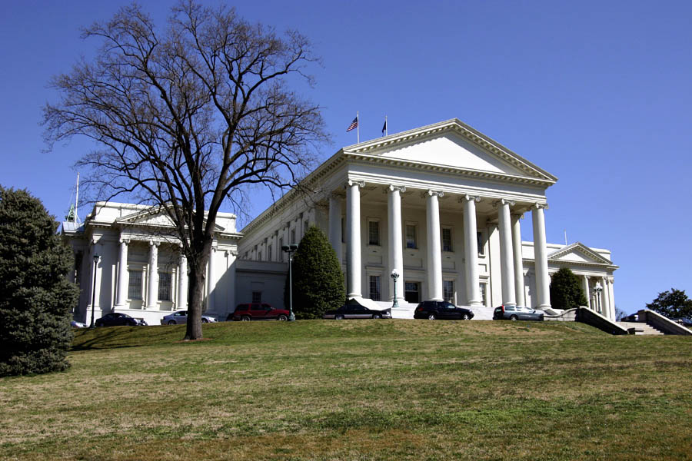
Virginia State Capitol
Maison Carree

Slide 12
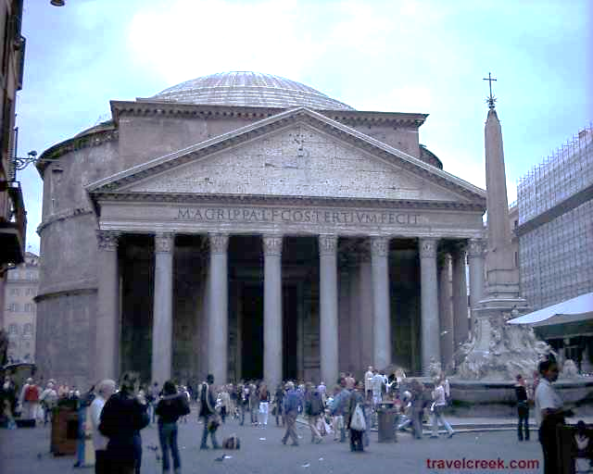
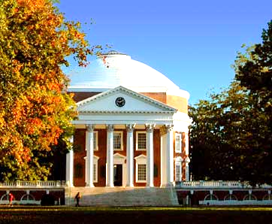
Pantheon
University of Virginia

