Slide 1
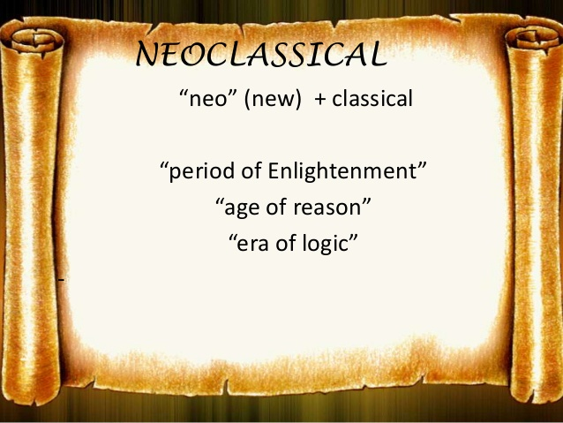

Slide 2
Baroque Review
Draw a line matching the names with the correct item!
Velazquez
Bernini
Bach
Caravaggio
Jean Baptiste Lully
Handel
Palace of Versailles
Rembrandt
Christopher Wren
Vivaldi
Violin Virtuoso
Las Meninas
Oratorio
The Ecstasy of St. Teresa
The Conversion of St. Paul
Hall of Mirrors
St. Paul’s Cathedral
Organ
Ballet
The Night Watch

Slide 3
Baroque Review – ANSWERS!
Draw a line matching the names with the correct item!
Velazquez
Bernini
Bach
Caravaggio
Jean Baptiste Lully
Handel
Palace of Versailles
Rembrandt
Christopher Wren
Vivaldi
Violin Virtuoso
Las Meninas
Oratorio
The Ecstasy of St. Teresa
The Conversion of St. Paul
Hall of Mirrors
St. Paul’s Cathedral
Organ
Ballet
The Night Watch

Slide 4
“Enlightenment” Article
(top) Begin with “It is a scene…”
1) Describe eighteenth century nobility life.
2) Define the spirit of enlightenment.
3) How did aristocratic life differ from middle-class life?
(bottom) Begin with “The goal of the…”
4) What was the Enlightenment’s philosophical goal?
5) What did thinkers feel an Enlightenment education would lead to?
6) What type of world government could Enlightenment ideals lead to?
7) Complete the following sentence: “Kant believed that world peace required only the application of sufficient ___________________ ___________________.”
Notes:
Answers:
Leisured decadence who threw parties in elegant gardens, town houses, and country manors
The belief in the supremacy of reason over pleasure, and a conviction that humans could perfect society through the application of the intellect to human affairs.
Middle class: sober advocates of reason and enlightenment endured an uneasy coexistence with an aristocratic society devoted to artful pleasure.
Educate citizens so that they could exercise their powers of reason unhindered by tyranny and superstition.
World peace and general prosperity
One that guaranteed equal rights and universal education
Human reason

Slide 5
“Enlightenment” Article – ANSWERS!
1) a. Leisured decadence who threw parties in elegant gardens, town houses, and country manors
2) b. supremacy of reason over pleasure, and a conviction that humans could perfect society through the application of the intellect to human affairs.
3) a. Middle class advocates of reason; aristocratic society devoted to artful pleasure.
4) a. Educate citizens so that they could exercise their powers of reason unhindered by tyranny and superstition.
5) b. World peace and general prosperity
6) b. equal rights and democracy with universal education
7) human reason

Slide 6
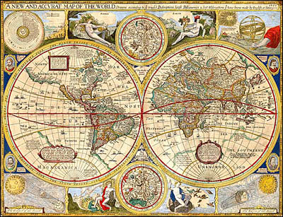
The Enlightenment and Revolutions
Between the 1700 and 1800, the world was drastically transformed by intellectual, mechanical, social, and political revolutions.
http://www.nlm.nih.gov/exhibition/smallpox/Images/Large/map.jpg

Slide 7
Based on the video “Enlightenment – Words of the World,”
  http://www.youtube.com/watch?v=4Vkx7hNXE3Y
How is Enlightenment defined?

Slide 8
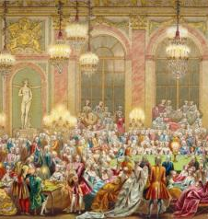
During the 1600’s, Absolute monarchs lived in lavish courts that were decadent and self-serving.
Long term effect:
  France: Lavish court life was disconnected from the average individual
    France’s national debt grows
    New Political Thought develops
http://images.easyart.com/i/prints/rw/en_easyart/lg/1/4/The--Jeu-du-Roi--gaming-table-in-the-court-of-Louis-XV-Anonymous-144260.jpg

Slide 9
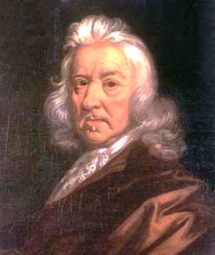
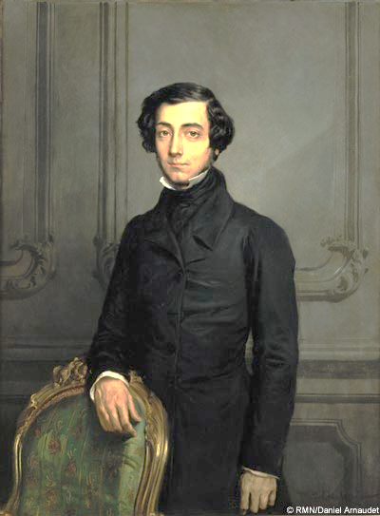
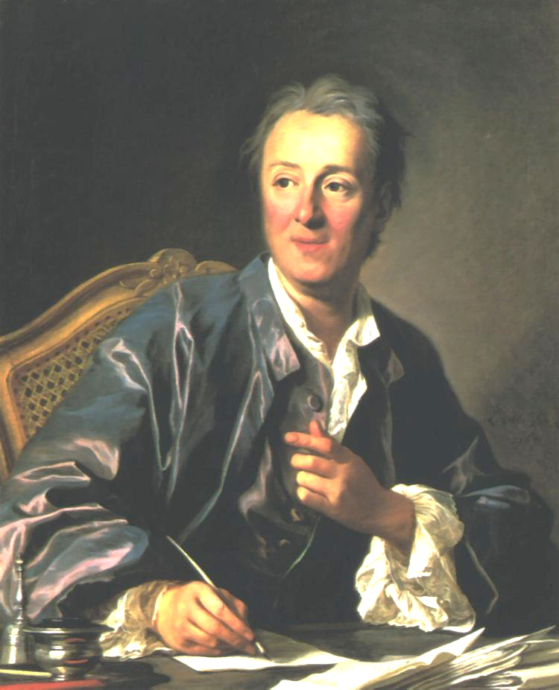
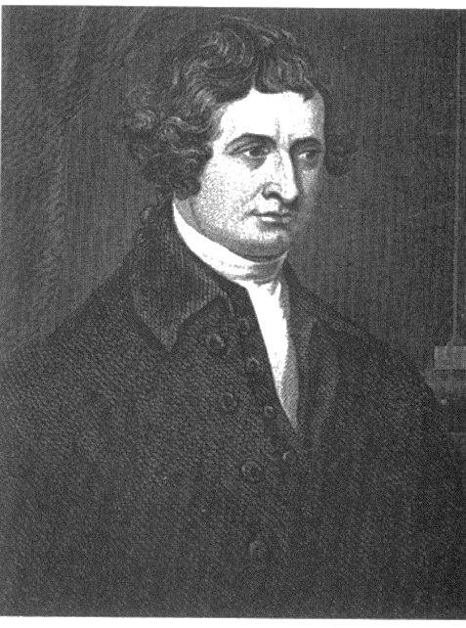
The Enlightenment Ideals
Emphasized the mind’s ability to reason
Secular concerns
Main ideas:
  Freedom from tyranny and superstition
  Belief in goodness of human nature
  Equality of men
http://www-gap.dcs.st-and.ac.uk/~history/BigPictures/Hobbes_3.jpeg
http://www.diplomatie.gouv.fr/en/IMG/jpg/58l1.jpg
http://www.u-bourgogne.fr/cimeos/CRCM/images/stories/dossierSerge/diderot.jpg
http://www.harpers.org/media/image/blogs/misc/edmund-burke.jpg

Slide 10
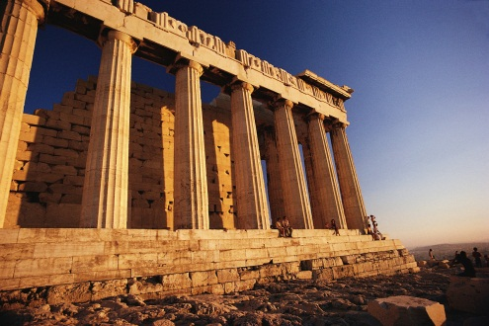
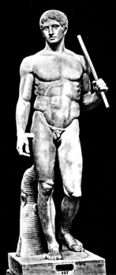
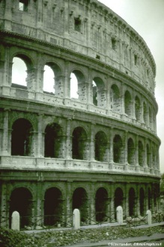
Characteristics of the Neoclassical Period
Reaction to the Baroque Period caused…
  Political thinkers to ponder Revolutions to create democracies and republics (a la Greece and Rome) so that people would have a voice in government.
  artists, musicians, and architects wanted to emulate the clean, uncluttered style of Classical Greece and Rome in their works.

Slide 11
If countries are “baroque” from the Baroque movement, who is paying for art?
  The aristocracy, or “upper class,” were the main patrons of the arts.
    Aristocracy: non-royals who have lots of money
  The Church and Monarchs were no longer the principle benefactors of the arts due to the political upheaval in Europe at the time.

Slide 12
Origins of Neoclassical Art
Discoveries and publications about antiquity also allowed for Classicism to become the new, favored, style.
1. Excavations of Pompeii and Herculaneum
2. Elgin Marbles
3. Johann Winckelmann’s Artist Circle

Slide 13
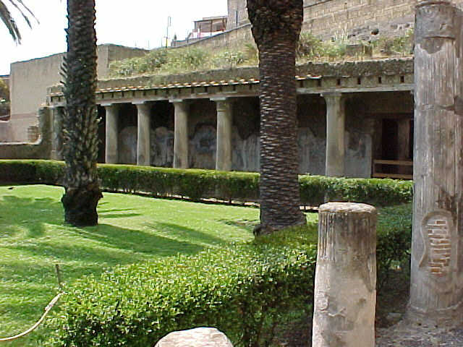
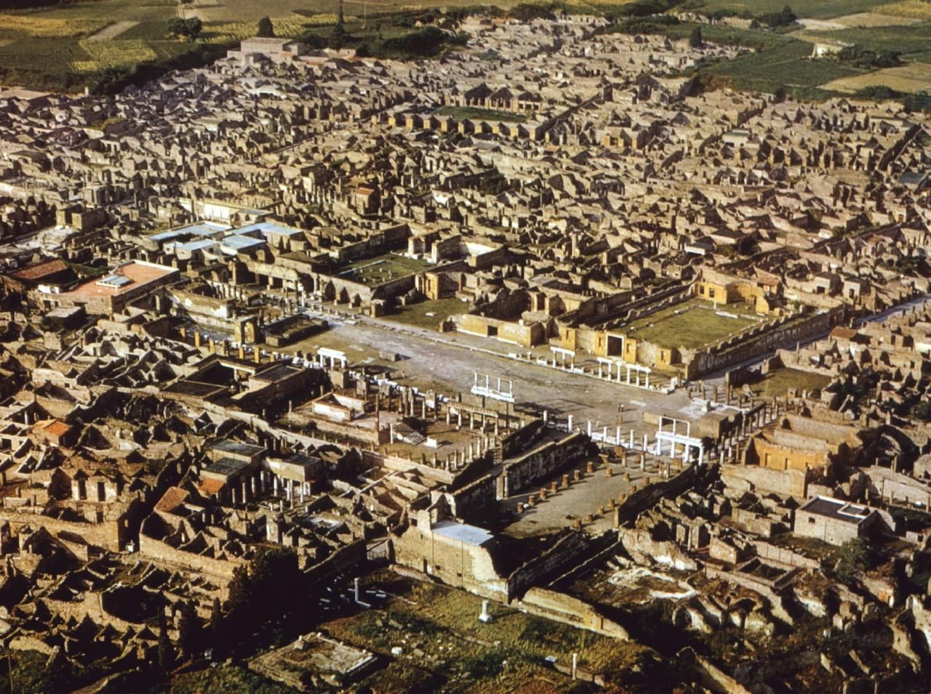
1. Excavations of the Ruins of Italian Cities
Pompeii in 1748
Herculaneum in 1738
http://www.youtube.com/watch?v=F4HguzrUuCY
http://www.youtube.com/watch?v=4mg0j7Uzsg0&feature=related

Slide 14
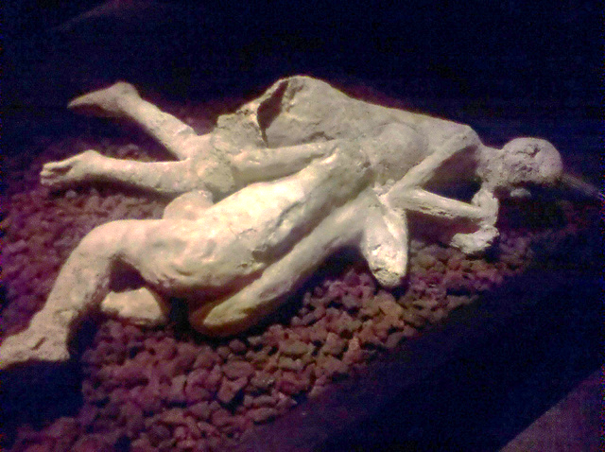
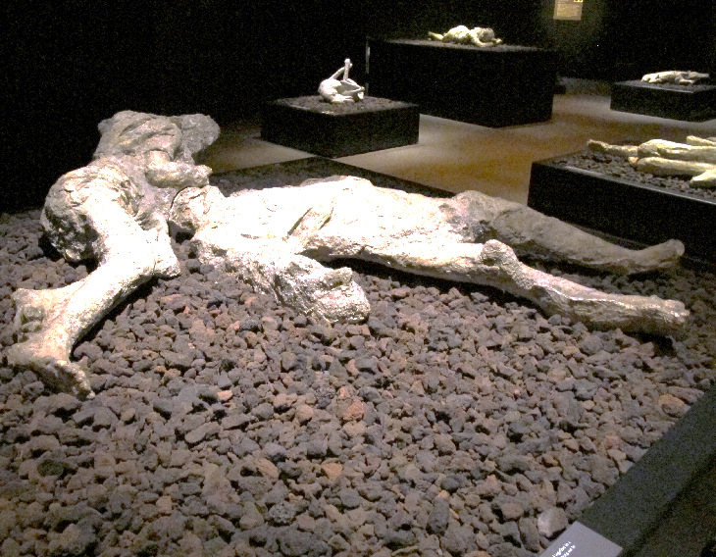
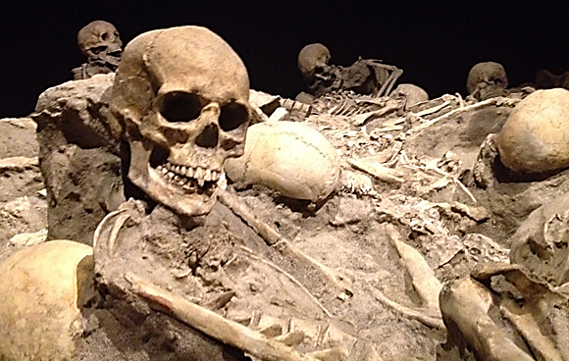
Pompeii in Cincinnati
How did the shapes of bodies get preserved?
ADD IMAGES!

Slide 15
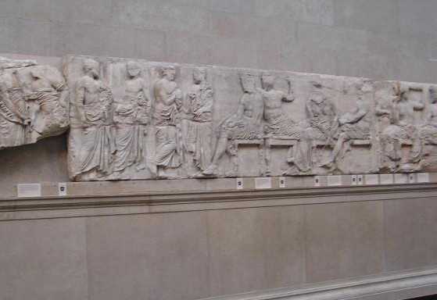
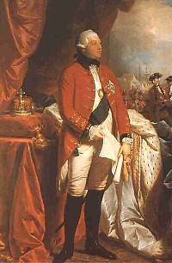
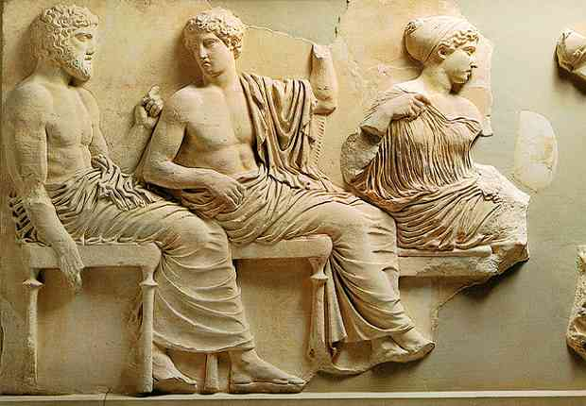
2. Elgin Marbles
Thomas Bruce,
7th Lord of Elgin
British Museum, 1806
From the top façade of the Parthenon in Athens.
http://www.youtube.com/watch?v=gFlW9gd9REI

Slide 16
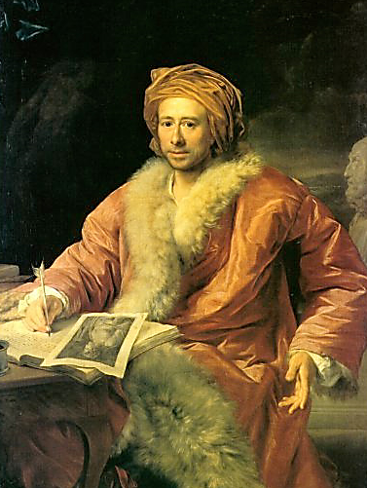
3. Johann Winckelmann’s Artists Circle
Artists should “imitate” the timeless, ideal forms of the classical world.
international artists gathered about him in the 1760s in Rome.
Ideas discussed/shared in coffeehouses (the poor man’s universities)
German art historian
*Show 33:00-38:00
https://www.youtube.com/watch?v=beG6ljMCx-Y
Notes:
Play video starting at 2:28- just coffee house section

Slide 17
Neoclassical Sculpture Characteristics
Profoundly influenced by ancient art since the Renaissance.
Neoclassical sculptors avoided the dramatic twisting poses and colored marble surfaces characteristic of late Baroque/Rococo sculpture.
They preferred:
  Crisp contours
  A noble stillness
  Idealized white marble forms

Slide 18
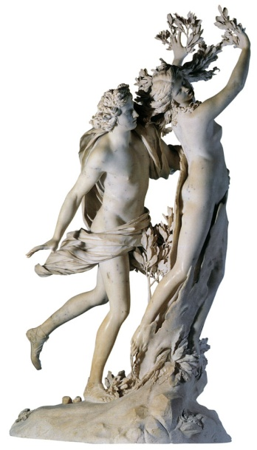
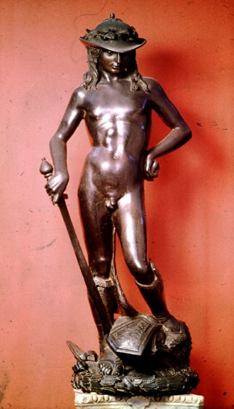
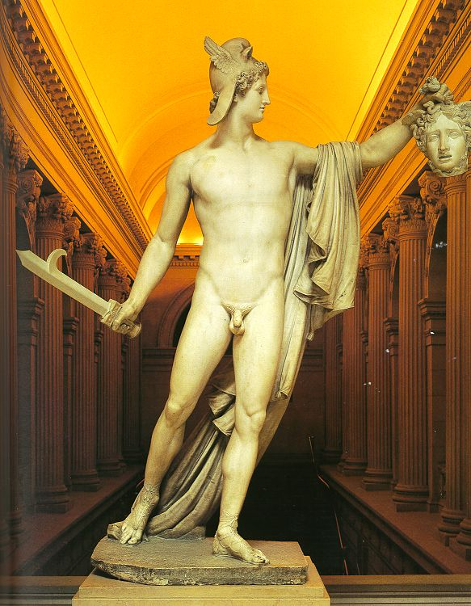
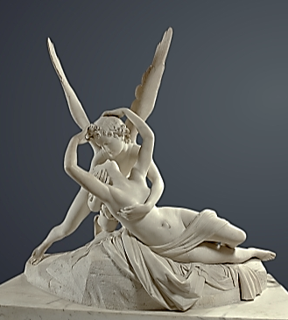
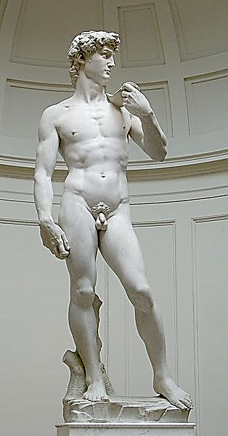
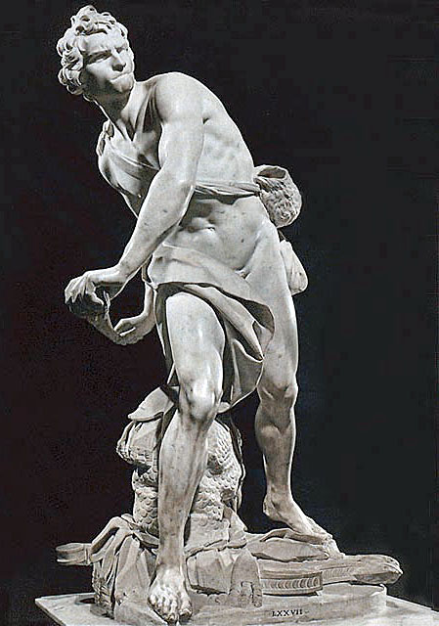
List three differences YOU SEE in these sculptures!
Canova
Donatello
Bernini
Michelangelo

Slide 19
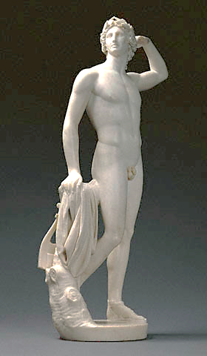
Antonio Canova
“Apollo Crowning Himself,” 1781
“Perseus with the Head of Medusa,” 1804-1806
https://www.youtube.com/watch?v=QtI_HGQFSy0

Slide 20
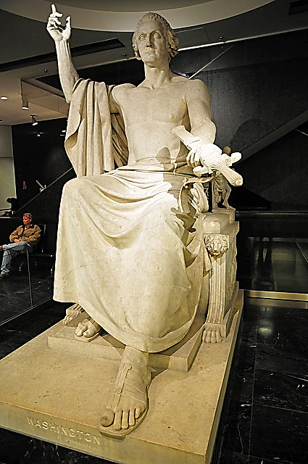
How is this statue of George Washington sculptured in the style of Neoclassicism?

Slide 21
Neoclassical Painting Characteristics
Clean lines
Geometric arrangement
Classical themes with contemporary clothes and settings
Emotion is NOT the main force in the pieces.
  Why? Political leaders of the Enlightenment (right to life, liberty, property) distrusted emotions as a guide to the truth; they relied on human reason.

Slide 22
Exit Slip
Should the Elgin Marbles be returned to Greece? Why or why not? Explain!
How did sculpture change in the Neoclassic period versus the Baroque? Explain!
Why was Pompeii significant in the development of the Neoclassic Period? Explain!
Name two ways in which Neoclassic Painting differed from Baroque Painting.

