Slide 1
Neoclassical music

Slide 2
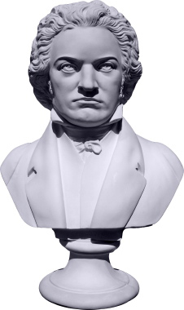
INTRODUCTION
Composers rejected the intensity of religious feeling and dramatic contrasts of the Baroque style.
Distinguished by the growth of popular audience for serious music.
Vienna, Austria was the center of classical music.
Public concerts became more popular in the 18th century and the average person’s experience with music grew.

Slide 3
INTroduction (cont’d)
The Aristocratic, upper middle class demanded more accessible and recognizable musical language than the Baroque offered.
Composers gained fame by reshaping old forms such as the concerto and then establishing new forms like the symphony. The music was organized clearly according to the principles of the musical form.

Slide 4
patronage
Composers relied on general support from the Aristocratic, upper middle class.
Supported themselves by offering music lessons, printing books of instruction, and writing simple pieces of music to be played at home.
Not as rich as previous composers, but free in composition. (NO KINGS OR PRIESTS TELLING THEM WHAT TO WRITE!!!)

Slide 5
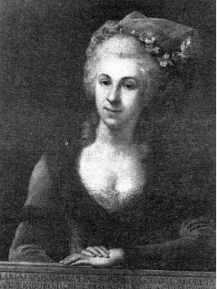
WOMEN
Women made music in the home to entertain families, suitors, and close friends.
The harpsichord was the most traditional instrument in the home.
Women could become professional musicians for the first time.
Marianna Martinez (1744-1812) studied under Haydn and created full length works that earned her fame.
Marianna Martinez (1744-1812)
Studied with Haydn

Slide 6
SYMPHONY
https://www.youtube.com/watch?v=eVXalu0p1wo
- Four parts that follow a predictable pattern
- An extended work for orchestra - 20 - 40 min. in length. It has four parts (movements) that follow a predictable pattern.
Characteristics of Form:
First Movement:
Allegro- Dramatic
Second Movement:
Adagio/Andante- Reflective
Third Movement:
Moderato (popular dance)- Stately and Elegant
Fourth Movement:
Allegro- Happy

Slide 7
characteristics
References to Greco-Roman art in its clarity of form, balanced design, and emotional restraint.
Elements of music:
Form - order, symmetry, clarity
Melody - duality of two or more contrasting phrases
Texture - homophony
Dynamics - changes more subtle and dramatic
Timbre - instrumental music dominated

Slide 8
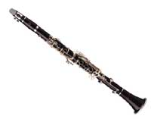
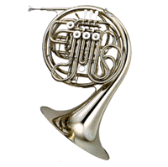
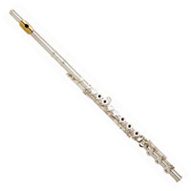
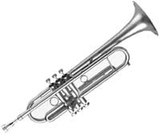
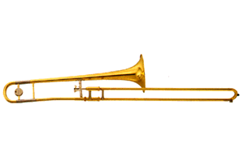
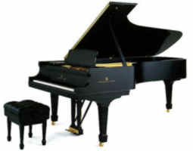
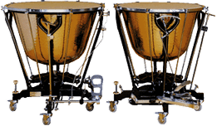
Classical Period Instruments
Flute
Clarinet
French Horn
Trumpet
Trombone
Percussion
Piano

Slide 9
SONATA
https://www.youtube.com/watch?v=0G0lr9yUgJI
As a stand-alone it is one movement piece for a solo instrument, usually accompanied by a piano.
Also the name for the first of four movements of a symphony.
The exposition introduces themes.
The development modifies themes.
The recapitulation returns to the main theme.

Slide 10
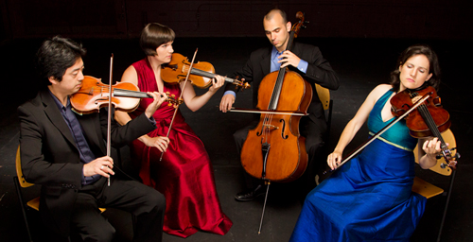
STRING QUARTET
https://www.youtube.com/watch?v=oXLKu-HglnM
A composition for four solo string instruments:
2 violins, 1 viola, and 1 cello.
Each part is equally important.
Haydn was the first to write one. He also was considered the master of the string quartet.
The piece usually has four movements similar to that of the symphonic form but generally shorter.

Slide 11
OPERA
https://www.youtube.com/watch?v=dK1_vm0FMAU
Opera is a combination of music, drama, scenery, costumes, and dance to create a complete art form.
During this period is when the majority of operas were written including The Magic Flute, The Marriage of Figaro, and Don Giovanni.
Movie Clip: The Shawshank Redemption
https://www.youtube.com/watch?v=Bjqmg_7J53s&sns=em

Slide 12
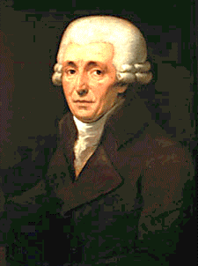
franz joseph haydn
Court musician for Prince Esterhazy for over 30 years.
He moved from Vienna, Austria to England in 1791 where he was received at the Royal Court, awarded an honorary doctorate at Oxford and began to receive financial benefits. While at the English court, he wrote the “London Symphonies.”
He became known as “Papa Haydn.”
He came up with the basic form for string quartet and wrote over 100 symphonies.

Slide 13
franz joseph haydn
Characteristics of Haydn’s music:
-clarity, balance, restraint
-he set the guidelines for classical style while adapting to his patron’s needs
-transitioned music from the court to the public
“The Surprise Symphony”
https://www.youtube.com/watch?v=tF5kr251BRs

Slide 14
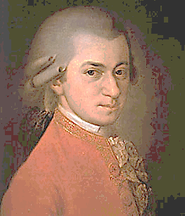
wolfgang amadeus mozart
Born and raised in Salzburg, Germany.
His father was a music teacher.
Considered a child prodigy as he was a master of the violin and piano by age 5 and wrote his first opera by age 12.
As an adult, he suffered from depression and illness making it difficult for him to secure an income.
He wrote more than 600 works.
He died at age 35 in serious debt.

Slide 15
wolfgang amadeus mozart
Characteristics of Mozart’s Work:
-combination of German and Italian styles
-shows a wide range of emotions so often
unpredictable, dynamic, and furious
-Wrote the most famous opera ever
-The Marriage of Figaro
-The Magic Flute
-Don Giovanni
Requiem Mass- Lacrimosa
https://www.youtube.com/watch?v=Zi8vJ_lMxQI

