Slide 1
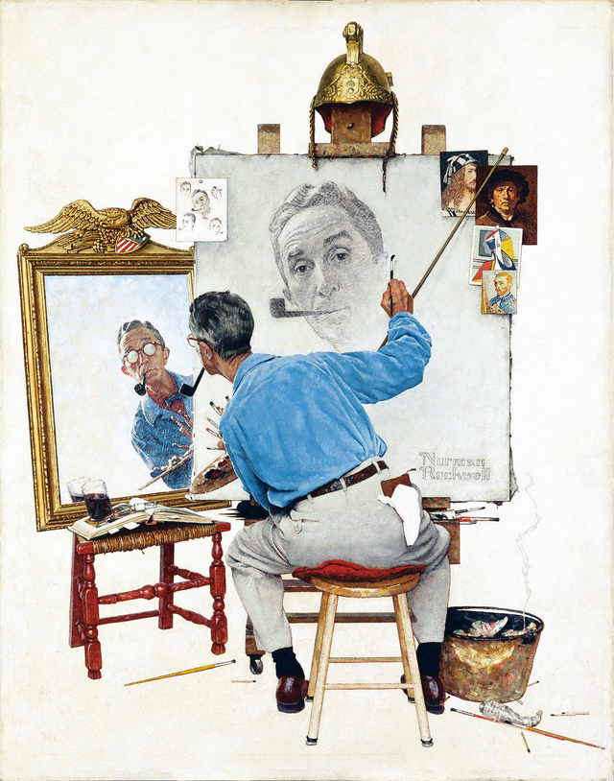
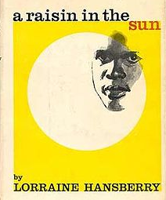
Norman Rockwell Meets A Raisin in the Sun
https://www.youtube.com/watch?v=e7qQ6_RV4VQ

Slide 2
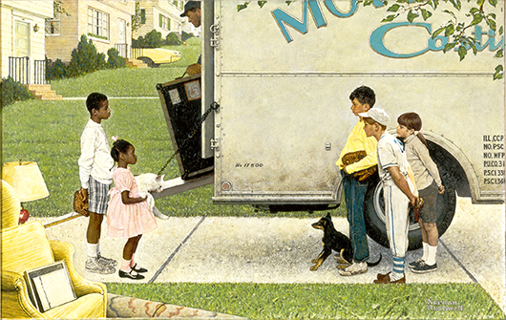
Remembering the Youngers’ move to Clybourne Park, their new neighborhood, look at the key symbols in the famous painting by Norman Rockwell.

Slide 3
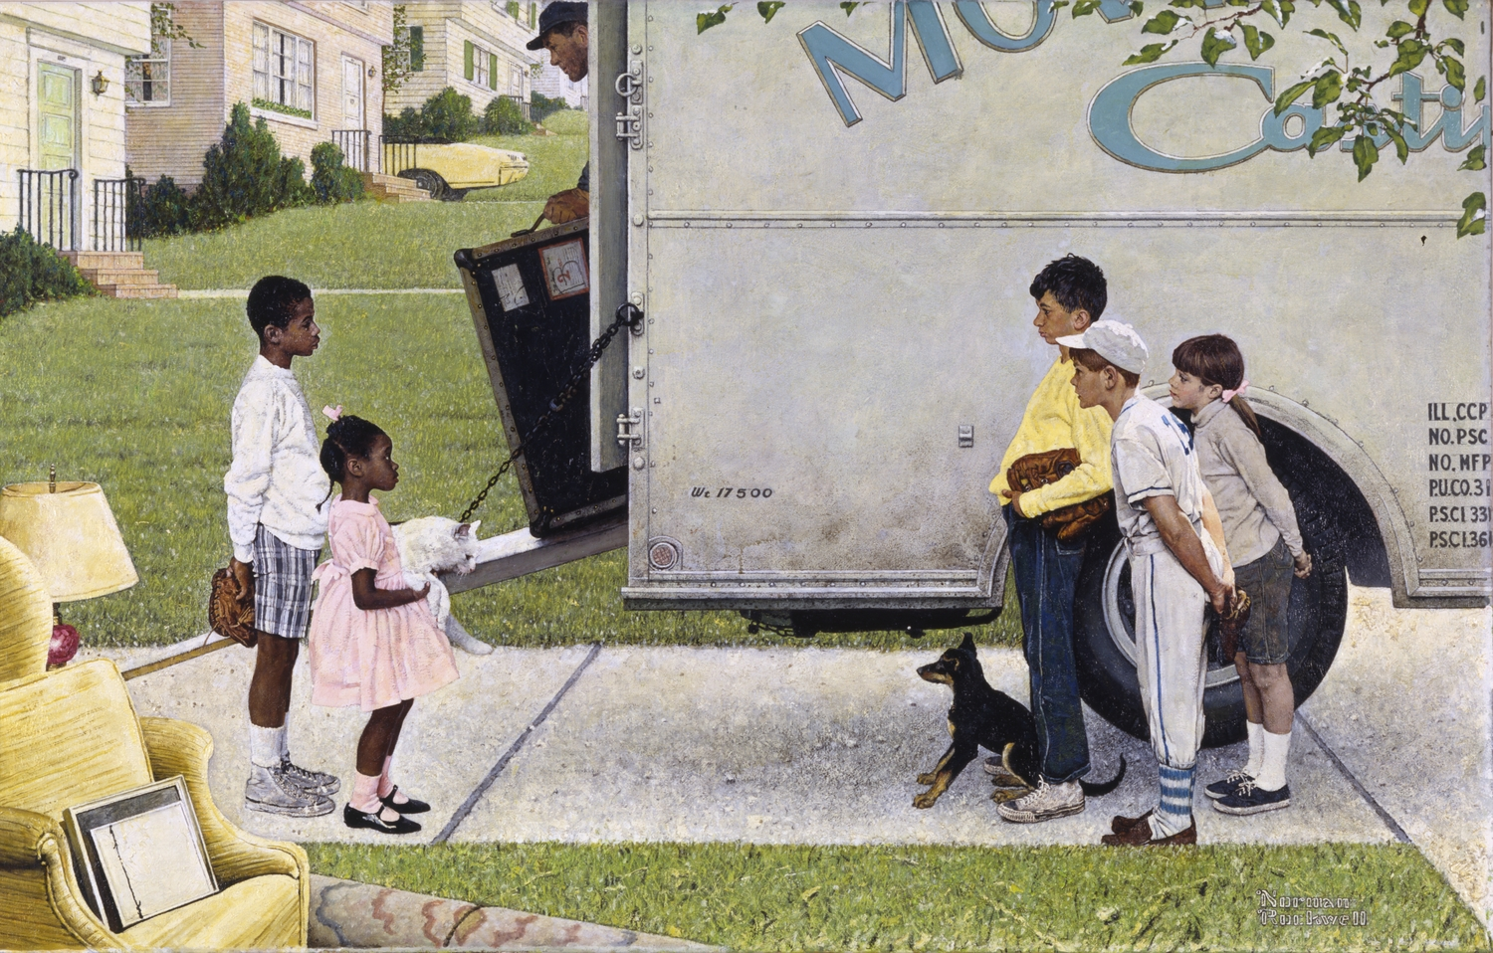

Slide 6
Raisin Prompt #1
- NOW write down clues about how Travis, or any other person here, might feel about this meeting along the sidewalk of their new neighborhood.

Slide 7
New Kids in the Neighborhood, 1967
Norman Rockwell
Story illustration for Look,
Oil on canvas,
36 1/2" x 57 1/2"
From the permanent collection of Norman Rockwell Museum.
Reference photos for New Kids in the Neighborhood by Louie Lamone, 1967.

Slide 8
In his illustration of suburban integration in Chicago's Park Forest community, Rockwell was secure in expressing his philosophy of tolerance.
We can see the children will soon be playing with each other, but the face peering from behind a window curtain makes us wonder how the adults will fare.
https://www.youtube.com/watch?v=TA7A7lciQGo&feature=youtu.be

Slide 9
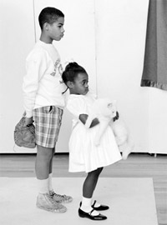

Slide 11
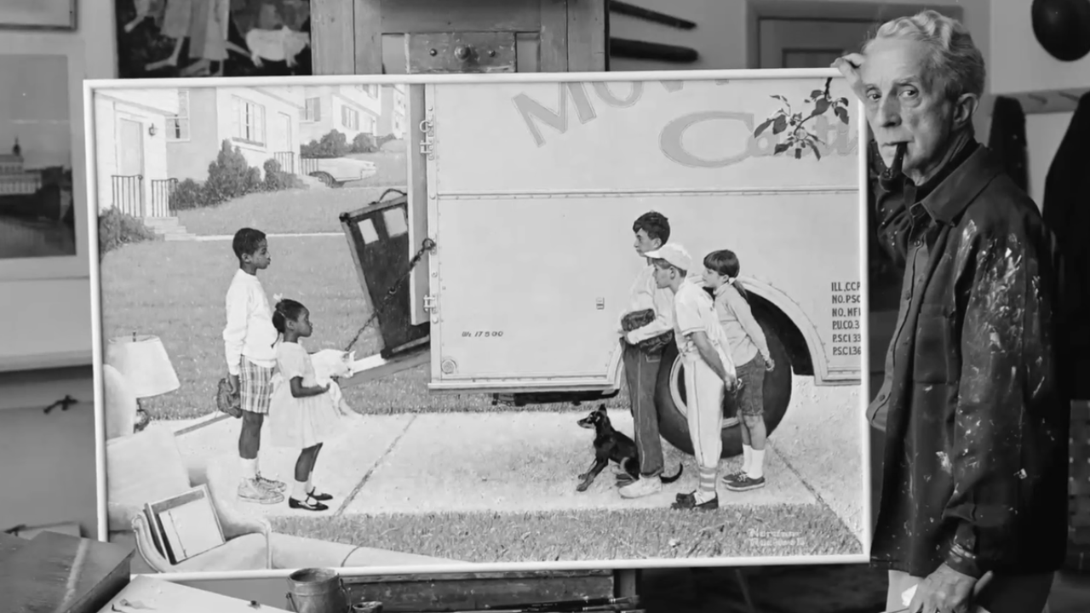

Slide 12
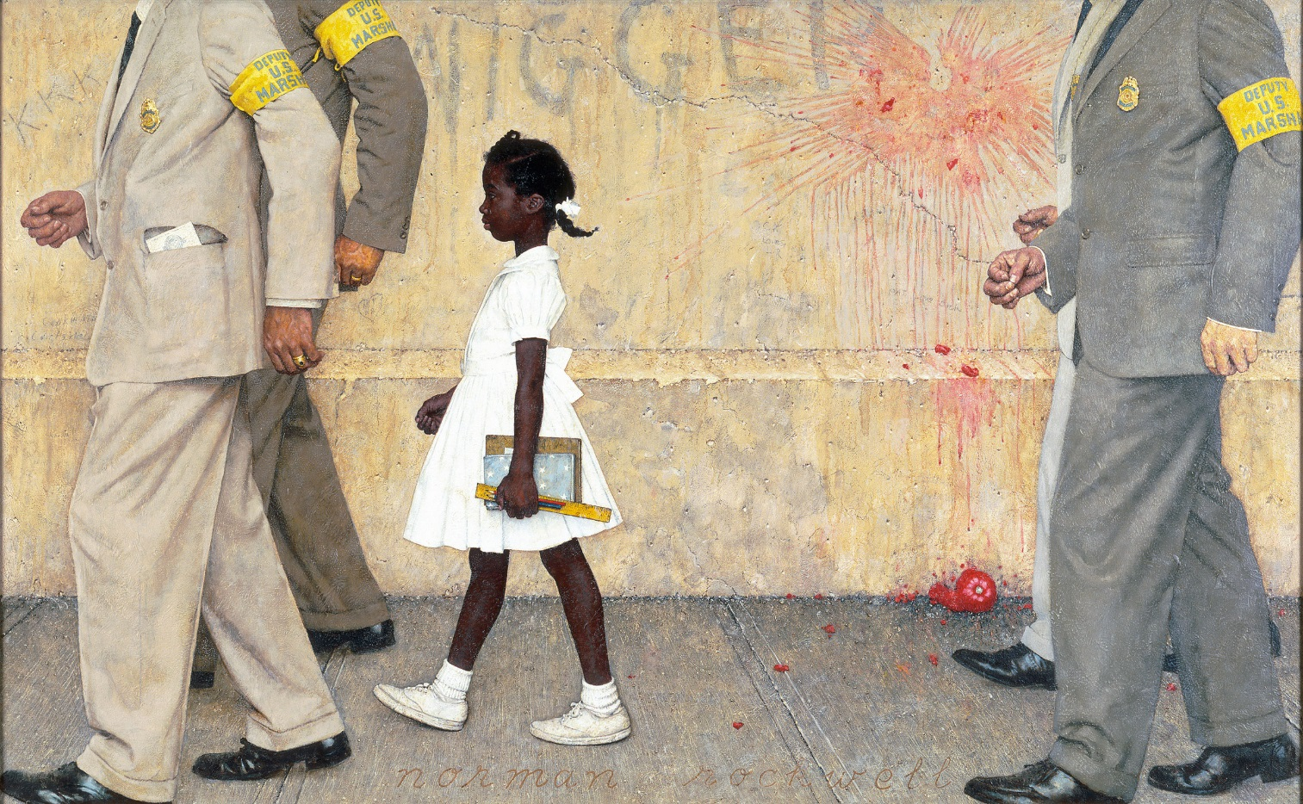
Ruth Younger was expecting a baby, maybe a daughter. Imagine that this girl is starting her first day of school in their white neighborhood.

Slide 14
Raisin Prompt #2
- NOW write down clues about how this young girl, feels about this situation, along with clues about the OTHER people feel.

Slide 15
The Problem We All Live With, 1964
Norman Rockwell
Story illustration for Look,
Oil on canvas, 36" x 58"
From the permanent collection of Norman Rockwell Museum.

Slide 16
Subject: a six-year-old African-American school girl being escorted by four U.S. marshals to her first day at an all-white school in New Orleans.
After the 1954 Brown v. Board of Education ruling, Louisiana lagged behind school desegregation until federal agencies forced the school board to start in 1960.
Rockwell recalled that he once had to paint out an African-American person in a group picture since The Saturday Evening Post policy dictated showing African-Americans in service industry jobs only.
https://www.youtube.com/watch?v=l4Trz-ijBYg

Slide 17
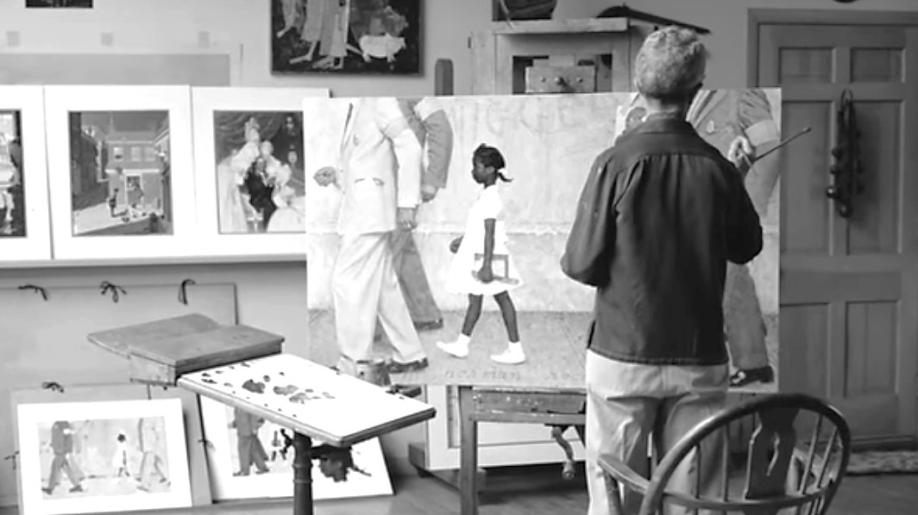

Slide 18
According to legend, Ernest Hemingway was once challenged to write a short story using only six words. It is said that he wrote:
For sale: baby shoes, never worn.

Slide 19
As you can see, these stories can be humorous, dark, mysterious, and anything else you can think of.
MORE EXAMPLES:
Misleadingly deep puddle. Curious child missing.
Painfully, he changed “is” to “was.”
Born a twin; Graduated only child.
We’re lying in bed. He’s lying.

Slide 20
Raisin Prompt #3
Write at least THREE six-word stories about characters or plot for A Raisin in the Sun.
* Chicago knows strength, ask the Youngers.

Slide 21
Raisin Prompt #3
A1 EXAMPLES:
I’m rich. I’ve got white shoes.
I wanna be a doctor, Joseph.
I’m from Africa; I love you!
Ten thousand dollars, paid in tears.
I’m dramatic, but I’m your mother.
Family will stay, but money doesn’t.

Slide 22
Raisin Prompt #3
A3 EXAMPLES:
One neighborhood, one black family (lives).
Plants grow better with a little sun.
I want to graduate to succeed.
Many dreams can only choose one.
One fresh death; one new birth.
She loved him, he loved alcohol.
Wanting one change to make more.
She fights, he drinks pain away.

Slide 23
Raisin Prompt #3
A4 EXAMPLES:
One

