Slide 1
Principles of Art Notes
Term | Definition | Illustration
Example:
Term | Definition | Illustration
Subject | The central image of the work | Subject

Slide 2
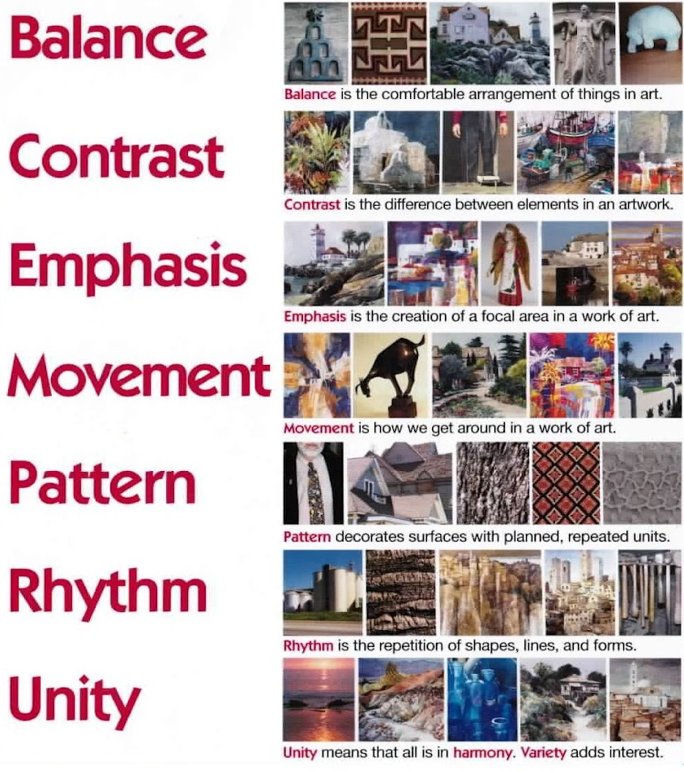
The Principles

Slide 3
The Principles (cont’d)

Slide 4
The Principles (cont’d)

Slide 5
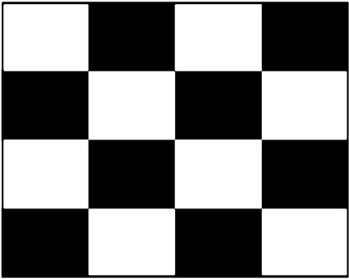
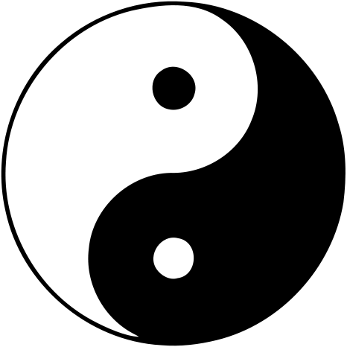
Contrast: the technique for creating a focal point using two different elements

Slide 6


Slide 7
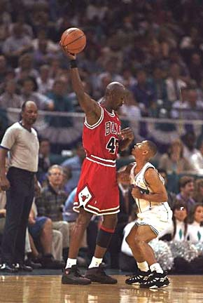
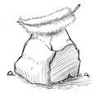

Do you see the contrast?

Slide 8
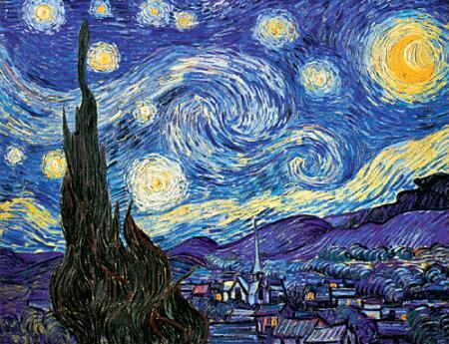
Rhythm, Repetition, Pattern: the repetitive use of an element to create a visual effect

Slide 9


Slide 10
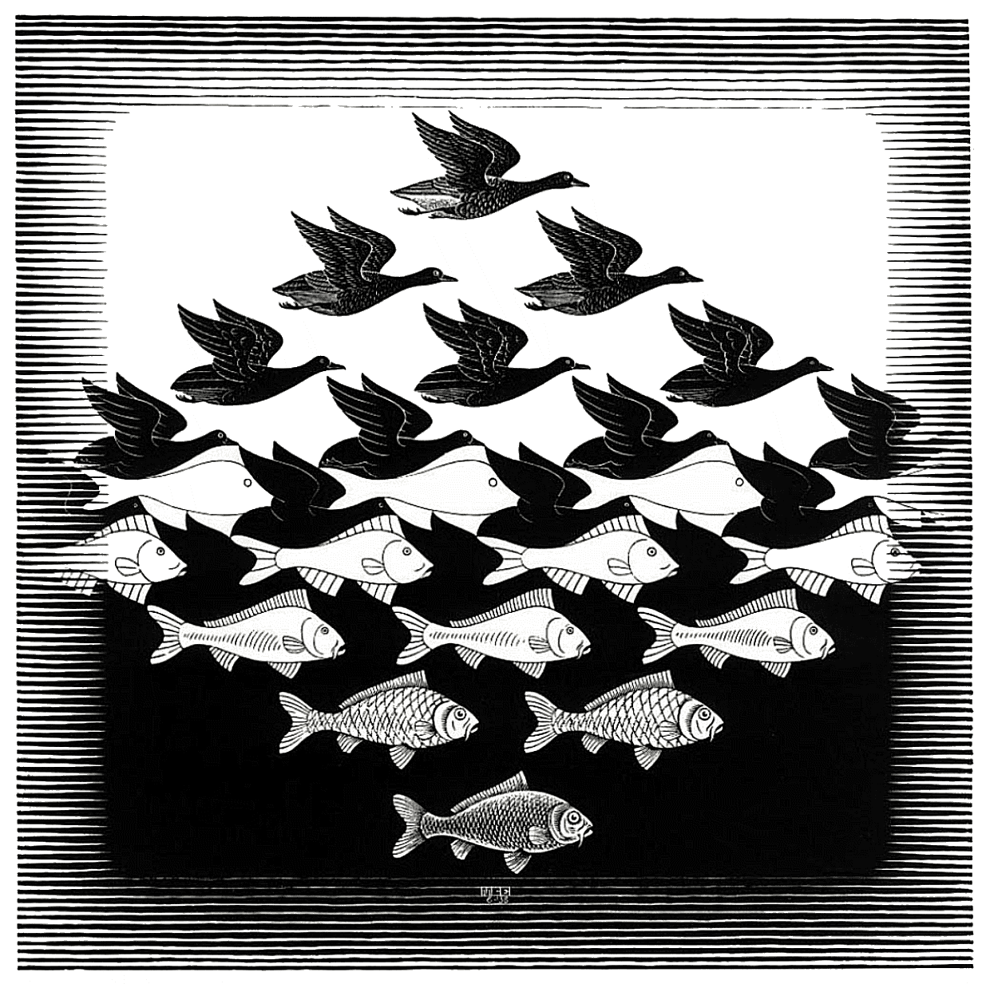

Slide 11
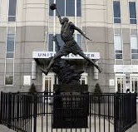
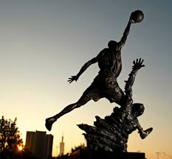
Movement: Arrangement elements in a way that makes the eye follow a path through the composition. Achieved by use of repetition and patterning.

Slide 12
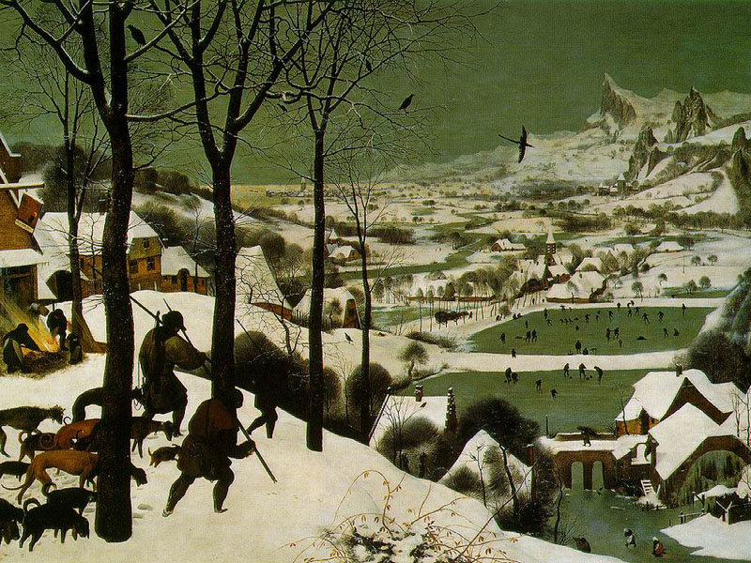

Slide 13


Slide 14
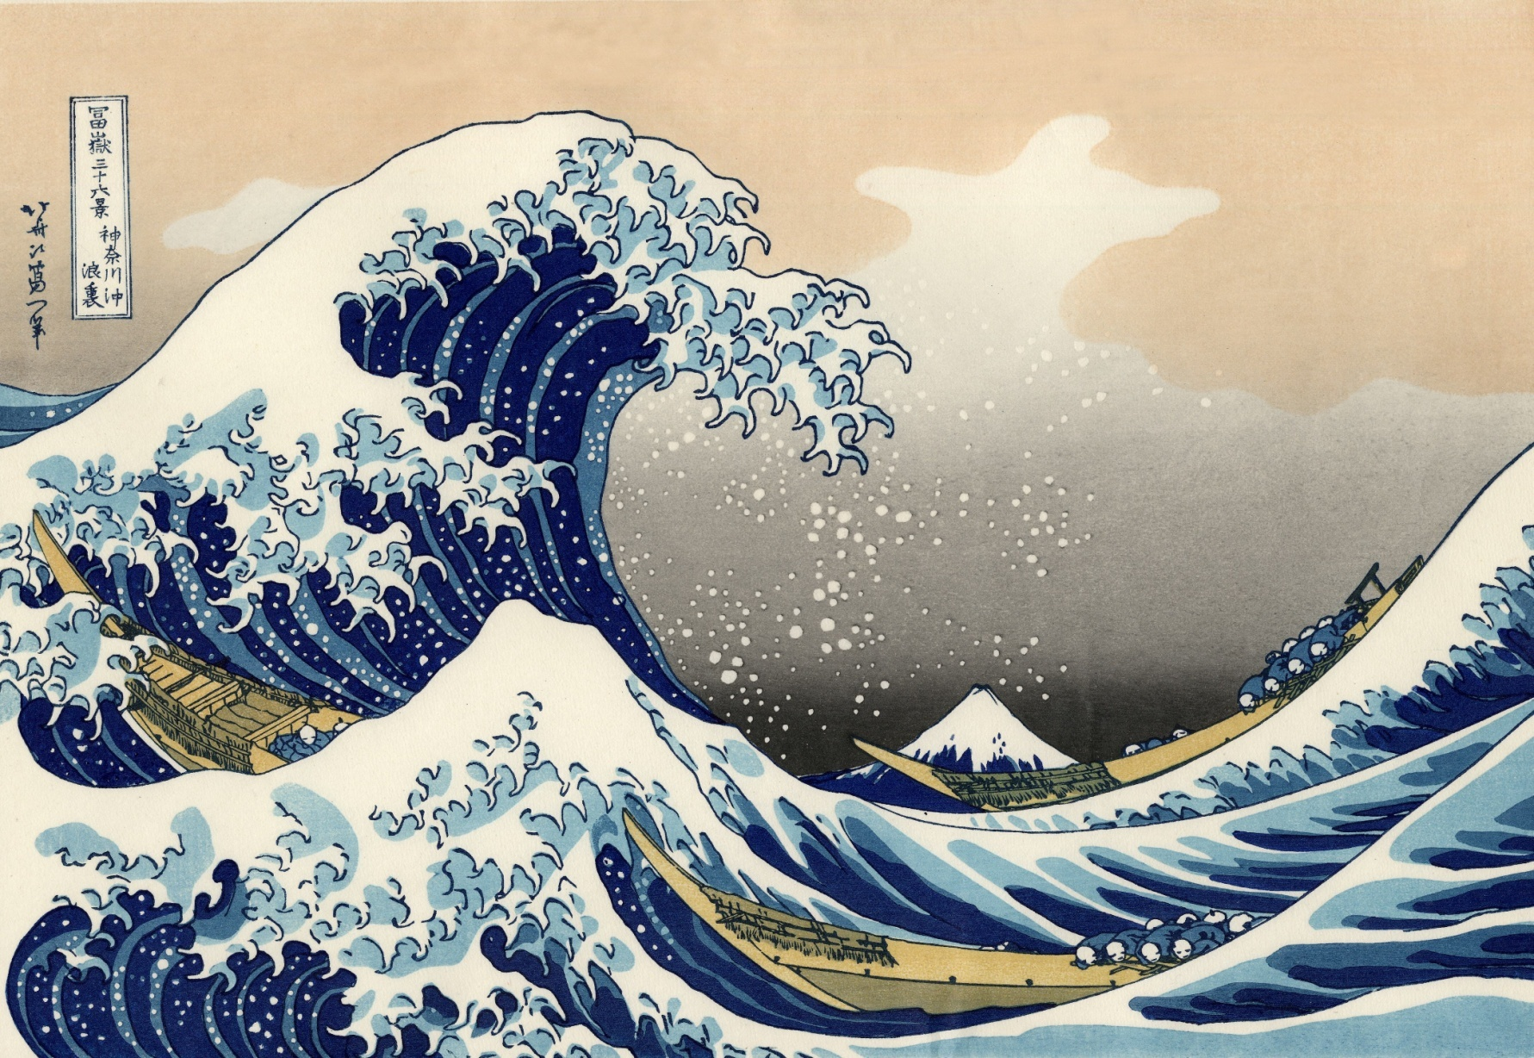
Emphasis: when elements are used to make one image dominant over another
Notes:
The Great Wave off Kanagawa
Hokusai

Slide 15


Slide 16

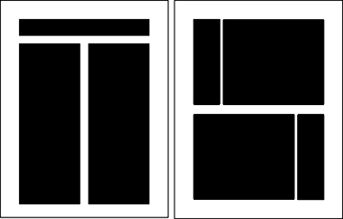
Balance: the comfortable arrangement of things in art.
  1 - Asymmetrical: balance isn’t completely the same on both sides
  2 - Symmetrical: balance is the same on both sides

Slide 17
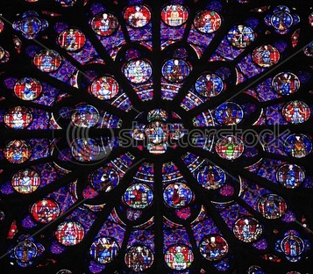
Balance (cont’d)
  3 - Radial: elements radiate out evenly from central axis

Slide 18
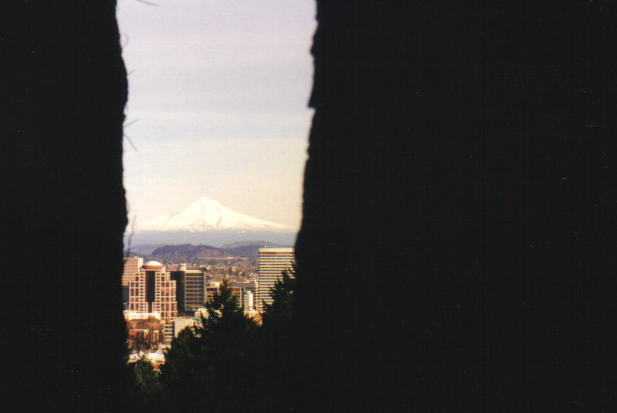
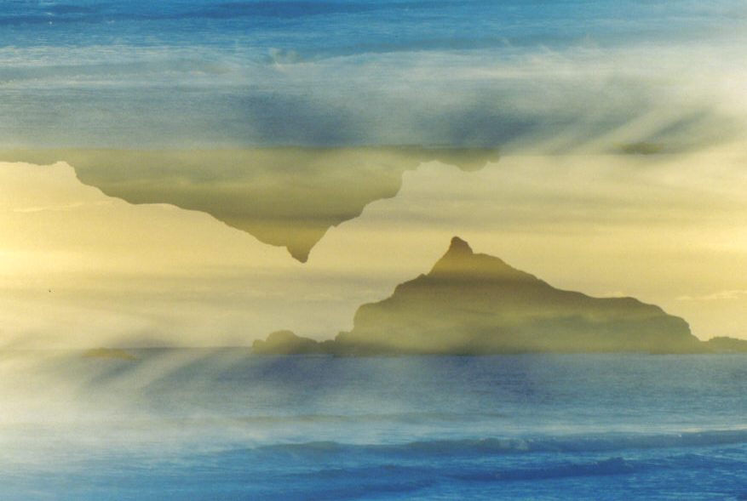

Slide 19
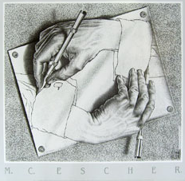

Slide 20
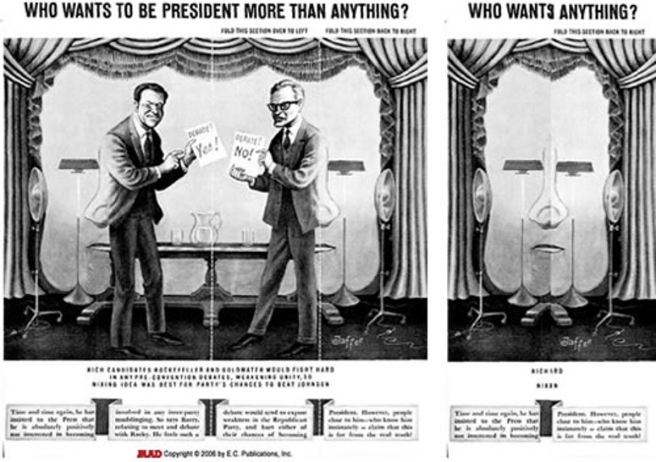

Slide 21


Slide 22
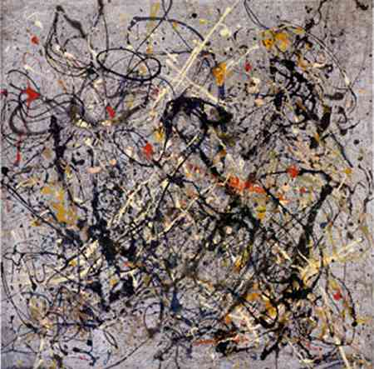
Variety: use of several different elements
Notes:
Jackson Pollock

Slide 23
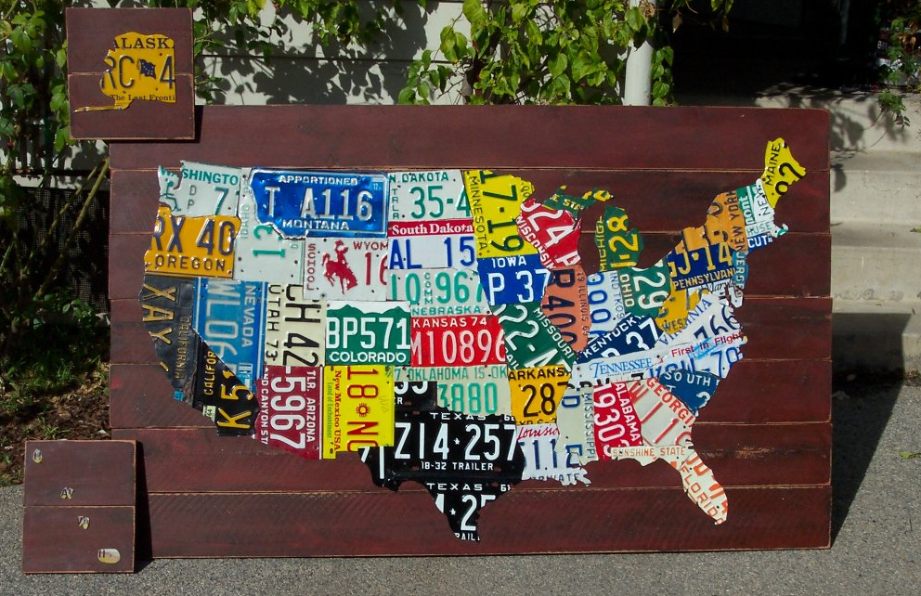
Unity: wholeness of the work

Slide 24
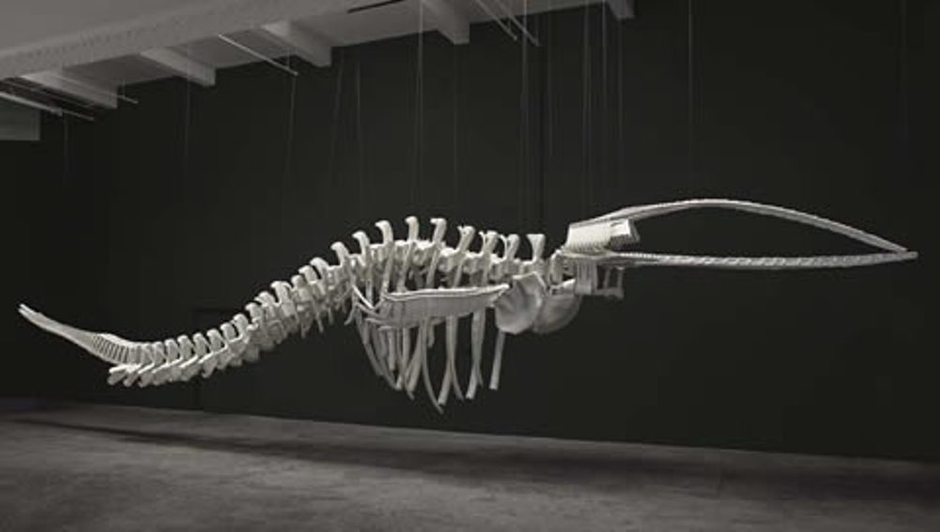
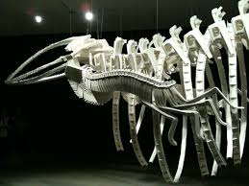

Slide 25
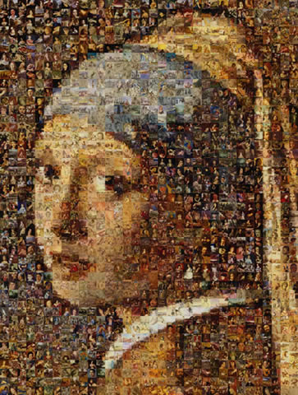
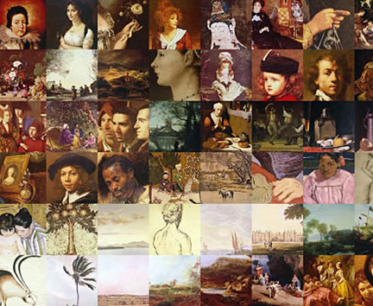
Notes:
Girl with the Pearl Earring – Vermeer
Robert Silvers Photomosaics
http://www.photomosaic.com/portfolio.html

Slide 26
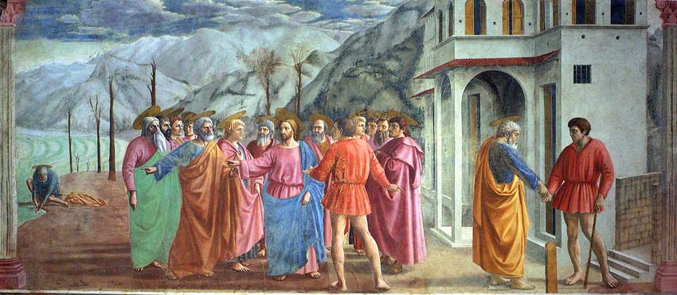
Perspective:
a graphing system that creates the illusion of depth and volume on a 2D surface
Notes:
The Tribute Money
Massiccio

Slide 27
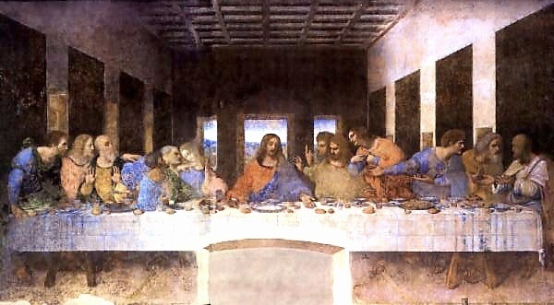
Linear Perspective:
  using lines to show distance and depth
  vanishing point

Slide 28
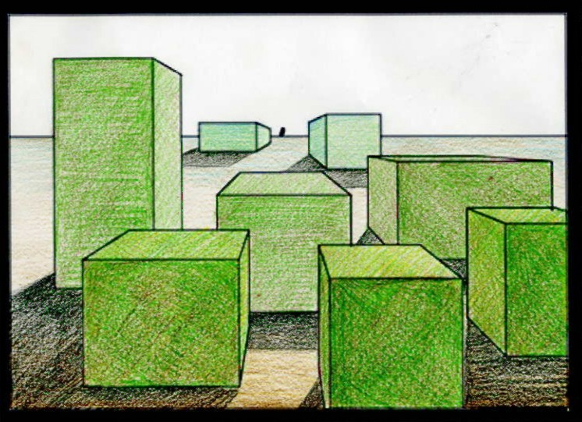
Atmospheric Perspective:
  effect of air and light on how an object is viewed by the viewer
    the more air between the viewer and the object, the more the object seems to fade
    A bright object seems closer to the viewer than a dull object
http://www.teachartathome.com/POD%20DW%20Images/Lesson%2016_files/KB%2016%2013%20c.jpg

Slide 29
Which perspective is it: linear or atmospheric?

Slide 30
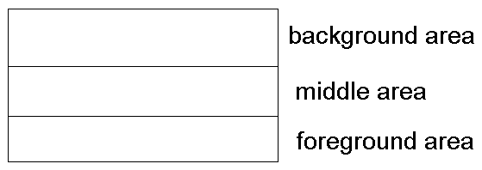
The Areas of Art:

Slide 31
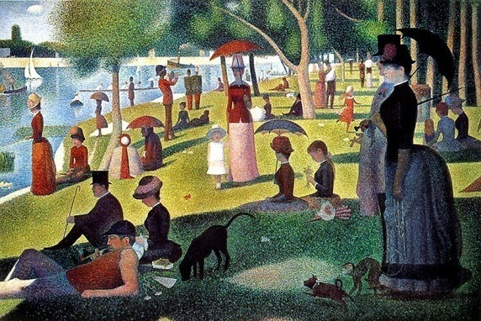
Which area is which?
http://www.ibm.com/developerworks/java/library/j-j2d/Seurat_SundayAfternoonGrandJatte.jpg

Slide 32

Which area is which?

Slide 33
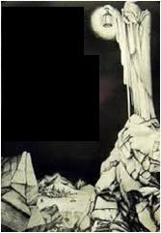
Which area is which?

Slide 34
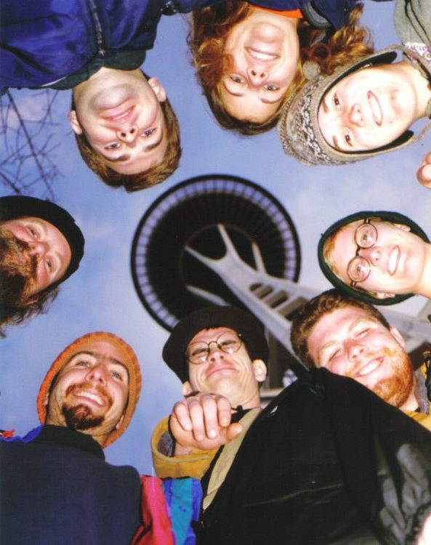
Which area is which?

Slide 36
Principles
Drawing Activity
Step 1: Take a sheet of computer paper and fold it EVENLY three times; unfold. You have 8 equal size boxes.
Step 2: Draw a faint line with a pencil that passes through all 8 boxes; make it curved or angular.
Step 3: Flip the page over and with a pencil faintly label each box with one of the 8 principles of art. Flip the page back over.
Step 4: Using the elements of art, create a visual example of each principle and illustrate it in the correctly labeled box.

Slide 37
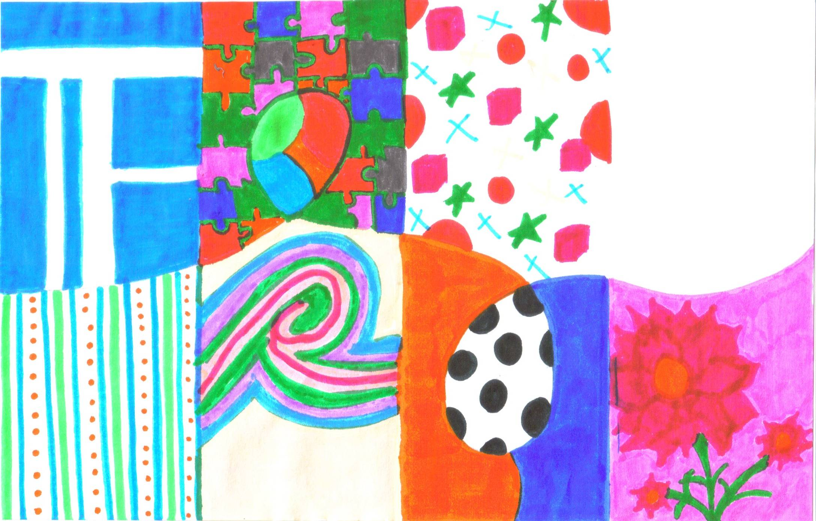
Which principle is missing?

Slide 38
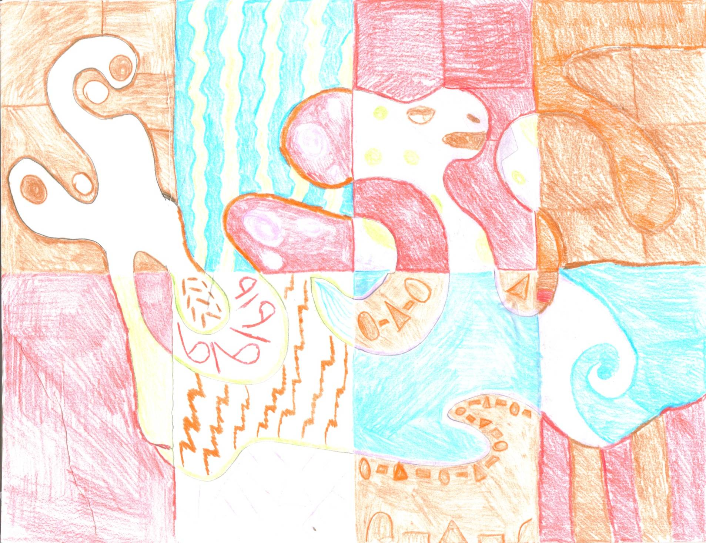

Slide 39
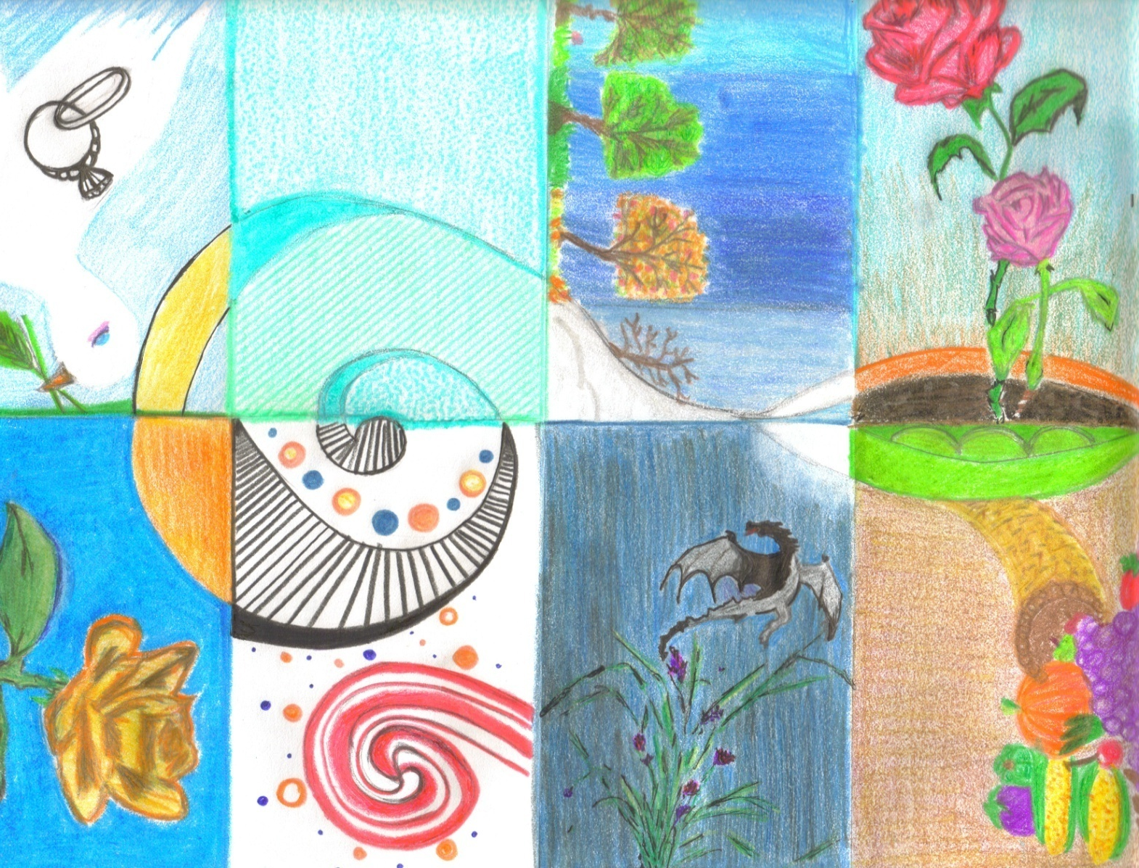

Slide 40
