Slide 1
The Purposes of Art
Ceremonial - ritual, celebration, artworks created to support worship ceremonies or rituals
Artistic expression - artwork to express or communicate emotions, ideas, feelings (e.g., for self-expression, to decorate or beautify objects)
Narrative - artworks that tell stories, describe and illustrate experiences, or communicate information, art to document important or historical events (e.g., Lange’s photography of the Depression era)
Functional - artistic objects used in everyday life (e.g., pottery, quilts, baskets, etc.)
Persuasive - philosophies, or products meant to influence someone’s opinion (e.g., advertising, marketing, propaganda, ideology, etc.)

Slide 2
Complete the Chart on Page 42 as we look at the images on the board.
Be sure to explain WHY you think it is your chosen purpose of art.
Keep in mind, art can have multiple purposes, however, there will be one MAIN purpose overall.

Slide 3
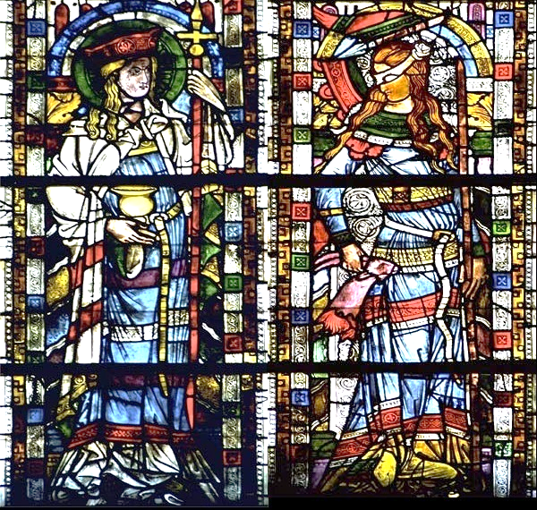
STAINED GLASS WINDOWS
The term stained glass refers either to the material of coloured glass or to the art and craft of working with it. Throughout its thousand-year history the term "stained glass" was applied almost exclusively to the windows of churches, cathedrals and other significant buildings. Although traditionally made in flat panels and used as windows, the creations of modern stained glass artists also include three-dimensional structures and sculpture.
http://www.flholocaustmuseum.org/history_wing/assets/room1/ecclesia_synagoga.jpg

Slide 4
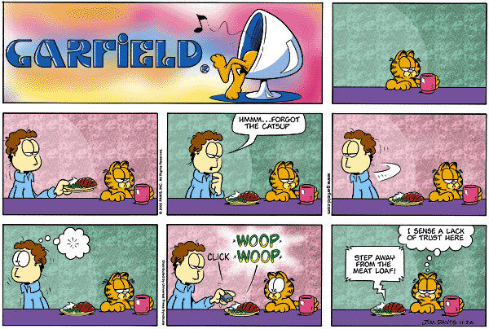
COMIC STRIP
A comic strip is a sequence of drawings that tells a story.
Currently in the Western world, most comic strips are written and drawn by a comics artist or cartoonist, and many such strips are published on a recurring basis (usually daily or weekly) in newspapers and on the Internet.
http://melanconent.com/catsup/allies/images/garfield_catsup.gif

Slide 5
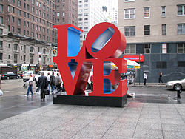

Slide 6
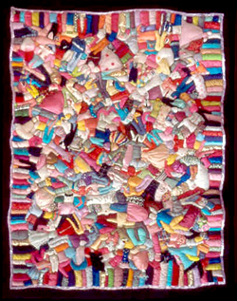
A quilt is a type of bedding— a bed covering composed of a quilt top, a layer of batting, and a layer of fabric for backing, generally combined using the technique of quilting. Many quilts are made with decorative designs; some quilts are not used as bed covering at all, but are rather made to be hung on a wall or otherwise displayed.
http://www.phl.org/art/images/quilts.jpg

Slide 7


Slide 9
Partner Activity - Description
FIND A PARNTER: One person is facing the back wall and the other person is facing the front wall.
The person facing away will draw an image described to them by the person looking at the screen.
Do not look at your partner’s drawing
Fully describe the work so that your partner can produce a replica of the work on the screen
Use descriptive words!

Slide 10
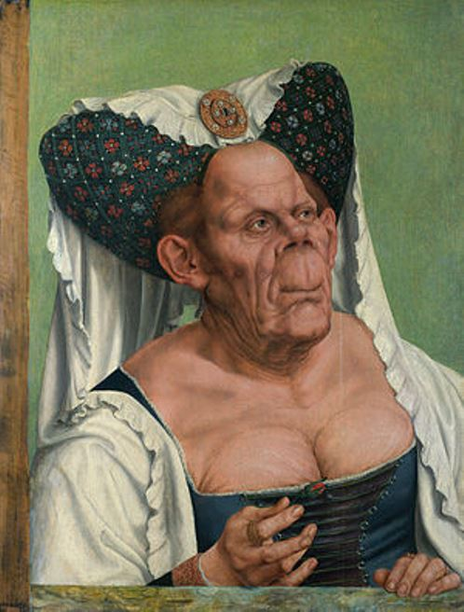
Partner #1: Describe this work to your partner!

Slide 11
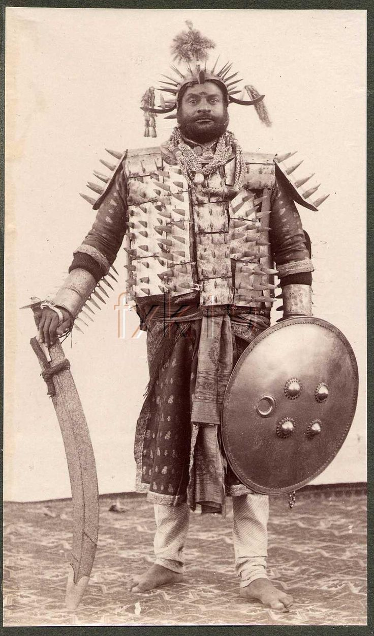
Partner #2: Describe this work to your partner!

Slide 12
The Ugly Duchess
(1513) by Quentin Matsys
The woman has been often identified as Margaret, Countess of Tyrol. Michael Baum, professor of surgery at University College London, suggested that she suffered from a form of Paget's disease, in which the victim's bones enlarge and become deformed.
The portrait is thought to be a source for John Tenniel's 1869 illustrations of the Duchess in Alice's Adventures in Wonderland.
It shows a grotesque old woman with wrinkled skin and withered breasts. She wears the aristocratic horned headdress of her youth, out of fashion by the time of the painting, and holds in her right hand a red flower, then a symbol of engagement, indicating that she is trying to attract a suitor. However, it has been described as a bud that will 'likely never blossom'. The work is Matsys' best-known painting.

Slide 13
Executioner
(India 1903) by Samuel Bourne

Slide 14
AVG Practice
Page 43
Complete an AVG on the Ill-Matched Lovers
The following must be completed:
  Information (title, artist, date, place, style, and media)
  Sketch
  Name the Subject
  Complete color and value (element) and the contrast (principle)
    Cross out shape and form and replace with color and value

Slide 15
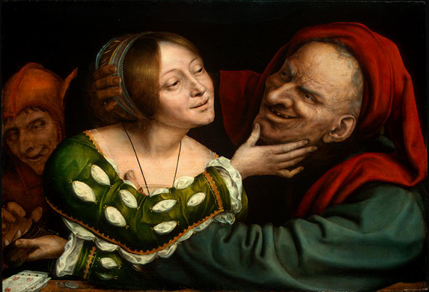
Title:
Ill-Matched Lovers
Date:
1525
Artist:
Quentin Matsys
Place:
National Gallery, Washington, D.C./
Belgium
Style: Portrait - Northern Renaissance
Media: oil on panel

Slide 16
An old lecher, whom Matsys modeled after a drawing by Leonardo da Vinci, fondles a willing young woman. She meanwhile slips his purse to a gnome like accomplice in a fool’s cap. The large, brightly lit figures press close to the front of the painting, as if seen through a window. This separation makes us aware that we are witnesses of the scene, not participants, and therefore free to judge and make a moral choice. Messages like this one about the consequences of vice were familiar to audiences in Antwerp.
Matsys’ painting evokes these lines from an anonymous Dutch poet:
  A rover—short, old, and free
  With purse running over with gold,
  Took a Venusberg lass for a spree
  Who took clients like him in her hold.
  That lass has her loose, lowly wiles,
  Undoing his purse with its glut
  While showing a face full of smiles
  Like the grin of a flat halibut.

Slide 18
Subject/Physical/Cultural Context
1. WHO -This painting is of three people, an old man, a younger woman, and a younger man in the background.
2. WHAT - The old man lusting is after the young women and she is trying to take his money.
3. HOW - She is distracting him by touching his chin and letting him get to “second base”.
4. WHY - The theme of the painting is to teach you WHAT NOT TO DO by showing how foolish some people behave.

Slide 19
How to analyze a piece of art
We are now going to take your AVG to the next level….
Write down the following steps on the back of page 37 in your workbooks.

Slide 20
Analyzing a Piece of Art
Step One: Intro
-Read the prompt, develop a thesis, and write your intro.
You will be asked to i.d. the purpose and the two most important elements and one principle.
Step Two: Body Paragraphs
Describe and explain the use of the two elements and one principle you selected.
Why did the artist do that? Show how the elements and principles relate to the purpose you chose.
3 total paragraphs!
Step Three: Conclusion
-Restate your thesis. Revisit what the purpose of the work was and how you know.
-Wrap up all your ideas and make sure one last time you have gotten your argument across.

Slide 21
How do you analyze a piece of art?
    After viewing The Ill-Matched lovers, write an essay that discusses the purpose of this work and evaluates the artist’s use of two elements and one principle. Support your position using evidence from the painting.

Slide 22
Step One: Thesis Writing
Using what we know about the painting, fill in your formula:
The purpose of the Ill Matched Lovers is ____________. The artist demonstrates this purpose with his use of (Color), (Value), and (contrast).
Once you have your thesis,
Carry on with the rest of your
Intro, include cultural context.

Slide 23
Thesis and Intro Paragraph
The purpose of the Ill-Matched Lovers is persuasive. The artist demonstrates this purpose with his use of color, value, and contrast. This painting is of three people, an old man, a younger woman, and a younger man in the background. The old man lusting is after the young woman and she is trying to take his money. She is distracting him by touching his chin and letting him get to second base. The overall meaning of the painting is to teach you WHAT NOT TO DO by showing how foolish some people behave.

Slide 24
Body Paragraph - Color
The element of color makes this artwork persuasive. The man with the red head dress is representing lustfulness. The woman in green is possibly representing envy; he has money and she wants it! The color combination of red and green are trying to persuade the viewer not to be lustful and envious based on how silly the figures look.

Slide 25
Body Paragraph - Value
The element of value is used to show the age difference between the old man and the young woman. The high value of the woman makes her stand out and distracts the viewer from noticing that she is stealing the man’s wallet. The low value on the man’s face let’s you know how “dirty” and old he actually is compared to the woman. The value convinces you that they are both evil or bad people.

Slide 26
Body Paragraph - Contrast
Both color and value are used in this image to create contrast. The contrasting colors of red and green make the main characters stand out and the contrasts in value show their age differences. The “lovers” are ill-matched in age, but the artists is persuasive in showing that they are both bad people, so maybe, they are actually well-matched lovers!

Slide 28
Conclusion Paragraph
The use of the elements and principles of color, value, and contrast help communicate the artistic purpose of persuasion. By showing you what not to do the artist communicates Christian themes in his artwork. In addition to persuasive this piece also uses narrative and ceremonial ideas to instruct people on how to live a proper life.

Slide 29
Useful Tips
Do not use short, choppy sentences to describe the painting. Be concise, descriptive and interesting.
Do not say “you” or “I”.
I know what you think, you are writing it!
3)Have transition sentences between paragraphs, don’t jump from paragraph to paragraph!
4)Do not use abbreviations, bullets, Venn Diagrams – this is formal writing!

Slide 30
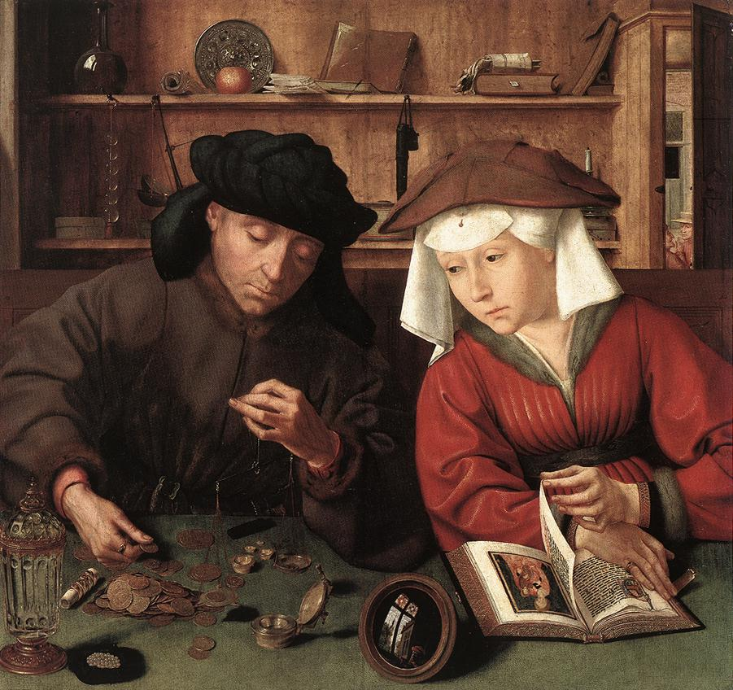
Money Lender and His Wife

Slide 31
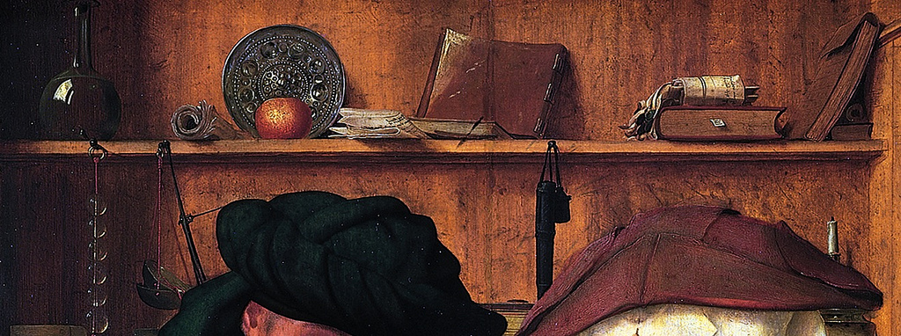

Slide 32
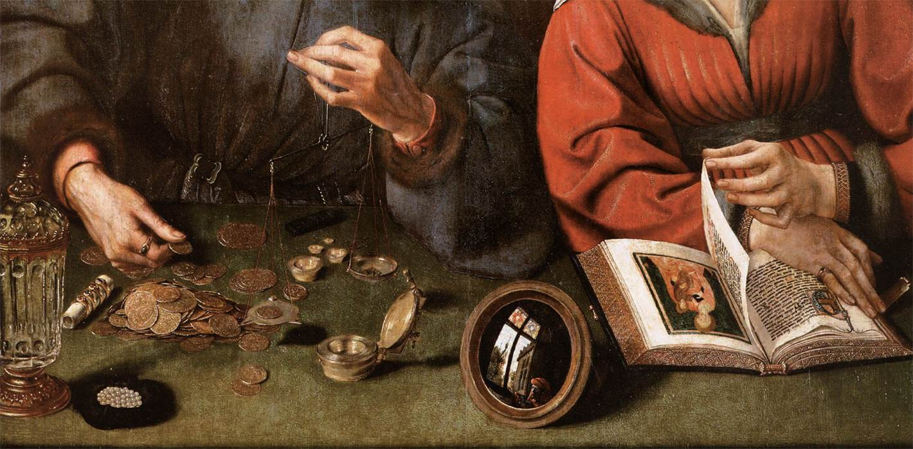

Slide 33
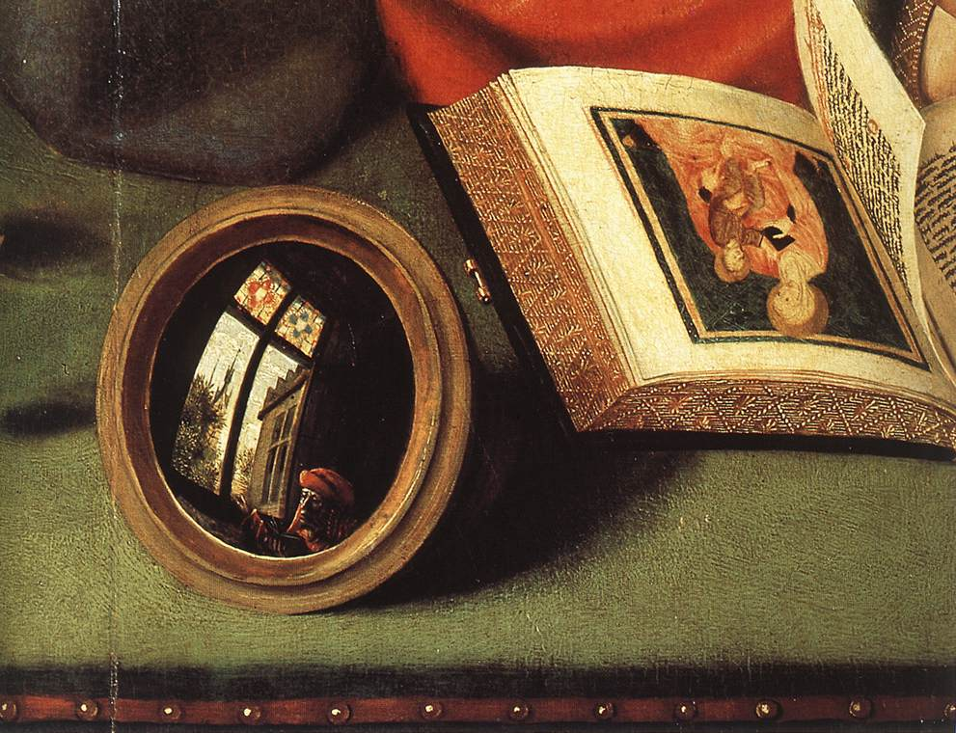

Slide 34
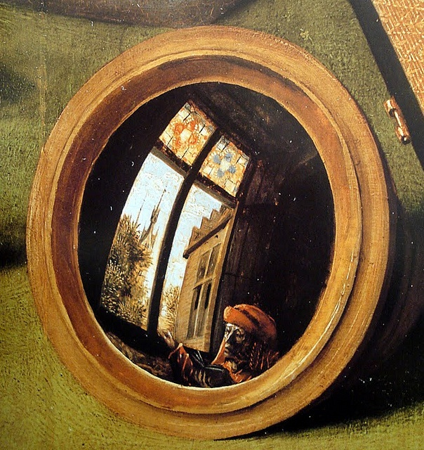

Slide 35
Exit Slip
Finish the sentence with the best possible purpose of art.
  The purpose of a stained glass window is…
  The purpose of a comic strip is…
  The purpose of a necklace is…
  The purpose of a billboard is…
  What purpose of art can apply to ALL visual art?

