Slide 1
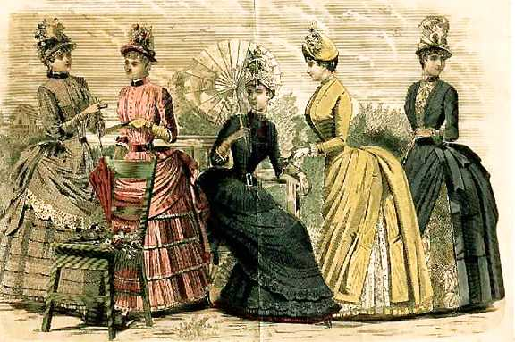
Realism Theater

Slide 2
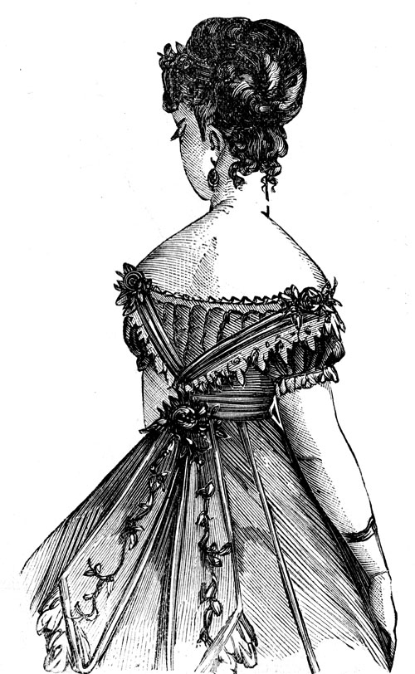
Realism Theater
There is significant character development
  Dialogue
  Foreshadowing
Cause-and-Effect Structure
  sometimes even seemed “plotless”
  no real story but only a focus on the characters.
    Characters finally seen as individuals with props that give information on the character
Subjects:
  Dismal
  Controversial topics
    topics which Victorian society attempted to conceal.
    The plays you will study confront and redefine Victorian gender roles.

Slide 3
Realism Theater
  Theme One:
    Direct observation of human behavior and it was to deal with everyday life and problems as subjects and themes.
  Theme Two:
    Criticism of societies and the recognition of the absurdity of life.
  Theme Three:
    A longing for another life that is either better or different than the one being lived.

Slide 4
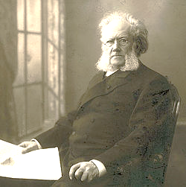
Henrik Ibsen
1828 – 1906
Born in Norway
His plays attacked society’s values and dealt with unconventional subjects within the form of the well-made play (cause-and-effect structure).
Wrote about controversial topics of the time
  (STDs, marriage issues, roles of women in society)
James Joyce said Ibsen’s work "has provoked more discussion and criticism that of any other living man."
Famous work: A Doll’s House (1879).
Notes:
http://www.youtube.com/watch?v=JLXkzcR1YK0&feature=results_video&playnext=1&list=PL2B02A2DA0A01F339

Slide 5
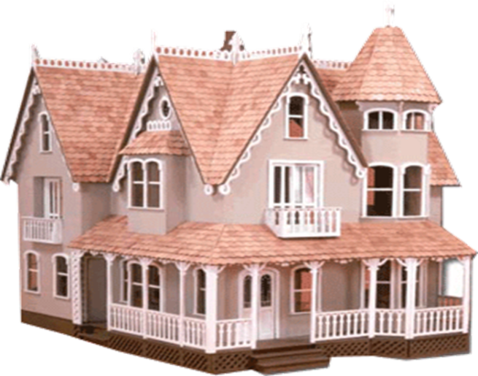
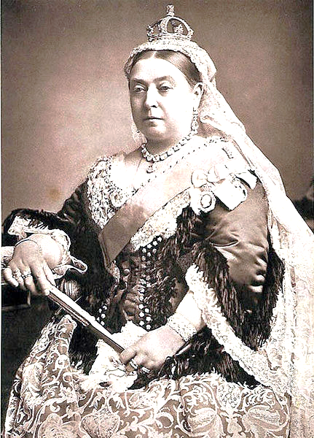
A Doll’s House - Background Knowledge
Major Idea: Gender Roles in Victorian England
  “In terms of gender ideology, the accession of Victoria (as a Queen) was something of a paradox. Traditionally, women were defined physically and intellectually as the 'weaker' sex, in all ways subordinate to male authority. In private life women were subject to fathers, husbands, brothers even adult sons. Publicly, men dominated all decision-making in political, legal and economic affairs.” http://www.vam.ac.uk/collections/periods_styles/19thcentury/gender_health/gender_ideology/index.html
Famous Work: A Doll’s House
Notes:
http://www.youtube.com/watch?v=JLXkzcR1YK0

Slide 6
Why does A Doll’s House still impact us today?
Objective:
  Demonstrate your knowledge of the impact of these plays on Victorian and Contemporary society
Assignment:
  Read the summary of the play and answer the corresponding questions on your handout
    Note: Some of the questions are
      comprehension questions
        (Do you understand the text?)
      while others require you to analyze the impact of the play
        (Do we still struggle with the same issues discussed in the play?)
Time Allotment:
  12 minutes

Slide 7
Theater Viewing Guide
Name of work: Doll’s House
Author: Henrik Ibsen
Date: 1879
Place: Norway
Director: Ibsen
Genre: Drama
Main Performers: Torvald, Nora, Krogstad, Ms. Linde, Dr. Rank

Slide 8

A Doll’s House - Modernized
What Realist theater theme(s) relate to this clip? Explain by citing evidence from the clip.
  Use must site one of the three Realist theater themes we discussed last class.
One character in this clip resembles Nora. Identify this character and explain how she is similar to Nora from A Doll’s House.
Fried Green Tomatoes clip
http://www.reelz.com/trailer-clips/36727/fried-green-tomatoes-trailer/

Slide 9
A Doll’s House – Four Corner activity
Assignment:
  In class we read a section from Henrik Ibsen’s, A Doll’s House. This play debuted in 1879 and caused much controversy when, at the end of the play, the lead character, Nora, decides to leave her husband, Helmer.
  Your assignment is to formulate an opinion on Nora’s actions.
  You must chose from the following scenarios:
    “Nora is a wife and mother above all else, and she shouldn’t have left.”
    “Nora is a human and can leave if and when she chooses.”
    “ Nora can leave for a while, but needs to come back when she’s found herself.”
    “ Nora should continue to live in the house as brother and sister with Torvald to “keep up appearances” and be there for her children.”
On an index card provided, select one of the options above and support your opinion using facts gained from the reading or class discussion.
Notes:
Last year, we had a discussion about changing these options because there wasn’t enough discussion points: no one chose that Nora would be cast out from society, even though this was a real possibility for her character. As a result, I have changed the fourth bullet to something that Torvald says in the play. If we meet before we teach this, we should discuss this.

Slide 10
A Doll’s House – Four Corner activity
Procedure
  Go to the corner that matches your opinion.
    If multiple people go to the same corner, you must have no more than three people per large butcher paper.
    Once there, tape your notecard beneath the appropriate opinion.
    As a group, establish a common argument for this statement.
      In other words, create a new statement that combines all of your justifications.
When your group justification is completed, go to the poster on the right and create a counter-argument as a group. Write this statement below the previous groups’ work.
Once you have completed this statement, return to your assigned seat.

Slide 11
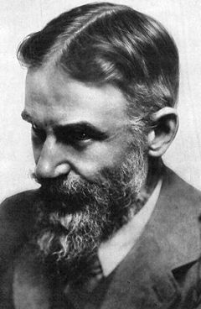
George Bernard Shaw
1856 -1950
Born in Dublin, Ireland
Wrote 60+ plays
Works are known for:
  Radical rationalism
  Disregard of conventions
  Dialectic interest (how people speak) and verbal wit
Famous Work: Pygmalion (1912)
  Won the Nobel Prize for literature and an Academy Award
  Overview: a witty study of phonetics as well as a clever treatment of middle-class morality and class distinction
In your notes, summarize the story of Pygmalion in your
notes after watching the following clip:
http://www.youtube.com/watch?v=zDEdd5Moffc
Notes:
http://www.nobelprize.org/nobel_prizes/literature/laureates/1925/shaw-bio.html

Slide 12
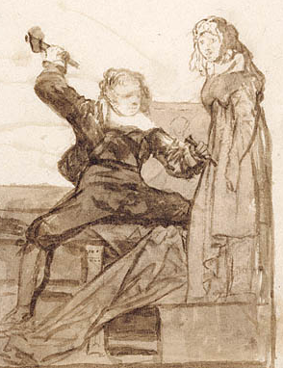
Pygmalion
  1) Pygmalion is based on ______________ where _________ carves ________ the perfect woman named ____________. This made ________ very mad. ______ makes __________ a real girl and everyone lives happily ever after.
  2) In G.B. Shaw’s Pygmalion, _________ makes a bet with his friend where he will turn a _________ into a _________. He will accomplish this by changing how __________.
  3) How does this play differ from the myth?
  http://www.youtube.com/watch?v=zDEdd5Moffc
Notes:
The Galatean Myth; pygmalion; Galatea; Aphrodite; Aphrodite; Galatea
Henry Higgins; a flower girl; princess; she speaks
Eliza falls in love with Higgins, but will find another suitor (boyfriend).

Slide 13
Pygmalion - Characters
Henry Higgins
  Professor of phonetics - States that he could pass Eliza off as a duchess instead of a poor flower girl by changing how she speaks
Colonel Pickering
  Student of dialects who seals the bet with Higgins by paying for Eliza’s dialect lessons
Eliza Dolittle
  Poor flower girl who is forced to sell her flowers off of the streets due to her lack of proper speech and manners
Mrs. Higgins
  Henry Higgins’ mother who is more prim and proper than her son
Mrs. Pearce
  Mr. Higgin’s housekeeper. She is very aware of class distinctions
Freddie
  Well to do young man who falls in love with the remade Eliza
Narrator(s)
  Readers who will not only introduce Acts but highlight key events and provide conclusions for the scene.

Slide 14
Pygmalion - Language
Assignment:
  Translate a selection of quotes from Pygmalion for an audience of teenagers today by altering diction, syntax, and style, but maintaining Shaw’s plot and meaning.
Presentation
  You will present the original quote and the translation to the class.
Class Requirements during Presentation:
  Identify the character who spoke these original lines.
  Identify stereotypes associated with the re-interpretation of the quote.

Slide 15
Evaluation:
A Doll’s House, Pygmalion, and Women’s Rights in a Victorian Society
In Pygmalion, a character states, “You certainly are a pretty pair of babies, playing with your live doll.” (Act Three)
1) Explain how this statement supports gender roles in a Victorian society.
  Use the following quote to help you justify your statement:
  “Traditionally, women were defined physically and intellectually as the 'weaker' sex, in all ways subordinate to male authority. In private life women were subject to fathers, husbands, brothers even adult sons. Publicly, men dominated all decision-making in political, legal and economic affairs.”
2) Explain how both Nora and Eliza defy the quote above stating information you learned from the plays.

Slide 16
Reader’s Theater
Why does Pygmalion still impact us today?
Objective:
  Demonstrate your knowledge of the impact of Pygmalion on Victorian and Contemporary society
Assignment:
  You will be divided into groups where you will complete a reader’s theater over Pygmalion
    When in your groups, select your role (Henry Higgins, Eliza, etc.)
    Answer the questions about your Act on your Learning Guide
Time Allotment:
  10 minutes to read through your script
Presentation Format:
  Acts will be performed in order. As soon as Act One is complete, Act Two will present, and so on.
Audience Requirements:
  No talking while another group is presenting.
  Answer the questions about each Act as the Acts are being presented.

