Slide 1
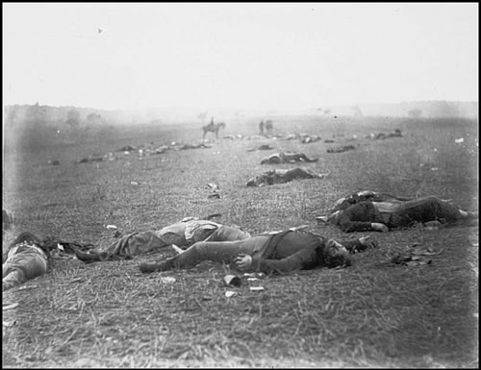
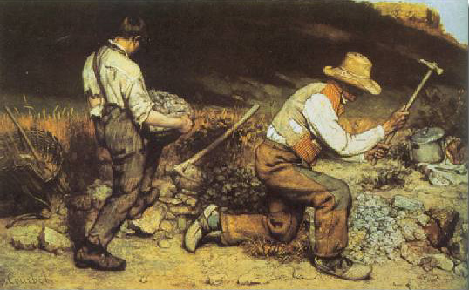
Realism Visual Arts
Objective: a truthful objective, scientific, view of the world
Artists wanted to show society as it really was
(not “Romanticized”)
Scenes of industrial cities, physical labor, real people who complete the real work.
Artist was thought of as a scientific observer of detail
Movement was heavily influenced by the invention of the camera

Slide 2
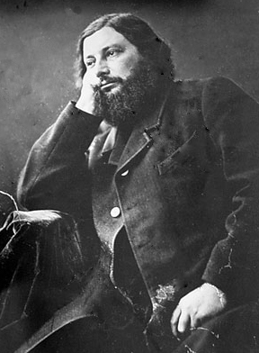
Gaustave Courbet
1819-1877
French
“Father of Realist movement”
Despised labels
Famous works:
-Burial at Ornans
-Interior of My Studio
Technical elements:
Simple and direct methods of construction
Somber palette applied with palette knife
Addressed social and controversial issues through his art.
Many of his works were considered pornographic.
His style encompassed the spontaneity, irregularity, and harshness of real life.

Slide 3
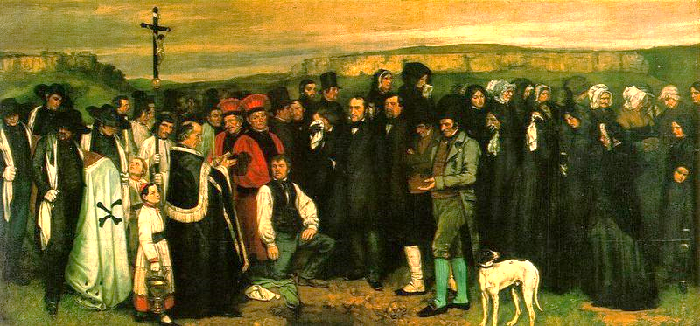
Burial at Ornans
Burial at Ornans Gustave Courbet 1850

Slide 4
Burial at Ornans
“It was in reality the burial of Romanticism.”
No heroism/exalted truth
It’s a small town funeral. There is no glorification
Incarnation of Socialism= funeral goers
Even though the painting is divided into three groups of people, each group is equal in social status. There is no social hierarchy.
Also, these individuals, who were once not permitted to be the subject of fine art, are now able to be the subjects.
Scale of a history painting
History painters are paintings that are extremely large and depict a historic event.
This large canvas is dedicated to the average people
Subject’s ordinariness and anti-heroic composition outraged critics
This image lacks bright color.
Courbet used color to symbolize the mundane realities of life and death.
Notes:
“It represents a small town funeral and yet reproduces the funerals of all small towns.

Slide 5
Burial at Ornans

Slide 6
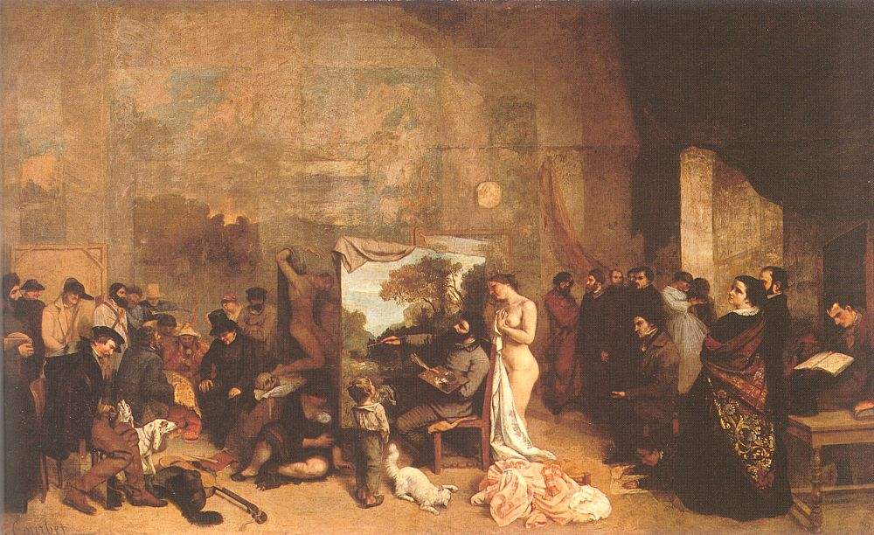
Interior of My Studio – Seven Years of My Life as an Artist (1855)

Slide 7
Interior of My Studio – Seven Years of My Life as an Artist (1855)
“Fantasy Self-Portrait”
Even though this painting depicts Courbet and other individuals present in a realistic manner, the organization of the composition is a figment of Courbet’s imagination.
Courbet central character
Courbet unites this otherwise divided painting. This painting is divided into three sections.
The individuals to his left are peasants, a hunter, a priest, a mother and child who represent life in his hometown. Courbet’s art is made for these people.
The individuals to his right are critics, clients, and intellectuals. These are the people who criticize his work; he DOES NOT create his work for them.
Small child
The small child represents innocence.
Nude model
The nude model represents nature.

Slide 8
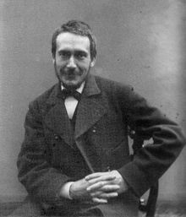
Thomas Eakins
1844 – 1916
Born in Philadelphia, PA
A painter, photographer,
sculptor, and professor
Commonly used nude subjects
(was fired from his teaching position for using a nude
model in a drawing class in front of a female student).
Had an interest in and was an innovator in
the subject of motion photography. He used
photographs to paint his subjects.

Slide 9
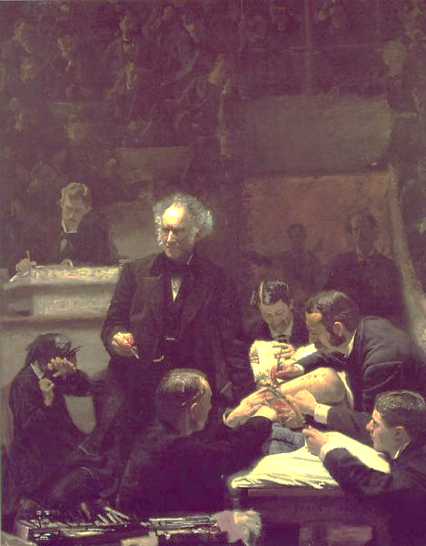
The Gross Clinic 1876

Slide 10
The Gross Clinic
Dr. Gross, a Pennsylvania doctor, is a pioneer surgeon who is demonstrating a daring procedure
Physician is relatively emotionless; the patient’s mother is very upset
Attendants hold chlorophorm and the bloody incision- very important! Why?
Symbolizes the people’s faith in scientific and medical progress
The light focuses on Dr. Gross’ head (his brain) and on the dissected leg.
Patient suffered from osteomyelitis (a bone infection)
This painting is controversial because of its graphic nature and also because the surgery itself is controversial (they would have amputated rather than done procedure).
“It is a picture that even strong men find difficult to look at long, if they can look at all.”
Notes:
Painting hung in the ampitheater of the Jefferson Medical College in Philadelphia where the painting hung until it was sold in 2006.
All people in this painting can be identified by historians

Slide 11
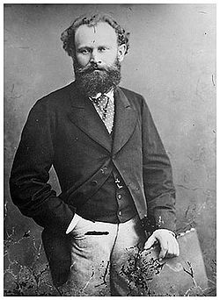
Édouard Manet
1832 – 1883
Born in Paris, France (frequently
visited and studied at the Louvre
when he was young).
Painted “modern-life” subjects
He began as a Realist but made the transition to Impressionism
His two most famous paintings are thought to
have marked the beginning of Modern art.
The Luncheon on the Grass
Olympia

Slide 12
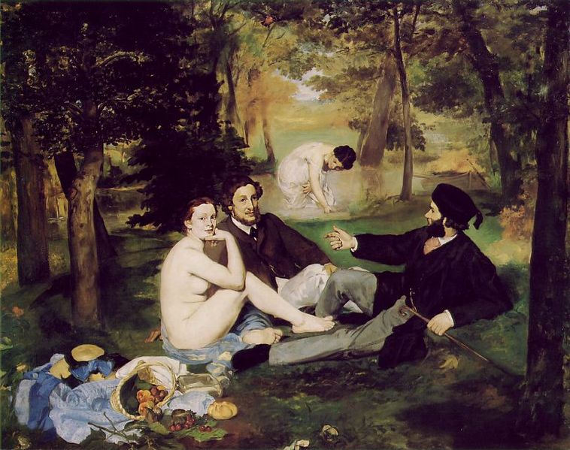
The Luncheon on the Grass 1863 (Le déjeuner sur l'herbe)

Slide 13
The Luncheon on the Grass 1863 (Le déjeuner sur l'herbe)
Models from real life
Woman is a combination of Manet’s wife and favorite model.
Men are Manet’s brother and brother-in-law.
Nude is unidealized and unabashed
Without shame, the woman sits at a picnic with two FULLY clothed men.
Nothing is idealized…
Ordinary men with a promiscuous woman in the park
Flattening of forms, loose manner of composition
These characteristics were some of the objections critics had to this piece.
“A commonplace woman of the demione, as naked as can be, shamelessly lolls between two dandies dressed to the teeth The latter look like schoolboys on a holiday, perpetrating an outrage to play the man, This is a young man’s practical joke- a shameful, open sore.“

Slide 14
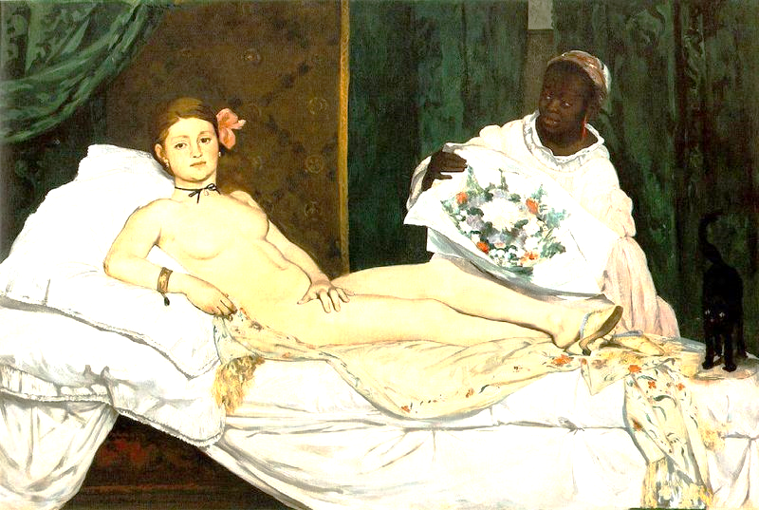
Olympia 1863
Notes:
– women’s liberation; how? NOT IDEALIZED!

Slide 15
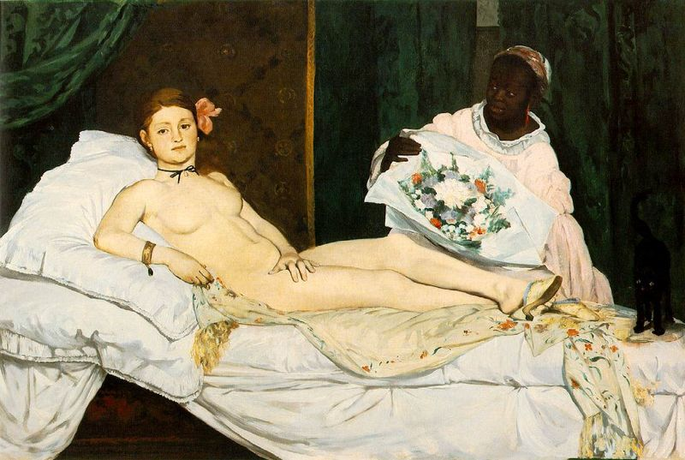
This is an image of a woman of his time-- a courtesan
“Olympia” was the professional name for prostitutes
Formal Composition
quickly, in rough brushstrokes
No carefully constructed perspective
Manet offers a picture frame flattened into two planes
Body is a commodity.
While middle-and- upper class gentlemen of the time may frequent courtesans and prostitutes, they do not want to be confronted with one in a painting gallery.
A real woman, flaws and all, with an independent spirit.
Shamelessness and look of defiance shocked viewers
She is not idealized (no s-curve)
Reference to racial divisions
The maid serves the courtesan.
A black maid and prostitute evoked moral depravity, inferiority, and animalistic sexuality
“a courtesan with dirty hands and wrinkled feet… her body has the livid tint of a cadaver displayed in the morgue; her outlines are drawn in charcoal and her greenish, bloodshot eyes appear to be provoking the public, protected all the while by a hideous Negress.”
Notes:
– women’s liberation; how?

Slide 16
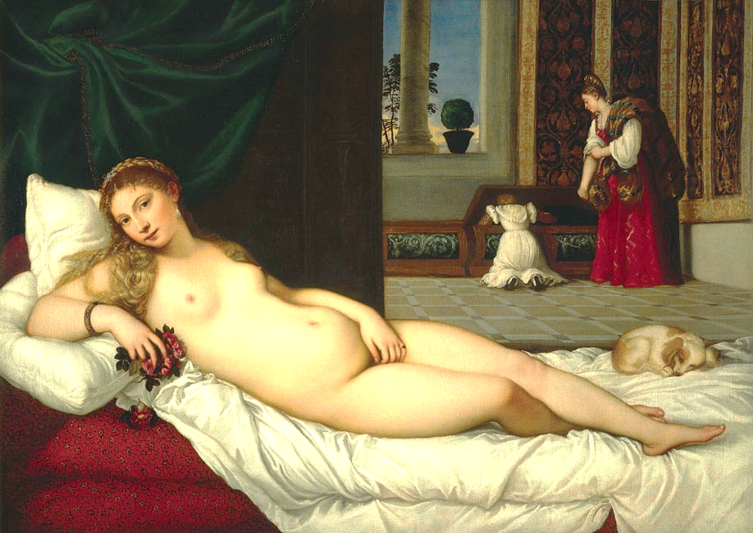
Venus of Urbino
Titian, 1538
Olympia
Manet, 1863
Notes:
Compare/contrast Renaissance idelized beauty vs. Realist “real” beauty.

