Slide 1
The Renaissance
Why did this cultural revolution start in Italy?

Slide 2
Time Period Units
Focuses on artistic time periods and covers all five strands of VPA in each period.
  Visual Art, Dance, Music, Theater, and Architecture
Heavily connected to historical events, technology and cultural characteristics
Test will generally be given after each time period unit, i.e., Renaissance, Baroque, Neoclassical. Generally every 2-3 weeks.
Make sure you have a 3 ring binder every class, you will be getting handouts like crazy!
Label this tab “Renaissance”

Slide 3
Page 20
Renaissance Review – what do you know already?
1) Where did the Renaissance start?
2) What does the term “Renaissance” mean?
3) Why was da Vinci a Renaissance man?
4) The Divine Comedy was written by whom?
5) What was Michelangelo’s main medium?
6) Who supported the idea that girls should gain an education?
7) Name one Shakespeare play.
8) Name one great Renaissance thinker.
http://www.youtube.com/watch?v=0CRX_mqpzdU

Slide 4
Opener:
Renaissance
http://www.youtube.com/watch?v=0CRX_mqpzdU

Slide 5
What is the Renaissance?
Around 1350 in Italy (1400-1600 Historically)
Renewed artistic and historic interest in the past.
Why and How?
  Black Death (Plague) reduced the population in Europe from 85 to 60 million.
  Europe benefited from a warm climate that enabled a larger supply of crops.
    A larger supply of crops allowed Italy’s economy to grow (surplus)
    elite class of society increased
    Development of a Middle Class
    Allowed people to become more educated/scholars/historians

Slide 6
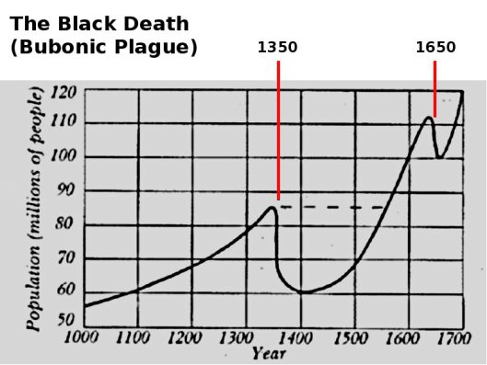

Slide 7
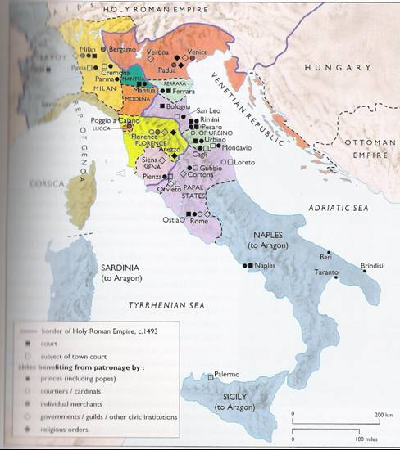

Slide 8
Who are Humanists?
Studied how to lead a proper life according to the ancient Greeks and Romans through their literature
The Italian scholars emphasized the study of several subjects: grammar, rhetoric, history, and poetry, while using classical texts.
These subjects are called the humanities and the individuals who study these subjects are called humanists.
What do humanists believe?
  Studying the classical texts led Humanists to believe that it was important to learn how things worked, to emphasize education, led a meaningful life, and to financially support the arts. Humanists celebrate both life and the afterlife.

Slide 9
The Art
of the
Italian Renaissance

Slide 10
New Techniques
A. Fresco
  Painting done on fresh, wet plaster with water based paints
B. Perspective
  Organization of outdoor space and light through geometry – 3D
C. Human anatomy and movement
  Realism of humans
D. Sculpture
  Donatello- Greek and Roman influence
E. Architecture
  Brunelleschi- focused on human needs not divine

Slide 11
Art and Patronage
Italians were willing to spend a lot of money on art.
  Art communicated social, political, and spiritual values.
  Italian banking & international trade interests had the money.
Public art in Florence was organized and supported by guilds.
The consumption of art was used as a form of competition for social & political status!
Patronage was a display of wealth = public art!
Yes, it educated the masses but it also displayed who had money! Donated by…….

Slide 12
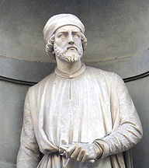
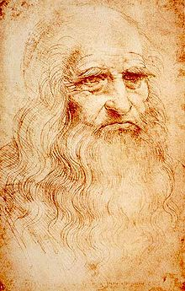
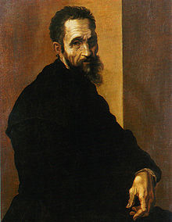
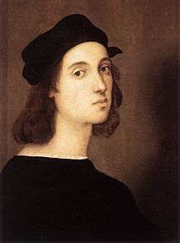
Masters of High Renaissance
Donatello
  Reinvented the free-standing nude in
  classical style
Leonardo da Vinci
  Masters realistic painting, dissected human bodies, goal to create idealized forms that capture the perfection of nature
Michelangelo
  Accomplished painter, sculptor, architect
Raphael
  Admired for Madonnas and frescoes in Vatican palace

Slide 13

Masters of the Italian Renaissance?

Slide 14
Characteristics Carousel
Page 20 in your notebook
Objective:
  To learn about the SIX characteristics of Renaissance Art
Directions:
  In pairs, you will be assigned a COLORED poster
  You will have 5 minutes to get the required information from each poster to complete your learning guide.
  You must DRAW ON YOUR LEARNING GUIDE in order to receive credit
Time Allowed: 30 minutes

Slide 15
Characteristics
of
Renaissance Art

Slide 16
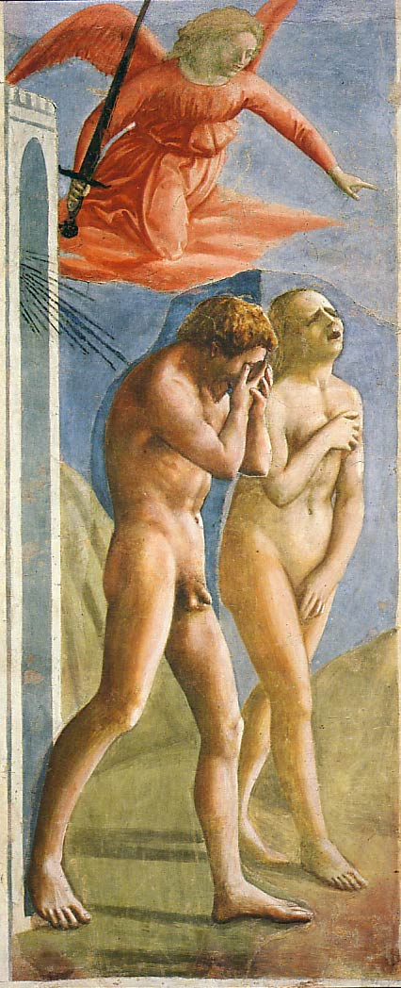
1. Realism & Expression
i) Realism: showing scenes as they actually appear
ii) Expression is different depending on the individual and the scene
  The emotions showed matched the subject or story told
iii) First nudes since
classical times.
iv) Expulsion from
the Garden
  Masaccio
  1427

Slide 17
Realism & Expression
Voice of God expelling Adam and Eve from the Garden.
Realism is shown through the detail in Adam and Eve’s Anatomy
Look at the expressions of Adam and Eve as they get kicked out of the garden of Eden. Are they happy about it?

Slide 18
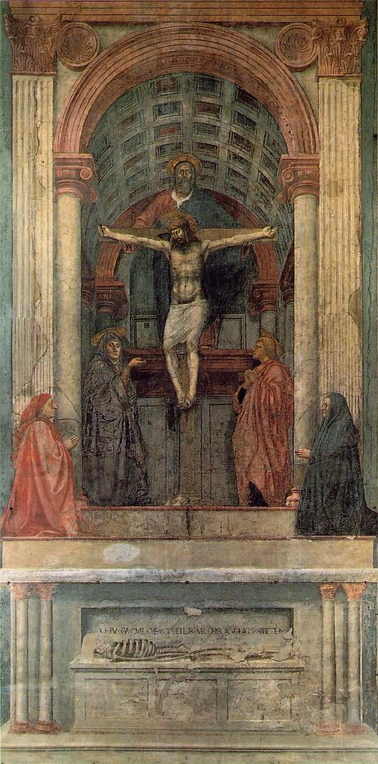
2. Perspective
Perspective: a graphic system that creates the illusion of depth and volume on a two-dimensional surface
Draw on your paper
First use of linear perspective (using lines to show distance and depth)
iv) Painting information:
The Trinity
Masaccio
1427
What you are, I once was; what I am, you will become.

Slide 19
Perspective
Where is the vanishing point?
This painting shows Jesus, God, and the Holy Spirit. The Holy spirit is symbolized by the dove above Jesus’ head.

Slide 20
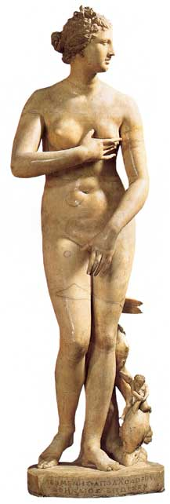
3. Classicism
i) Classicism: Greek and Roman influence where perfect proportion is the ideal
ii) Secularism- without religious influence
  Humanism-emphasizes reason, scientific inquiry, and human fulfillment in the natural world
iii) Individualism → free standing figures; S curve
  a curve shaped like an S that the side of the body makes
      iv) Symmetry/Balance
v) The “Classical Pose”
Medici “Venus”

Slide 21
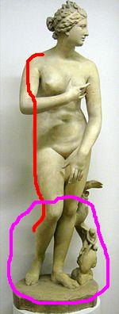
Classicism
S Curve was used to show a more natural human standing position.
This image is classical because it shows an ideal nude. In other words, this is an image of a perfectly beautiful woman.
Contrapposto is used to show a relaxed human standing position.

Slide 22
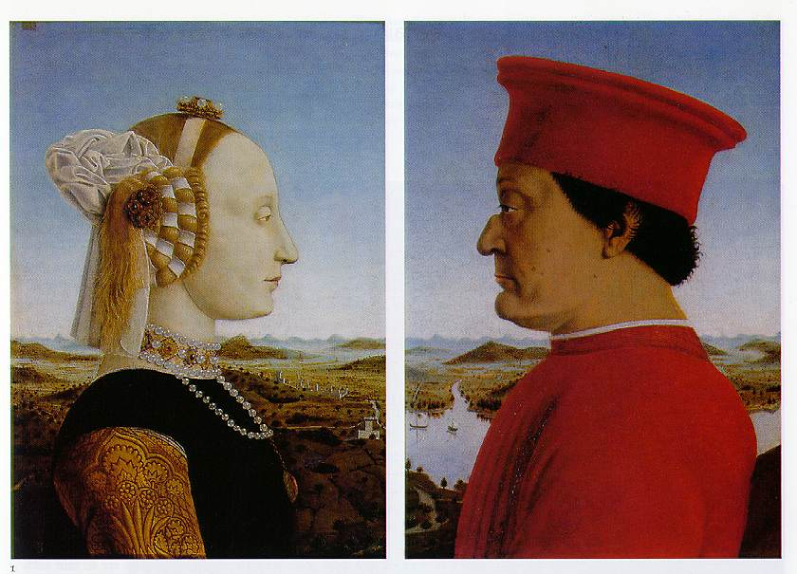
4. Emphasis on Individualism
iv) Battista Sforza & Federico de Montefeltre: The Duke & Dutchess of Urbino
Piero della Francesca, 1465-1466.
Individualism: highlighting specific characteristics to show how one subject is unique from another
Circle your painting.
Revolutionary?
  Perspective
  Realism/ Expression

Slide 24
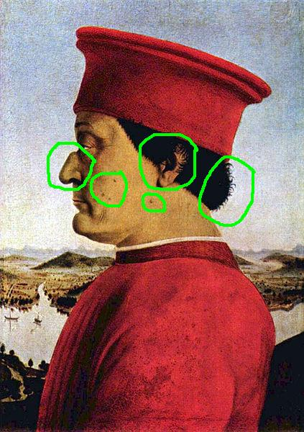
Emphasis on Individualism
What makes the Duke of Urbino not look like anyone else?
What are his distinguishing facial features?

Slide 25
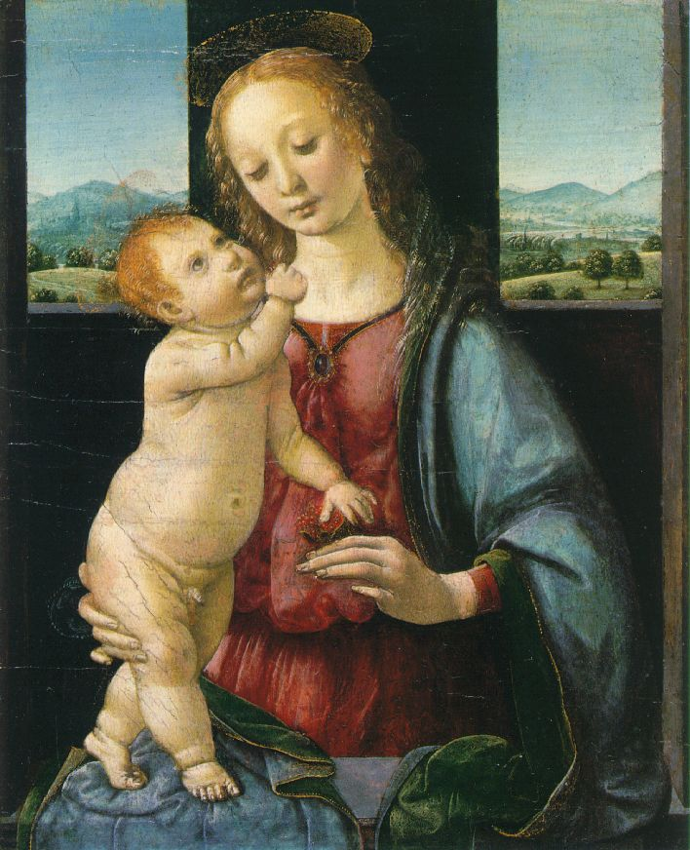
5. Geometrical Arrangement of Figures
i) Geometric Arrangement: the arrangement of figures to form geometric shapes
ii) Draw on your painting.
iii) Revolutionary?
  Realism/ expression
  Classicism
  Perspective
iv) The figure as architecture!
v) The Dreyfus Madonna
with the Pomegranate
  Leonardo da Vinci
  1469

Slide 26
Geometrical Arrangement of Figures
Why is the top of the triangle Mary and Jesus’ face?
The most important point of a triangle is the top point; as a result, the top of the triangle forms Mary and Jesus’ face to draw the audience’s attention to their expression.

Slide 27
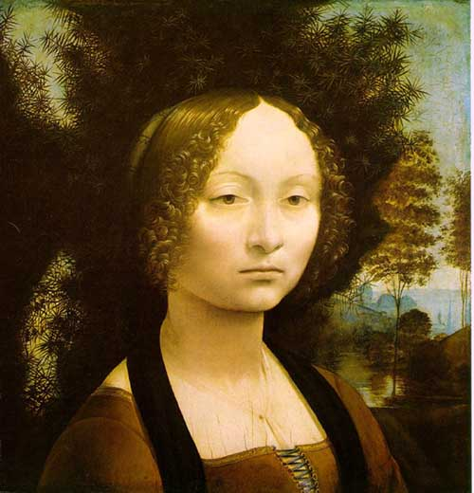
6. Light & Shadowing/Softening Edges
chiaroscuro:
  the use of extreme contrast between light and dark to create a dramatic effect
  sfumato: The blurring or softening of sharp outlines by gradually blending one tone into another.
Revolutionary?
  Realism, Expression, Individualism
Leonardo da Vinci, Ginevra de' Benci, c. 1474/1478, oil on panel, National Gallery of Art, Ailsa Mellon Bruce Fund

Slide 28
6. Light & Shadowing/Softening Edges
Sfumato
  The blurring or softening of sharp outlines by gradually blending one tone into another.
Chiaroscuro
  the use of extreme contrast between light and dark to create a dramatic effect

Slide 29
Partner Work to Group Work
On the next slide, we will discuss a painting from the Renaissance to assess your knowledge of Renaissance art techniques.
Complete your learning guide by drawing the characteristics on your paper.

Slide 30
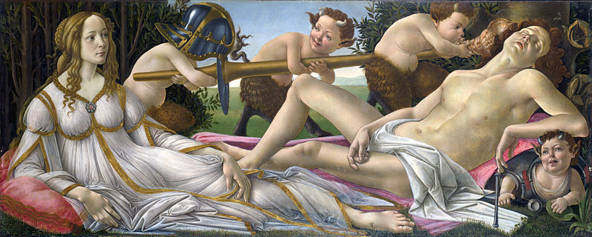
Whole Group Discussion:
Six Characteristics of Renaissance Art Content Check
Notes:
Venus and Mars by Botticelli, 1483

Slide 31
Botticelli's, Venus and Mars.
Botticelli painted this in 1483, and the picture depicts Venus and Mars, God of War, lying facing each other in the sacred garden of the Goddess of Love surrounded by myrtle trees.
The theme is that the power of love can overcome the physical strength of the warrior.
The Goddess of Love stares at the sleeping figure of Mars, safe in the knowledge that her own sexual prowess has overcome his taste for war.

Slide 32

Exit Slip
Put on your handwritten note sheet
1) List the five new techniques created during the Renaissance.
2) Why were patrons willing to spend a lot of money on art?
3) List the six characteristics of Renaissance art.

