Slide 1
Renaissance Architecture
COPY THIS INFORMATION IN YOUR NOTES!!!!!!!!!!!!!!
WHEN: 1420-1600
WHERE: Florence, Rome, Venice, western Europe
BIG NAMES: Brunelleschi, Alberti, Bramante, Raphael, Michelangelo, Romano, Palladio, Jones
INSPIRATION: Roman Antiquity
MOOD: Calm, Harmony, Equilibrium
TRAITS: Round arch, columns, barrel vaults
PREFERRED PLAN: Portico with columns supporting the pediment, rotunda covered by dome
ESSENTIAL ATTRIBUTES: Regularity, symmetry, proportion
BUILDING TYPES: Churches, urban palaces, chateaux, country villas, public squares

Slide 2
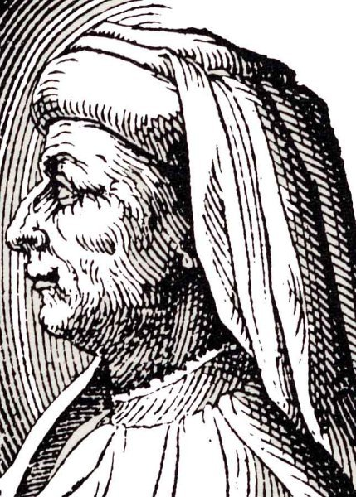
Filippo Brunelleschi
1377-1446, Florence
architect and engineer
  one of the pioneers of early Renaissance architecture in Italy.
Major work: dome of the Cathedral of Santa Maria del Fiore (the Duomo) in Florence (1420–36)
Important Innovation: credited with rediscovering linear perspective
Most of what is known about Brunelleschi's life and career is based on a biography written in the 1480s by an admiring younger contemporary identified as Antonio di Tuccio Manetti.

Slide 3
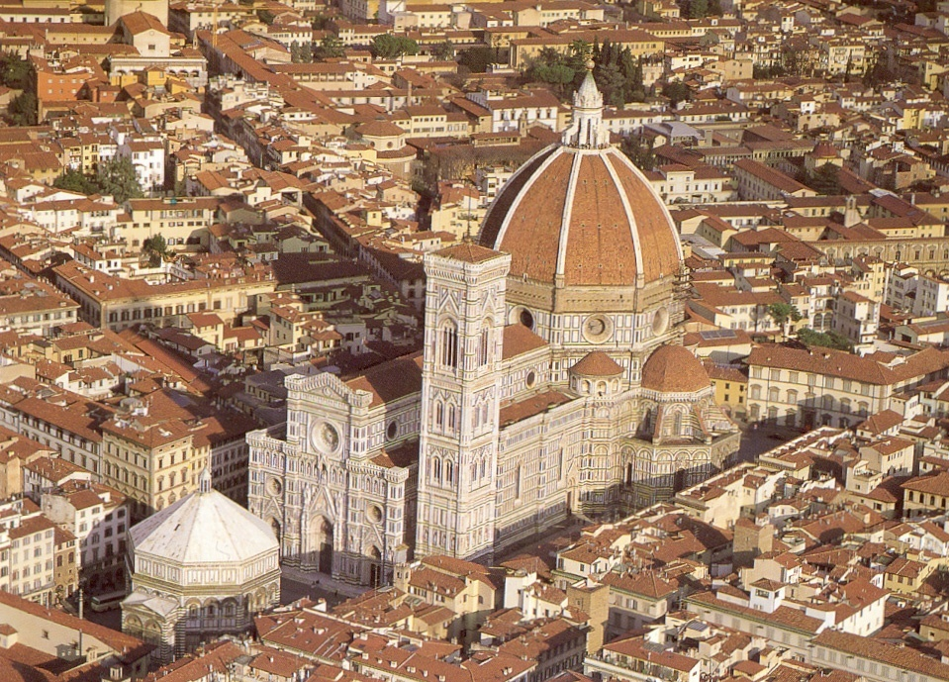
The Florence cathedral, baptistery, and Giotto’s Tower
Cathedral of Santa Maria Novella; Brunelleschi’s Dome; 1424-1436

Slide 4
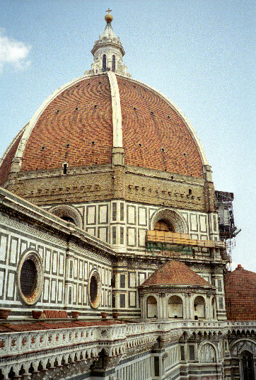
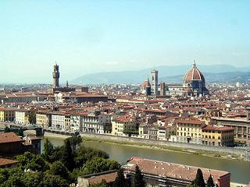
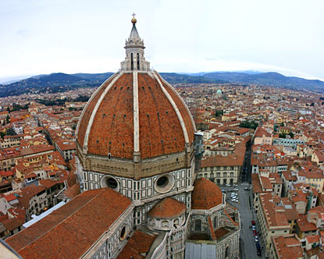

Slide 5
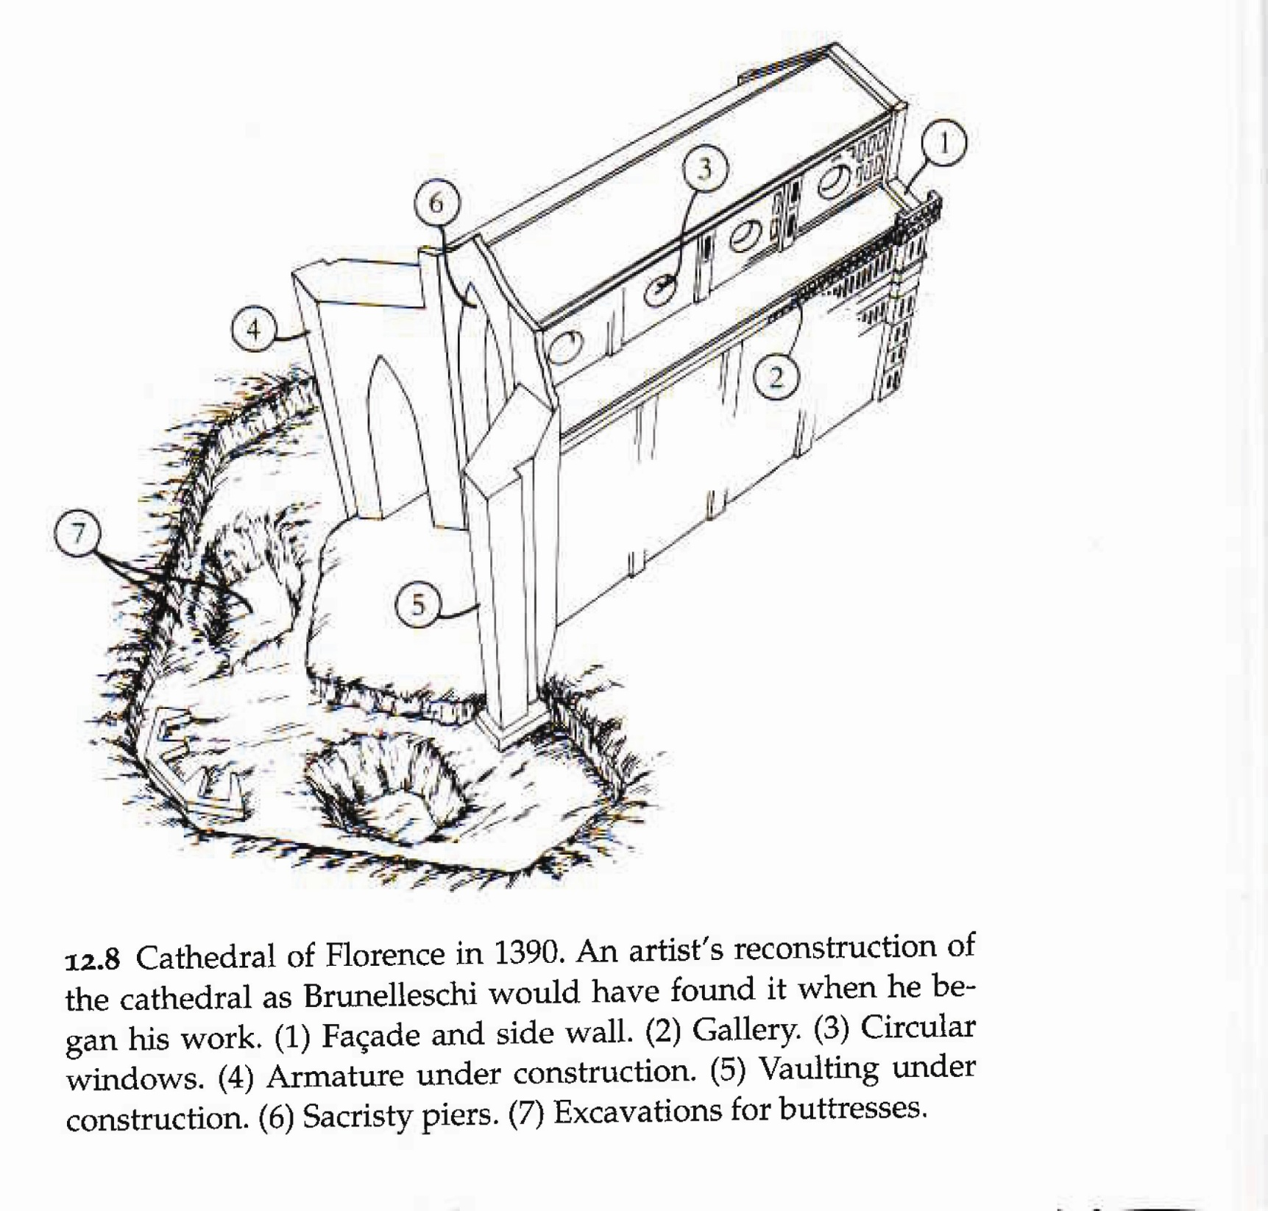

Slide 6
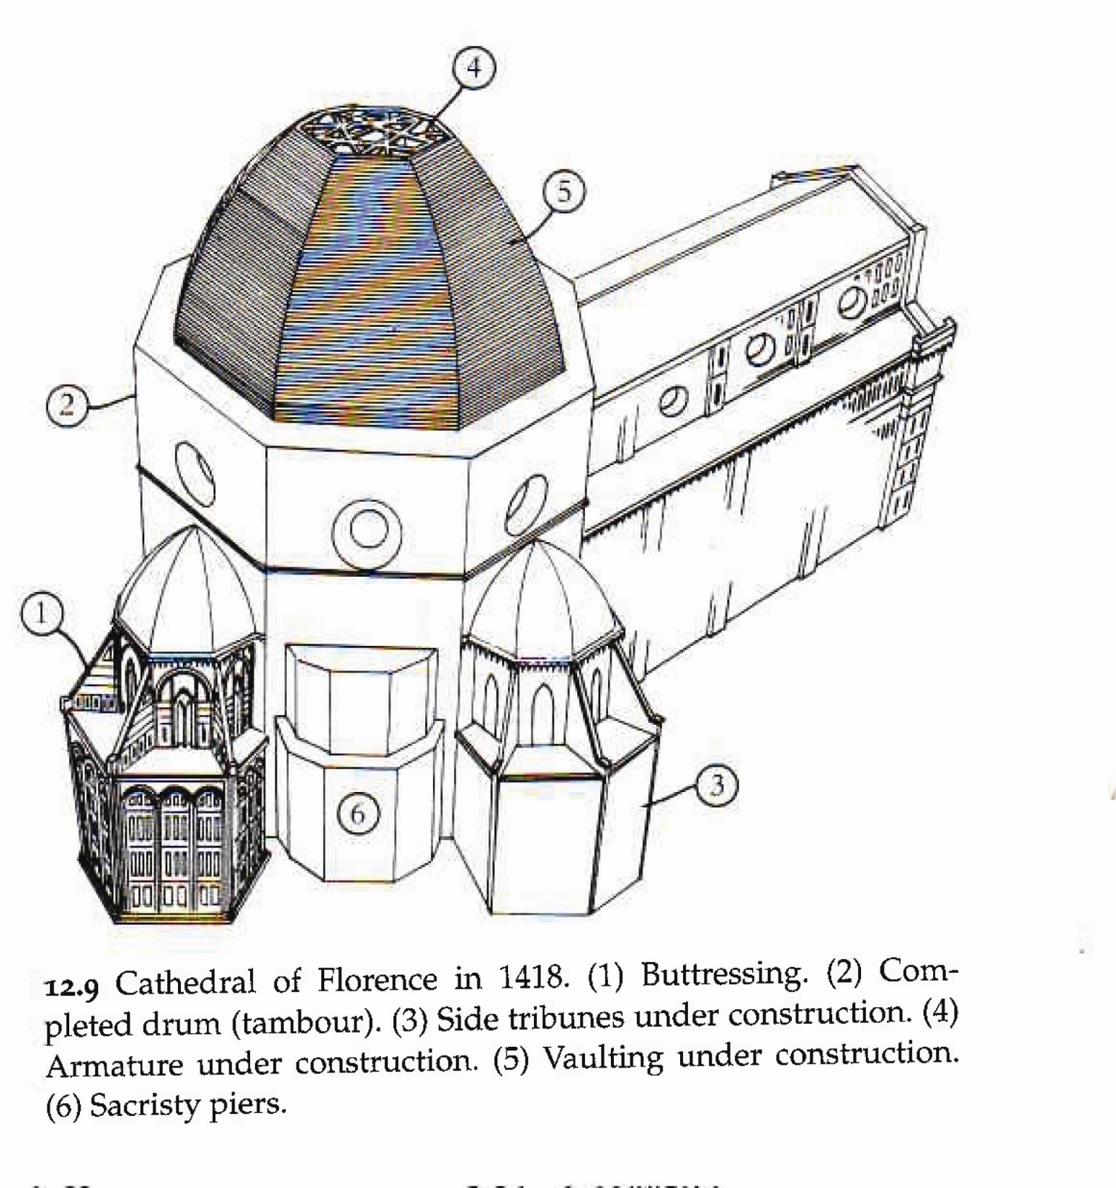

Slide 7
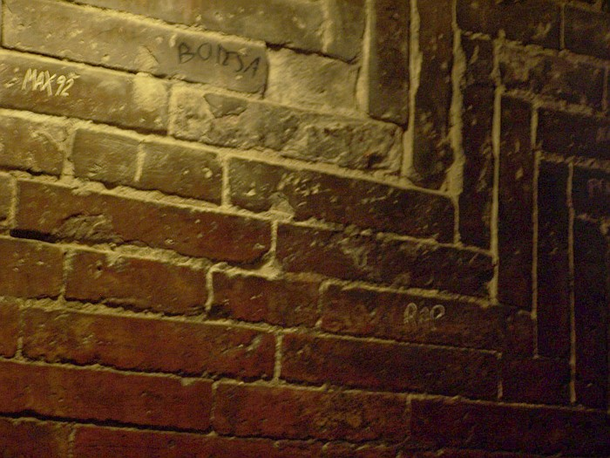
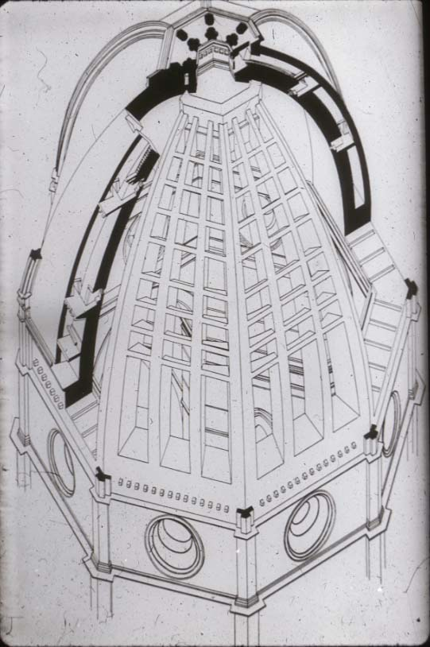
Dome Construction
So, what did this Cupola have that was so amazing?
  octagonal
  self-supporting
  Varied Materials:
    Stone on the bottom where the dome wasn’t as curved
    Brick on the top to be lighter
      assembled in a fishbone fashion
  Double Domed
    Two parallel shells are connected by brick 'spurs'
      Different functions:
        Inner dome- the real roof
        External dome: protects the dome from water and makes it visible from far away
Notes:
Brunelleschi’s Innovations are highlighted in red. These are the characteristics that students need to identify in the activity.

Slide 8
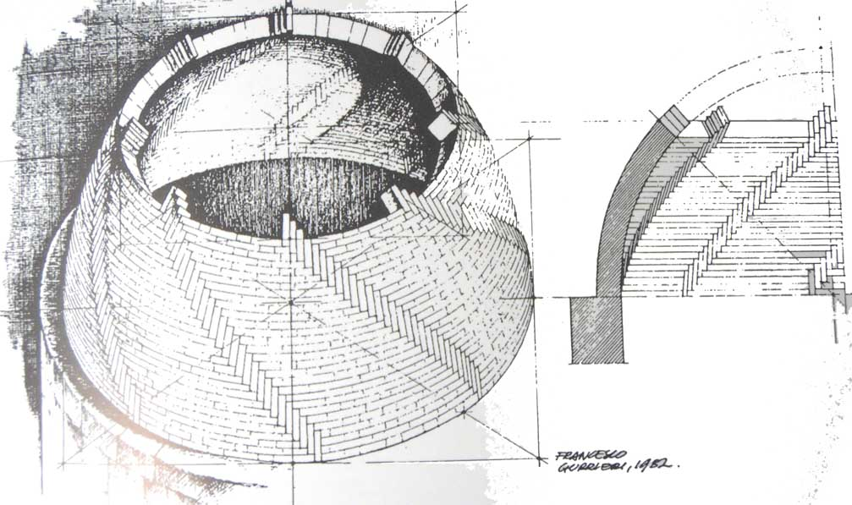

Slide 9
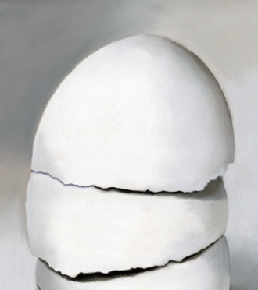
Inspiration in Nature!
Brunelleschi explained his design by stacking two egg shells to show the inner and outer dome structure.

Slide 10
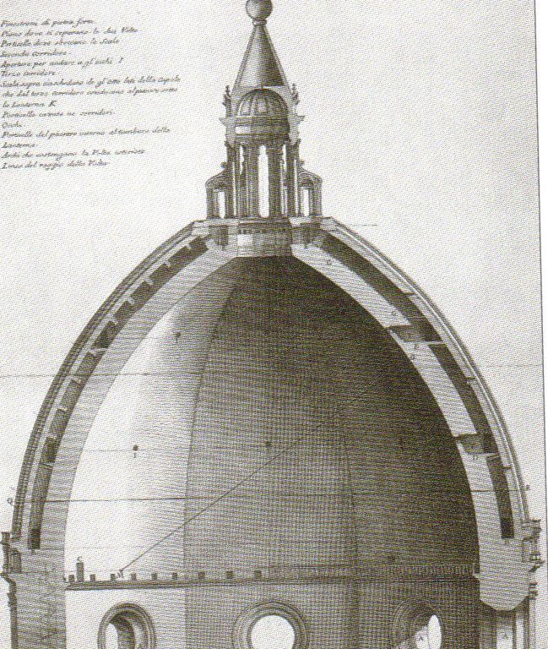

Slide 11
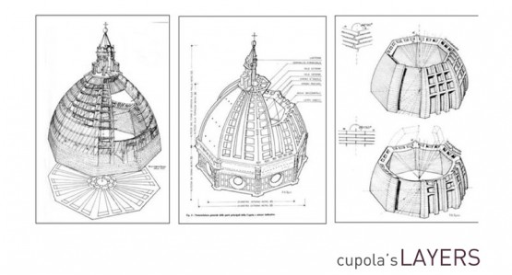

Slide 12
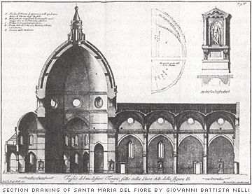

Slide 13
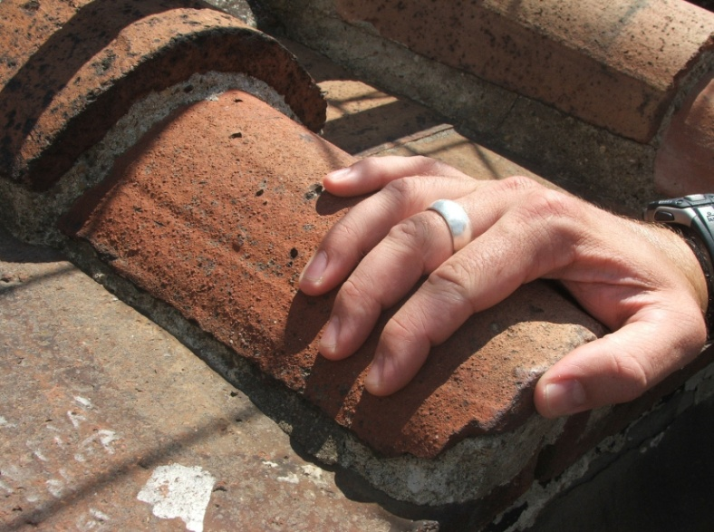
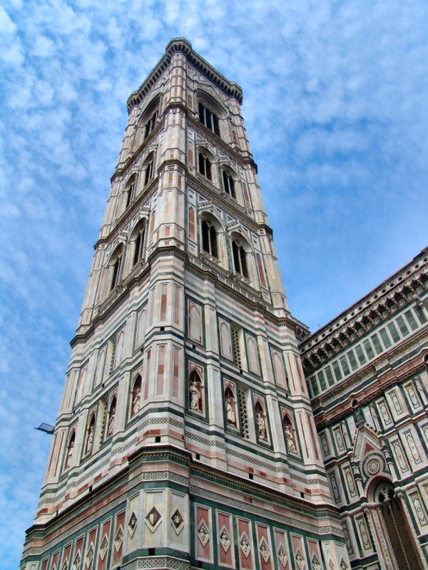
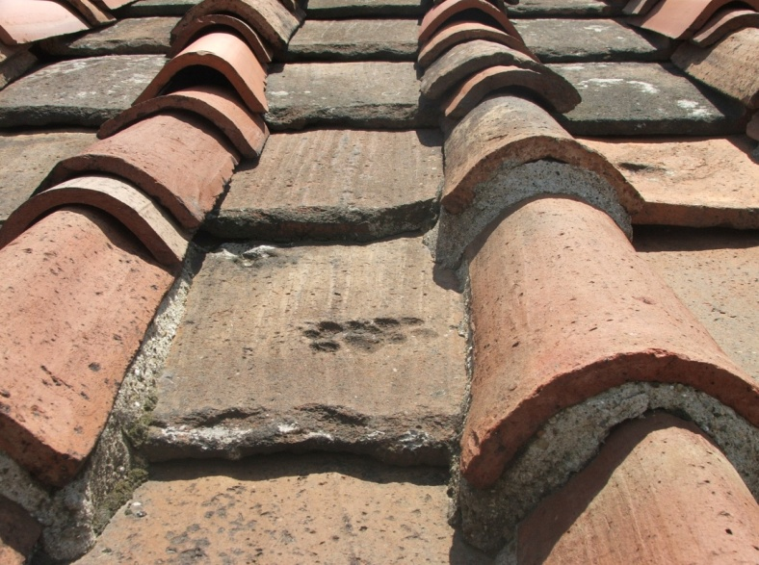
Giotto’s Tower
This is where the video begins!

Slide 14
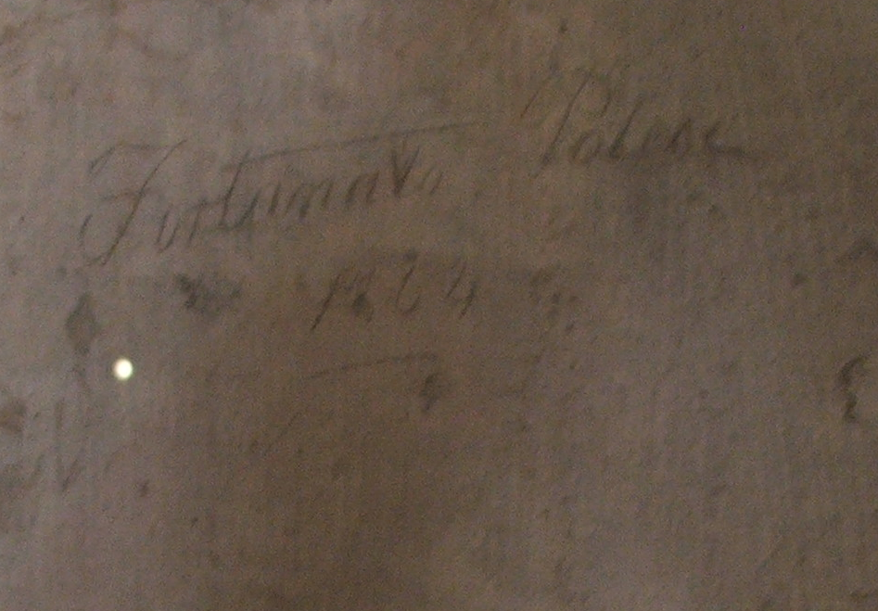
Timeless Graffiti

Slide 15
Agenda – Sub Lesson
To Get:
  Notebook pages 13 and 14 (Arch Viewing Guide)
  Historical Context Handout (front table)
To Do:
  Opener: Historical Context – 40 points!
  Il Duomo Video and Architecture Viewing Guide (Use as your January Culture Project!)

Slide 16
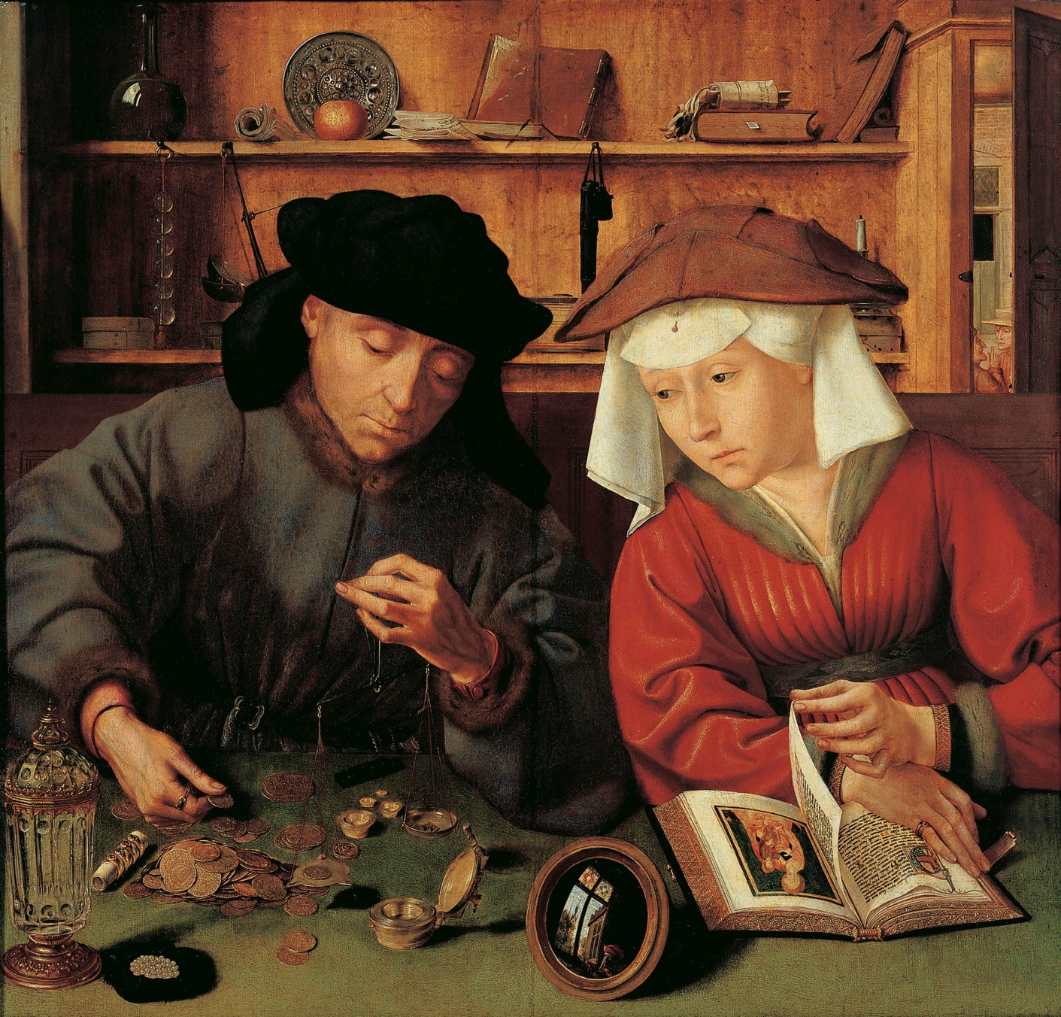
Historical Context Opener – 40 points!
Using the 6 characteristics of Renaissance Art determine the historical context of the image. In the middle of your work sheet create a thesis statement that explains WHY you believe this to be a piece of Renaissance Art. Turn in after 15 minutes; PUT YOUR NAME ON IT! Fill all parts of the paper to receive credit!
The Moneylender and his Wife
Quentin Massys
1514
Oil on panel, 71 x 68 cm
Musée du Louvre, Paris

Slide 17
Architecture Viewing Guide
Title: Basilica di Santa Maria del Fiore – Il Duomo (the dome)
Architect: Filippo Brunelleschi
Date of Construction:
Location: Florence, Italy
Style: Renaissance
Materials: Brick, Stone, Marble, Mortar
Function: Catholic Cathedral
Video Link: http://www.pbs.org/wgbh/nova/ancient/great-cathedral-mystery.html
  53:00 minutes
Turn in at the end of class to receive credit for your January Culture Project
You must IDE, (Identify, Describe, and Explain) for each element and principle as well as complete the questions on the reverse side.

Slide 19
Agenda
To Get:
  Notebook pages 64, 65, 13, and 14 (Arch Viewing Guide
  Annotated Arch book on the front shelf
To Do:
  Opener: Palladio Reading Questions (Pg. 65)
  Finish Architecture Lecture (Pg. 64)
  Art Viewing Guide – Il Duomo (January Culture Project)

Slide 20
Palladio and the Villa Rotunda
Answer the following questions on page 66 in your NOTEBOOK Read The Annotated Arch – Pg. 65 to get answers
1) Who is the most copied architect of all time?
2) Where and what did Palladio study?
3) How does the answer mentioned above reflect the ideas of the Renaissance (use your brain. This answer isn’t in the book)?
4) What book did Palladio write?
5) What famous Americans owned this book?
6) Palladio was famous for designing what?
7) What was the floor plan of the answer mentioned above? (his theory behind them)
8) What mistake did Palladio make? (what did he copy wrong?)
9) Describe Palladio’s most famous home, the Villa Rotunda.
10) Palladio’s buildings have supreme __________________.
11) How many centuries was Palladio’s work influential?
12) What famous U.S. President’s home is a model of the Villa Rotunda? What is the name of this home?

Slide 21
1) Who is the most copied architect of all time?
Andrea Palladio
2) Where and what did Palladio study?
Rome and Study math, music, and Latin
3) How does the answer mentioned about reflect the ideas of the Renaissance (use your brain. This answer isn’t in the book)?
He traveled to Rome… aka the birthplace of the Roman empire and inspirer of antiquity.
4) What book did Palladio write?
Four Books of Architecture (1570)
5) What famous Americans owned this book?
Thomas Jefferson and George Washington
6) Palladio was famous for designing what?
Country villas
7) What was the floor plan of the answer mentioned above? (his theory behind them)
Buildings should extend symmetrically around a central axis
8) What mistake did Palladio make? (what did he copy wrong?)
Palladio tacked Roman temple fronts on his villas
9) Describe Palladio’s most famous home, the Villa Rotunda.
Porticos on all sides, center room is lit overhead by a dome, on the top of a hill, symmetrical, proportional
10) Palladio’s buildings have supreme __________________.
symmetry
11) How many centuries was Palladio’s work influential?
2
12) What famous U.S. President’s home is a model of the Villa Rotunda? What is the name of this home?
Thomas Jefferson- The Monticello

Slide 22
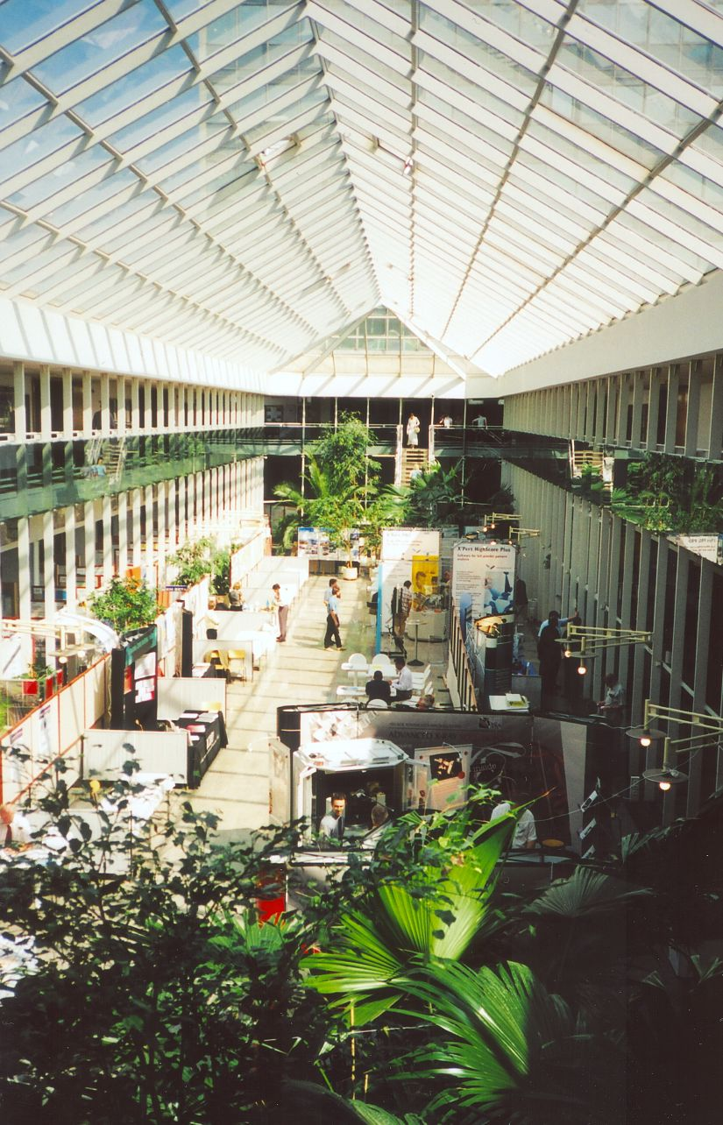
Lifestyles of the Rich and Famous:
Renaissance Homes (notes)
Atrium:
  Central courtyard flanked by wings of a building.

Slide 23
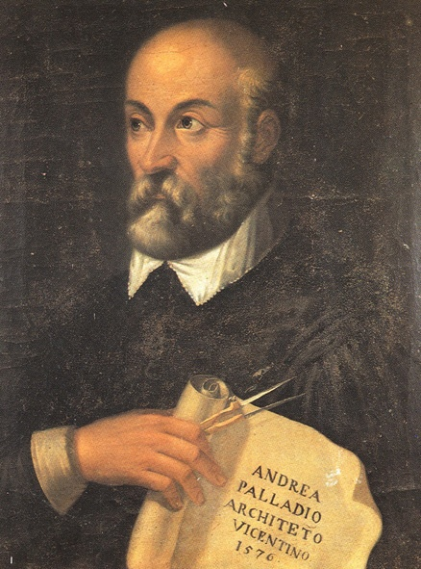
PALLADIO
born Nov. 30, 1508- died August 1580, Vicenza
Studied mathematics, music, philosophy, and Classical authors
Inspired by the writings of the ancient Roman architect VITRUVIUS.
Why important?
  Palladio was the first to systematize the plan of a house and to use the ancient Greco-Roman temple front as a portico
  Master of supreme symmetry
Palladian Style: rounded arches flanked by rectangular openings

Slide 24
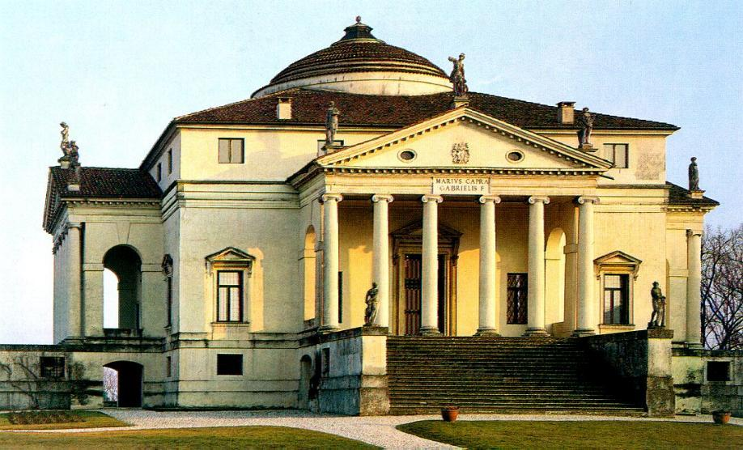
The Villa Rotunda

Slide 25
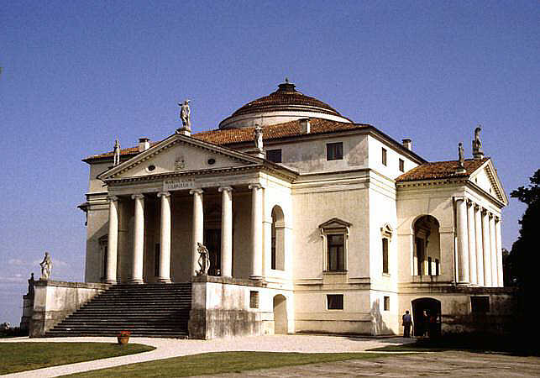
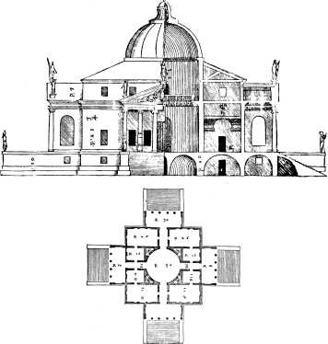
Villa Rotunda
Built for a retired monsignor who wanted a place for parties ☺
On a hill- belvedere
Central plan with four identical facades and projecting porches to the four compass points
  Each façade shows new view of the country side
  Central plan- circular platform where people can pick whichever view
Each façade- a Roman ionic temple
Inspired by Pantheon but no equal
Notes:
Belvedere- beautiful view of the countryside or sea

Slide 26
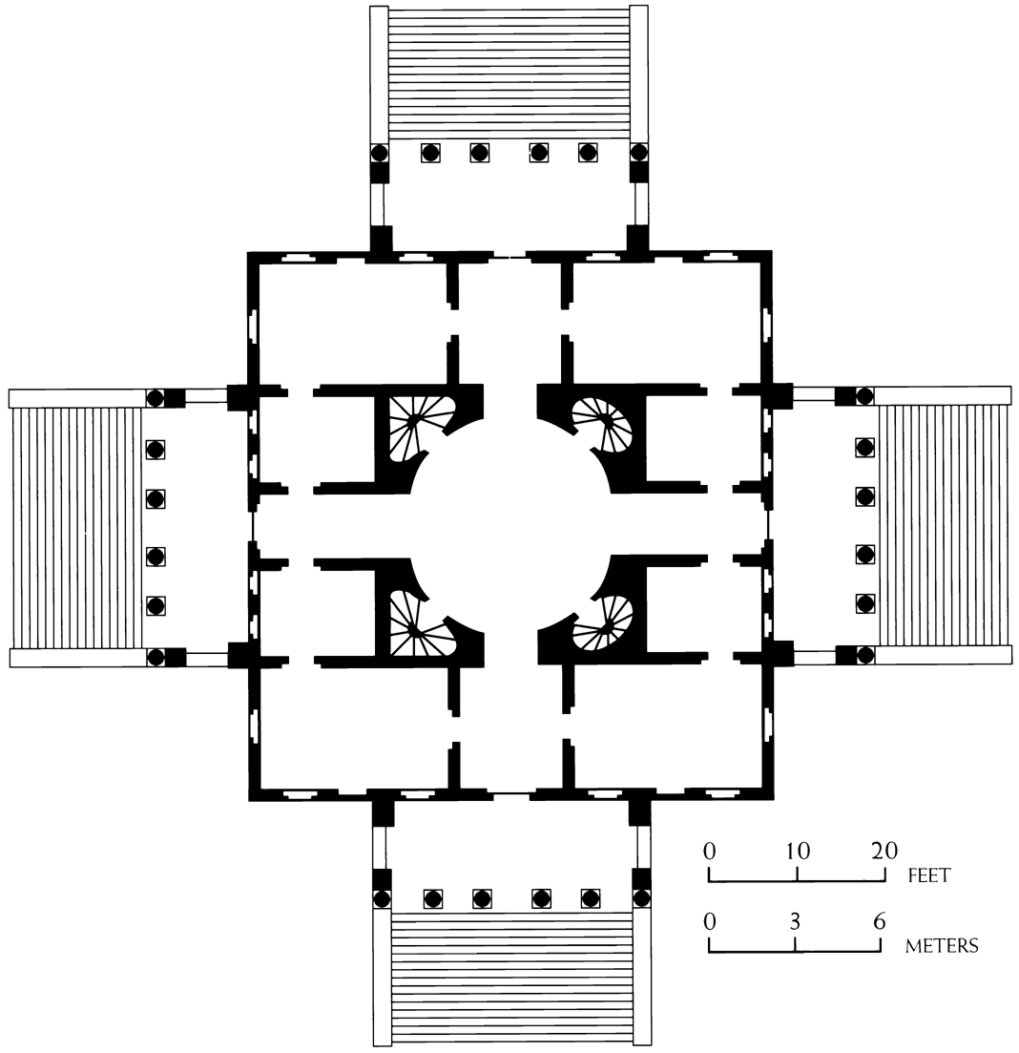
Figure 22-30 ANDREA PALLADIO, plan of the Villa Rotonda (formerly Villa Capra), near Vicenza, Italy, ca. 1550–1570. (1) dome, (2) porch.

Slide 27
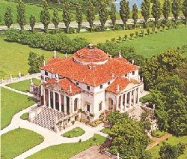

Slide 28
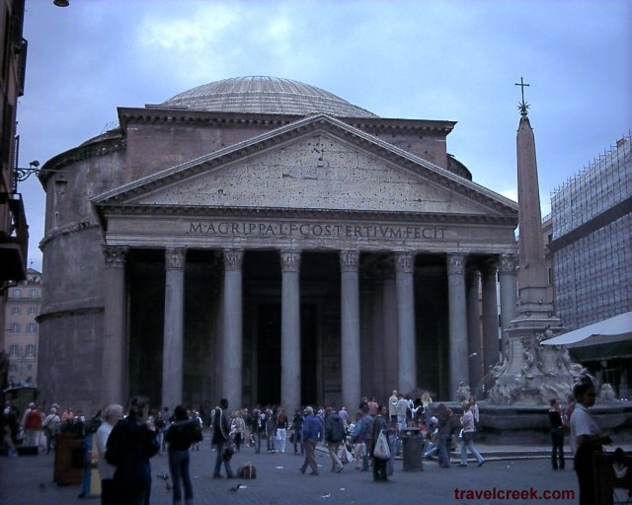
Palladio’s Inspiration:
Name three architectural designs Palladio “borrowed.”

Slide 29
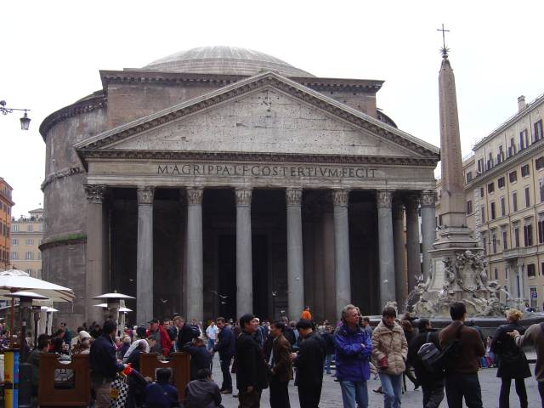
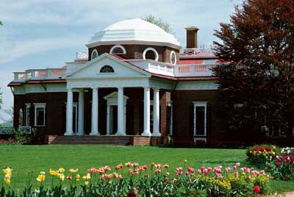
PALLADIO
His Four Books of Architecture was possibly the most influential architectural pattern book ever printed. His influence climaxed during the 18th-century Classical Revival; the resulting Palladianism spread through Europe and the U.S.
  Pantheon… to the Villa Rotunda… to Monticello

Slide 30
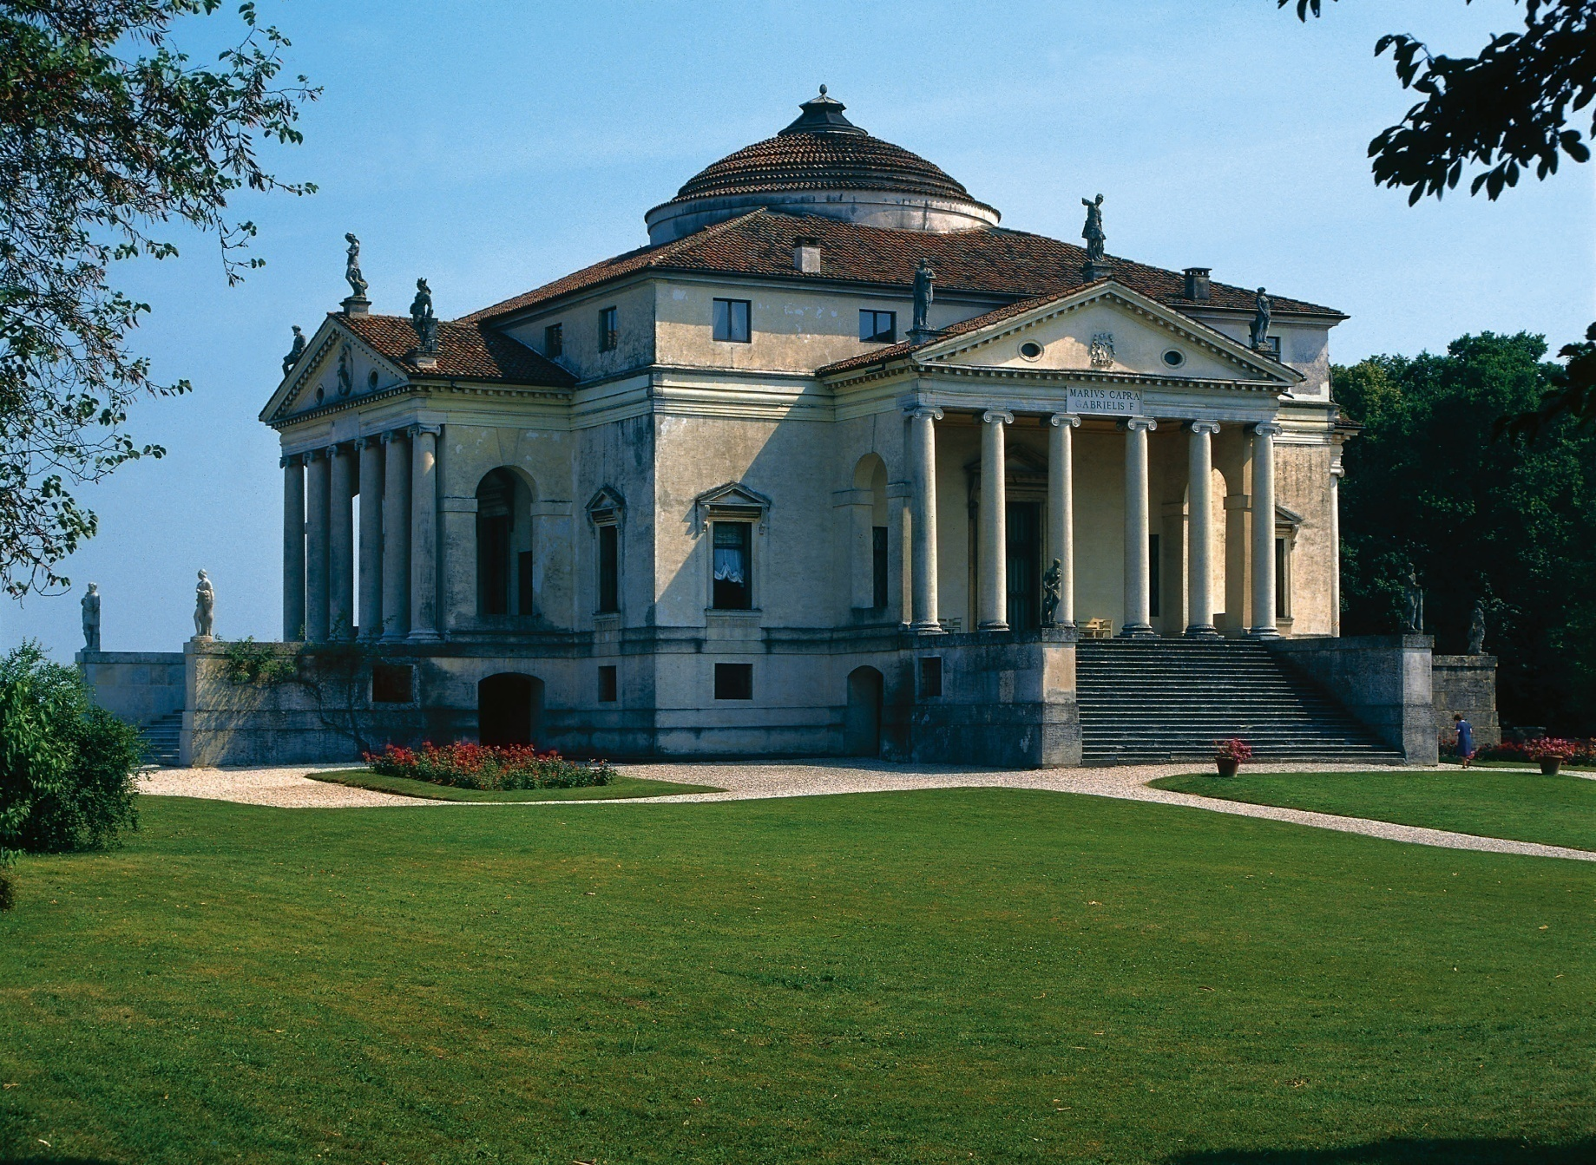
Figure 22-29 ANDREA PALLADIO, Villa Rotonda (formerly Villa Capra), near Vicenza, Italy, ca. 1566–1570.

Slide 31
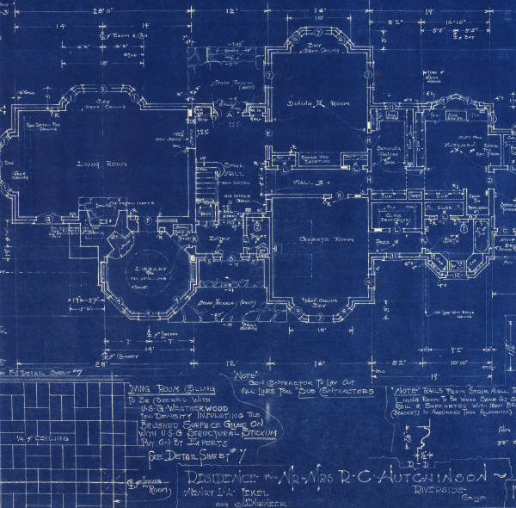
Activity- Palladio Application
Objective:
  To demonstrate your knowledge of why Palladio is known for his supreme symmetry
Assignment:
  Create a simple sketch of Palladio’s Villa Rotunda ON PAGE 63
Product Requirements:
  Palladian characteristics
  A complete floor plan
Time allotted:
  5 minutes

Slide 32
Exit Slip
What are the basic structures of architecture that both the Pantheon and the Villa Rotunda have?
What influences of Ancient Rome can be seen in the Villa Rotunda (you will have to remember what basic structures of architecture the Romans invented in order to properly answer this question).
  a) What basic structure(s) are Greek?
What architectural principle is the most important in Palladio’s design?
Why would this building be called the Villa Rotunda?
What mistake did Palladio make when he was designing his villas?
How was Brunelleschi’s Dome constructed?
What’s one cool thing that you saw in the video about Brunelleschi’s Dome?
http://www.youtube.com/watch?v=a8HpZo89LiA

Slide 33
Sources
http://www.italyguides.it/us/florence/the_dome_of_brunelleschi.htm
Annotated Arch

