Slide 1
Opening Agenda
Things to Get:
Theatre notes from last class
One piece of notebook paper
The article and learning guide (opener and exit slip) from the table in the front of the room
Things to Do:
Finish Theatre Exit Slip Questions
Opener- Review of Music
Class work:
Notes: Renaissance Court Dances
Performance Assessment: Court Dances
Exit Slip: Social Dance as an example of Renaissance society

Slide 2
Opening Agenda
Things to Get:
Notebook page 58
Two handouts from front table
Things to Do:
Study Guide Page 2 questions; read page 58 in your notebook to answer – 10 minutes
Dance mini-lesson
Test Review
Notebook Check Items
TEST NEXT CLASS

Slide 3
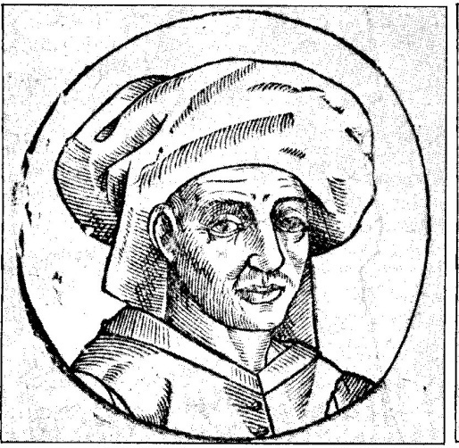
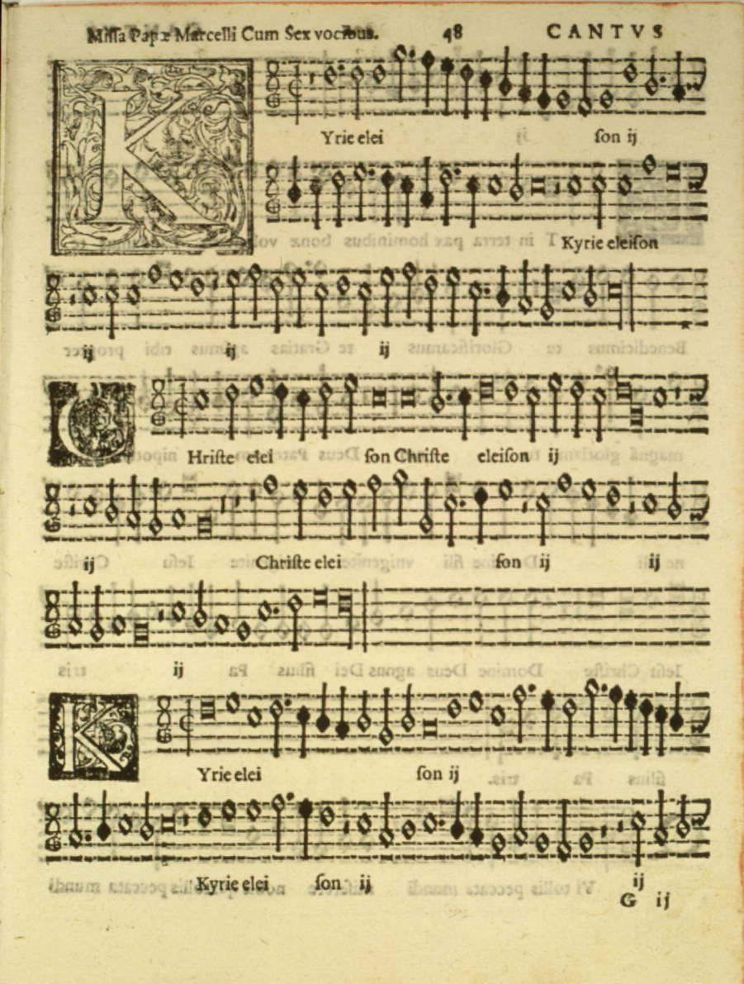
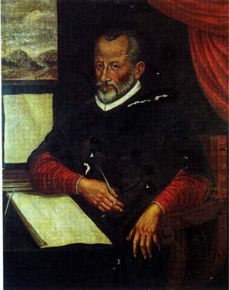
Opener
Read the article entitled “Music History 102: the Renaissance” and answer the questions on your Learning Guide.

Slide 4
Check the answers!
1) Identify and describe two inventions from the Renaissance and their impact on society.
printing press
Compass
2) What were two factors that caused the Catholic church to loose its grip on society during this period?
Copernicus’- position of the Earth
Martin Luther/Protestant Reformation
3) Name two important composers of Renaissance dance music?
Praetorius (c.1571-1621) ; Susato (c.1500-1561)
4) Why is La Spagna an excellent example of Renaissance dance music?
Buoyant rhythms / sounds of Renaissance dance
5) Who did Des Prez study under?
Johannes Ockeghem
6) What work survives Des Prez?
a dozen masses, a hundred motets, and lots of secular music
7) How does Des Prez’s Gloria show influence of the Flemish school?
otherworldly choral sound new music for counterpoint
8) Describe polyphony during this period.
could be complex, obscured words and meaning of the text
9) What were two occupations held by Palestrina?
Composer and owner of a fur business
10) How did Palestrina modify his work to meet the demands of the Council of Trent? Describe the characteristics of the vocal part that made this modification possible.
composed in a restrained style (simpler)
11) What is Palestrina’s most famous work?
Pope Marcellus Mass
12) Who did Palestrina influence?
Mozart, Beethoven, Brahms

Slide 5
Agenda
To Do:
Turn in January Culture Projects to the A2 box.
Staple page 4 to the correct viewing/listening guide along with your evidence.
Turn to page 68 for your opener and notes on Renaissance Dance.

Slide 6
Opener – page 68
1. Name the two types of Renaissance theater.
2. What were the two developments to theater in England during the Renaissance?
3. Name two things used in Commedia dell Arte that make it a unique style.
4. Name the song title, composer, and form.
5. Name the song title, composer, and form.
6. Name the song title, composer, and form.
7. Why do these songs sound the same?
8. Watch the provided clip and describe three things about Renaissance Dance.

Slide 7
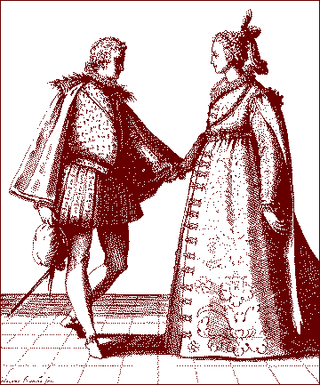
Renaissance Court Dances

Slide 8
Renaissance Dance Notes – on your own paper!
Two types of dance to discuss during this period:
Ballet developed during the Italian intermezzi (late 1400s) were interludes between acts of plays (operas) that combined dance, music, and drama
In Italy and France, Court Dances is where social dancing returned to the court.
The court describes the King and the supporting elite.

Slide 9
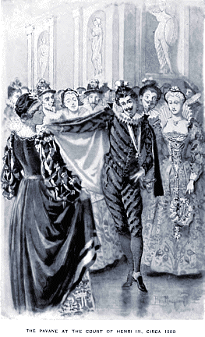
Renaissance Dance
Renaissance court spectacles were often ornate
They emphasized geometrical patterns
They used steps that were taken from the popular ballroom dances of the day, including the pavane galliard, volta, and others
Women and men did these dances together in the ballroom, but onstage, the women’s parts were danced by men
Clothing was bulky and tight in the torso, restricting movement mostly to the feet.
Dancing became stylish at all Renaissance courts in Europe, including those of Queen Elizabeth I and Henry VIII

Slide 10
Kiss With the Bow
Show respect to the court, king and queen and dance partner
Introduction to the dance

Slide 11
Emphasis on Foot Movement
Restrictive clothing prevented much upper body movement
Focused on the men showing off to attract females!

Slide 12
Lack of Physical Contact
Shows restraint of the time
Touching hands = twerking like it is 1575!

Slide 13
Renaissance Dance
In the Renaissance, dance returned to the courts.
Take notes on the following video.
Whenever the video is stopped for discussion, you need to write down that information on your blank sheet of notebook.

Slide 14
Renaissance Court Dances Exit Slip
Today, you have learned how to dance like it was 1575. The dances of this time developed because of certain aspects of Renaissance society. On your own paper, you need to describe the Renaissance court dances while explaining why certain portions of the dance listed below developed:
The kiss with the bow
The emphasis of foot movement
The lack of physical contact between dancers
Write your answer on your own paper. You answer must be half a page long and must be written in complete sentences. Anything less will receive no credit.

