Slide 1
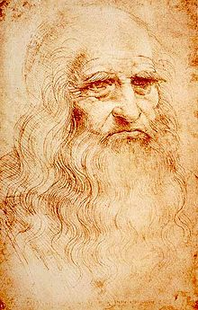
Masters of High Renaissance
Donatello
Reinvented the free-standing nude in
classical style
Leonardo da Vinci
Masters realistic painting, dissected human bodies, goal to create idealized forms that capture the perfection of nature

Slide 2
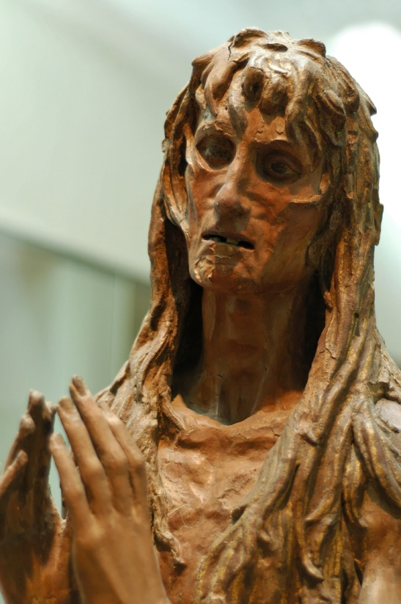
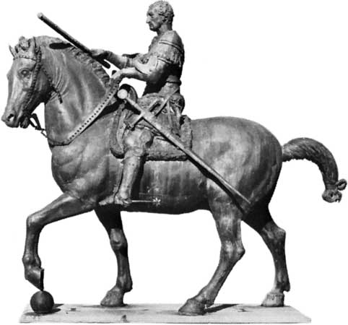
An Introduction to Donatello
As you watch the following clip, gain an understanding of why Donatello’s work is considered so realistic.
http://www.youtube.com/watch?v=rzyu_FtAXZ8

Slide 3
Donatello
1386-1466
Location of Birth:
Florence
Interesting/Important Fact:
Reinvented the free-standing nude classical style
Patron (s):
The Catholic Church and Cosimo de’ Medici
Medium:
Stone and Bronze (sculptures)
Influences:
Early training in a goldsmith’s shop and from Ghiberti (a famous artist)
Biblical history

Slide 4
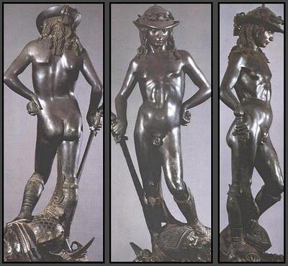
Donatello, The Sculptor
Title:
David
Artist:
Donatello
Medium:
Bronze
Subject:
Biblical story of David from the Old Testament- the book of Samuel
Date:
1430-32

Slide 5
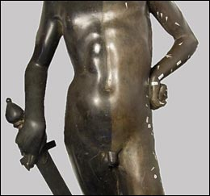
Before and After 2008 Restoration
Video
The left side is the cleaned side, minus 450 years of dirt and corrosion!

Slide 6
Art Application: Contrapposto
Objective: To demonstrate your knowledge of the skills needed to create a realistic sculpture
Assignment: Using the clay provided, create a statue that uses contrapposto (s-curve)
Requirements:
Your statue must be at least four inches high
It must have all limbs of the human body represented
It must clearly illustrate contrapposto
It must stand on its own.

Slide 7
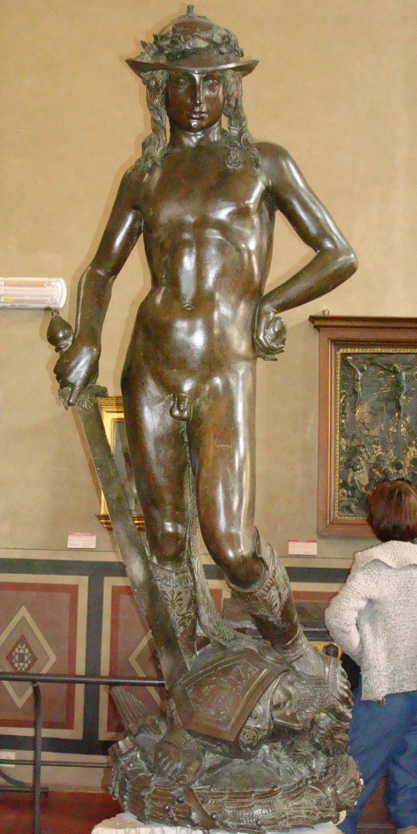
Opener
On page 67 write a well-developed paragraph (5 sentences) on how Donatello influenced the early Renaissance.
Include two characteristics and 1 technique in your response.
Explain WHY David looked feminine.
Use your notes on page 20-21

Slide 8
This is a sculpture of David by Donatello.
It uses realism and classicism.
Realism is seen in the anatomy and facial features.
Classicism is seen in the nudity and use of the s-curve.
He looks feminine because it is more impressive that prepubescent boy killed a giant.

Slide 9
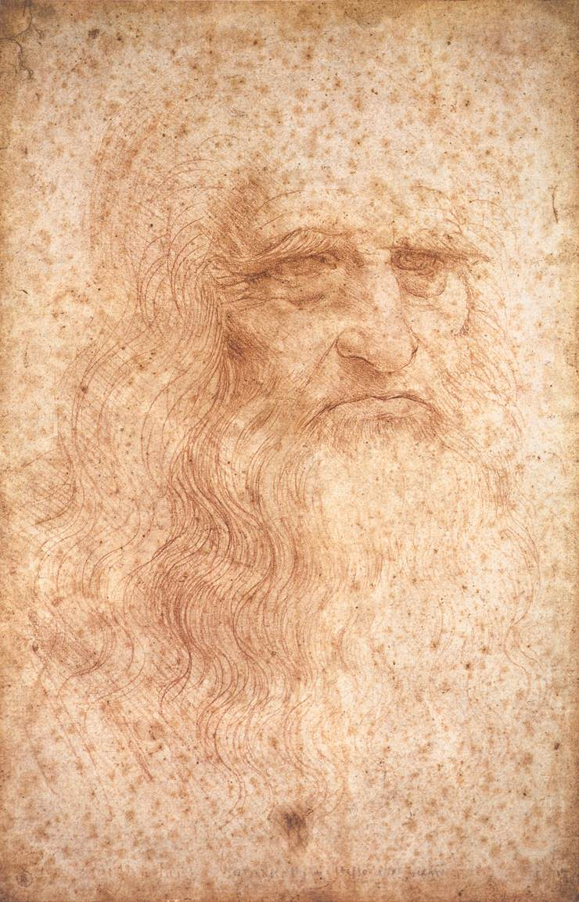
1452-1519
Location of Birth:
Vinci, Italy (a region of Florence)
Interesting/Important Fact:
Born out of wedlock to a notary (f) and a peasant (m)
Known for his procrastination and ability to leave works unfinished
Patron (s):
De’ Medici, the Duke of Milan, Francis 1 (King of France)
Medium:
Oil, tempera on gesso (dry plaster), chalk, etc.
Influences:
Verrocchio
Patrons’ wishes
Leonardo da Vinci
Self-Portrait- da Vinci, 1512

Slide 10
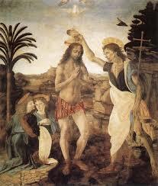

Slide 11
1. Self-Portrait -- da Vinci, 1512
He was a Renaissance Man!
Artist
Sculptor
Architect
Scientist
Engineer
Inventor
1452 - 1519

Slide 12
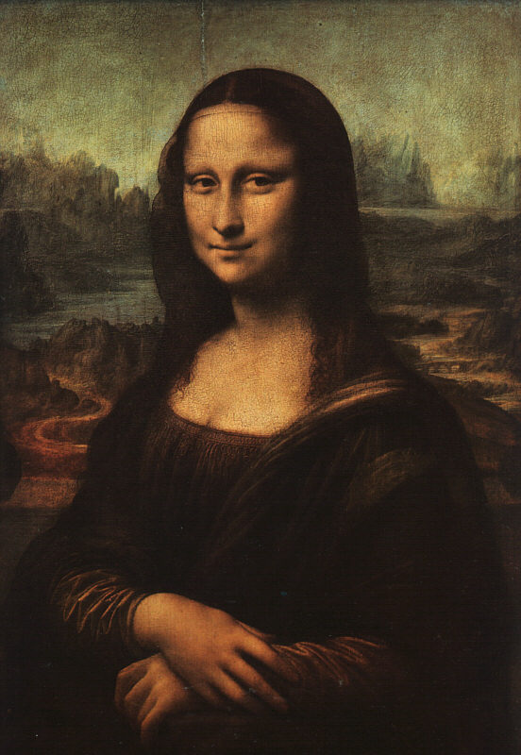
Mona Lisa Video
As you watch the following video, figure out why this simple portrait is so famous.
http://www.youtube.com/watch?v=IitbJszd1kM&sns=em
http://www.youtube.com/watch?v=V3OINVUUVcY

Slide 13
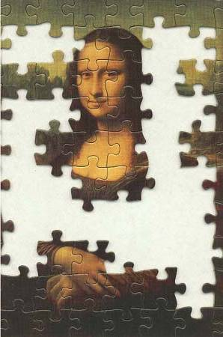
Mona Lisa – da Vinci, 1503-4
?

Slide 14
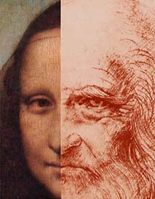
Mona Lisa OR da Vinci??

Slide 15
Mona in the Louvre
Video 1
Video 2
Is it as big as you thought it might be? Why not?
Da Vinci liked this painting so much he did not give it to his patron when completed. After da Vinci’s death it was owned by Napoleon and stolen several times.

Slide 16
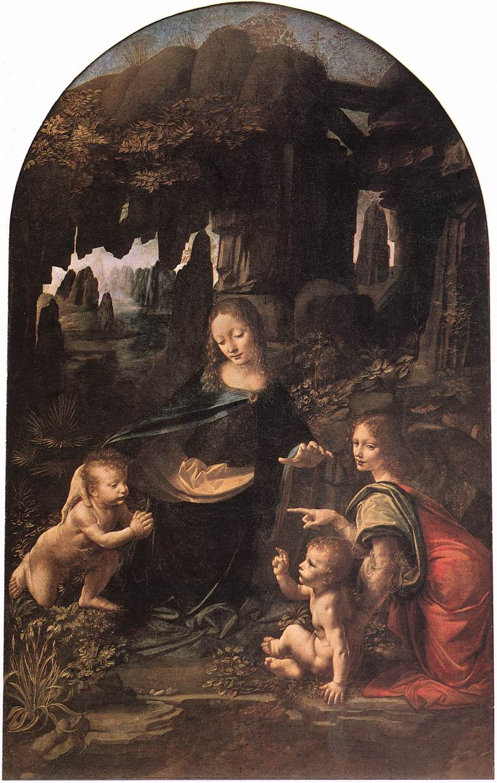
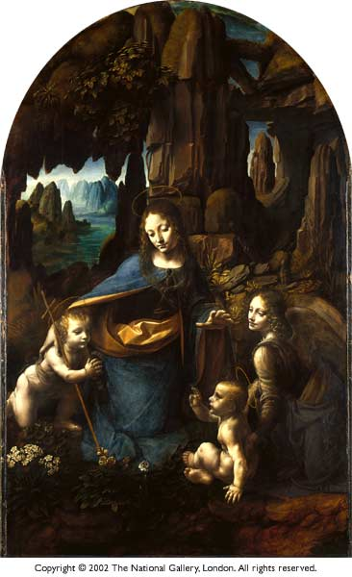

Slide 17
Two Versions; why?
The nuns who requested the work from da Vinci were not happy with the first version, on the right, because the religious imagery was too vague!
What things have been added to the second version to make it more religious?

Slide 18
Leonardo, the Artist
The Virgin of the Rocks
Leonardo da Vinci
1483-1486

Slide 19
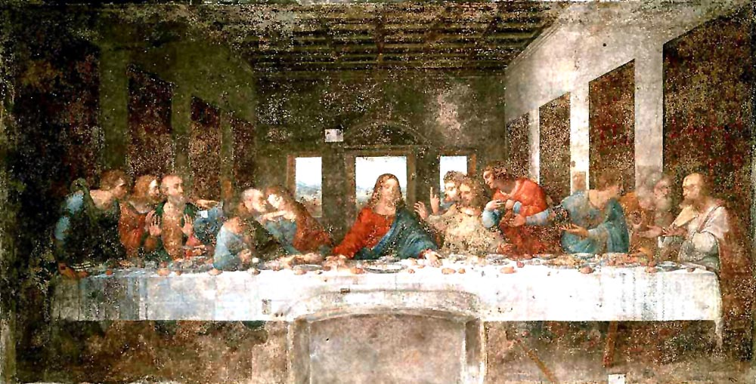
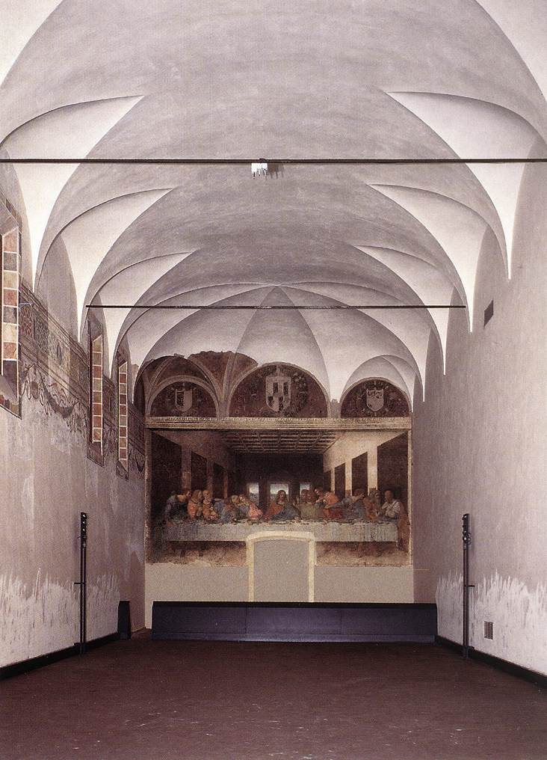
The Last Supper by da Vinci- 1498
As you watch the following clip, understand why only 25 people can see this work at a time.
http://www.youtube.com/watch?v=6NlTXWPBalo

Slide 20
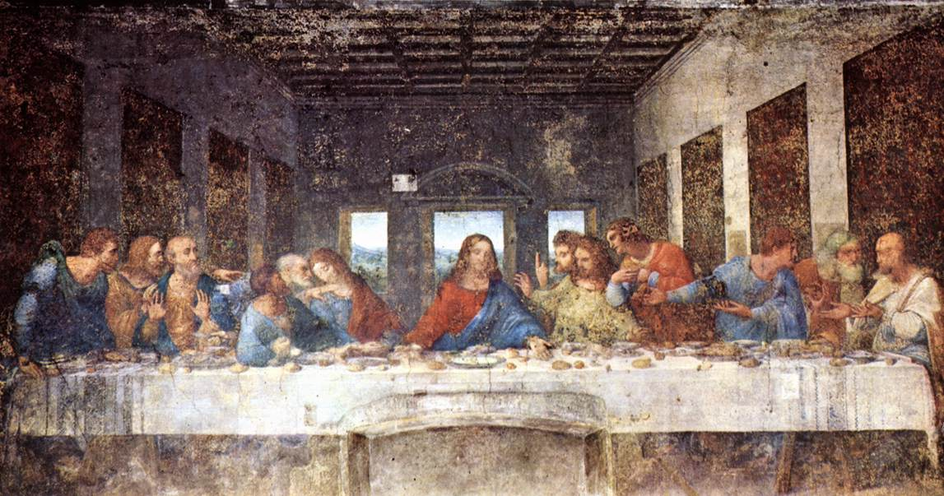
The Last Supper
Tempera on dry fresco
1498

Slide 21
The Last Supper - da Vinci, 1498 & Geometry

Slide 22
Refractory
Convent of Santa Maria delle Grazie
Milan

Slide 23
The Last Supper - da Vinci, 1498
vertical
horizontal
Perspective!

Slide 24
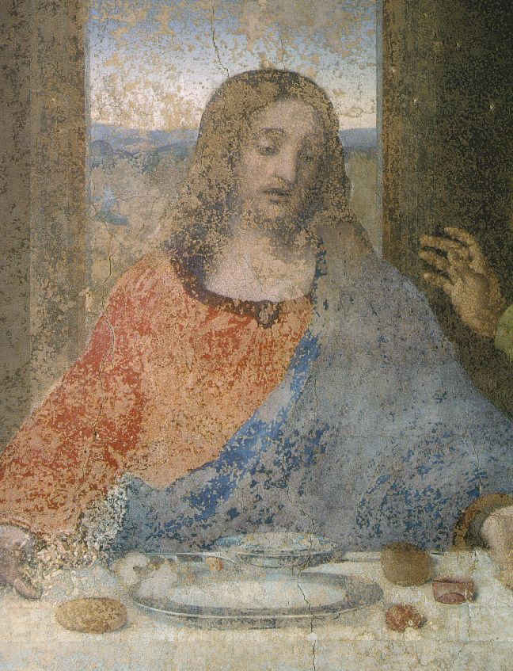
Deterioration
Detail of Jesus
The Last Supper
Leonardo da Vinci
1498

Slide 25
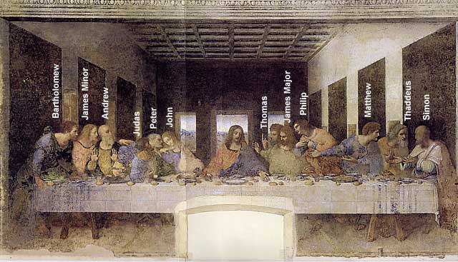
A Da Vinci “Code”: St. John or Mary Magdalene?

Slide 26
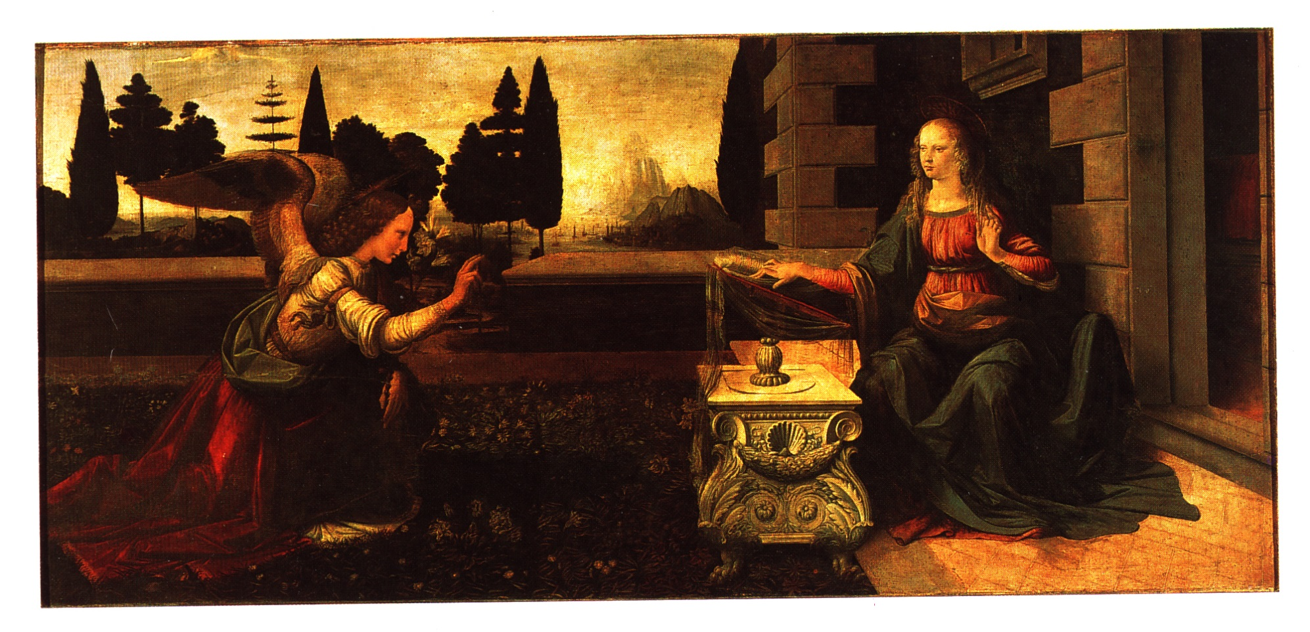

Slide 27
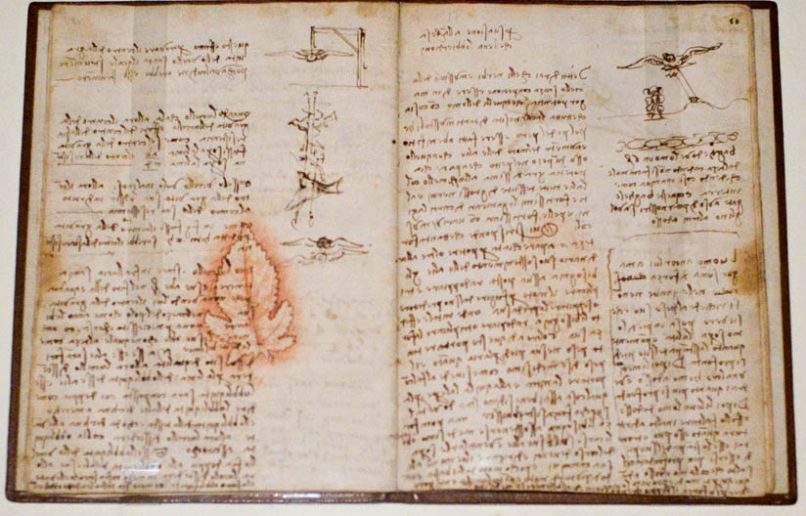
Leonardo, the Renaissance Man: From hisNotebooks of over 5000 pages (1508-1519)

Slide 28
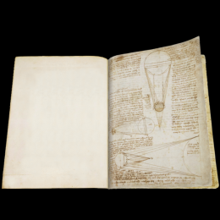
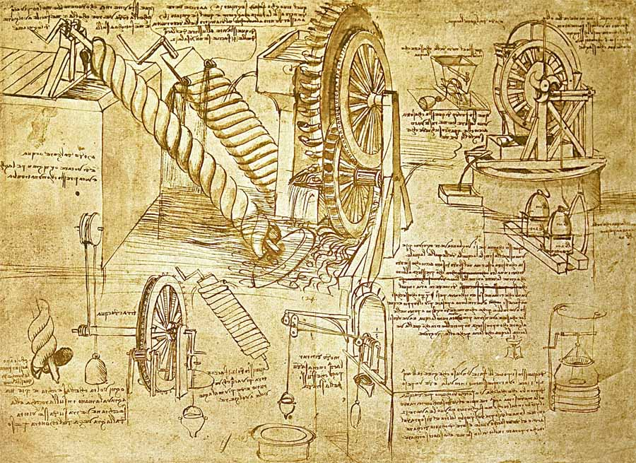
Can you protect your ideas like da Vinci?
On your Learning Guide, copy the quote on the following slide while writing backwards with your left hand.
This was the way in which da Vinci protected his ideas.

Slide 29
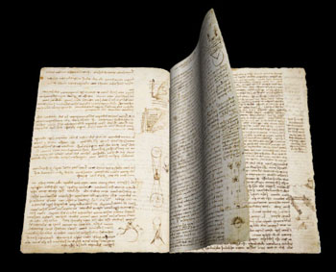
Leonardo da Vinci….
“Indeed, whatever exists in the universe, whether in essence, in act, or in the imagination, the painter has first in his mind and then in his hands.”

Slide 30
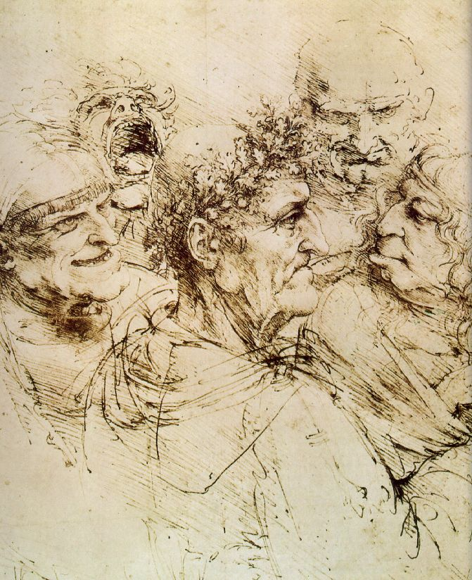
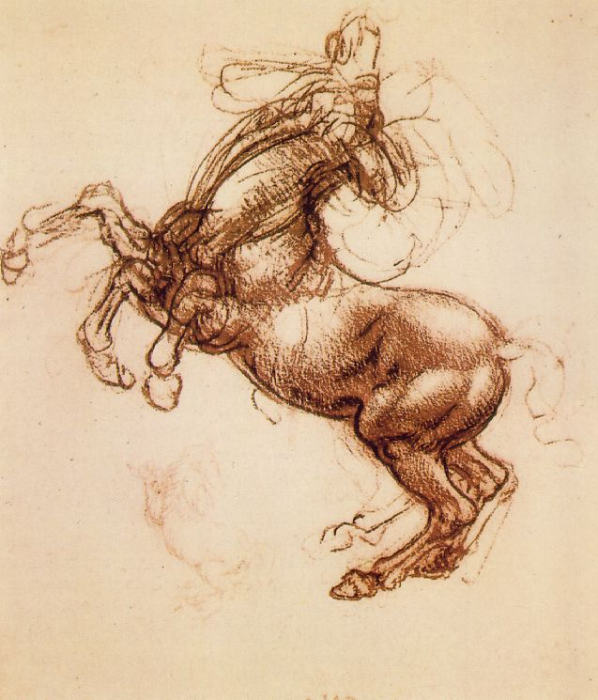
Leonardo, the Artist: From hisNotebooks of over 5000 pages (1508-1519)

Slide 31
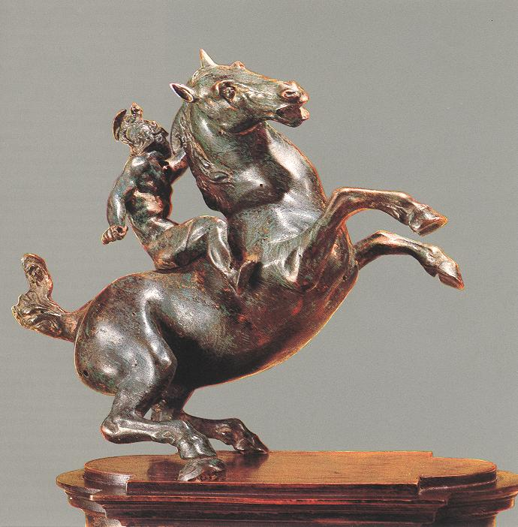
Leonardo, the Sculptor
An Equestrian Statue
1516-1518

Slide 32
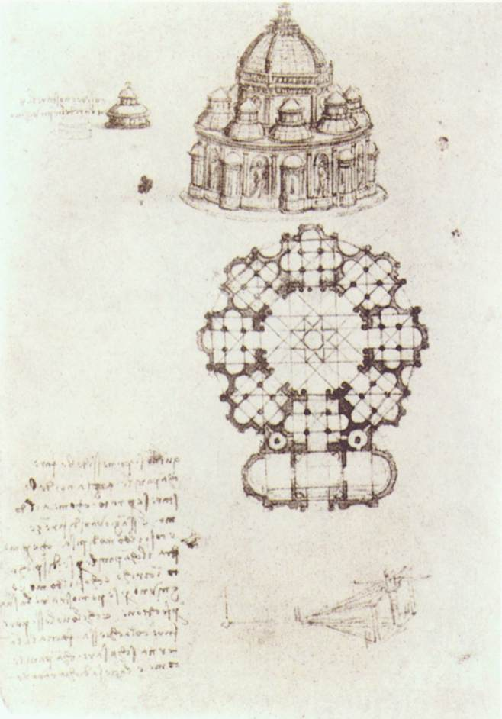
Leonardo, the Architect: Pages from his Notebook
Study of a central church.
1488

Slide 33
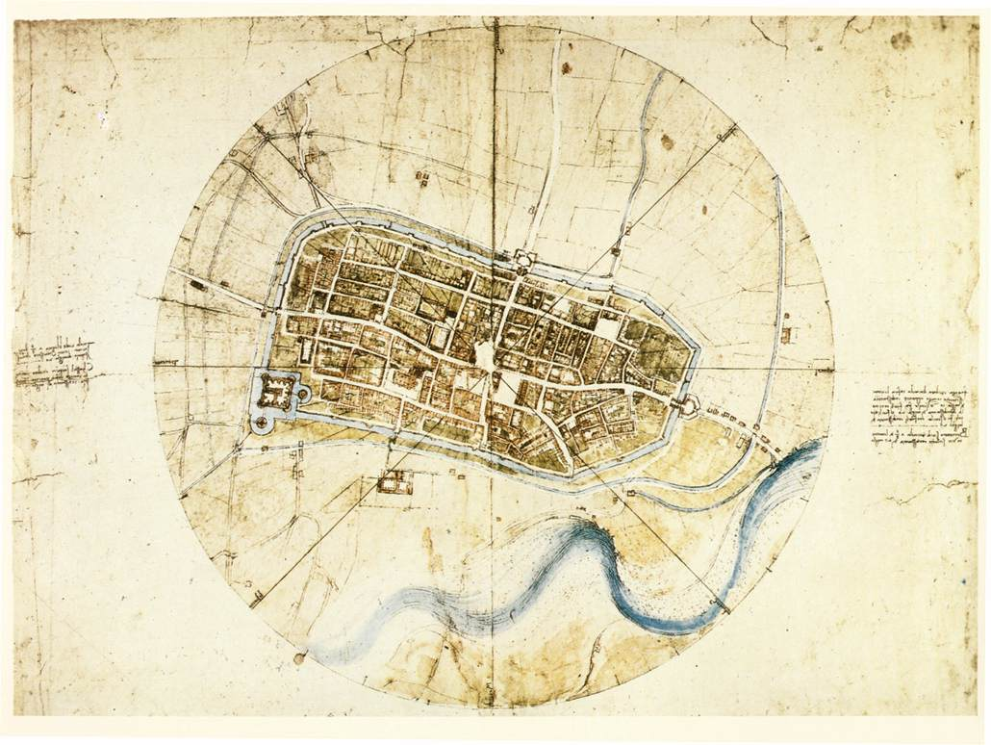
Leonardo, the Architect: Pages from his Notebook
Plan of the city of Imola, 1502.

Slide 34
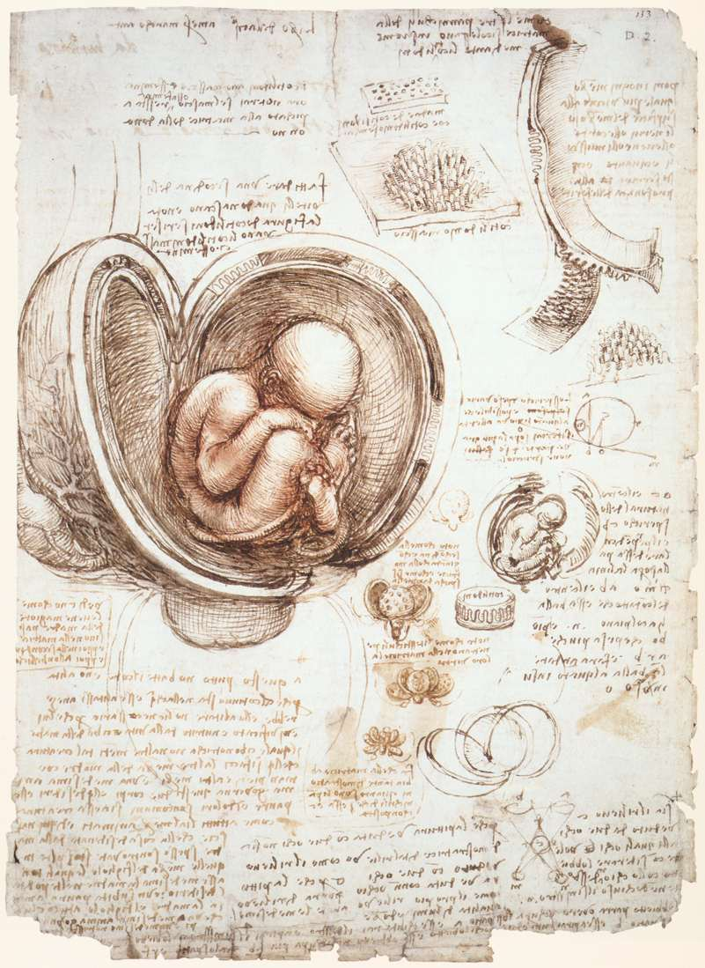
Leonardo, the Scientist (Biology): Pages from his Notebook
An example of the humanist desire to unlock the secrets of nature.

Slide 35
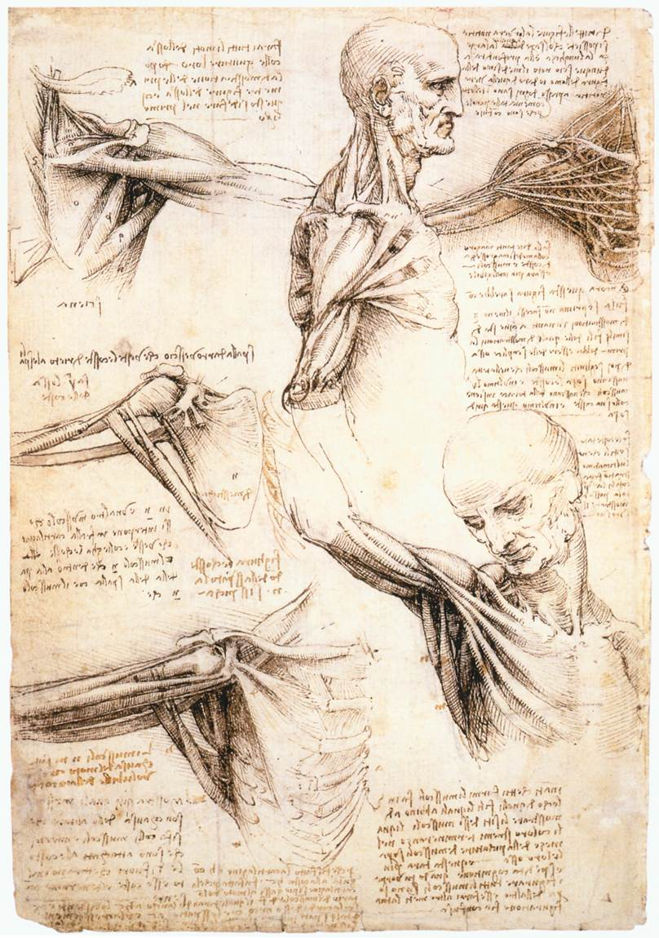
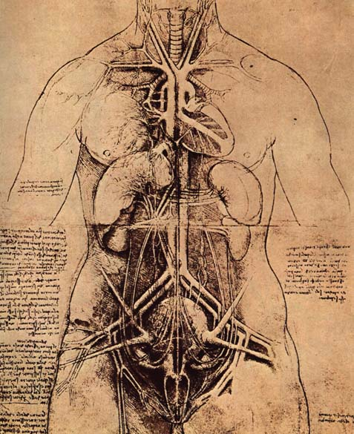
Leonardo, the Scientist (Anatomy): Pages from his Notebook

Slide 36
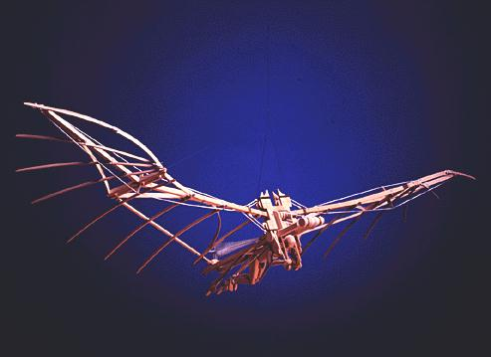
Man Can Fly?

Slide 37
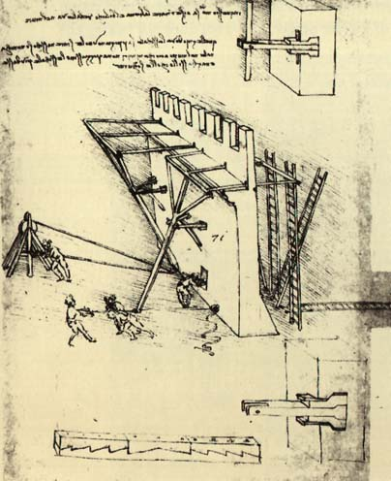
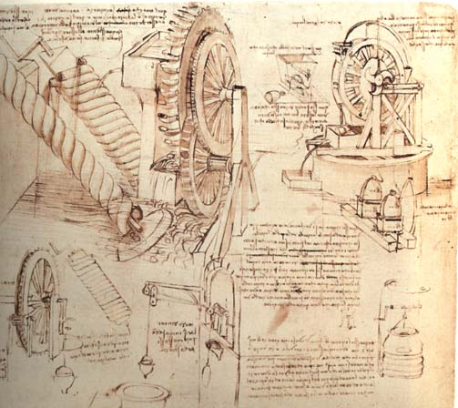
Leonardo, the Engineer: Pages from his Notebook
Studies of water-lifting devices.
A study of siege defenses.

Slide 40
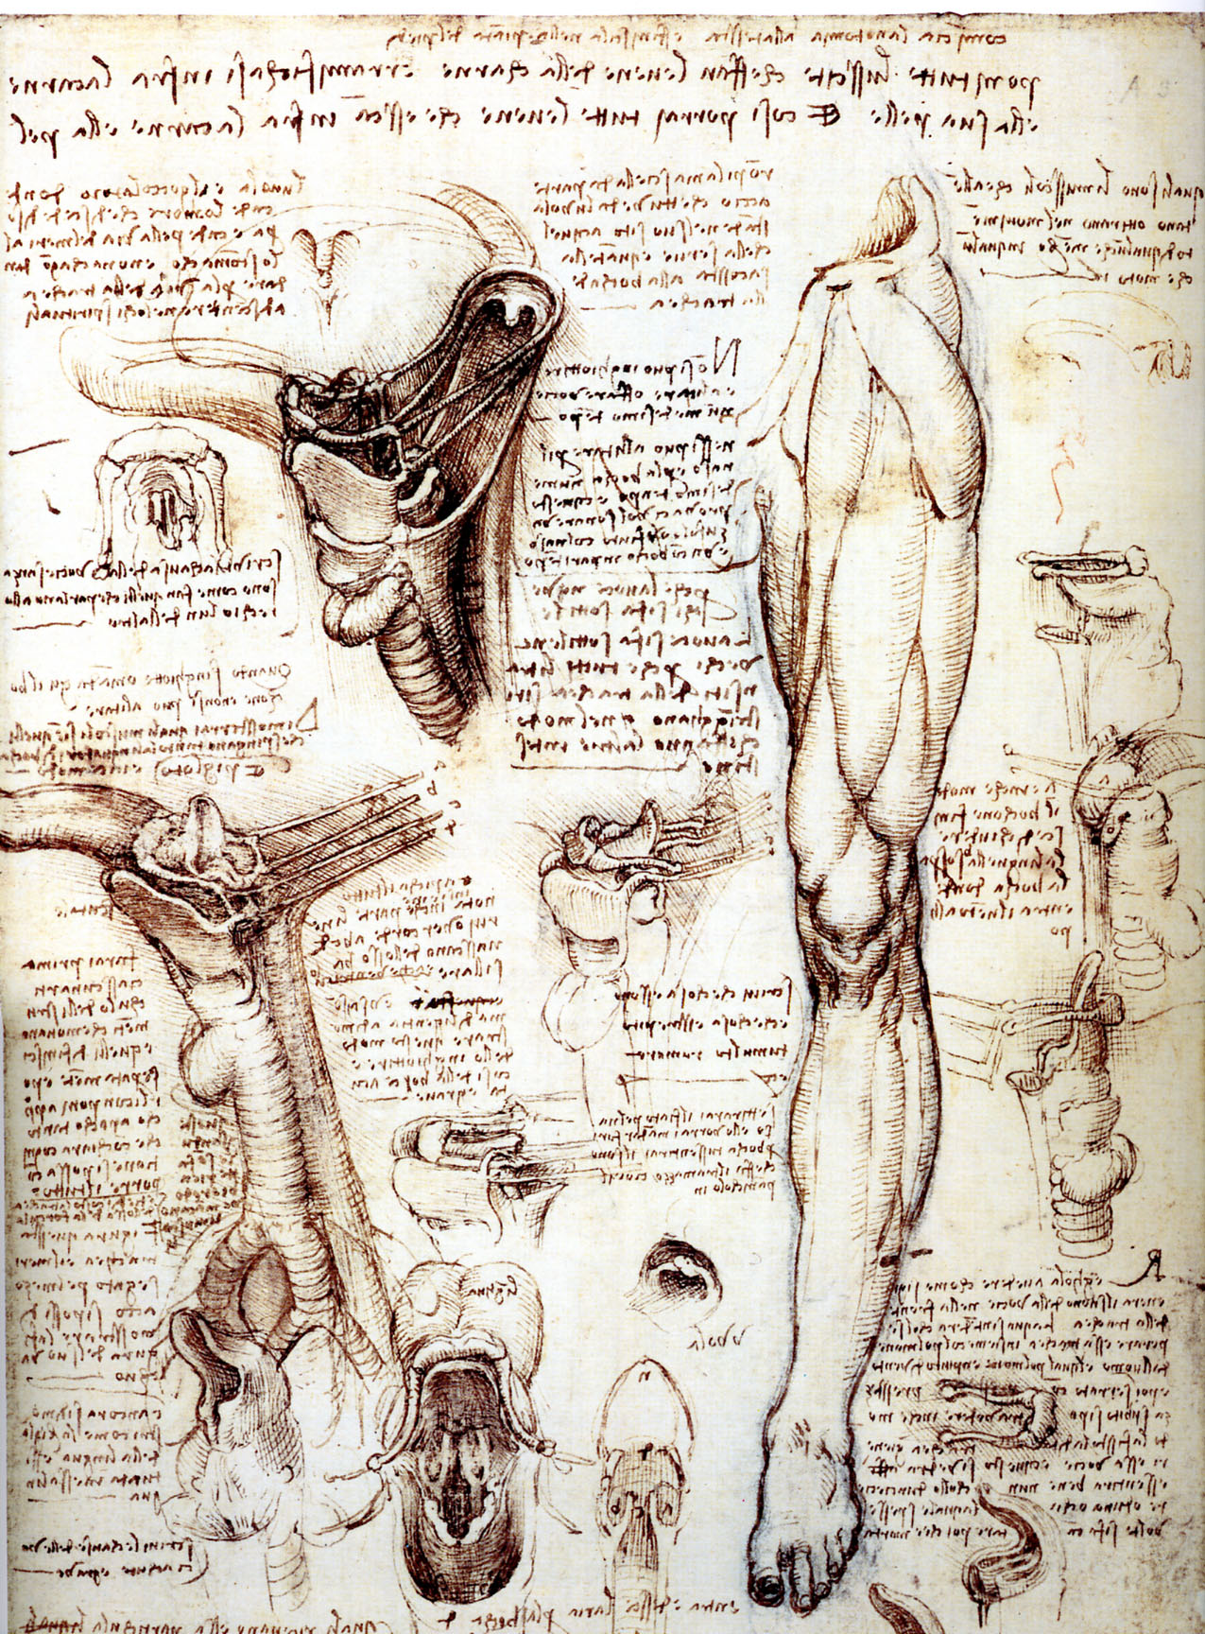

Slide 41
