Slide 1
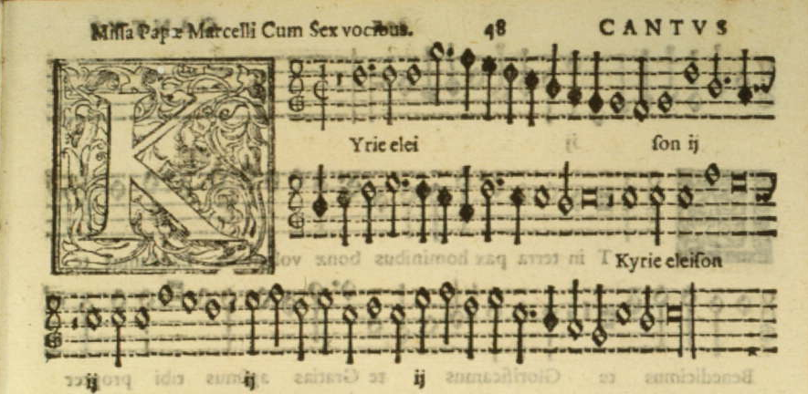
Renaissance Music
Palestrina’s Pope Marcellus Mass (circa 1562)

Slide 2
By the end of class you should to know:
Terms
Sacred
Secular
Harmony
Polyphony
Eleison
Music Forms
Mass
Madrigal
Motet
Musicians
Josquin des Prez
Giovanni de Palestrina

Slide 3
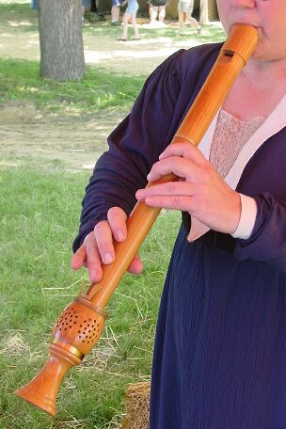
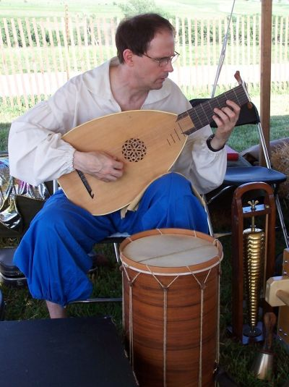
Renaissance Music – The Basics
Most music is vocal during this period – instruments were not yet standardized or mass-produced
Two categories of music:
  Sacred – for use in Catholic churches (remember, Europe, at the time, was almost entirely Catholic)
  Secular – everything else: ie. dancing, love, etc.
  Sacred music written in Latin
  Secular music written in vernacular (local language)
  Lute: http://www.music.iastate.edu/antiqua/mp3/Musica_Antiqua_have_you_seen.mp3
  Recorder: http://www.music.iastate.edu/antiqua/mp3/musica_antiqua_merry_month_of_may.mp3
Notes:
Lute: http://www.music.iastate.edu/antiqua/mp3/Musica_Antiqua_have_you_seen.mp3
Recorder: http://www.music.iastate.edu/antiqua/mp3/musica_antiqua_merry_month_of_may.mp3

Slide 4
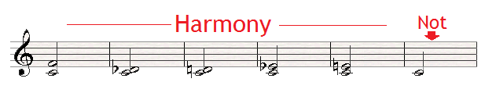
Harmony
Harmony: when two or more pitches sound at the same time
Therefore, if you have two or more singers on different pitches, you have harmony.
https://www.youtube.com/watch?v=i1wZVVMKojw

Slide 5
Polyphony
When the music sounds like two completely independent lines of melody, you have polyphony.
multiple (Greek)
sound (Greek)
Poly phony
https://www.youtube.com/watch?v=7mAH7FjxwzQ

Slide 6
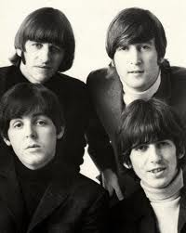
Polyphony - Application
While listening to this classic Beatles’ tune, identify the parts of the song that contain polyphony. Where is it?
  Intro?
  Verses?
  Chorus?
https://www.youtube.com/watch?v=69Symo0XtSk

Slide 7
Polyphony in the Church
When composers wrote church music, they often recycled (or sampled) the tunes of secular songs – even songs about drinking and sex – just like today’s artists sample songs from earlier years.
  Ray Charles – I’ve Got a Woman
  The song builds on "It Must Be Jesus" by the Southern Tones, that Ray Charles was listening to on the radio while on the road with his band in the summer of 1954….” “…built along a gospel-frenetic pace with secular lyrics and a jazz-inspired rhythm and blues.”(Wikipedia)
  https://www.youtube.com/watch?v=Zui6dblGntU – Ray Charles
  http://www.youtube.com/watch?v=AvCbVLZW4EY – Southern Tones
Notes:
(Of course, the church wasn’t happy about this – think of hearing Lil’ Wayne at a religious ceremony.)
http://www.youtube.com/watch?v=Mrd14PxaUco – Ray Charles http://www.youtube.com/watch?v=AvCbVLZW4EY – Southern Tones

Slide 8
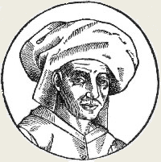
Josquin des Prez
Dates of Life: 1450-1521
Location of Birth: Belgium or France
Patrons: Julius II
Interesting Fact:
  He was directing the Sistine Choir while Michelangelo was painting the ceiling and Raphael was creating the School of Athens
Influences: Master of multiple genres, specifically the motet
Important Fact: One of the greatest composers of complex polyphonic music – called the High Renaissance style.
https://www.youtube.com/watch?v=3GBwbt6hK6c

Slide 9
Josquin des Prez
Structure of Music
Blended polyphony and 3 tone chord harmonies
Matched words with music (wordmatching)
All voice parts composed at one time
  → united parts rhythmically and harmonically
Preferred motet to the strict tradition of the Mass
required attentive/educated audience to be appreciated

Slide 10
Motet
Associated with Josquin des Prez’s (his favorite genre)
Popular genre of polyphonic music during Renaissance
Always vocal
Usually sacred (remember, sacred = church music)
Voices combine into chords as they change, creating shifting consonance and dissonance

Slide 11
Des Prez’s - Ave Maria
“Ave Maria” = “Hail, Mary”
Musical setting of the traditional “Hail, Mary” prayer used in many Christian churches.
Voices overlap, hear how the notes form different harmonies as the lines change one by one.
Listen for dissonance resolving to consonance:
http://www.youtube.com/watch?v=LUAgAF4Khmg
Notes:
http://www.youtube.com/watch?v=LUAgAF4Khmg

Slide 12
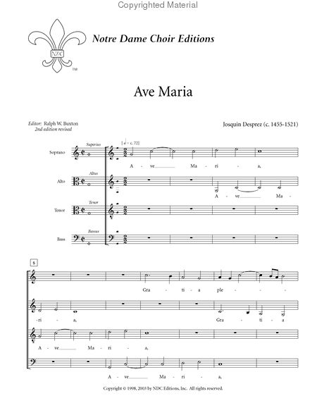
Des Prez’s - Ave Maria
Entering voices parts indicated by red marks
Voices range from high to low: soprano, alto, tenor, bass

Slide 13
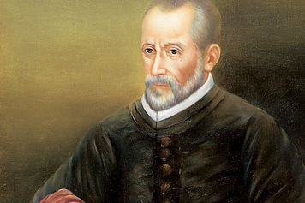
Giovanni Palestrina
Dates of Life: 1525-1596
Location of Birth: Palestrina, Italy
Patrons: Pope Marcellus
Interesting Fact:
  He was the choirmaster of the Julian Choir that performed exclusively in St. Peter’s Basilica. He was also the music director for the Vatican.
Influences: Gregorian Mass, Renaissance restraint, and the Counter-Reformation
Facts: He is the greatest composer of church music and he is known for his restrained polyphony.
https://www.youtube.com/watch?v=D1QjkhENZg8

Slide 14
Giovanni Palestrina
Abandoned secular music style of des Prez
His compositions are typified as very clear, with voice parts well-balanced and beautifully harmonized.
strict style created music that was always full and fluid
Restrained dissonance
  → 6 voices showed complex polyphony could still be pleasing to the ear
high point of sacred music in late Renaissance

Slide 15
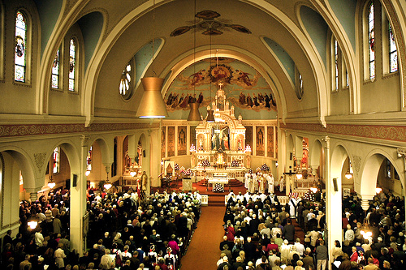
Mass
Associated with Giovanni Palestrina (his favorite genre)
The Mass is the weekly (or daily) worship service in the Catholic Church.
Often times entirely new music was written for the mass.

Slide 16
The Mass is always composed of five basic parts:
Kyrie
Gloria
Credo
Sanctus-Benedictus
Agnus Dei
King
George
Can’t
Sing
Alto

Slide 17
Mass
The sections always have the same basic texts.
Kyrie - Greek:
Kýrie, eléison
Christe, eléison
Kýrie, eléison
Kýrie, eléison
Kyrie - English:
Lord, have mercy
Christ, have mercy
Lord, have mercy
Lord, have mercy
https://www.youtube.com/watch?v=3n8XdKkrqgo

Slide 18
Palestrina’s - Pope Marcellus Mass
Listen for the words.
They repeat constantly in all six voices – it’s polyphony:
Kýrie, eléison
Christe, eléison
Kýrie, eléison
Kýrie, eléison
https://www.youtube.com/watch?v=wIvs7C2nW88
Notes:
http://www.youtube.com/watch?v=16cH1RZcPKs

Slide 19
Palestrina’s - Pope Marcellus Mass
According to legend, this piece caused early church fathers to allow polyphony to stay as part of the Mass. Remember, they were upset that composers were writing religious texts to the music of bawdy songs. Palestrina’s music showed them that polyphony could be refined and worthy of use in church ceremonies.

Slide 20
Madrigal
Popular genre of polyphonic music during Renaissance – in both Italy and England
Always vocal – between two and eight voices
Always secular
Choruses repeat, like today’s pop music. Voices enter and drop out suddenly to highlight the text
Music imitates words: called text painting.
Fun & spicy topics: love, sex, drinking, partying, etc.

Slide 21
VS.
Compare Palestrina to Josquin.
P’s is generally considered to be more refined polyphony than earlier composers (Josquin).
For this reason, Palestrina is probably the best known and most popular composer of Renaissance polyphony, and the greatest composer of church music of the period.

Slide 22
“Fair Phyllis I Saw Sitting All Alone”
Popular madrigal by John Farmer
(c. 1570 – c. 1601)
In four voices (soprano, alto, tenor, bass)
Words in English
Voices have slightly different rhythms. This overlap creates polyphony – 4 voices with equal importance
Secular subject matter sometimes created innuendos
  (double meanings – sometimes sexual or inappropriate topics)

Slide 23
“Fair Phyllis” (cont.)
Fair Phyllis I saw sitting all alone
Feeding her flock near to the mountain side.
The shepherds knew not,
they knew not whither she was gone,
But after her lover Amyntas hied,
Up and down he wandered
whilst she was missing;
When he found her,
O then they fell a-kissing.

Slide 24
“Fair Phyllis” (cont.)
Things to notice:
Word painting: soprano alone sings the line “Fair Phyllis I saw sitting all alone,” (because she’s alone)
Word painting: “Feeding her flock…” has all voices, (because a flock = lots of sheep)
Word painting: “Up and down he wandered…” – the voices follow up and down
“Hied” = “hurried” – an archaic English word

Slide 25
“Fair Phyllis” (cont.)
More things to notice:
Eleison: Two phrases may overlap, making the beginning and ending of both happen at the same moment in time.
Listen for Eleison – do you hear any new sentences formed by the combination of lines?

Slide 26
Music Listening Guide – Page 9
Title: Kyrie
Composer: Palestrina
Date Composed: 1562
Period/Style: Renaissance/Mass
Featured Instruments: Voices ONLY!

Slide 27
Recap:
3 forms: Mass, motet, madrigal
  Mass and motet in Latin, madrigal in English
Palestrina = Italian
Josquin = Belgium/French
Polyphony = overlapping voices of equal importance
  Consonance = 2 or more pitches that resonate pleasingly/smoothly together
  Dissonance = 2 or more pitches that somewhat clash

Slide 28
Exit Slip
1) Identify the composer, form, and title in the clips:
  Clip One:
  Clip Two:
  Clip Three:
2) How is the structure of Des Prez and Palestrina similar?
3) Discuss how historical events influence the difference between the music of Des Prez and Palestrina.

Slide 29
Medieval and Renaissance Instruments killer/filler
http://www.music.iastate.edu/antiqua/instrumt.html

