Slide 1
Romanticism Music

Slide 2
overview
Composers rejected the intensity of religious feeling and dramatic contrasts of the Baroque style.
Distinguished by the growth of popular audience for serious music.
Vienna, Austria was the center of classical music.
Public concerts became more popular in the 18th century and the average person’s experience with music grew.

Slide 3
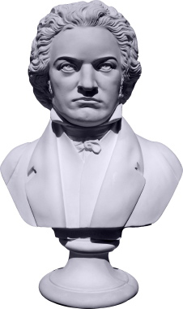
ludwig von beethoven
https://www.youtube.com/watch?v=-kSEi9QL0Qc

Slide 4
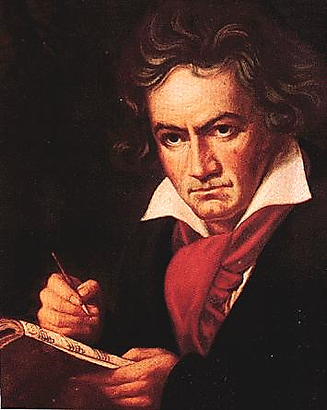
ludwig von beethoven
Born and raised in Bonn, Germany.
At 21 he moved to Vienna where he remained.
Known as a prodigy on the piano and for his improvisational skills.
Innovative and creative composer. He changed music from being a function of objective laws and rules to expressing one’s inner feelings.
Supported himself solely through composing and forming his own music
By 1800 he has started to go deaf and nearly commits suicide over the loss of his ability to hear music.

Slide 5
ludwig von beethoven
Characteristics of work:
-32 sonatas and 9 symphonies
-shows the tension between the classical and romantic
-Three periods
1) Classical Style (until 1802, stuck to Haydn’s rules)
2) The Middle Period/Heroic Phase (1803-1814)
works become dramatic, longer, and stretch classical form. Music modulates between emotions
3) The Final Period (1815-1827)
all composed after the complete loss of his hearing and were much more spiritual in nature

Slide 6
How do characteristics of Romanticism influence music?
Emotion: Expansion of formal structures within a composition, making the pieces more passionate and expressive.
Music has urgency, intensity, more contrasts in tempo and mood.
Common symphonic form:
extended orchestral composition
3-4 movements.
folk music (stories)
Begin to see virtuoso musicians

Slide 7
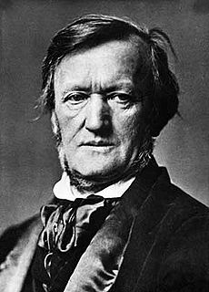
Richard Wagner (1813-1883)
1813 – 1883
Born in Leipzig, Germany
Personality:
Flamboyant egoist
Associated with anti-Semitism and Nazism
Music Terms he introduced:
Gesamtkunstwerk (Use reading assignment to define the word)
Leitmotifs (Use reading assignment to define the word)
Famous Works:
Ride of the Valkyries
Der Ring des Nibelungen
The Wedding March (Bridal Chorus) from Lohengrin

Slide 8
Richard Wagner (1813-1883)
1. Myth, Music, Poetry, Drama, and Pictoral design…. Gesamtkunstwerk
2. Opera itself (it’s commercialism)
3. A) The primary importance of the orchestra over the singing
B) the Leitmotif as unifying element
C) Chromatic, or colored, harmonies
4. Distinct melody or melodic fragment associated with a character, object, or idea
5. Yearning, love-death, transcendental bliss
6. Chromatic scale; Dissolved traditional tonality and gives music emotionalism
7. The Ring of the Nibelung…. 16 hours ☺

Slide 9
Der Ring des Nibelungen (1876)
Richard Wagner (1813-1883)
http://www.youtube.com/watch?v=xeRwBiu4wfQ
http://www.youtube.com/watch?v=Yxiv3CBMS4M
https://www.youtube.com/watch?v=30QzJKCUekQ
Synopsis:
“Ride of the Valkyries” begins in the prelude to the Act. The curtain rises to reveal a mountain peak where four of the eight Valkyrie sisters of Brünnhilde have gathered in preparation for the transportation of fallen heroes to Valhalla.
Romantic Characteristics:
Subject taken from folk story
High emotions shown through dramatic crescendos with emphasis on brass instruments
Music has urgency to it, intensity, and more contrasts in tempo and mood throughout the piece

Slide 10
Gesamtkunstwerk (gə.ˈzamtˌku̇nstˌveɐ̯k)
translated as total work of art, ideal work of art, universal artwork, synthesis of the arts, comprehensive artwork, all-embracing art form or total artwork) is a work of art that makes use of all or many art forms or strives to do so
Leitmotif (ˈlītmōˌtēf)
a recurrent theme throughout a musical or literary composition, associated with a particular person, idea, or situation.

Slide 11
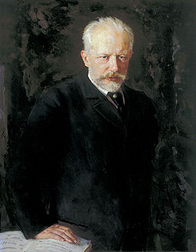
Pyotr Ilyich Tchaikovsky
1840 – 1893
Born in Votkinsk, Russia
Composed music for “Classical ballet”
Classical ballet is a full length ballet performed by a corps de ballet (a large company of dancers)
These works are choreographed and performed almost the exact same way for years/centuries to come.
Majors ballets include Swan Lake, The Sleeping Beauty, and The Nutcracker.

Slide 12
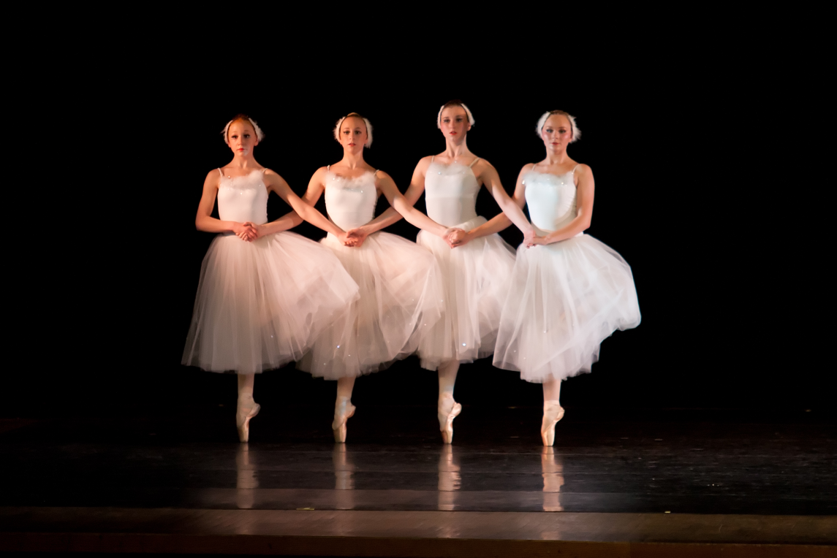
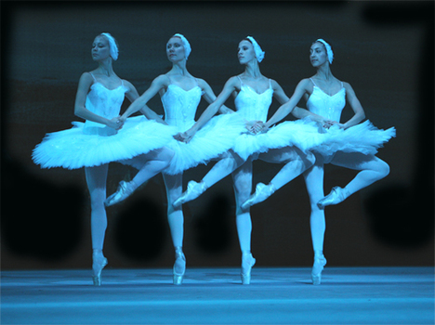
Tchaikovsky’s Swan Lake: Dance of the Four Swans
http://www.youtube.com/watch?v=-gApOfm4qd0
http://www.youtube.com/watch?v=giMQ05Q97mU

Slide 13
Romanticism ballet

Slide 14
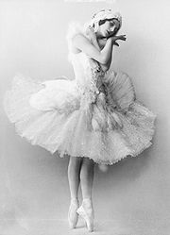
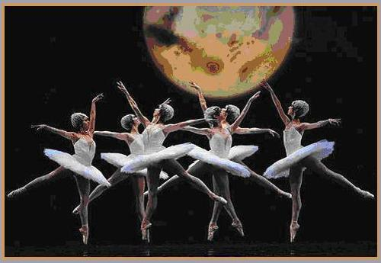
Romanticism in Ballet
Subject Matter:
the Supernatural
Earlier Times
Distant Lands
Folk Stories
Invention of gaslight which creates varying moods (lighting!)
Reflection of the Time:
Rising of the cult of the ballerina
As women gained more rights in society, women were featured and developed a specialized technique

Slide 15
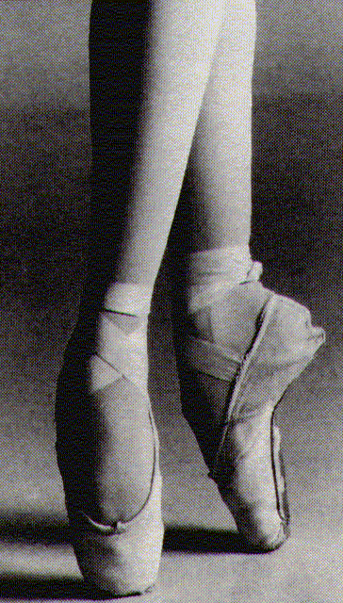
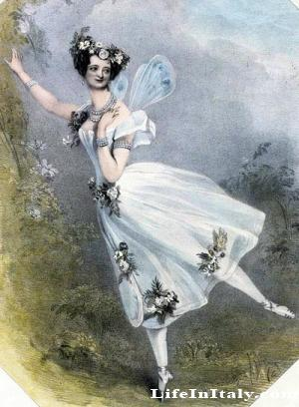
Cult of the Ballerina New Innovations to Ballet
Pointe Shoes:
Supportive shoes made of wood; allows ballerinas to dance on their toes
a strictly female characteristic of ballet
Shortened Skirts:
used to display the ballerina’s technique (specifically her feet/ankles)
Emphasis on Women:
Ballerinas were lifted by male partners or by wires to emphasize their lightness and delicacy.
This created an element of fantasy.
Answer the following in your notes:
How do these innovations surround the status of women during this time?

Slide 16
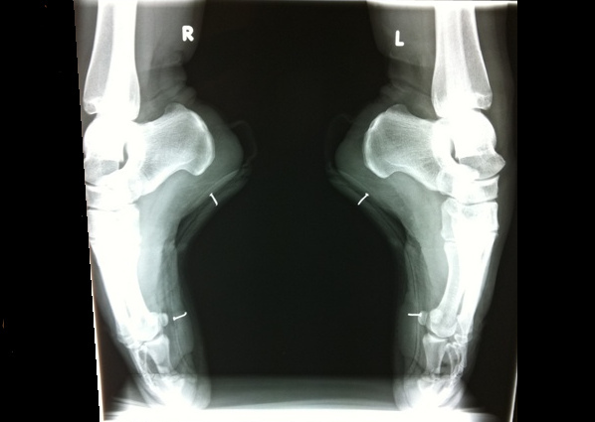

Slide 17
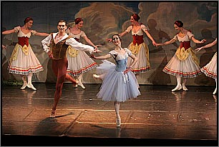
History of Ballet
Ballet performances blend choreographed movement with music and décor, and are performed by dancers trained primarily in classical ballet technique.
Ballet refers to both a dance genre and a particular dance
-A dance genre is a large category such as ballet, modern, or jazz
-Swan Lake or The Rite of Spring are both ballets or dances

Slide 18
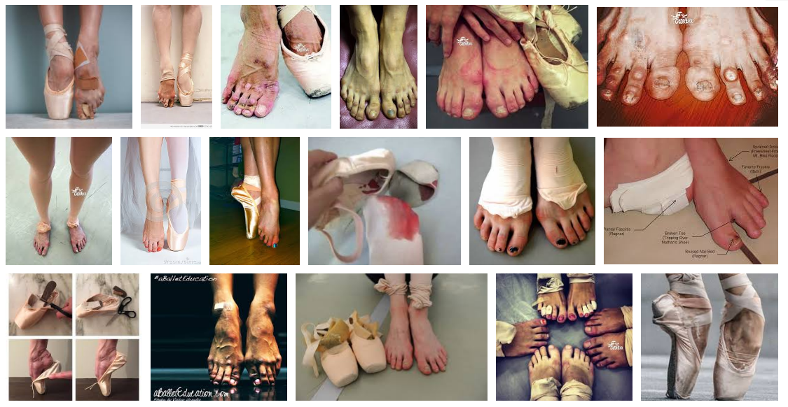
https://www.google.com/search?q=ballerina+feet&safe=strict&rlz=1C1DIEZ_en___US712&espv=2&biw=1152&bih=734&source=lnms&tbm=isch&sa=X&ved=0ahUKEwjX0u-81LXSAhXKRiYKHd1MCL4Q_AUIBigB

Slide 19
Ballet Technique
Ballet technique includes the following characteristics:
-5 positions of the feet, using “turnout”
-use of pointed feet
-toe shoes for women
-codified positions of arms and legs
-lightness, or pull away from gravity
-movements emphasizing balance and elevation

Slide 20
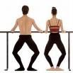
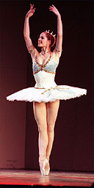
Ballet Terminology
Ballet uses French terminology such as
-plié (bend of the knees)
-pirouette (turn on one foot)
-grand jeté (leap)
-tendu ( stretch)
-chasse (a sliding movement)

Slide 21
Music
Traditional Romantic or Classical ballet is typically done:
to orchestral music of the 19th century.
The choreographer follows the rhythm and phrasing of the music, which was created specifically for the ballet by composers such as Peter Tchaikovsky and Serge Prokofiev.

Slide 22
Major ballet companies may have 60-80 members, and are organized hierarchically, with the corps de ballets at the bottom, then soloists, and principals at the top.

Slide 23
Ballet first developed in Europe in the Renaissance period…
-In Italy and France, dancing masters taught royalty and choreographed entertainments for the courts
-Italian intermezzi (late 1400s) were interludes between acts of plays that combined dance, music, and drama

Slide 24
Renaissance Dance
Renaissance court spectacles were often ornate and emphasized geometrical patterns
They used steps that were taken from the popular ballroom dances of the day
Steps became increasingly complex, and dancing masters asked their pupils to practice them holding onto the backs of chairs for balance; this is how the ballet barre developed
Dancing became stylish at all Renaissance courts in Europe, including those of Queen Elizabeth I and Henry VIII

Slide 25
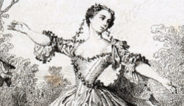
Over time, ballet became more professionalized….
In the early 1700’s, two women,Marie Camargo and Marie Sallé,broke tradition in the male-dominated field.
Camargo shortened her skirt to show off her technique. She was known for her aerial work.

Slide 26
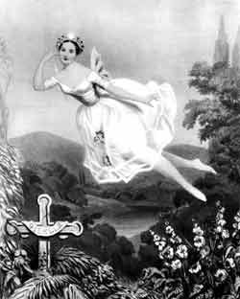
The Golden Age of Romanticism Early-Mid 1800’s
Romanticism was a movement involving all the arts, which rebelled against narrow ideas of morality and old artistic forms
Two examples of famous romantic ballets are Les Sylphides and Giselle. Giselle was choreographed in 1841 by Jules Perot and Jean Coralli to music by Adolphe Adam. This ballet is still performed extensively today.
Romantics often dealt with longing for the unattainable
In Giselle a young peasant woman falls in love with a man whom she can never marry, and she dies of a broken heart.

Slide 27
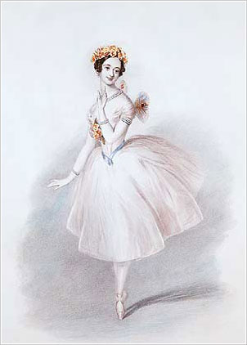
In La Sylphide, a tragic fantasy-romance, a husband-to-be is entranced on the night before his wedding by a "Sylphide," or forest fairy. He falls in love with the creature, but tragedy strikes when James places on the Sylphide's shoulders a scarf cursed by Madge, the forest witch. The Sylphide's wings fall off, and she dies.
Characteristics of Romantic ballet:
-Dancing en pointe -First tutus created -Women became dominant -Sylphs and fairies; supernatural -Ill-fated love

Slide 28
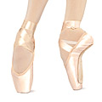
Dancing En Pointe
Toe dancing, or dancing en pointe, was invented during the romantic era
Today, toe shoes are made with reinforced toe boxes that are stiff
In the 1800’s, ballerinas wore soft slippers without support, but still managed to dance en pointe, due to their training
Marie Taglioni is the most famous pointe dancer of the era; her style was light and airy

Slide 29
Romeo and Juliet
http://www.youtube.com/watch?v=yg4c60wxmLw
Pg. 160 in your VPA notebook
As you watch this scene from Romeo and Juliet, answer the following questions:
1. What was the inspiration for this ballet?
2. Name two innovations that emphasize the focus of the ballerina that you see in this clip.
3. How is this an example of a Romantic ballet?
4. Would ballet have become so popular if there had not been the development of Romantic music? Why or why not? (Think about the major characteristic of Romantic music!)

Slide 30
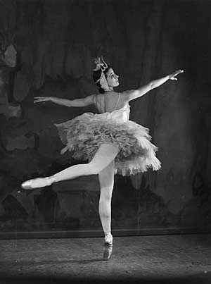
The Classical Period of Ballet, late 1800’s
After the Romantic ballet era, the next major development in ballet occurred in Russia.
-Marius Petipa, Frenchman, arrived in St. Petersburg in 1847 as a dancer, and eventually headed the Imperial Russian Ballet
-Choreographed many ballets with fairy-tale plots using panto-
mime and special effects
-Emphasized symmetry and classical pas de deux
-Most famous ballet is Swan Lake, 1890,
to music by Tchaikovsky

Slide 31
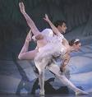
Characteristics of Classical ballet:
-Spectacular and realistic
- performances lasted a full evening.
-story was an excuse for exciting dancing, with the corps de ballet used as a decorative background, and the narrative told in formal mime gestures.
-The ballerina always danced on pointe, more demanding technical work was created; soloists often added their own steps to show off

