Slide 1
Romantic poetry
AND THEATRICAL MELODRAMA

Slide 2
American romantic poets
EMILY DICKENSON
EDGAR ALLEN POE
RALPH WALDO EMERSON
WALT WHITMAN
ENGLISH romantic poets
WILLIAM WORDSWORTH

Slide 3
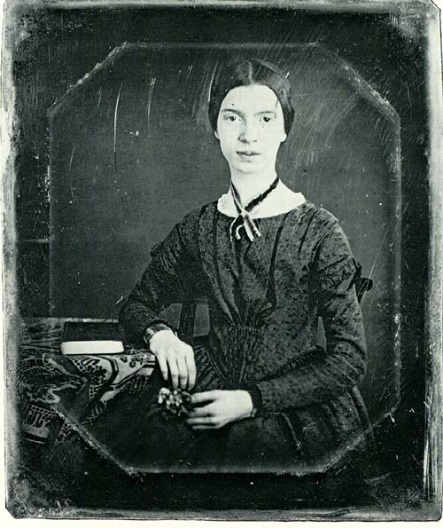
EMILY DICKENSON
Emily Dickenson often utilized themes of nature, life, and death in her poetry.
Most famous poems:
Narrow Fellow in the Grass
I Heard A Fly Buzz
Because I could not stop for Death
Just based on the titles alone, why do you think these poems are Romantic?
NATURE
DEATH

Slide 4
NARROW FELLOW IN THE GRASS
A narrow fellow in the grass
Occasionally rides;
You may have met him—did you not
His notice sudden is,
The grass divides as with a comb,
A spotted shaft is seen,
And then it closes at your feet,
And opens further on.
He likes a boggy acre,
A floor too cool for corn,
But when a boy and barefoot,
I more than once at noon
Have passed, I thought, a whip lash,
Unbraiding in the sun,
When stooping to secure it,
It wrinkled and was gone.
Several of nature’s people
I know, and they know me;
I feel for them a transport
Of cordiality.
But never met this fellow,
Attended or alone,
Without a tighter breathing,
And zero at the bone.
FINDING THE SUBLIME IN NATURE

Slide 5
I HEARD A FLY BUZZ
I heard a Fly buzz - when I died - The Stillness in the Room Was like the Stillness in the Air - Between the Heaves of Storm - The Eyes around - had wrung them dry - And Breaths were gathering firm For that last Onset - when the King Be witnessed - in the Room - I willed my Keepsakes - Signed away What portions of me be Assignable - and then it was There interposed a Fly - With Blue - uncertain - stumbling Buzz - Between the light - and me - And then the Windows failed - and then I could not see to see –

Slide 6
I HEARD A FLY BUZZ
1. The poem is first a Romantic poem in style because the subject includes references to:
a. reason and speech
b. religion and politics
c. nature and death
d. art and home-life
2. What is being described by the poet is the scene:
a. of the speaker’s death, the actual rites of dying
b. of a bee and a farm hand
c. of a church service
d. of a spirit and a priest
3. The two lines:
The Eyes around - had wrung them dry –
And Breaths were gathering firm indicates:
a. The fly scared the children in the room and made them cry
b. People that gathered by the bed had cried and were nervously
awaiting the death of the individual.
c. People were shocked beyond belief to see a dead person
d. The people could not breath the air because of the pollen in the air
4. The importance of the fly is that:
a. it is a nuisance (distraction) to the ritual taking place
b. it is a friendly reminder of nature and the world beyond the room
c. it is a traditional symbol of death and decay, appropriate in this context
d. it is an irrational “participant” in the room with the people beside the bed.
5. I willed my Keepsakes - Signed away What portions of me be Assignable
This portion of the poem describes what act taking place?
a. People taking away the speaker’s possession
b. The giving away of possessions to loved ones
c. The sale of the speaker’s keepsakes
d. The signing of a will

Slide 7
I HEARD A FLY BUZZ
1. The poem is first a Romantic poem in style because the subject includes references to:
c. nature and death
What is being described by the poet is the scene:
a. of the speaker’s death, the actual rites of dying
3. The two lines:
The Eyes around - had wrung them dry –
And Breaths were gathering firm indicates:
b. People that gathered by the bed had cried and were nervously awaiting the death of the individual
The importance of the fly is that:
c. it is a traditional symbol of death and decay, appropriate in this context
5. This portion of the poem describes what act taking place?
b. The giving away of possessions to loved ones

Slide 8
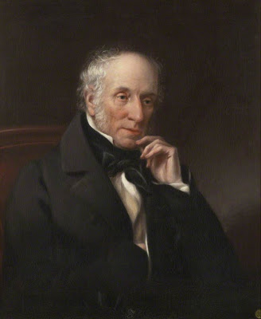
William wordsworth
English Romantic poet who utilized many concrete examples of the sublime in nature in his works.
He describes what is known as an aesthetic experience. It is a transcendental moment of awareness with heightened emotion and sensory experience
Famous Works:
I wandered lonely as a cloud

Slide 9
I WANDERED LONELY AS A CLOUD
I wandered lonely as a cloud
That floats on high o'er vales and hills,
When all at once I saw a crowd,
A host, of golden daffodils;
Beside the lake, beneath the trees,
Fluttering and dancing in the breeze.
Continuous as the stars that shine
And twinkle on the milky way,
They stretched in never-ending line
Along the margin of a bay:
Ten thousand saw I at a glance,
Tossing their heads in sprightly dance.
The waves beside them danced; but they
Out-did the sparkling waves in glee:
A poet could not but be gay,
In such a jocund company:
I gazed—and gazed—but little thought
What wealth the show to me had brought:
For oft, when on my couch I lie
In vacant or in pensive mood,
They flash upon that inward eye
Which is the bliss of solitude;
And then my heart with pleasure fills,
And dances with the daffodils.
FINDING THE SUBLIME IN NATURE

