Slide 1
the Age of Romanticism
Pg. 158
THEATER

Slide 2
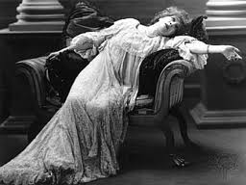
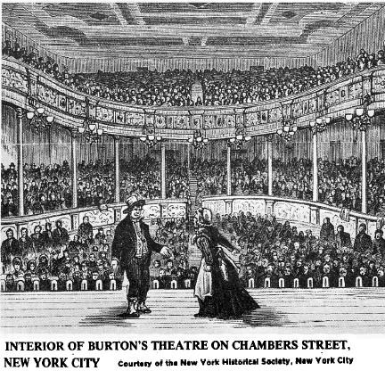
Romanticism in Theater
Actors and actresses are now more important than playwrights
  More rehearsals
Technological influences:
  Larger theater due to larger productions
  Lit with gas
  Steam-engine
    People could travel to see plays
New factories= new jobs = money to go to the theater
Urbanization: people needed entertainment in the cities
theaters opened in new places that previously had no form of theater
and actors begin tours around the United States

Slide 3
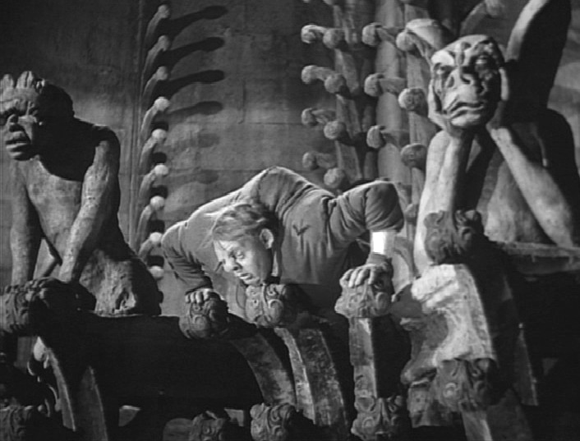
Romanticism in Theater
Types: Three Types
Romantic Plays
needed no rules (rejected the “rules” of Neoclassical theater)
no subject matter was inappropriate
conflict occurred between the character’s spiritual and creative wishes and their physical ability
http://www.youtube.com/watch?v=_pPUmv3U2XY
Notes:
Romantic: Part of Your World

Slide 4
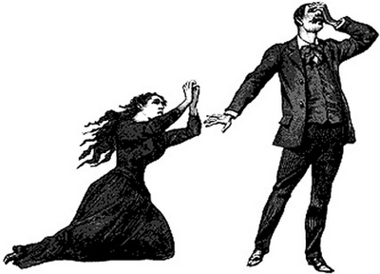
Romanticism in Theater
Type Two:
Melodramas
designed to pull the heart-strings of the audience by pitting good characters against bad characters – heroes against villains.
Full of over-the-top, dramatic expression; reintroduction of stock characters.
http://www.youtube.com/watch?v=rlQYqQs0R3w
Notes:
Lady in the Tramp: We Are Siamiese

Slide 5
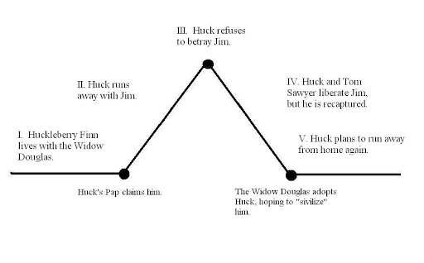
Romanticism in Theater
http://www.youtube.com/watch?v=nwZEcdBMLLU
Type Three:
Well-Made Plays
Structure builds to a climax through a development of plot events that take place logically in a cause and-effect fashion
the audience knows all of the information to know the characters; events are foreshadowed.
Notes:
Beauty and the Beast: Something There

Slide 6
Can you indentify the different types of Romantic plays?
Pg. 160 in your VPA notebook
http://www.youtube.com/watch?v=_pPUmv3U2XY
http://www.youtube.com/watch?v=nwZEcdBMLLU
http://www.youtube.com/watch?v=rlQYqQs0R3w

Slide 7
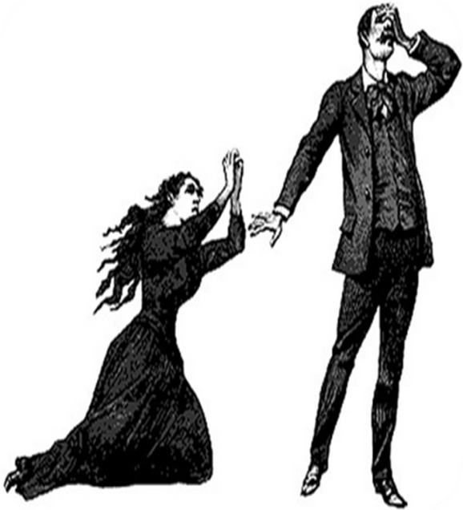


Application: (On the back of your learning guide)
With a partner, select one of the types of theater during the Romantic Period and write a brief plot synopsis that demonstrates your knowledge of these types.
Well Made Plays
Melodramas
Romantic Plays
10 Minutes

