Slide 1
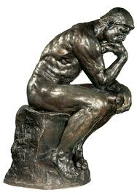
Sculpture Basics

Slide 2
Sculpture Lesson Agenda
To Get:
Handout
Package of clay
To Do:
Review Purposes of Art
Sculpture Notes/Lecture
Sculpture Activity
Exit Slip

Slide 3
Purposes of Art
On a blank half sheet of paper do the following:
*List the five purposes of art
*Give a real-life example of each purpose
1. Ex. Ceremonial – Stained Glass Window in a Church
2.
3.
4.
5.

Slide 4
Sculpture: a 3-dimensional piece of art that takes up space. There are two basic kinds: 1 - Free-Standing 2 - Relief Sculpture

Slide 5
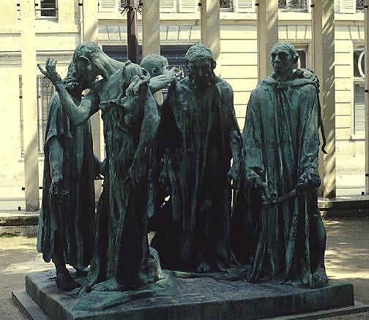
A free-standing sculpture is also called full round, meaning you can walk around it.
Auguste Rodin, Burghers of Calais

Slide 6
This one is carved from a single piece of wood.

Slide 7
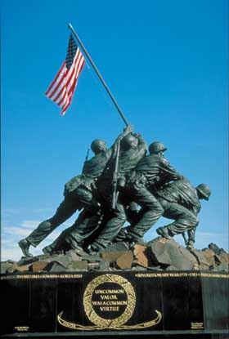
This is free standing, you can walk around it.

Slide 8
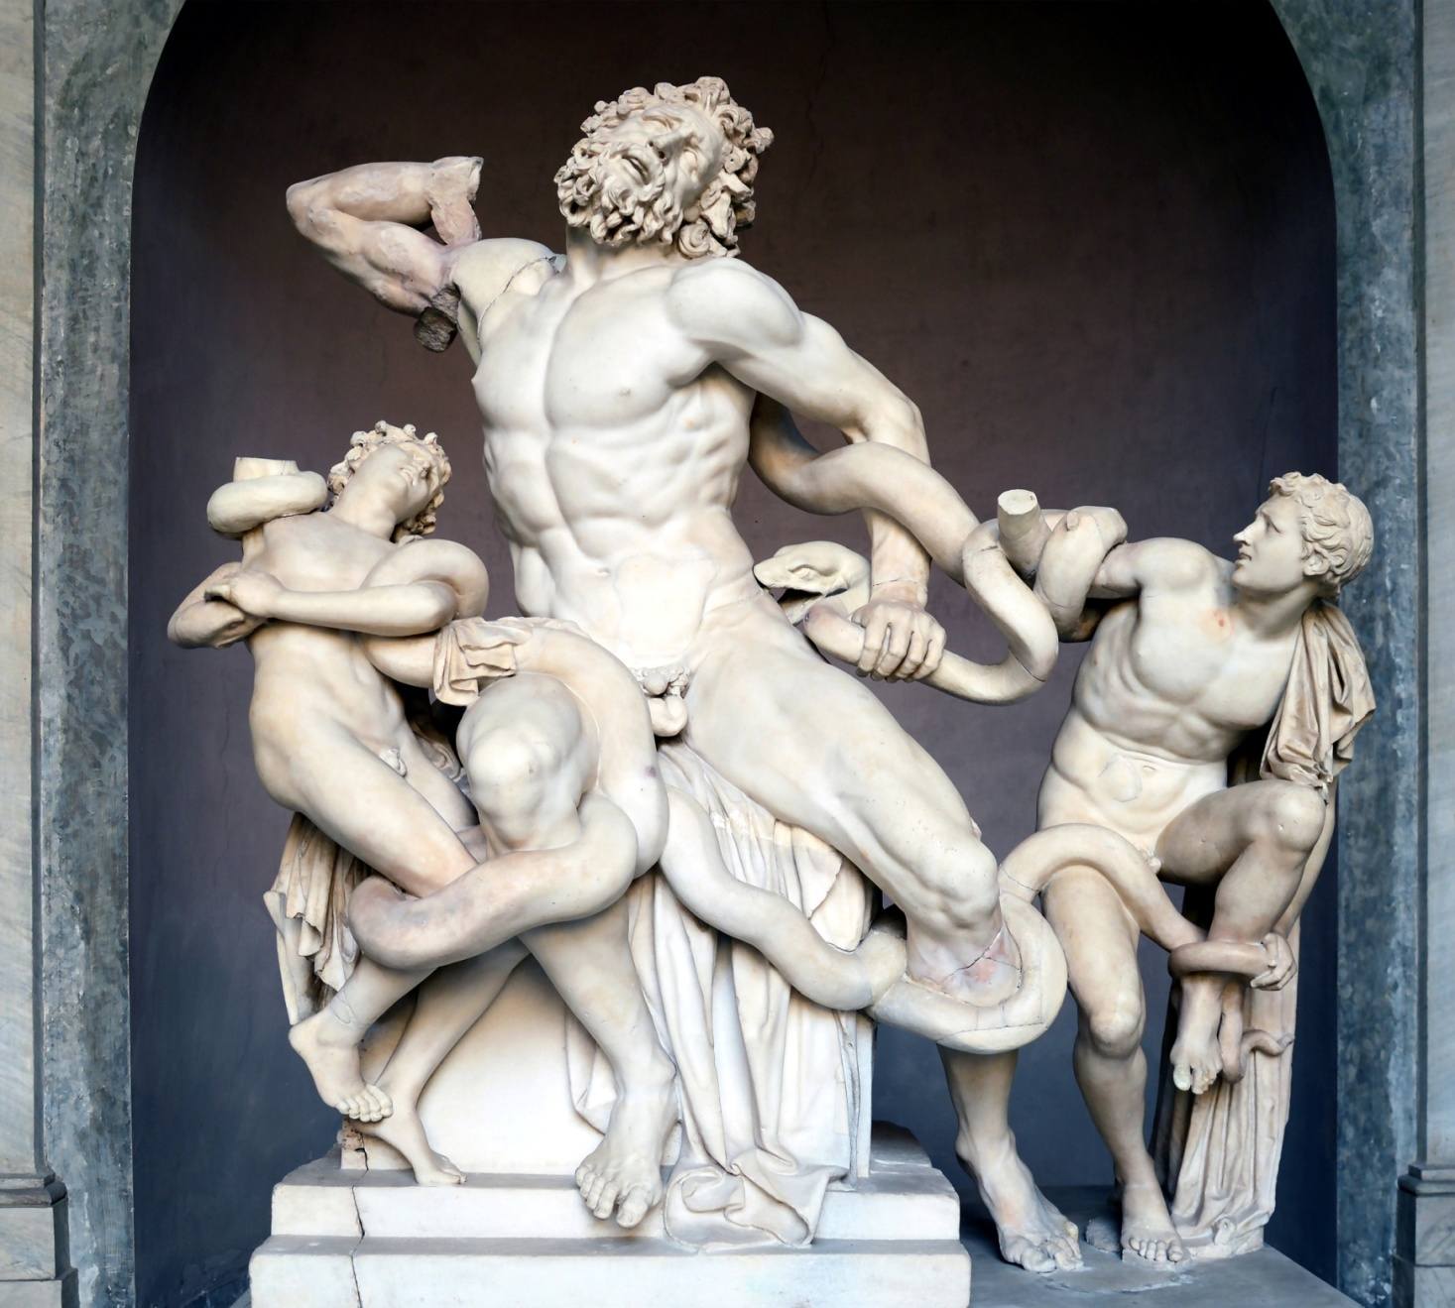
Laocoön and his sons. (20 B.C. Greek)

Slide 9
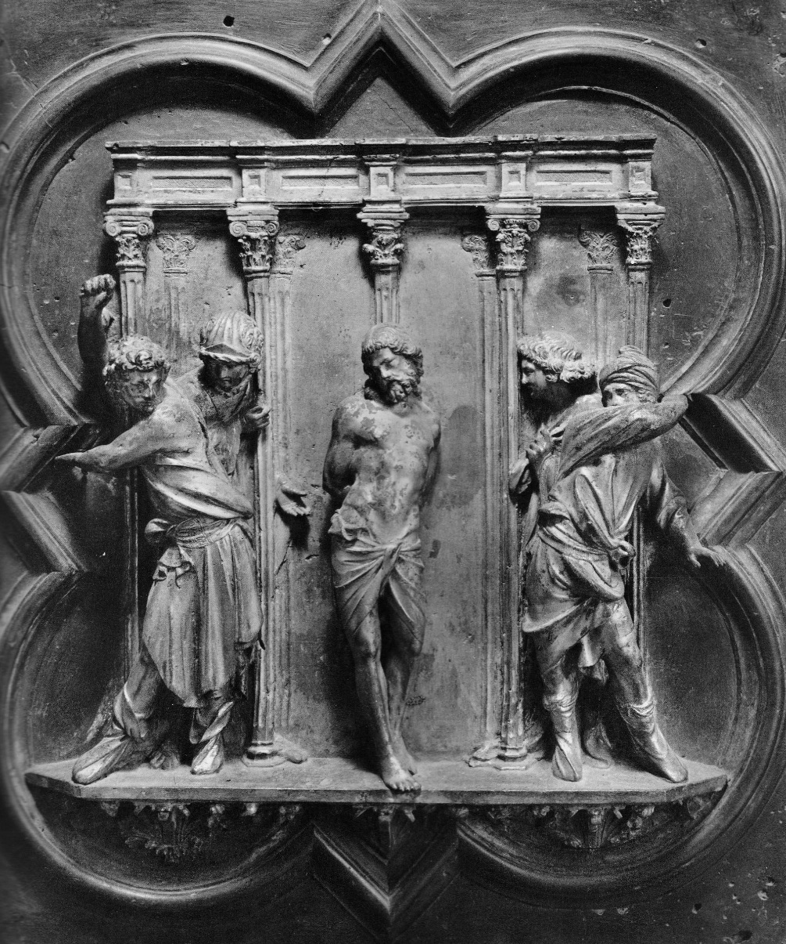
Relief Sculpture
Relief sculpture is where the form projects out of the plane: flat panel with ONE side that is 3-D

Slide 10
Low
Low and High Relief
Sculpture
High

Slide 11
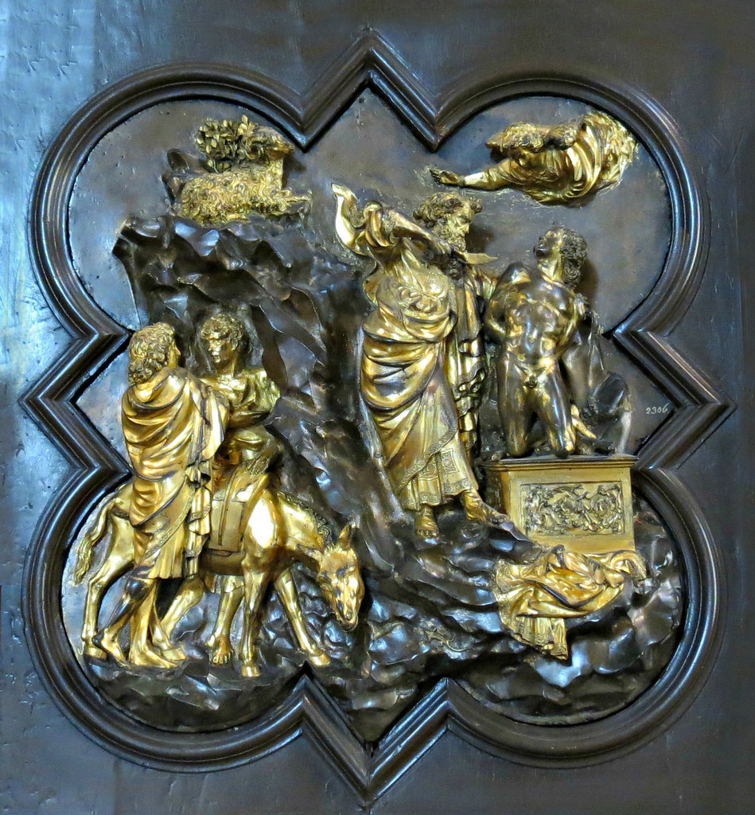

Slide 12
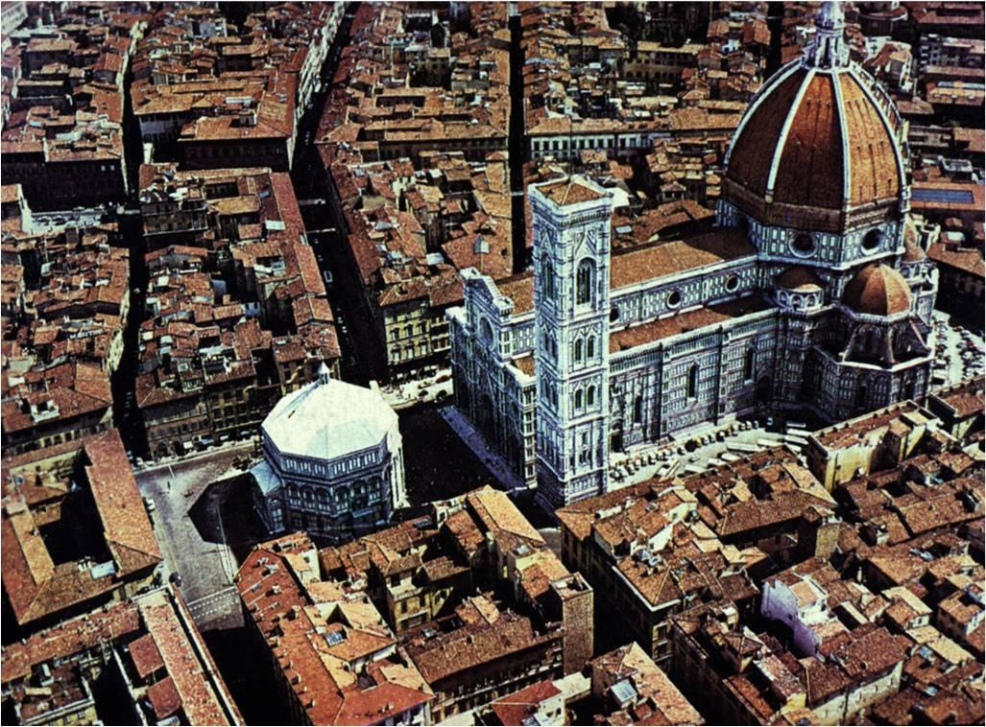
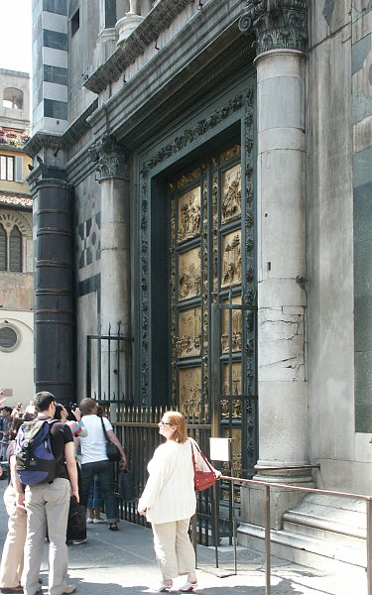

Slide 13
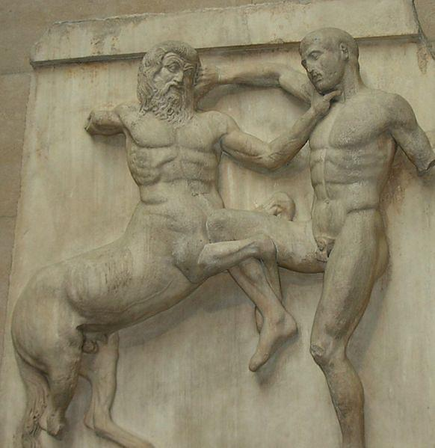
Bas-relief is a method of sculpting which entails carving or etching away the surface of a flat piece of stone or metal….To put it simply it is a sculpture portrayed in a very life-like manner, with great dimension.

Slide 14
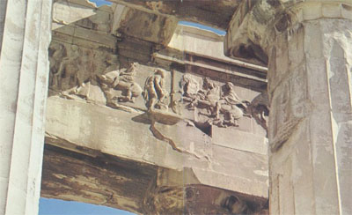
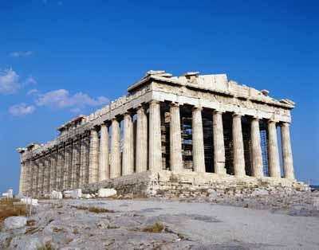
Parthenon Frieze

Slide 15
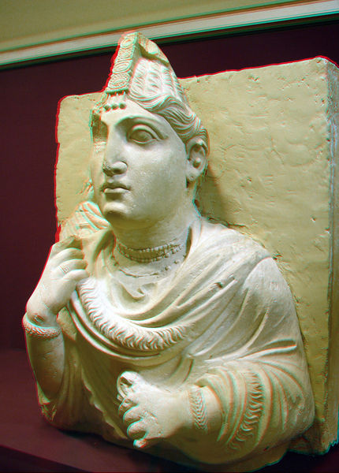

Slide 16
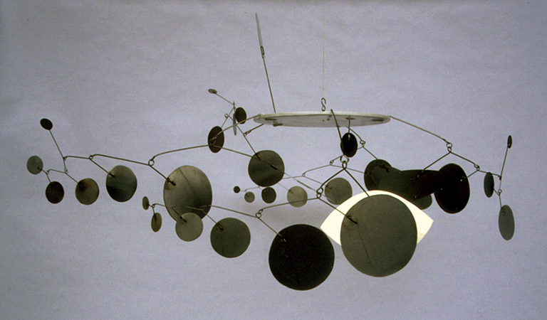
Sculpture can also be linear, made of wire or other materials and function as a mobile

Slide 17
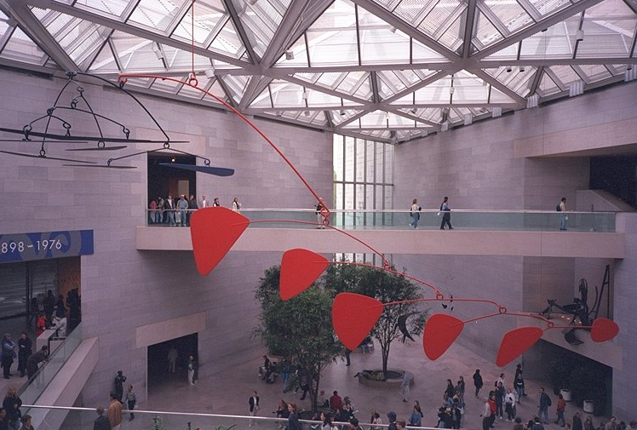

Slide 18
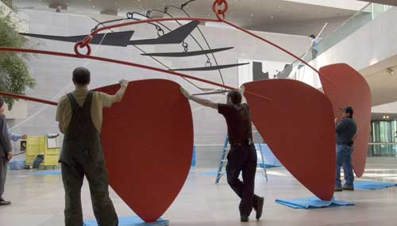

Slide 20
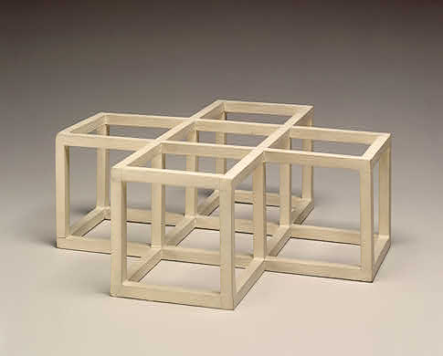

Slide 21
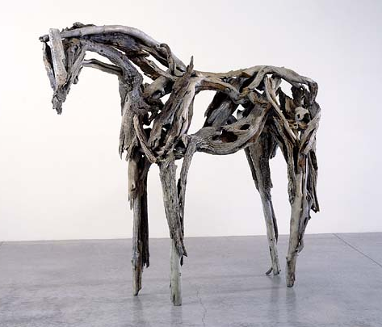
Pieces of wood make up this linear sculpture

Slide 22
-Open Forms
-Closed Forms
Both terms refer to where the eye is drawn to.

Slide 23
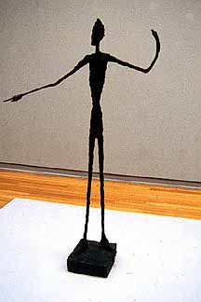
This piece shows open form because
it leads the eye outward.
It is by a famous sculptor named Giacometti.

Slide 24
This one is open, and also leads our eye upward and outward.

Slide 25
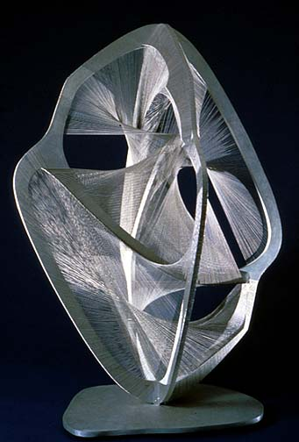
This is also a closed form

Slide 26
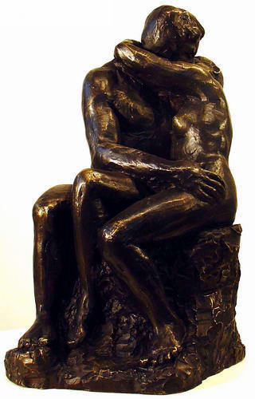
This is closed because the eye is drawn back into the figure.

Slide 27
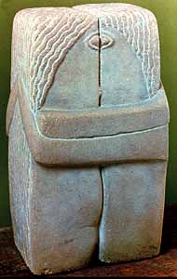
So is this….
“The Kiss” by Brancusi, 1912,
Limestone, 23” high

Slide 28
Additive & Subtractive
The two basic ways a sculpture is created.
Additive means adding to. It could include assembling materials, modeling as with clay, or casting metals or other substances.
Subtractive means taking away. This usually means carving.

Slide 29
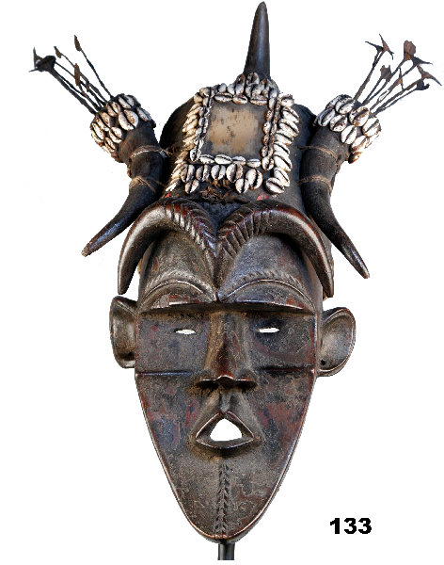
This sculpture is additive.

Slide 30
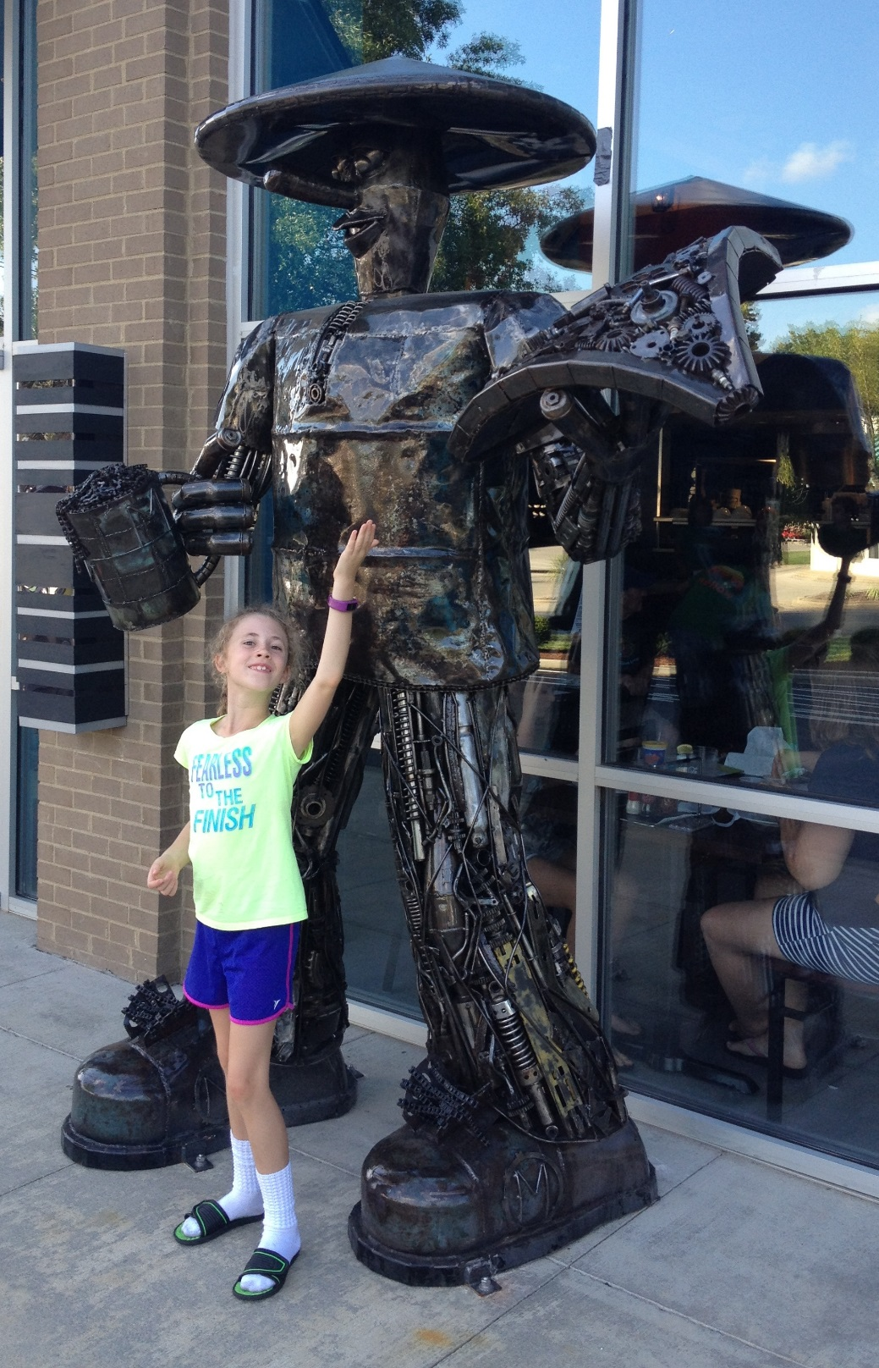
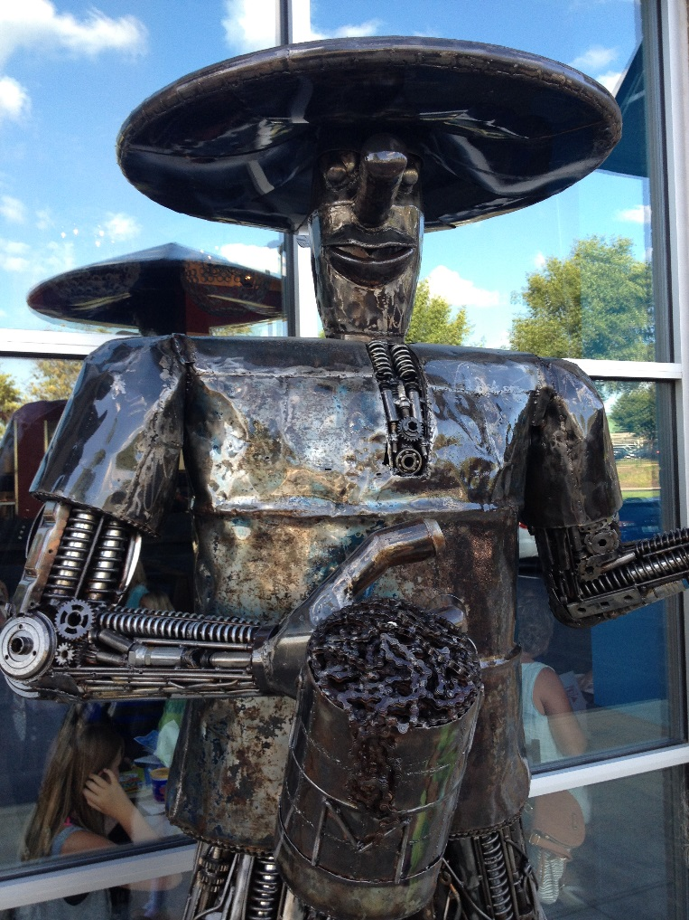

Slide 31
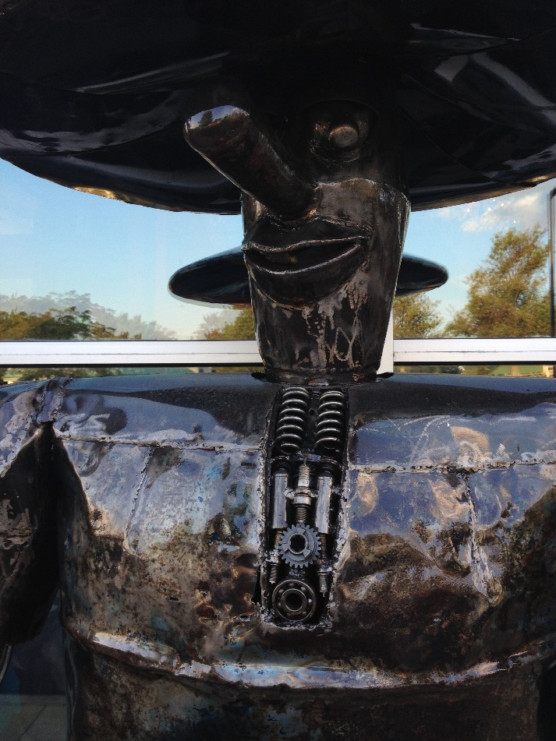
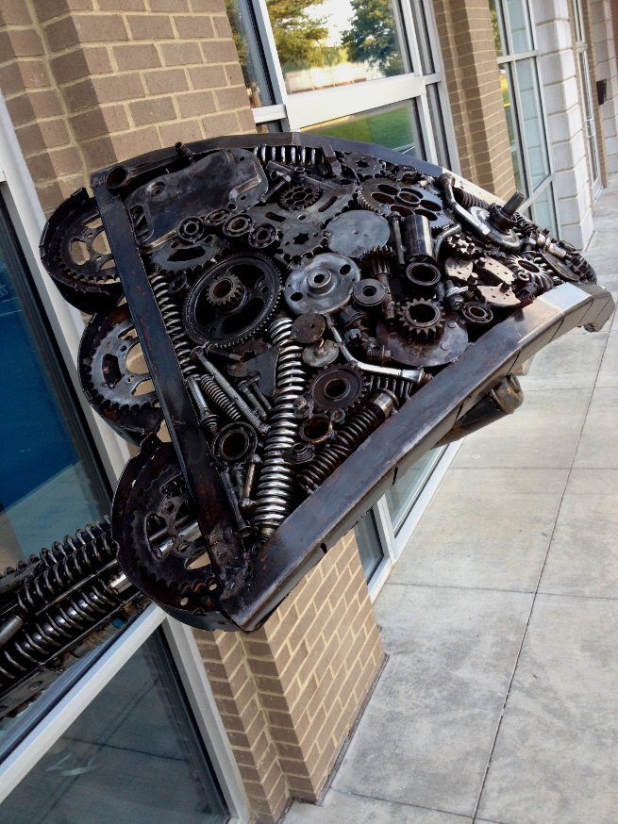
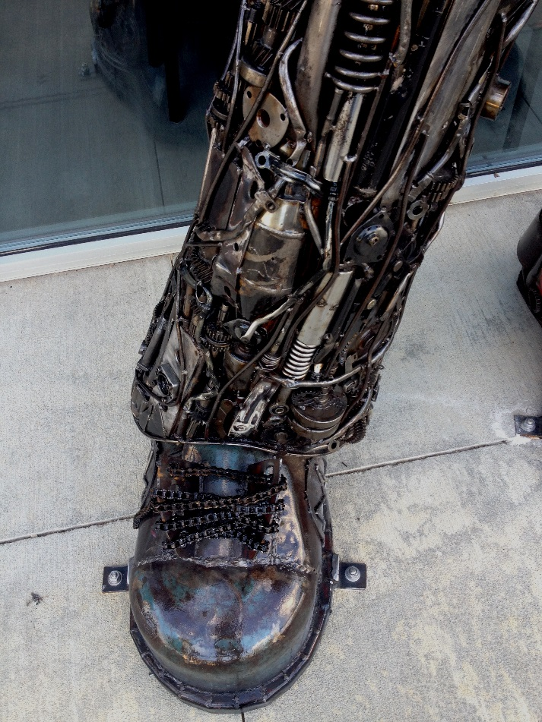
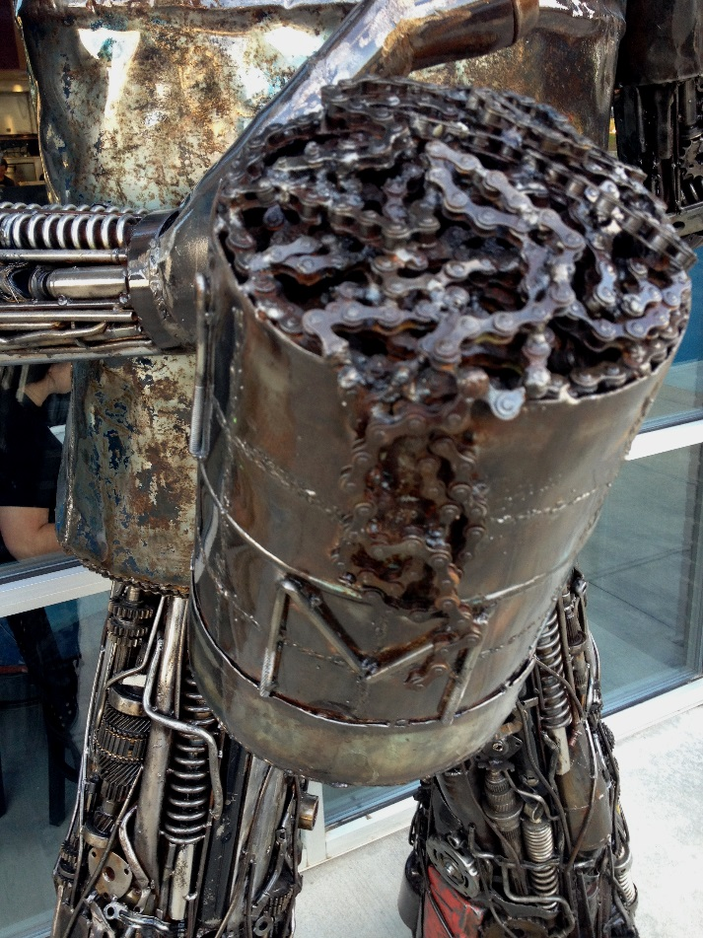

Slide 32
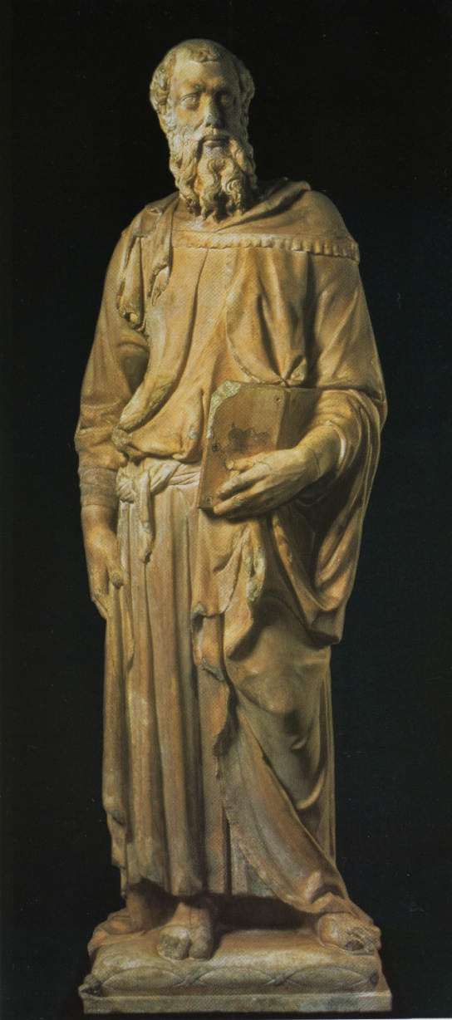
Subtractive means wood or stone or other medium is carved away
This is Donatello's statue of St. Mark

Slide 33
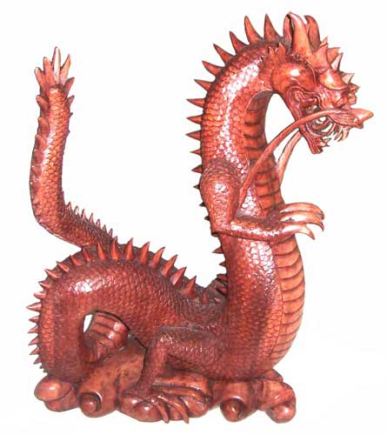
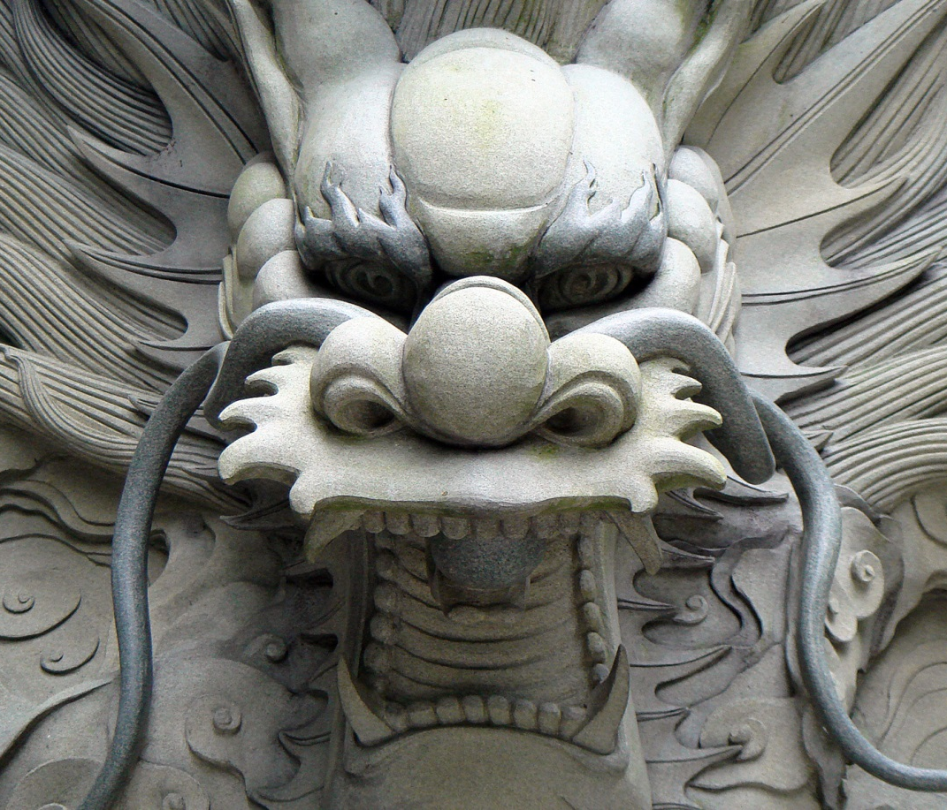
Anything that is carved is subtractive.

Slide 34
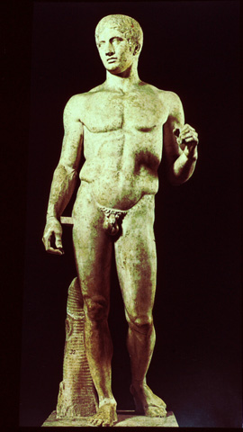
This was carved from marble

Slide 35
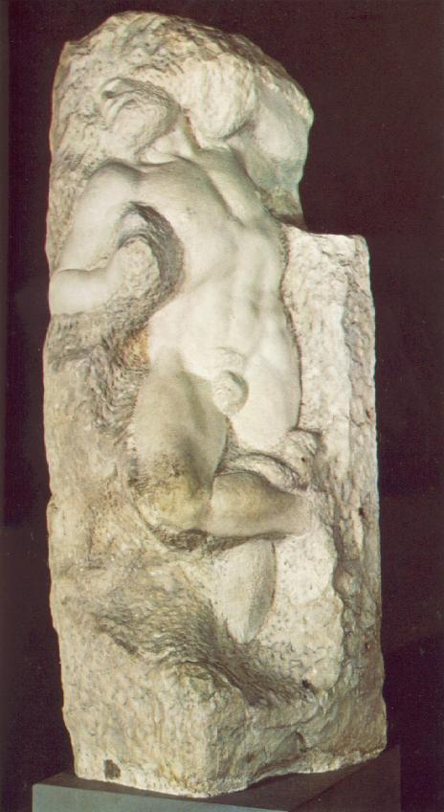
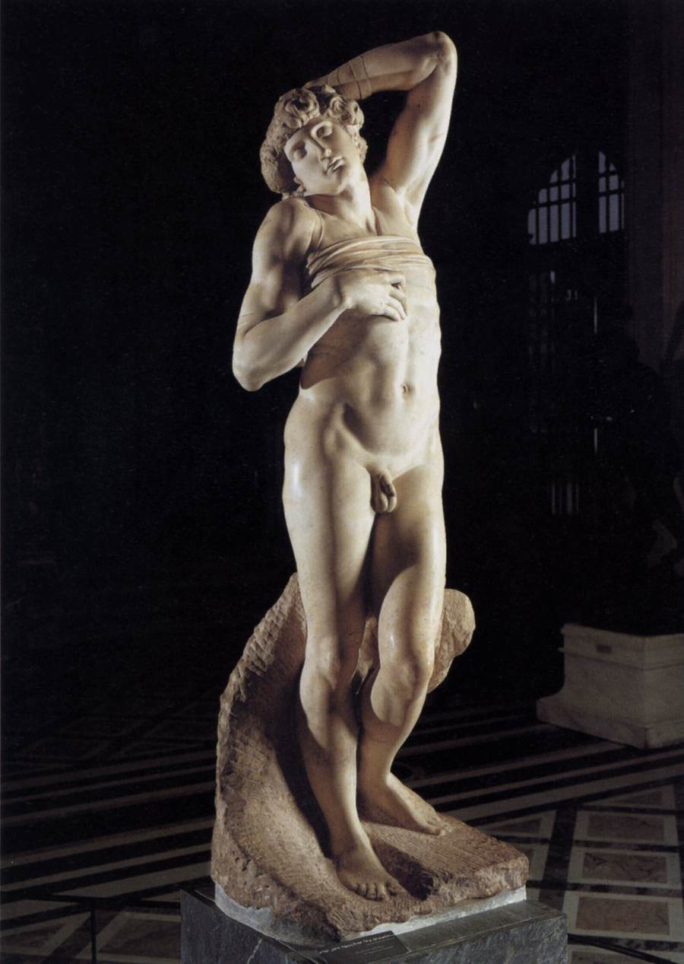
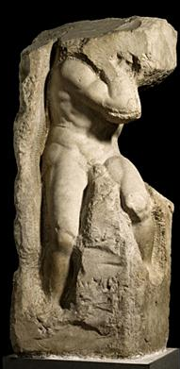
An unfinished sculpture in marble by Michelangelo

Slide 36
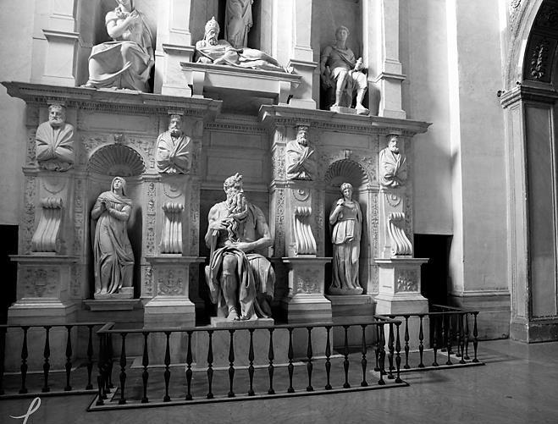
Pope Julius II Tomb

Slide 37
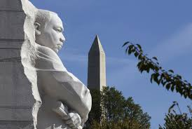
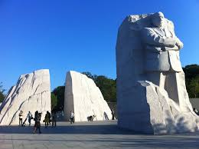

Slide 38
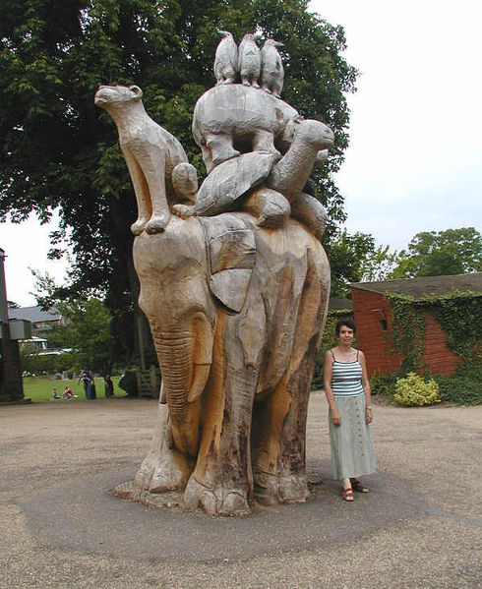
This was carved with a chain saw from a diseased tree, it’s in England.
After the ice storm here in Lexington, people made sculptures out of injured or dead trees

Slide 39
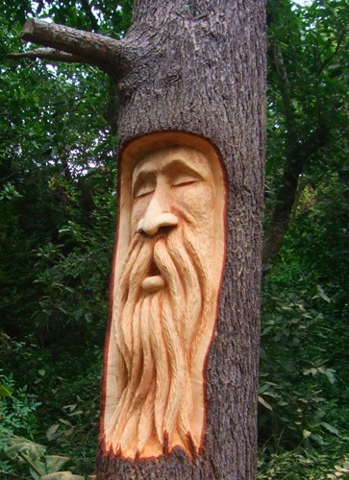
Chainsaw Sculpture Video
https://www.youtube.com/watch?v=D1LaSzwsA_I

Slide 40
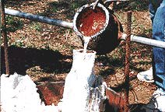
Casting is when an artist takes a metal or other material and heats it to liquid then pours it into a mold. It is an additive form of sculpture.

Slide 41
Bronze Casting Video
Lost Wax Casting Time Lapse
https://www.youtube.com/watch?v=6-TxIKt2cUE

Slide 42
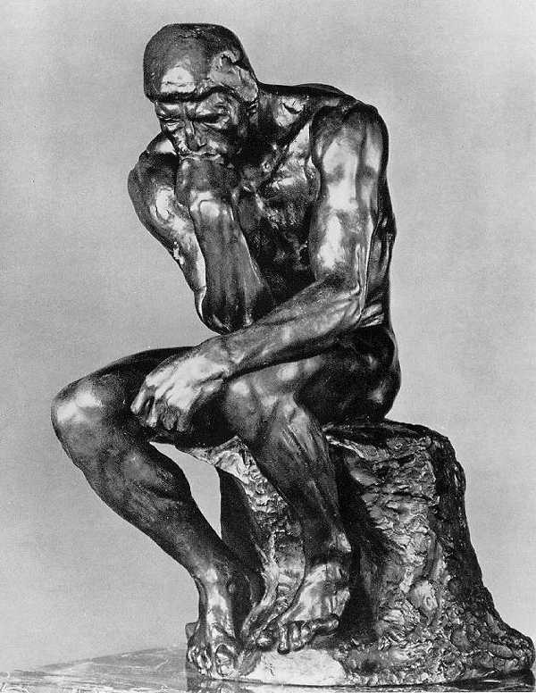
This is a cast of Rodin’s famous sculpture “The Thinker”
http://louisville.edu/about/thinker/

Slide 43
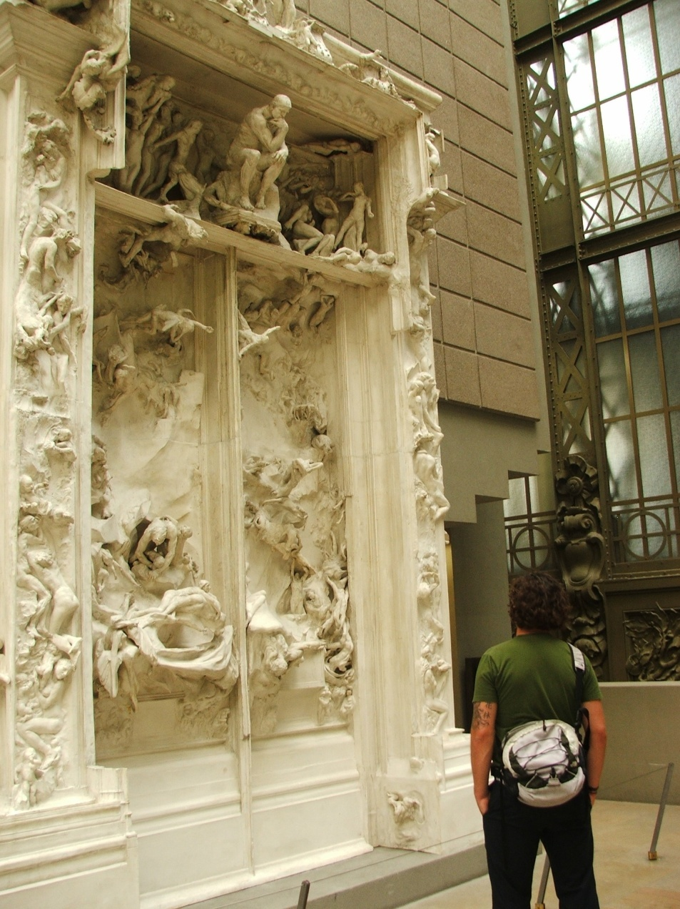
Dante’s Inferno inspired The Gates of Hell by Rodin

Slide 44
Additive Sculpture Full-Round Instructions
Step 1: Open your package of clay
Step 2: Divide your clay into 15 pieces
These should correspond in size to the following: 2 Hands, 2 forearms, 2 biceps, 2 Feet, 2 lower legs, 2 thighs, 1 torso, 1 neck, 1 head = 15 pieces
Step 3: “build” and additive full-round sculpture of a person using these pieces
Step 4: Make sure it can stand on its own!
Step 5: Show me when you are done

Slide 45
Subtractive Sculpture Relief Instructions
Step 1: Open your package of clay
Step 2: Work your clay into a square “block”
Step 3: Using the provided tools begin removing clay from the block to create a face. Make sure you do not pick it up while working; the back should remain flat to be a relief sculpture.
Step 4: Be sure to include as much detail as possible; nose, eyes, ears, mouth, eyes, etc.
Step 5: Show me when you are finished.

Slide 46
Exit Slip
Draw an example of a relief sculpture
How do you know if something is “full-round?”
What type of sculpture might use a hammer and chisel?
What type of sculpture might use melted bronze?
A linear sculpture consists mainly of what element of art?

