Slide 1
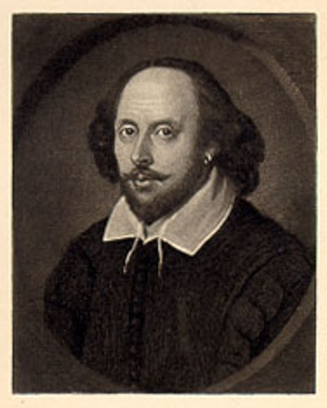
William Shakespeare

Slide 2
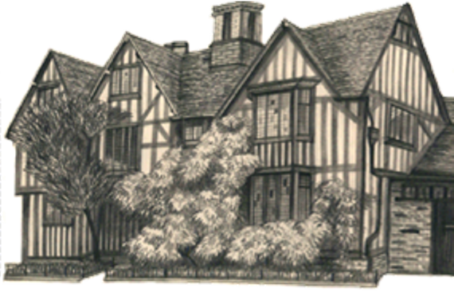
Shakespeare Facts
Born: 1564 in Stratford-Upon-Avon
Father: John Shakespeare (leather-maker & bailiff)
Education: 6-day/wk grammar school (age 6-16)
Married: Anne Hathaway (26-years-old) William (18-years-old)
Children: Susanna born after 6 months, Twins – Hamnet & Judith born 1585 (Hamnet d. 1596)
https://www.youtube.com/watch?v=geev441vbMI

Slide 3
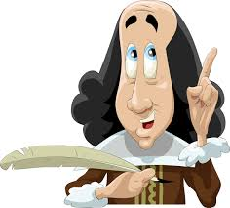
Career: Freelance Actor & Writer
~ 35 Plays (+6 Collaborations)
~ 154 Sonnets
Styles:
~ Tragedies
~ Comedies
~ Histories (England’s)
~ Poetry (Sonnets & Narrative poems)
Retired: 1613
Died: 1616

Slide 4
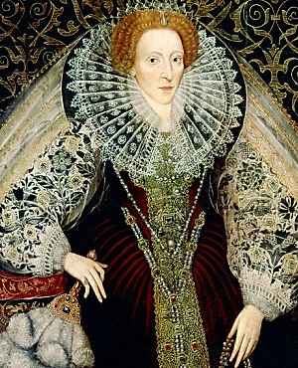
Queen Elizabeth I
Born in Greenwich (1533)
Daughter of King Henry VIII & Anne Boleyn
Took throne after half-sister’s death
Called “The Virgin Queen” because she never married
She ruled for 45-years (1558-1603) ~ the longest reign in English history
Took many voyages (mainly to the Americas) with Francis Drake, Sir Walter Raleigh, Humphrey Gilbert

Slide 5
Queen Elizabeth I
Founded East India Trading Company in 1600
Theatre & Arts thrived and flourished
Attended the first performance of A Midsummer Night’s Dream
Threatened invasion of Spain & France
In the “Golden Speech of 1601” she addressed Parliament saying, “There is no jewel, be it of never so high a price, which I set before this jewel; I mean your love.”
Died: March 24, 1603 ~ A National Holiday

Slide 6
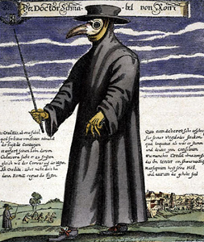
The Plague
Setback: London theaters closed for two years during the plague, or “Black Death,” that killed over 33,000 people in London.
Health: Shakespeare wrote two long poems and possibly his famous sonnets during this period.
Return: By the time theaters reopened in 1594, Shakespeare had written at least five new plays.

Slide 7
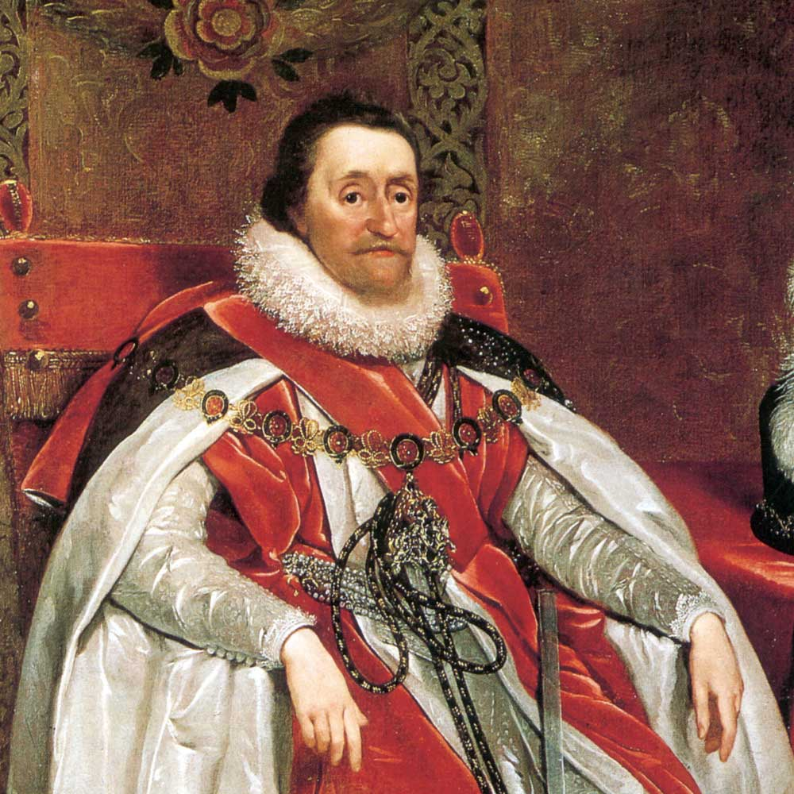
King James I
Born in Edinburgh, Scotland (1566)
Son of Mary Queen of Scots & Lord Darnley
James took the Scottish throne in 1581
When Elizabeth died in 1603, he became the first Stuart king of England as well, creating the kingdom of Great Britain.
One of James's great contributions to England was his authorized version of the bible (1611) which was to become the standard text for more than 250 years.
Died: 1625 and was succeeded by his second son, Charles.

Slide 8
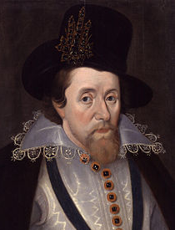
King James I
James was a great admirer of poetry and the drama from his earliest days, and later in life favored dramatic art.
James's tutor, the historian and poet George Buchanan, was a positive influence and James was a capable scholar.
James I became the patron of Shakespeare's company
He invited Shakespeare's company to perform 13 times a year!

Slide 9
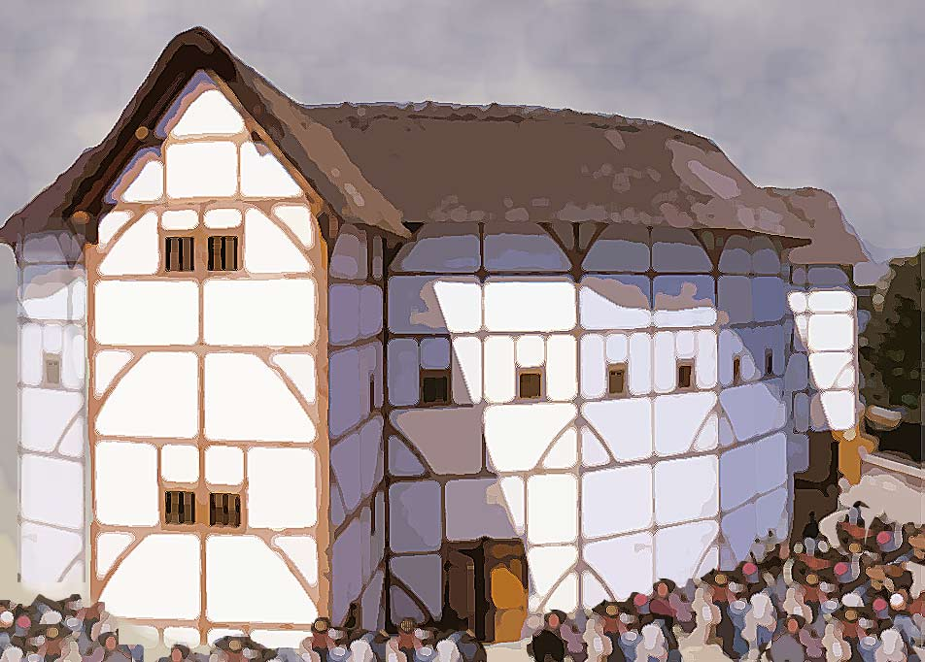
The Globe Theatre
https://www.youtube.com/watch?v=m3VGa6Fp3zI

Slide 10
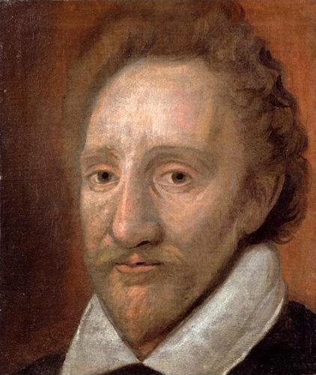
The Globe: History
Motto: “Totus mundus agit histrionem” (The whole world is a playhouse)
1576: Built in Shoreditch by Richard Burbage – the first playhouse in London
1599: Moved to Southworth, London--across the river

Slide 11
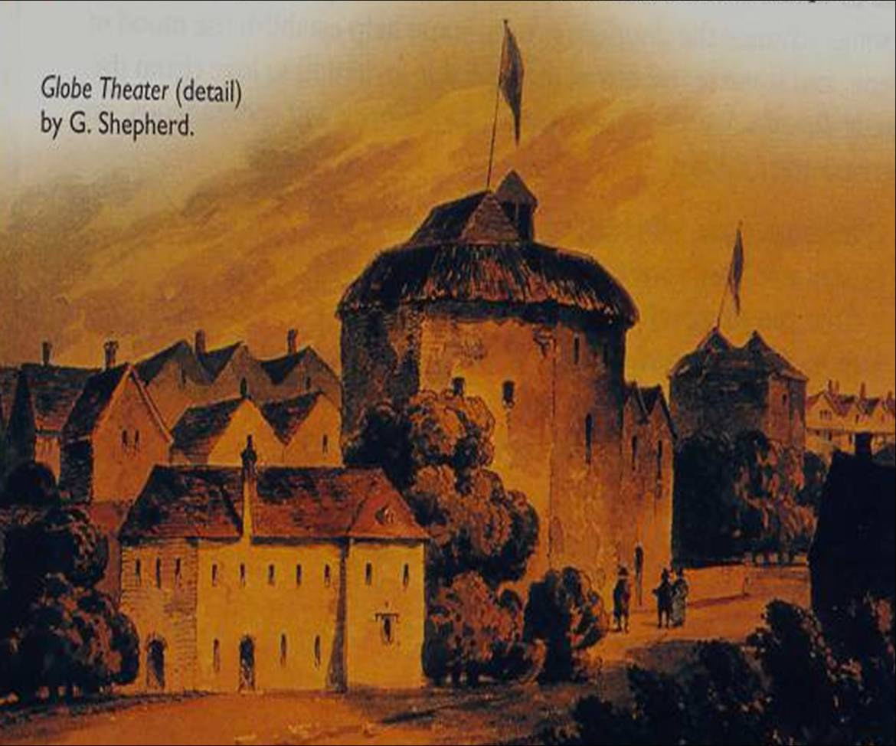
1613: during a performance of Henry VIII, wadding from a stage cannon ignited the thatched roof burning it to the ground in less than two hours.
The Globe Theatre remained the home for Shakespeare’s company until the closure of all the theatres under England’s Puritan law in 1642.

Slide 12
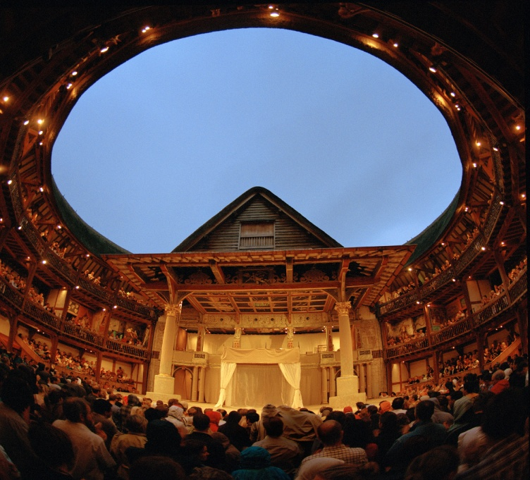
The Globe: Structure
Facts
- Open-air arena
- Octagonal-shape
- Built of timber, nails, stone and plaster
- 6 months to complete construction
- Held up to 1,500 people

Slide 13
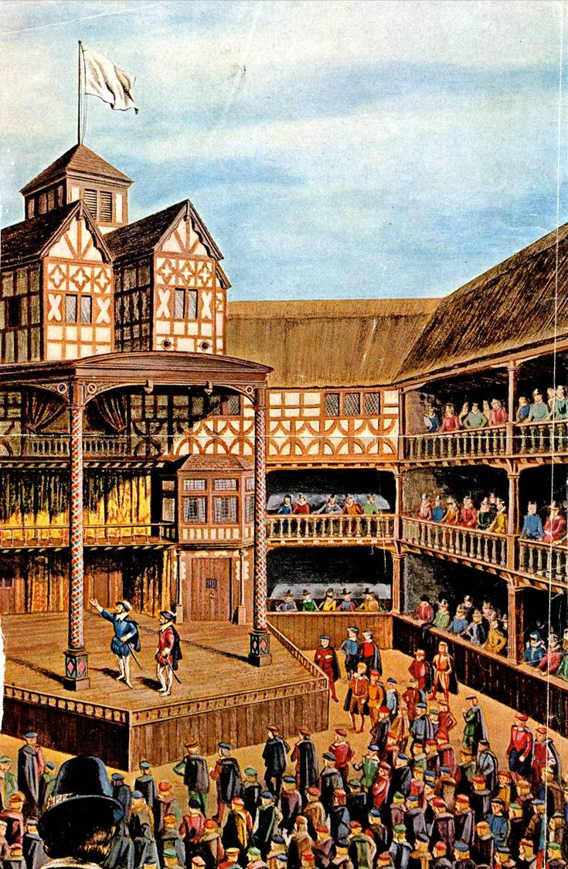
Flags
- Signified which type of play was being performed
Black = tragedy
White = comedy
Red = history

Slide 14
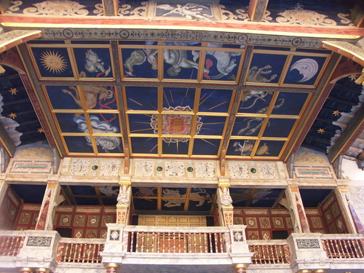
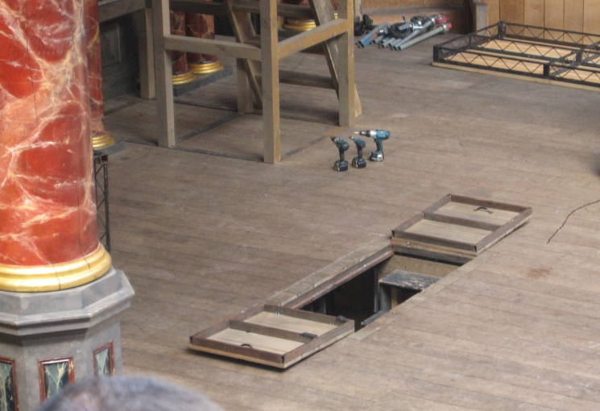
Canopy
- protected the actors from too much sun or rain also used for storage, better sound and “Heaven”
Trap Door
- used as storage, a quick exit and “Hell”

Slide 15
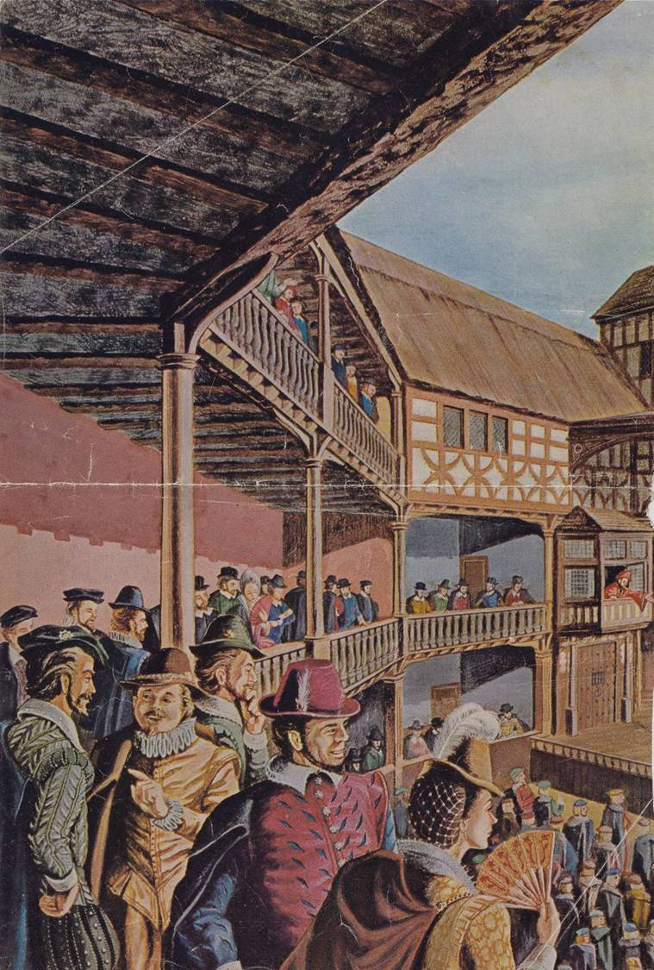
Galleries
- Three-tiered
- Thatch-covered roof
- Wooden benches
- More expensive
- Cushions cost a penny

Slide 16
Pillars
- Wooden pillars supported the roof and were painted to look like marble.

Slide 17
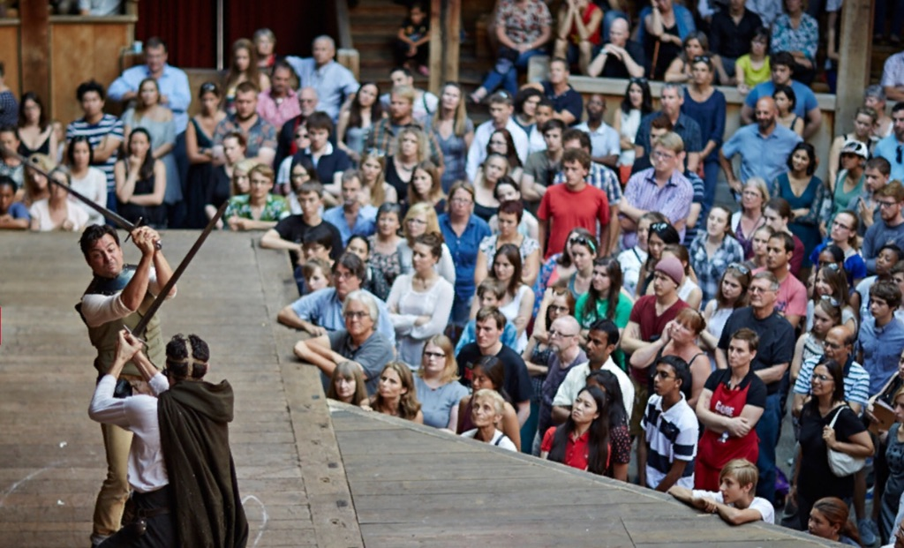
Open Yard
- Commoners (or “Groundlings”) stood on the floor to watch performances for just one penny ($4.00 now)
- It cost 2 pounds to put on a play ($1,000 now)
- Would often “participate” with the play; throwing food and shouting at the performers

Slide 18
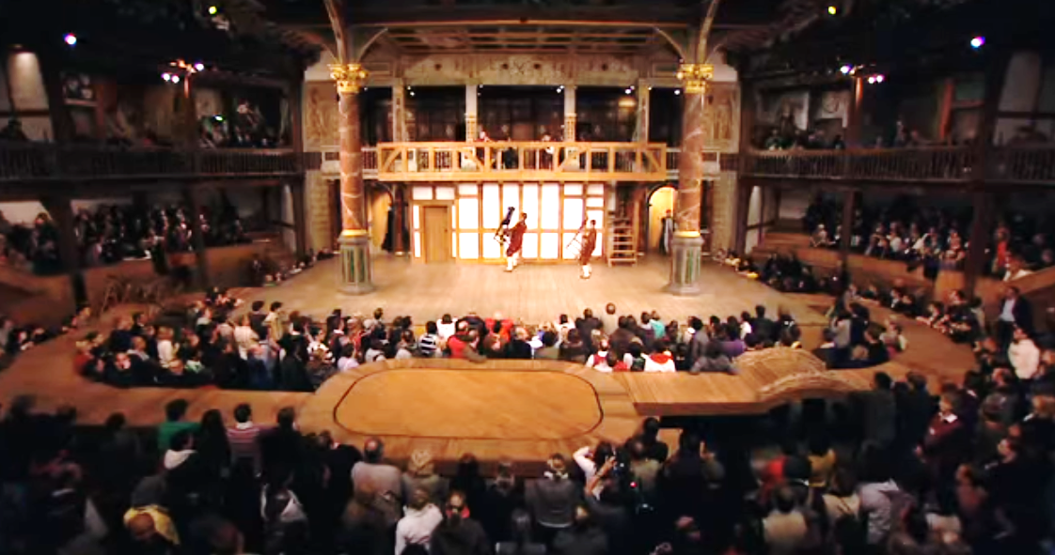
Main Stage
- Where the main action takes place
- Shakespeare’s was an “Apron” stage -- the audiences could sit on all three sides
- The stage was 4-5 feet high

Slide 19
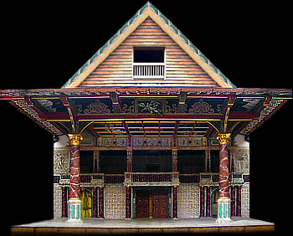
Inner Stage
- Used mostly for indoor scenes.
- Curtain could be opened and closed for scene changes

Slide 20
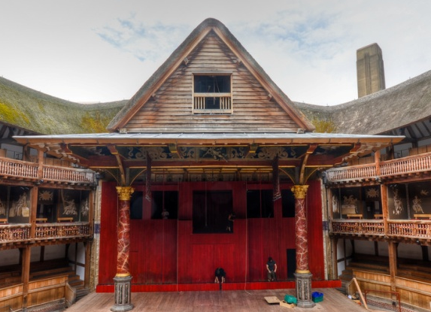
Upper Stage
- The “chamber” used for bedroom and balcony scenes
- The balcony above was used for musicians & sound

Slide 21
Tiring House
- Dressing room for changing actors’ costumes
- These doors were main entrance/exits to the stage

Slide 22
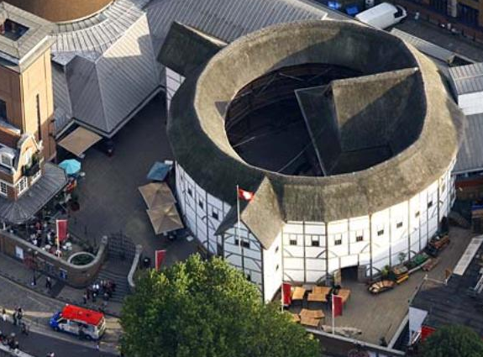
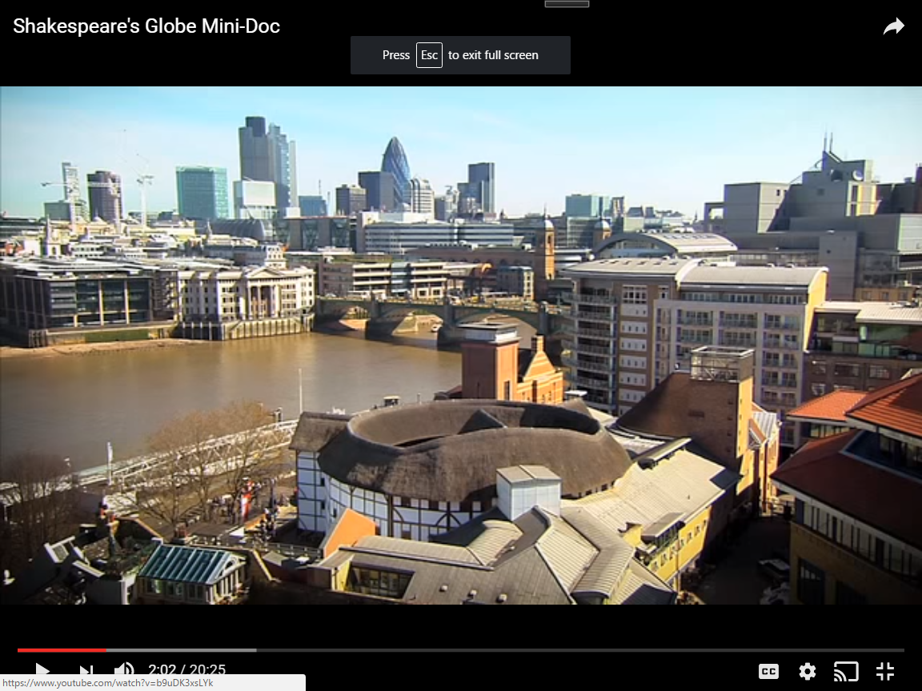
The New Globe Theatre
In 1970, Sam Wanamaker set up the Shakespeare’s Globe Trust.
It took 23 years to find land, get zoning permission and raise money for the construction.

Slide 23
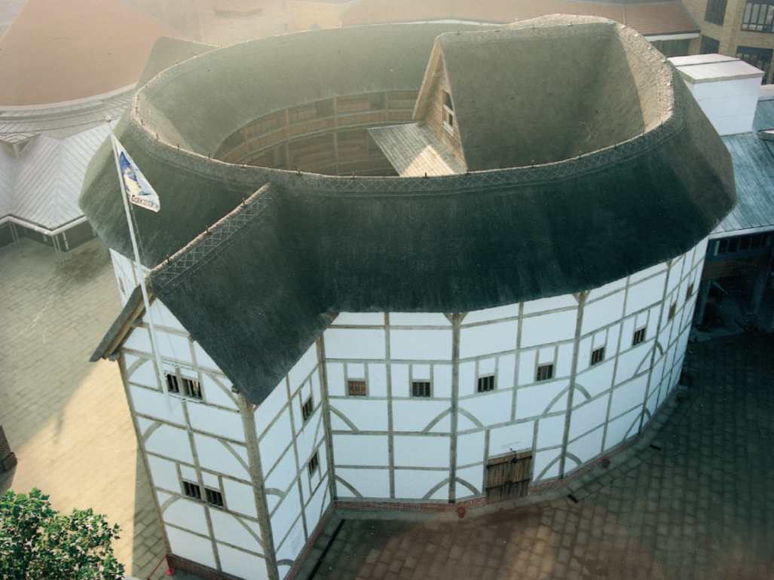
1997: The Globe Theater was rebuilt along the banks of the Thames River.
2015: 568 performances; $29.7 million total
https://www.youtube.com/watch?v=b9uDK3xsLYk

Slide 24
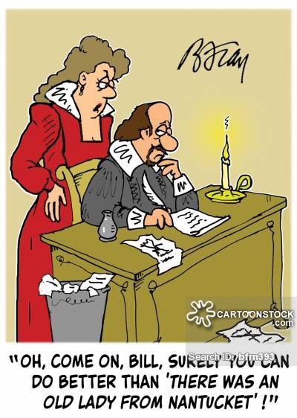
Literary Language

Slide 25
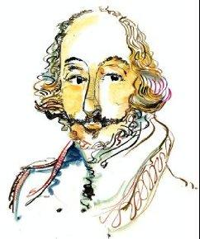
Shakespeare’s Language
Impact on the English: he invented over 1600 words
~ majestic ~ hint
~ lonely ~ excellent
~ gloomy ~ exile
Harry Potter connection: J.K. Rowling borrowed his words and names in writing her own books:
~ “Toil, toil, toil, & trouble. Fire burn and cauldron bubble.” (sung with the frogs)
~ Hermione Granger - a character in A Winter’s Tale

Slide 26
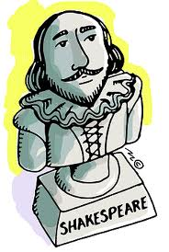
Against = for; in preparation for
“Look thou but sweet,
And I am proof against their enmity.”
Anon = soon
“Anon, anon!
Come let’s away; the strangers are all gone.”
Hence = away; from here
“Let Romeo hence in haste,
Else, when he is found, that hour is his last.”
Whence = where
“Could we but learn from whence his sorrows grow
We would as willingly give cure as know.”

Slide 27
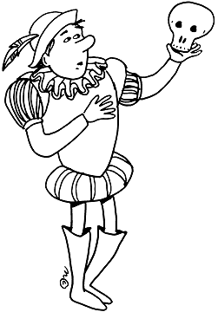
Shakespeare’s Devices
Soliloquy: a lengthy speech in which a character, alone on-stage, expresses his or her thoughts to the audience.
Monologue: a lengthy speech addressed to other characters on-stage.
Aside: a brief remark made by a character to the audience; unheard by the other characters.

Slide 28
Flat Character: one-dimensional; embodying only a single trait. (Shakespeare’s flat characters provide comic relief.)
Round Character: multiple personality traits; like a real person.
Allusions: references within dramatic speeches to past experiences, history or other works of literature.
Stage directions: tell the actors who is entering or exiting the stage and what they are doing; they are written in italics.

Slide 29
