Slide 1
Diego Velázquez
1599-1660
Lived in Madrid
Studied in Rome in June 1629
Throughout career, style became richer, color more brilliant, the figures more animated

Slide 2
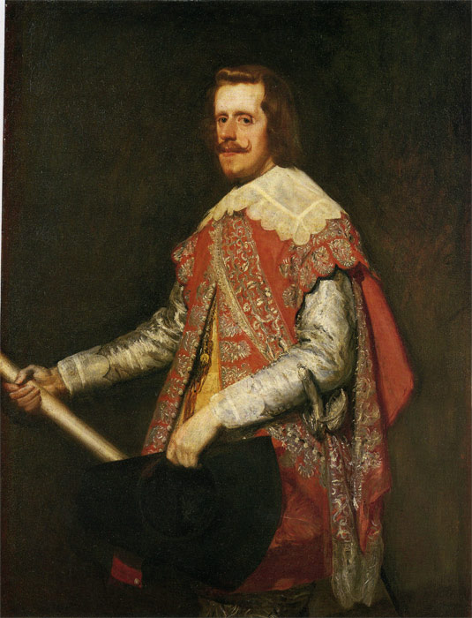
Diego Velázquez
Painted many portraits of the Royal Family
1621: Royal painter for Philip IV
King Philip IV of Spain, 1644, oil on canvas

Slide 3
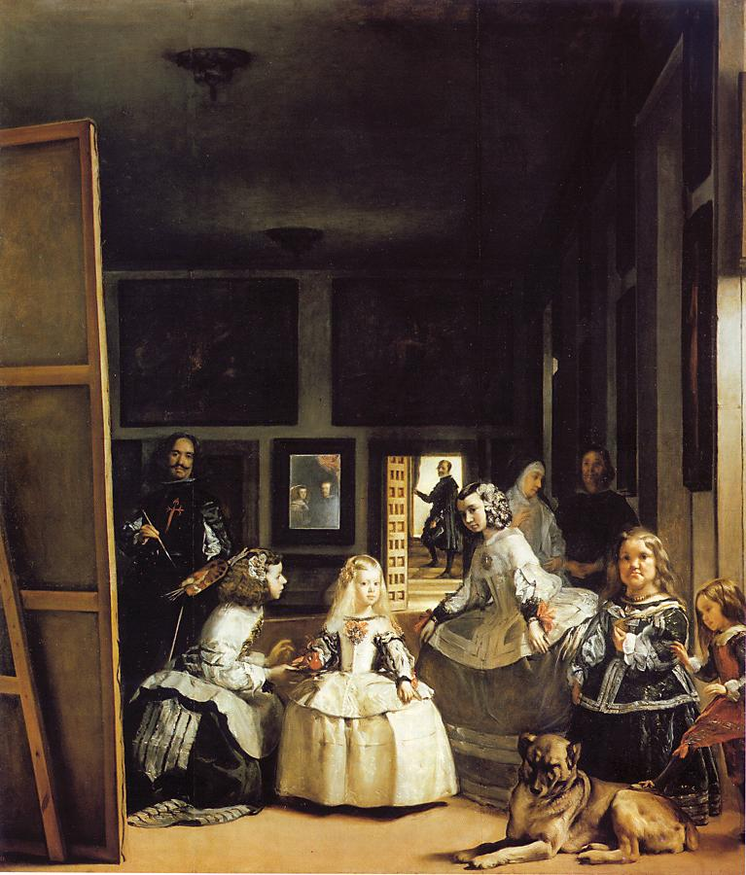
Las Meninas (Maids of Honor) - 1656
As you listen to the audio guide on Las Meninas, answer the following questions below the painting on your painting guide.
Who is the subject? What is the viewer’s place in the painting?
Where is Velasquez’s self portrait?
http://www.museodelprado.es/en/pradomedia/multimedia/the-family-of-felipe-iv-or-las-meninas/

Slide 4
Las Meninas (Maids of Honor) - 1656
Subject summary:
Worldly affairs await outside of this family moment
Portrait of Royal Family
Every day life on regal scale
Elements of Art:
- Line wasn’t used by artist; the forms are less solid as viewer approaches work
Connection to Artist:
Portrayed in image: cross added after artist’s death
Significance:
- Velasquez unites the world of the
sitter and the viewer
- Reminiscent of what Northern
Renaissance artist/portrait?

Slide 5
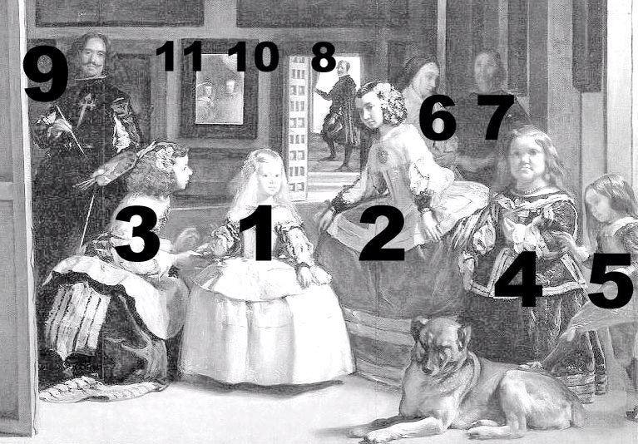
Who is in the painting?

Slide 6
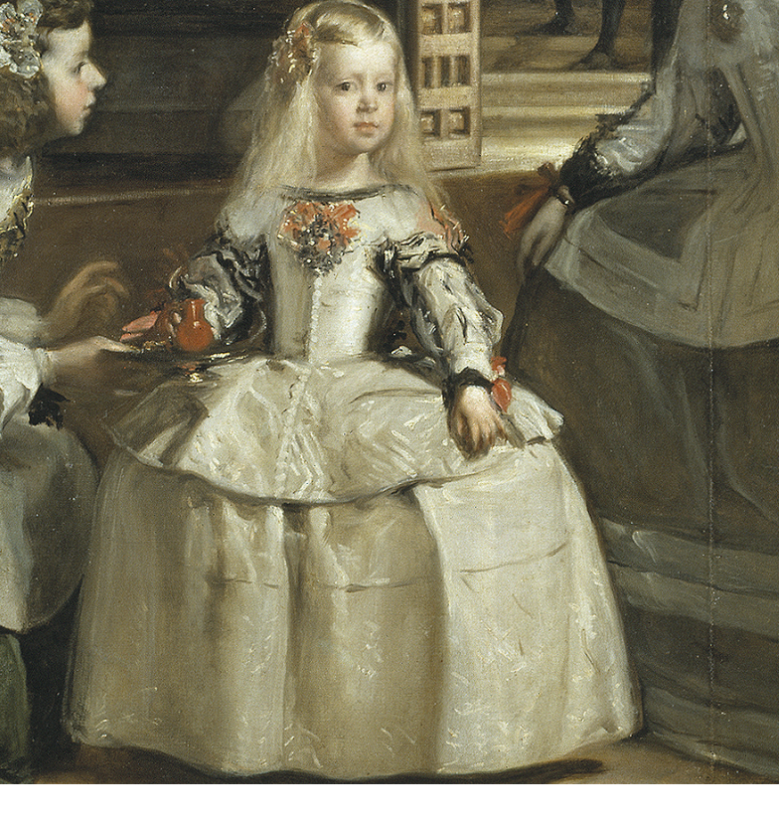
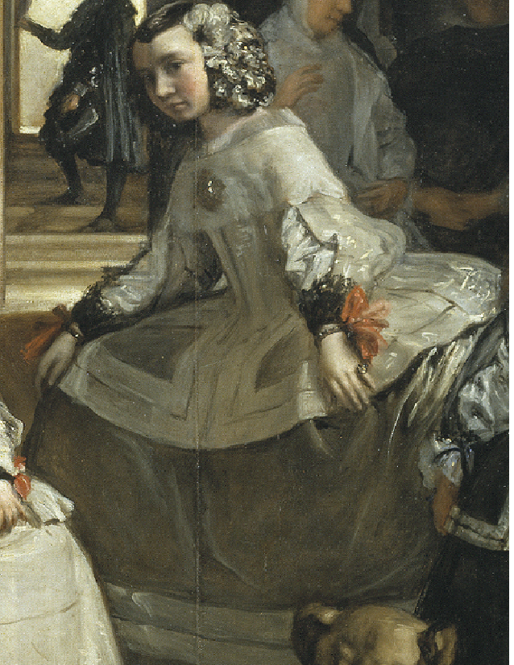
1 - La Infanta Maria Margarita
The child of the King and Queen
2 - Maria Agustina Sarmiento - maid to La Infanta

Slide 7
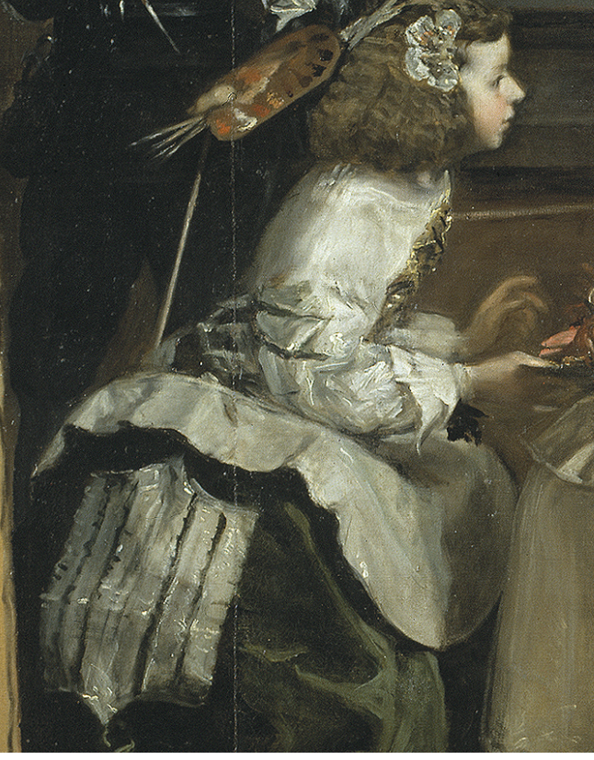
3 - Isabel de Velasco - maid to La Infanta

Slide 8
4 - Mari Barbola – Dwarf – Was a status symbol for the wealthy

Slide 9
5 - Nicolas Pertusato- Son of Mari - Jester

Slide 10
6 - Marcela de Ullo - the Chaperone

Slide 11
8 - Jose de Nieto - Head of the household (notice he is holding keys)
7 - Unidentified Body Guard

Slide 12
9 - Diego Velazquez - The Artist
The cross on Velazquez's chest is believed to have been added after his death at the request of King Philip IV.

Slide 13
Who is in the Mirror? Us?
This is how Velazquez successfully merges the world of the sitter and viewer.

Slide 14
The King and Queen - Philip IV and Mariana of Austria

